Slide 1
WEBSOCKET
Nguyễn quốc sơn – ititiu15054

Slide 2
Overview
WebSocket is a computer communications protocol, providing full-duplex communication channels ( transmission of data on both the direction simulataneously) over a single TCP connection.
The WebSocket protocol enables interaction between a web client (e.g. a browser) and a web server with lower overheads, with real-time data transfer from and to the server.
This is made possible by providing a standardized way for the server to send content to the client without being first requested by the client, and allowing for messages to be passed back and forth while keeping the connection open.
The communications are done over TCP port number 80 (or 443 in the case of TLS-encrypted connections), which is of benefit for those environments which block non-web Internet connections using a firewall.

Slide 3
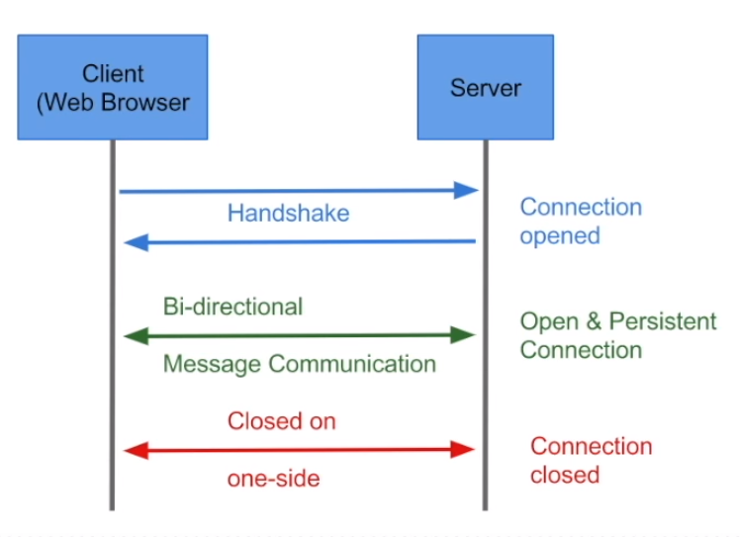
What Are WebSockets?
WebSockets provide new protocol between client and server which runs over a persistent TCP connection. Through this open connection, bi-directional, full-duplex messages can be sent between the single TCP socket connection (simultaneously or back and forth).

Slide 4
What Are WebSockets?
Because it is an independent TCP-based protocol, it doesn’t require HTTP tunneling (similar to Netflix and other streaming services), allowing for simplified communication when sending messages.
WebSockets come after many other technologies that allow servers to send information to the client. Web applications that use Comet/Ajax, push/pull and long polling all do this over HTTP. Other than handshaking the Upgrade Header, WebSockets is independent from HTTP.

Slide 5
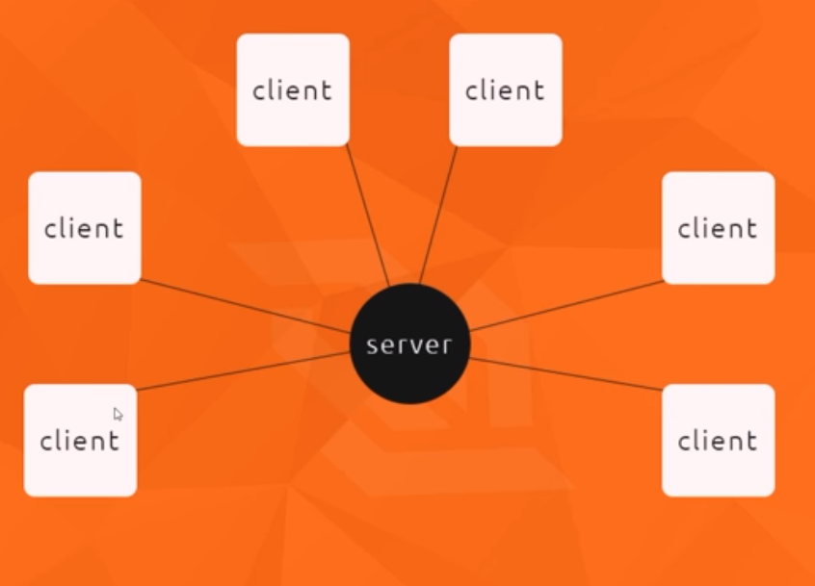

Slide 6
Browser implementation
The WebSocket protocol is currently supported in most major browsers including Google Chrome, Microsoft Edge, Internet Explorer, Firefox, Safari and Opera.
A secure version of the WebSocket protocol is implemented in Firefox 6, Safari 6, Google Chrome 14, Opera 12.10 and Internet Explorer 10.
An older, less secure version of the protocol was implemented in Opera 11 and Safari 5, as well as the mobile version of Safari in iOS 4.2. Because of vulnerabilities, it was disabled in Firefox 4 and 5, and Opera 11.

Slide 7
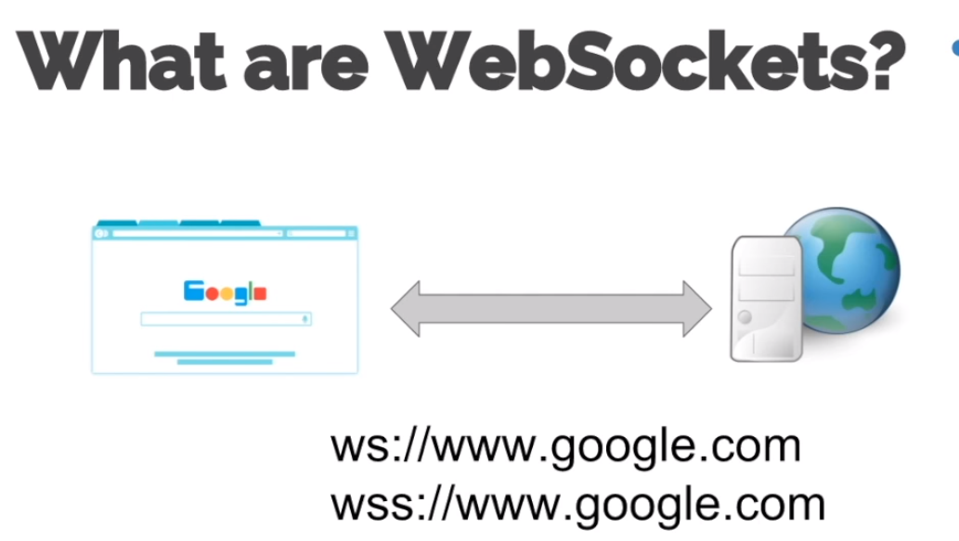
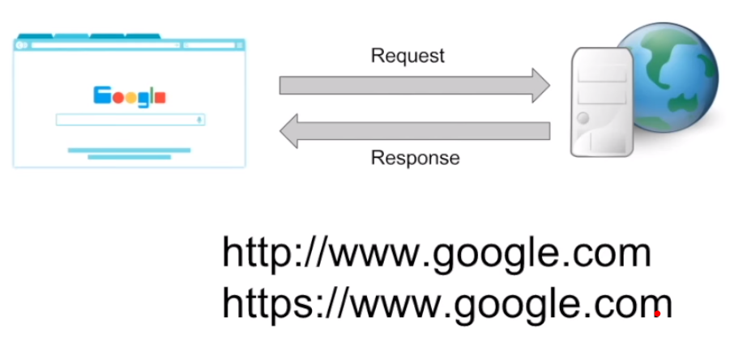
WebSocket vs HTTP
Unlike HTTP, WebSocket provides full-duplex communication. WebSocket enables streams of messages on top of TCP.
WEBSOCKET
HTTP

Slide 8
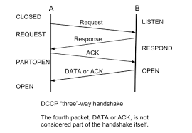
WebSocket vs HTTP

Slide 9
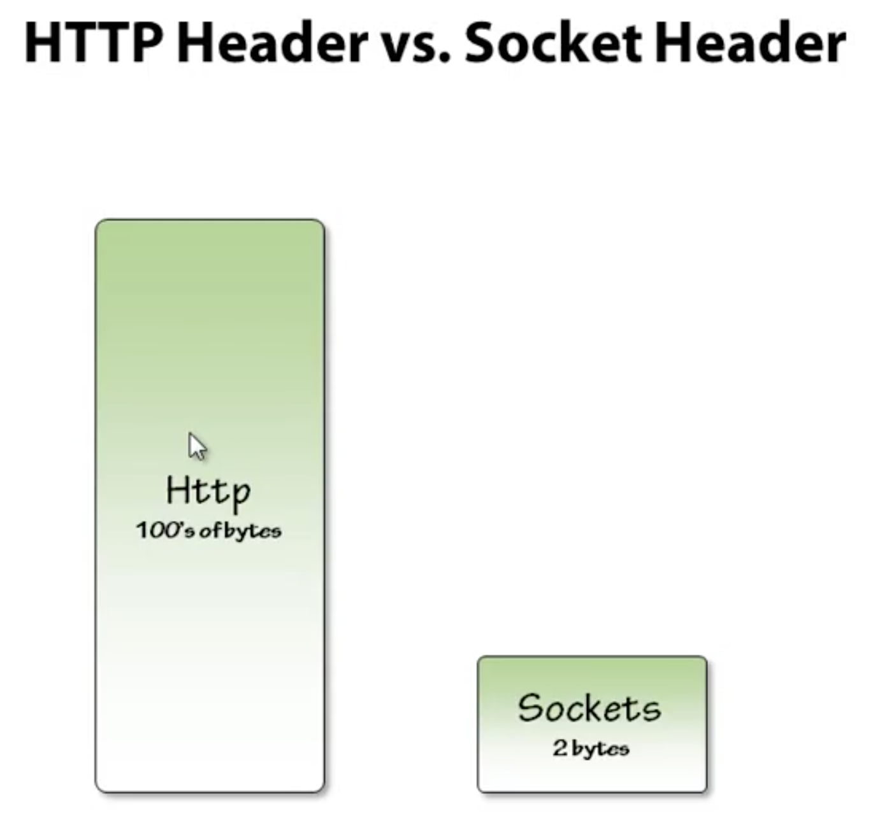

Slide 10
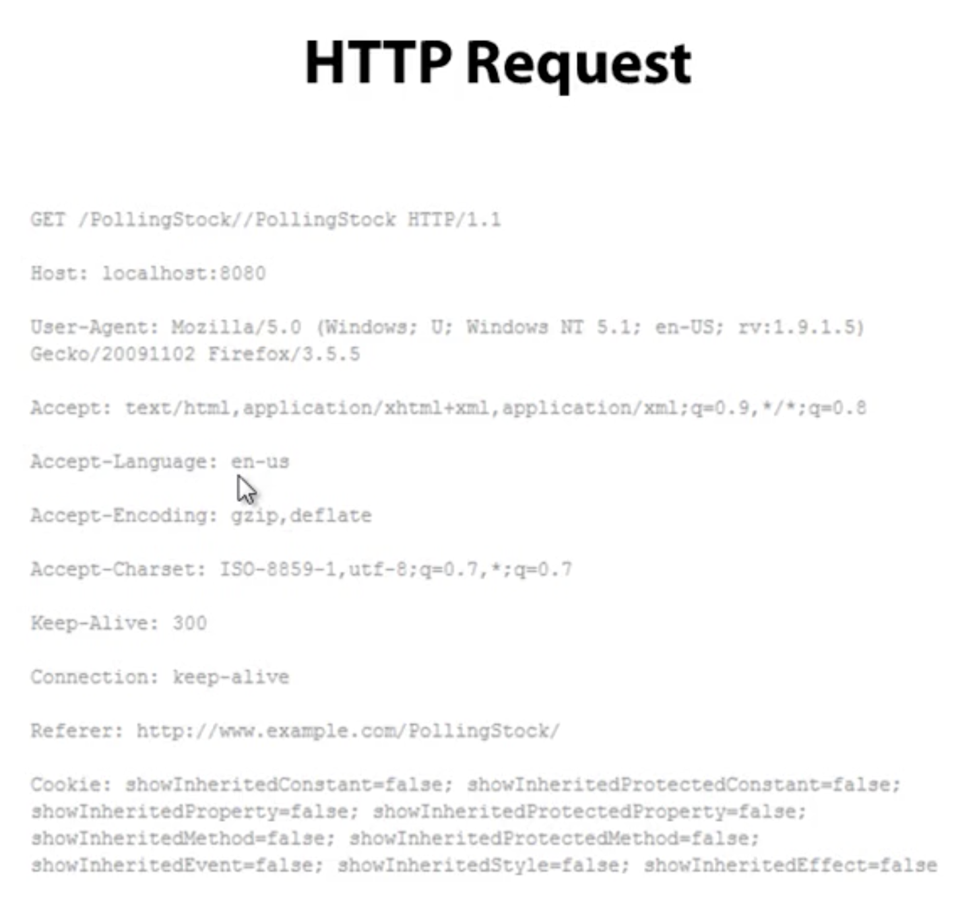
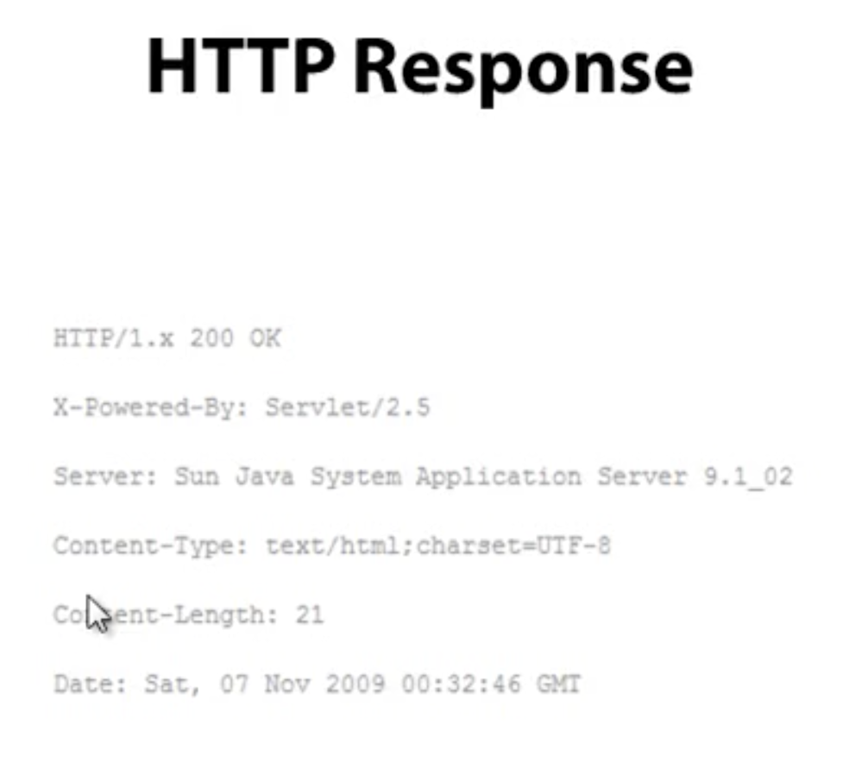

Slide 11
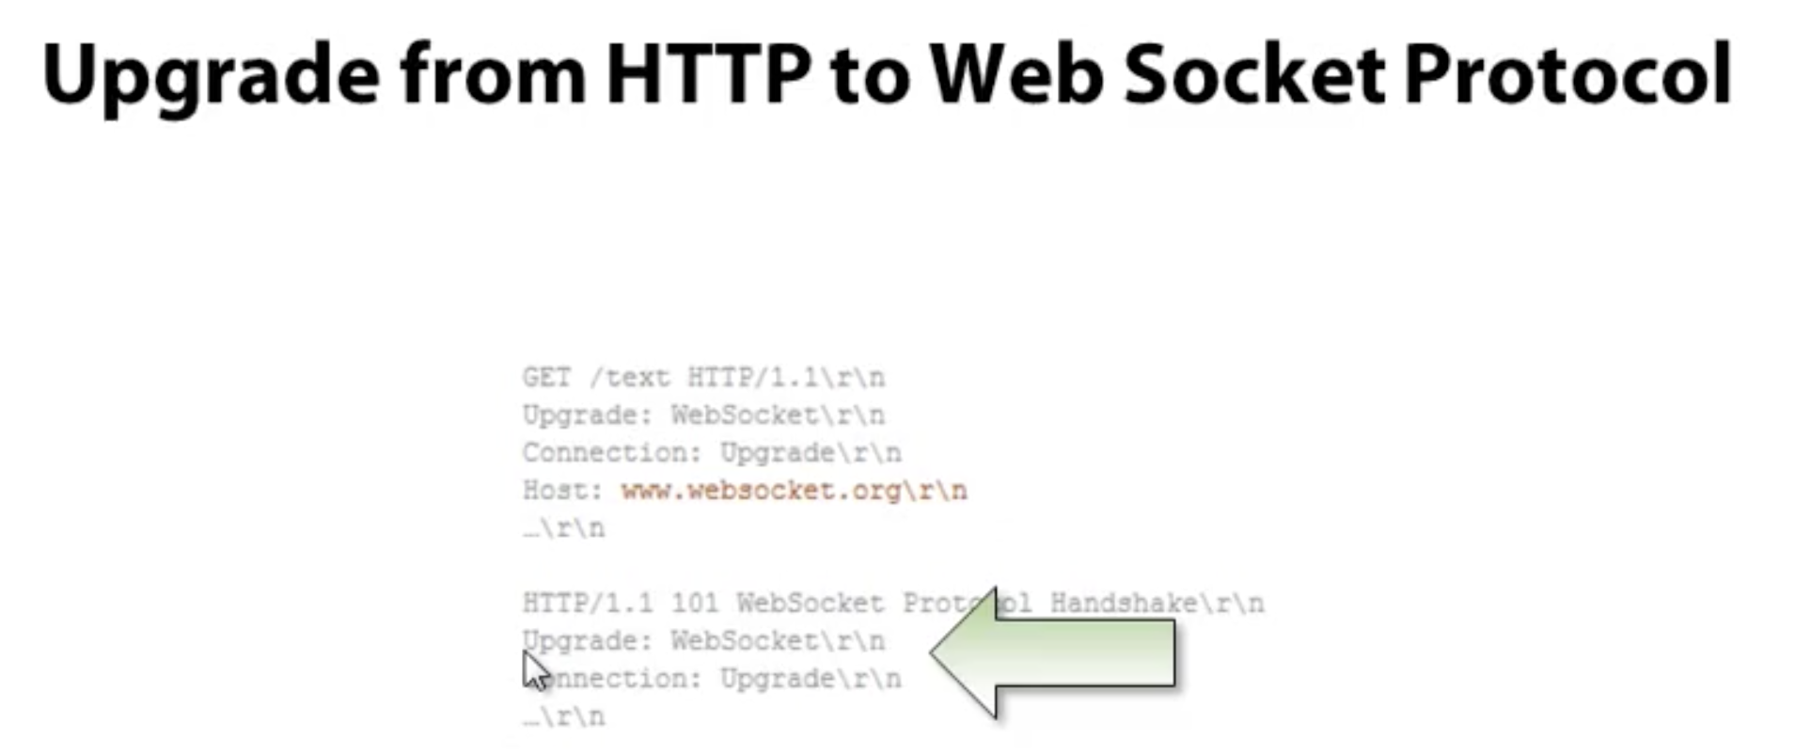

Slide 12
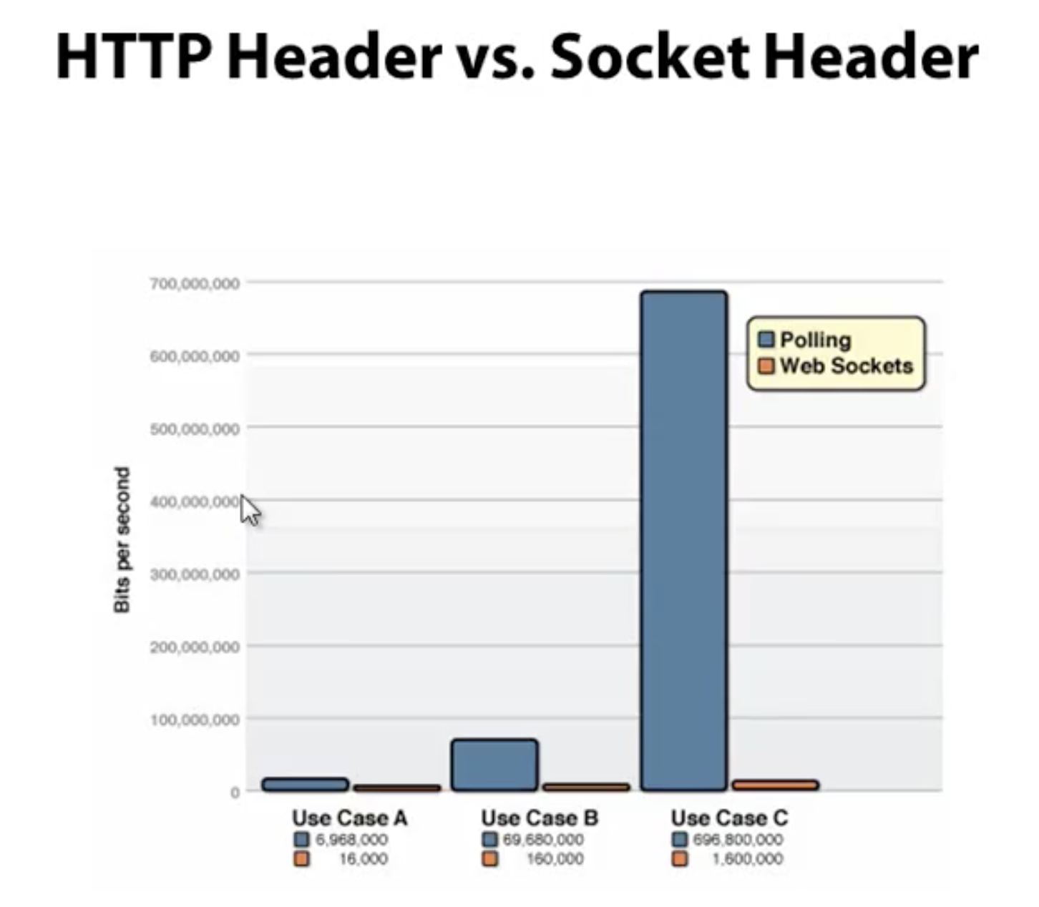

Slide 13
WebSocket and TCP
Websocket differs from TCP in that it enables a stream of messages instead of a stream of bytes
When you send bytes from a buffer with a normal TCP socket, the send function returns the number of bytes of the buffer that were sent.
If it is a non-blocking socket or a non-blocking send then the number of bytes sent may be less than the size of the buffer. If it is a blocking socket or blocking send, then the number returned will match the size of the buffer but the call may block.
With WebSockets, the data that is passed to the send method is always either sent as a whole "message" or not at all.

Slide 14
WebSocket and TCP
When the receiver does a recv (or read) on a TCP socket, there is no guarantee that the number of bytes returned correspond to a single send (or write) on the sender side. It might be the same, it may be less (or zero) and it might even be more (in which case bytes from multiple send/writes are received).
With WebSockets, the receipt of a message is event driven (you generally register a message handler routine), and the data in the event is always the entire message that the other side sent.

Slide 15
Pros
Cross platform compatibility (web, desktop, mobile)
Low weight envelope when passing messages
Enhances the efficiency of Client and Server Communication
Full-duplex asynchronous messaging. Both the client and the server can stream messages to each other independently, similarly to what happens with raw TCP. [raw TCP deals with streams of bytes with no inherent concept of a message]
WebSockets pass through most firewalls without any reconfiguration.

Slide 16
Cons
Firewalls
Security
Monitoring
Scaling, redundancy, load balancing, replication
There are still several proxies and transparent proxies not supporting WebSockets.
A WebSocket server requires different optimizations than traditional Web servers.

Slide 17
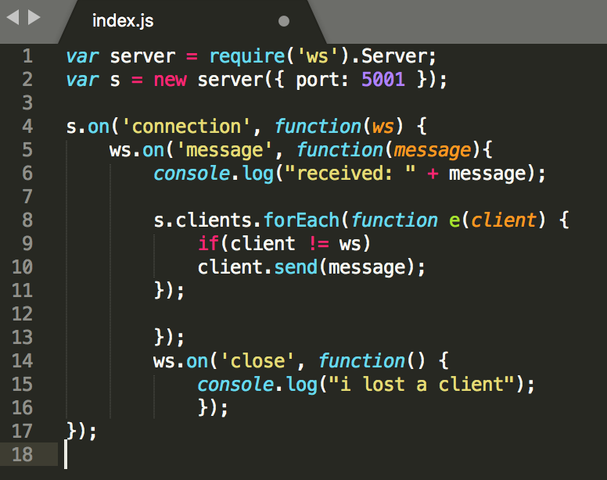
Demo

Slide 18
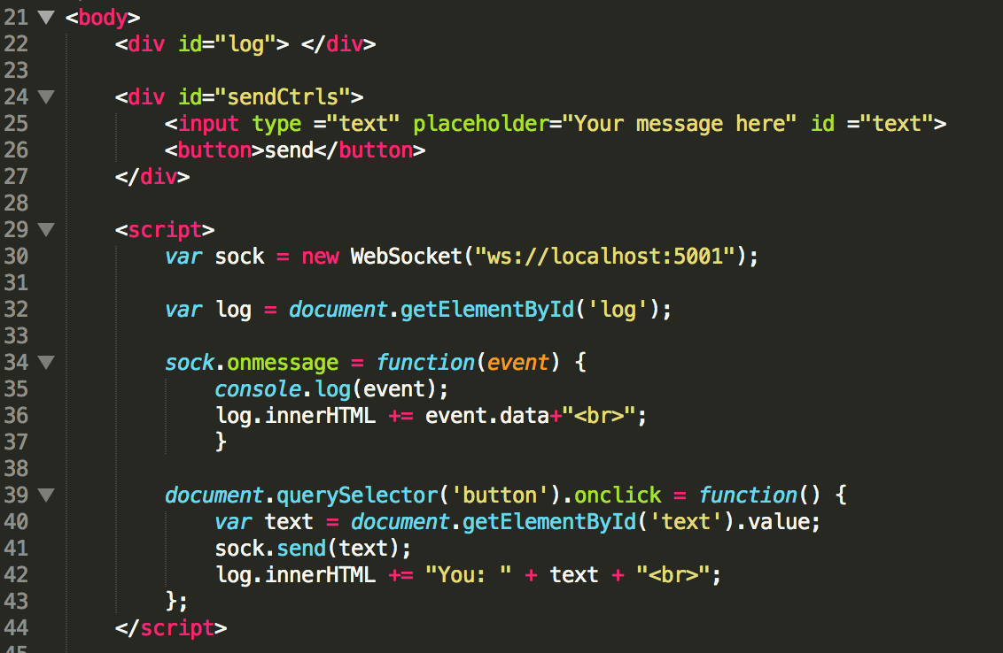
Demo

Slide 19
Thank you for listening

