Slide 1




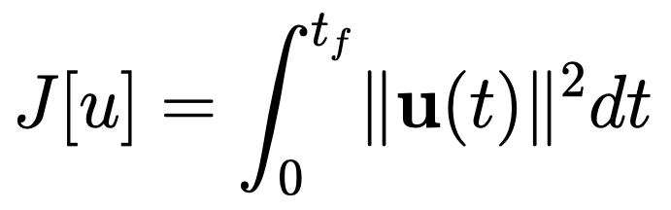


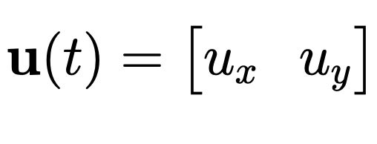

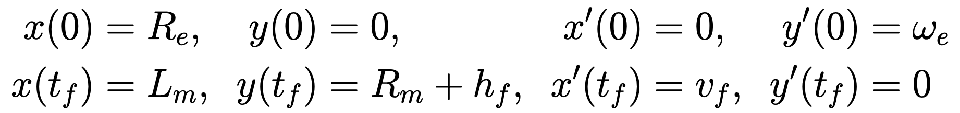


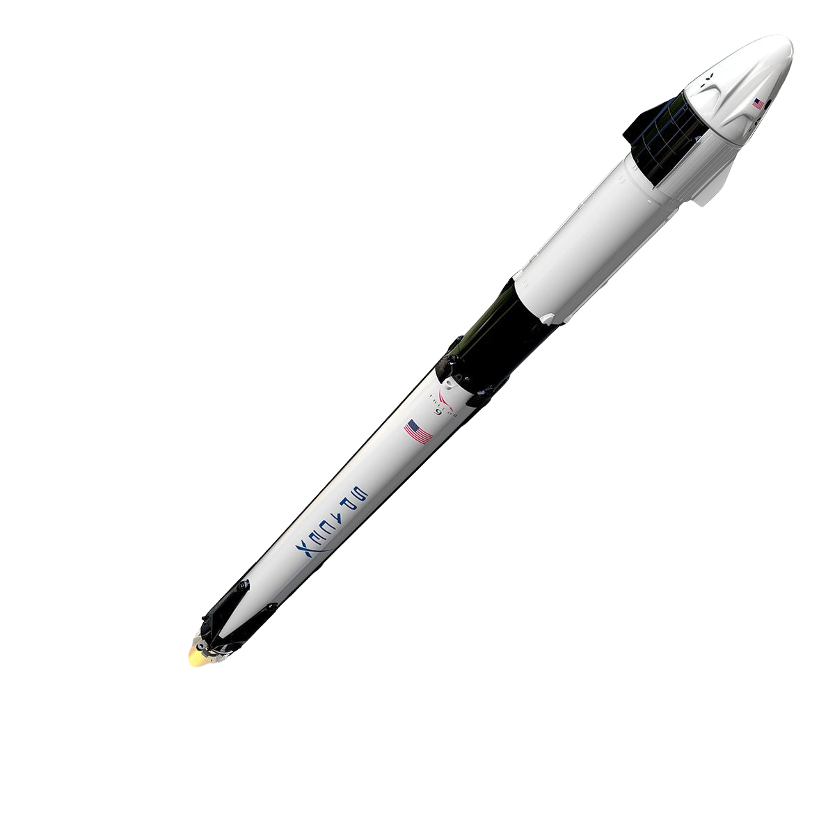
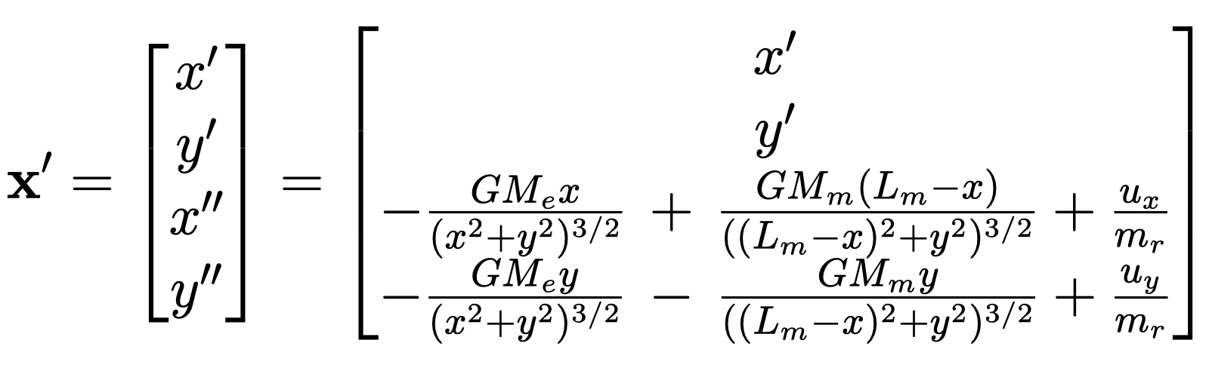
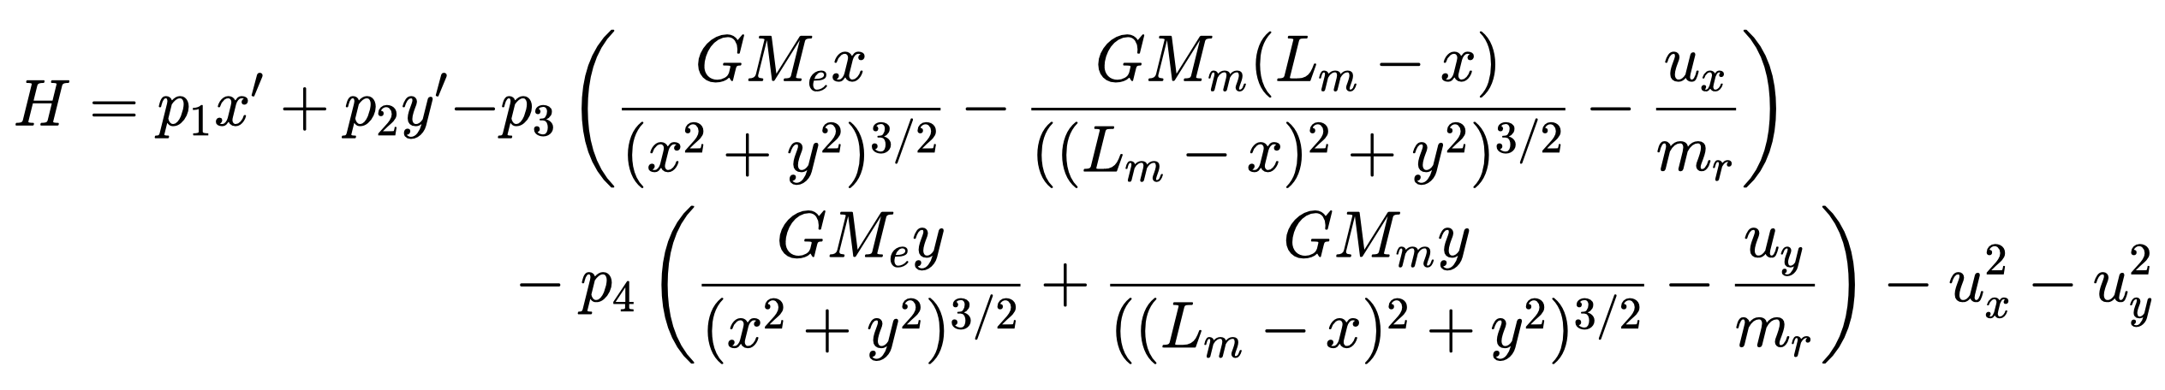
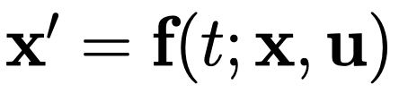
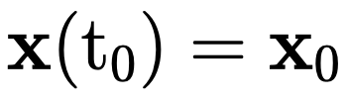

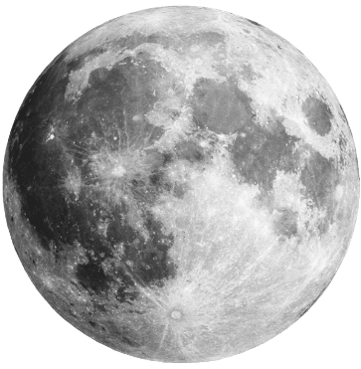
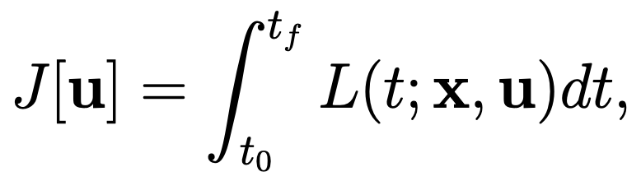
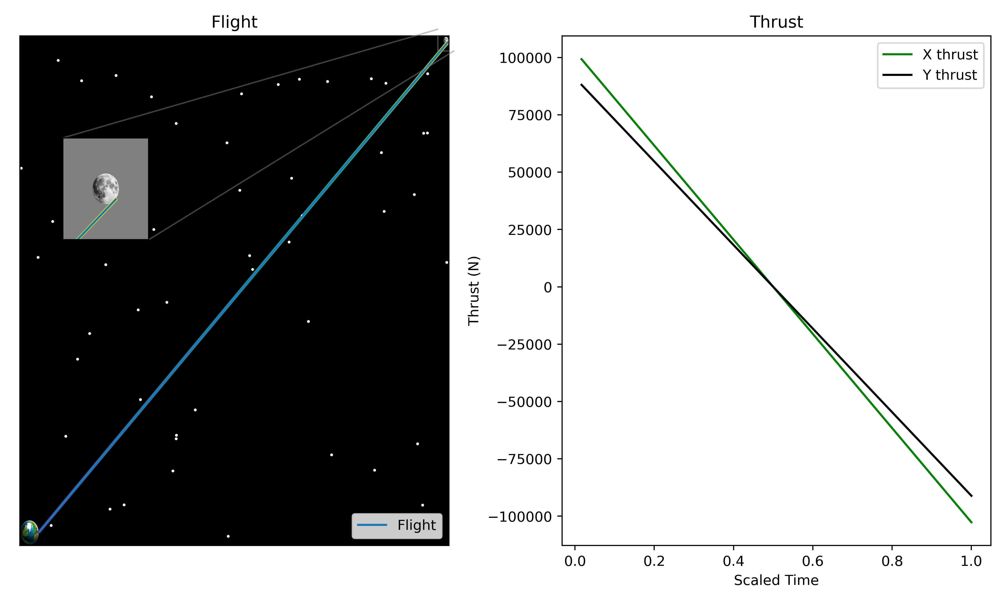
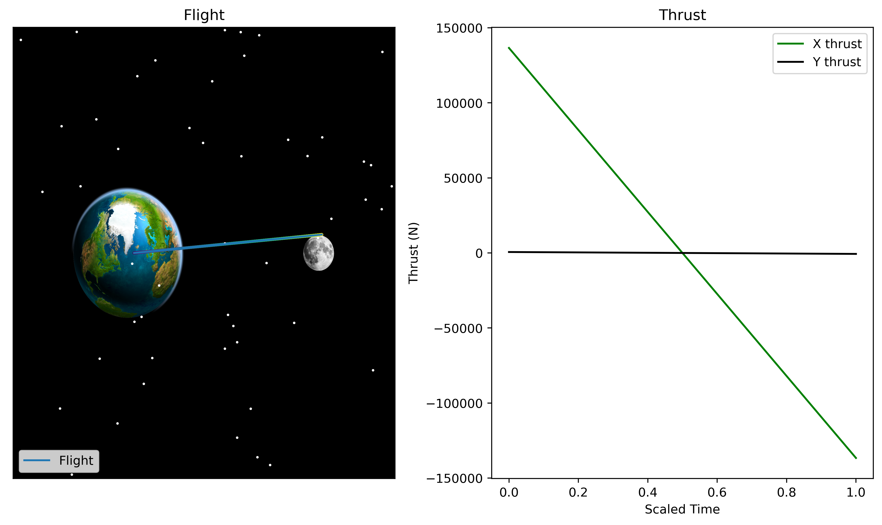
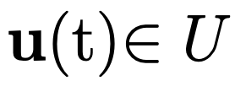

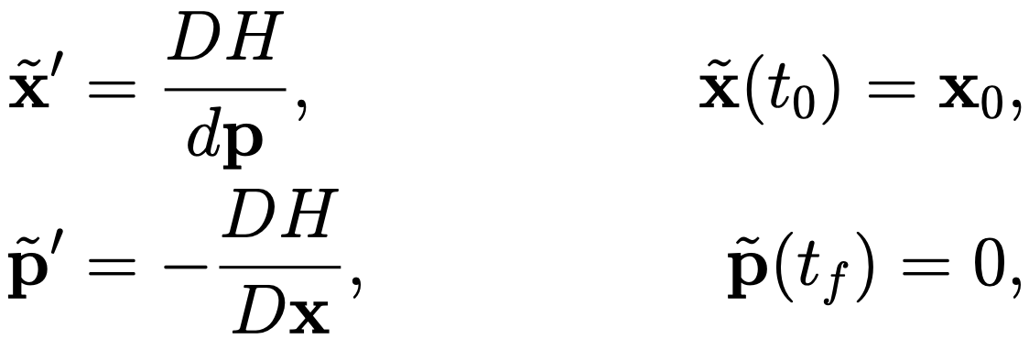
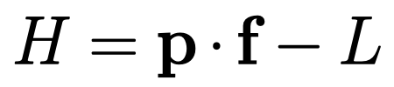
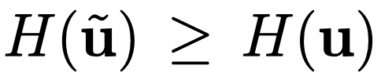
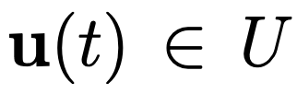
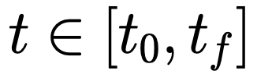
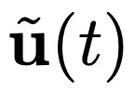
Lunar Ascent: From Earth to Moon's Orbit
Ethan Crawford, Dylan Skinner, Dallin Stewart, Jason Vasquez
ABSTRACT
OUR SET UP
PARAMETERS
We present a simulation of a rocket’s path from Earth's surface to the orbit of the Moon. We model the complex dynamics involved in rocket propulsion, gravitational interactions, and orbital mechanics by leveraging differential equations and numerical methods. Our simulation accurately captures the stages of ascent, including liftoff, trajectory optimization, and orbital insertion. Through detailed analysis and visualization, we explore the critical factors influencing orbital maneuvers required for this orbital trajectory. The results offer valuable insights into the challenges and considerations of space exploration, paving the way for future missions to celestial bodies beyond Earth's orbit.
We defined our cost functional as
with . We define our initial conditions to be
Since we only consider 2D motion in the first quadrant with the Earth at the origin and the moon starting on the x axis, we define our state equations as
Leading to our Hamiltonian
radius of Earth (kilometers)
distance between the center of the Earth and moon (kilometers)
radius of the moon (kilometers)
final distance between the rocket and the moon (kilometers)
final velocity of the rocket (kilometers per second)
angular velocity of the Earth at the equator (radians per second)
MODEL ROCKET
FUTURE WORK
Our specs used in this project are based off the SpaceX Falcon 9 rocket
Set the moon's motion as a function of time rather than stationary
Set the mass of rocket as a function of control variable
Optimize over final time
Incorporate a bound on the thrust
Incorporate discontinuous control (i.e., thrust to get into space and then float for a while)
Validate effect of gravity on model
Height: 70.0 m
Diameter: 3.7 m
Mass: 549,054 kg
Max Thrust (Stage 1): 7.560 millinewtons
Max Thrust (Stage 2): 981 kilonewtons
PONTRYAGIN’S MAXIMUM PRINCIPLE
Pontryagin’s maximum principle tells us that given an optimal control problem where with that is seeking to minimize the cost functional
via the control where is the admissible control region, we have that
(i)
(ii) The Hamiltonian has a global maximum for each
at the optimal control , i.e. for all .
RESULTS
REFERENCES
SpaceX. (n.d.). Falcon 9. Retrieved from https://www.spacex.com/vehicles/falcon-9/
Braeunig, R. A. (n.d.). Constants, Units & Physical Properties. Retrieved from http://www.braeunig.us/space/constant.htm
Example of flight path from Earth to moon where the moon is at a 42-degree angle from the x-axis. We see that the x-thrust and y-thrust start off very positive, then change linearly in time so that at the midway point thrust is in opposite direction to slow rocket down in time to reach the moon. In this picture, the distance between the earth and the moon is scaled based on size of earth and moon.
Example of flight path from Earth to moon where final position of the moon is on x-axis and does not move. We see very little y-thrust so the change in y is small compared to the massive change in x. There is a very high x-thrust until the midway point when x-thrust reverses to slow down the rocket. Here the size of the earth and moon are not to scale for readability.

