Slide 1



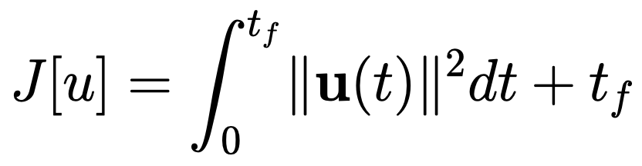


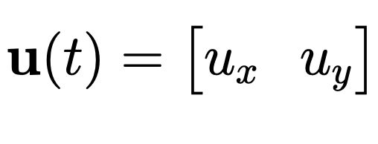

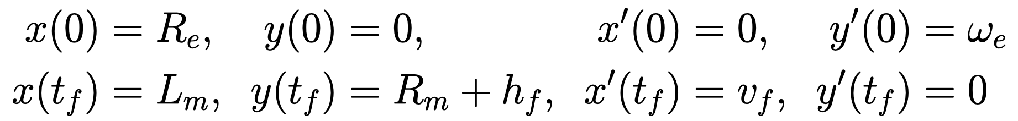


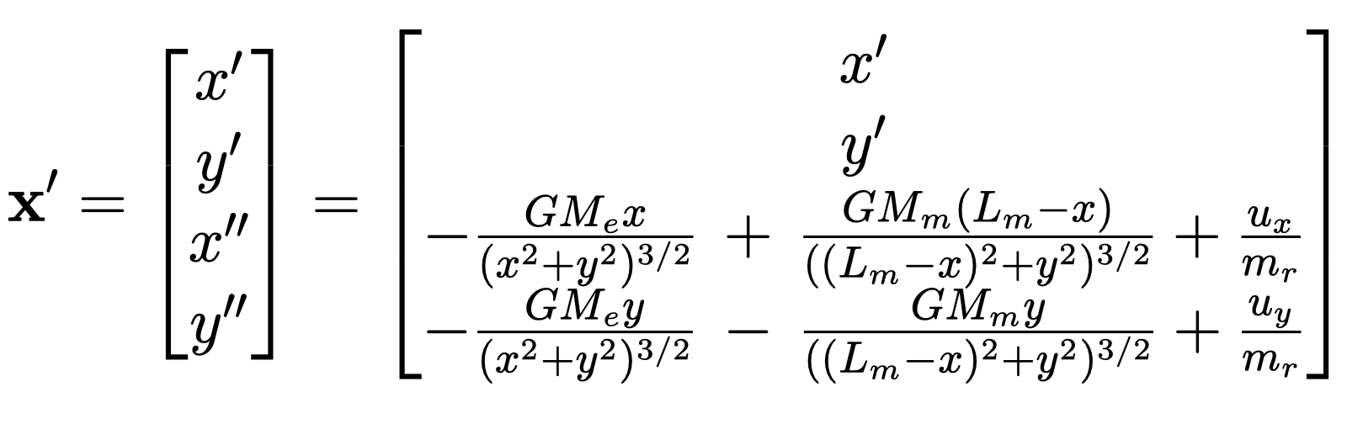
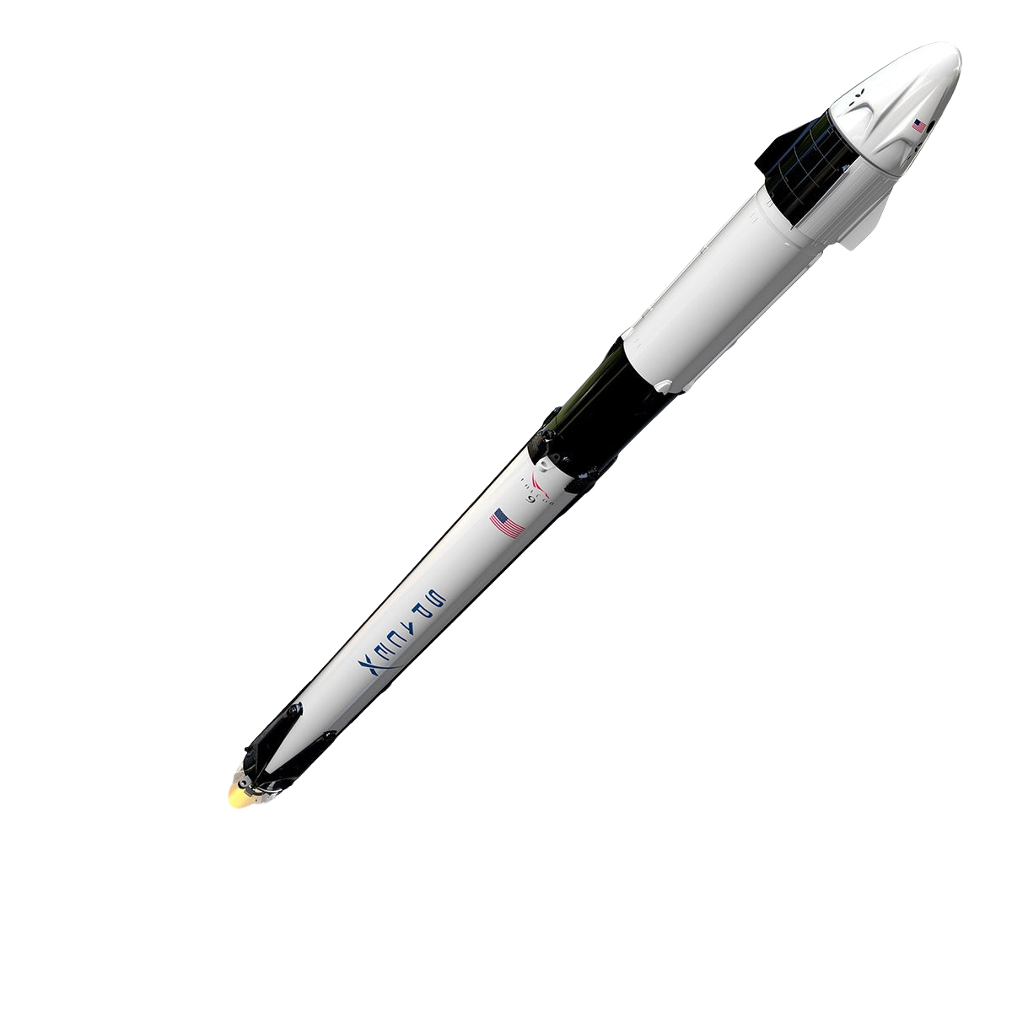
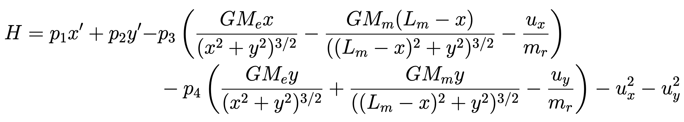
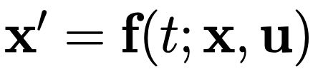
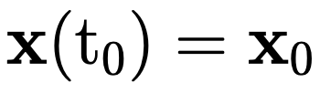
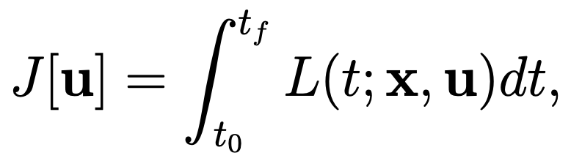

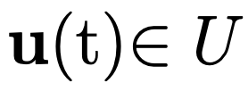

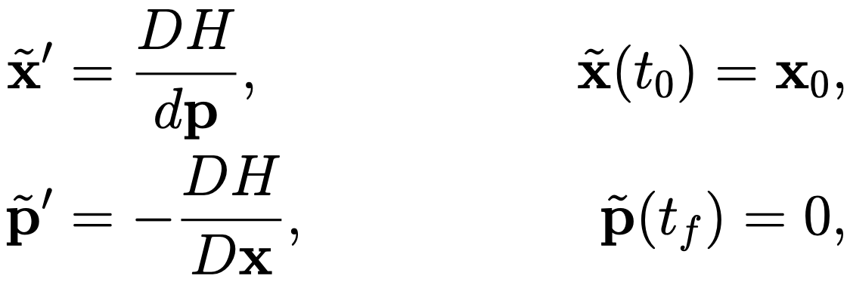
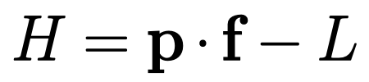
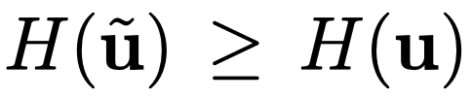
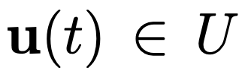
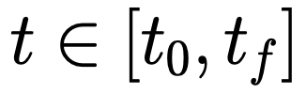
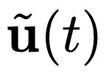

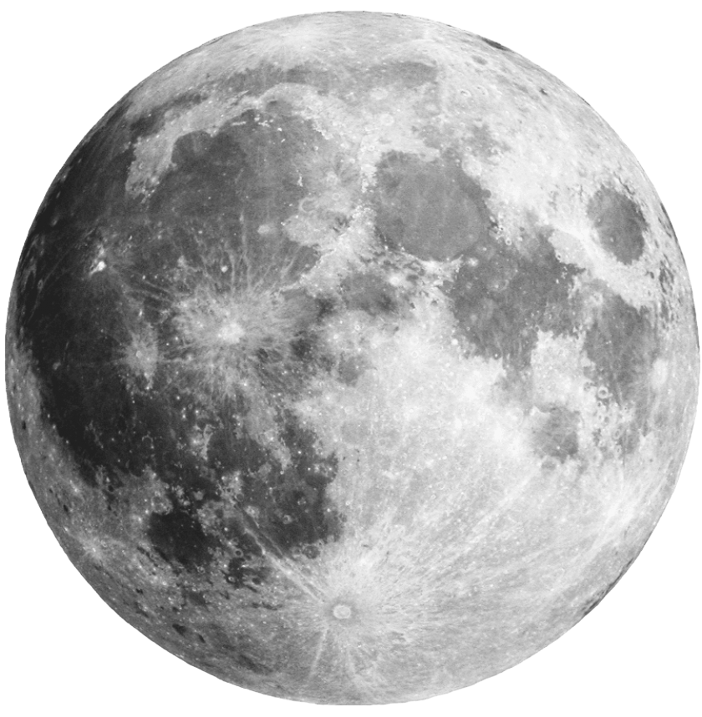
Lunar Ascent: From Earth to Moon's Orbit
Ethan Crawford, Dylan Skinner, Dallin Stewart, Jason Vasquez
ABSTRACT
OUR SET UP
PARAMETERS
In this project, we present a simulation of a rocket's journey from Earth's surface to the orbit of the Moon. Leveraging differential equations and numerical methods, we model the complex dynamics involved in rocket propulsion, gravitational interactions, and orbital mechanics. Our simulation accurately captures the stages of ascent, including liftoff, trajectory optimization, and orbital insertion. Through detailed analysis and visualization, we explore the critical factors influencing the success of the mission, such as thrust profiles, fuel consumption, and orbital maneuvers. The results offer valuable insights into the challenges and considerations of space exploration, paving the way for future missions to celestial bodies beyond Earth's orbit.
We defined our cost functional as
with . We define our initial conditions to be
We define our state equations as
Leading to our Hamiltonian
radius of Earth (kilometers)
distance between Earth and moon (kilometers)
radius of the moon (kilometers)
final distance between the rocket and the moon (kilometers)
final velocity of the rocket (kilometers per second)
angular velocity of the Earth at the equator (radians per second)
MODEL ROCKET
FUTURE WORK
Our specs used in this project are based off the SpaceX Falcon 9 rocket
Have the final position of the moon be a function of time
Have mass of rocket be a function of control variable
Optimize over final time
Incorporate a bound on the thrust
Incorporate discontinuous control (i.e., thrust to get into space and then float for a while)
Validate effect of gravity on model
Height: 70.0 m
Diameter: 3.7 m
Mass: 549,054 kg
Max Thrust (Stage 1): 7.560 millinewtons
Max Thrust (Stage 2): 981 kilonewtons
PONTRYAGIN’S MAXIMUM PRINCIPLE
Pontryagin’s maximum principle tells us that given an optimal control problem where with that is seeking to minimize the cost functional
via the control where is the admissible control region, we have that
(i)
(ii) The Hamiltonian has a global maximum for each
at the optimal control , i.e. for all .
RESULTS
REFERENCES
Only us.

