Slide 1
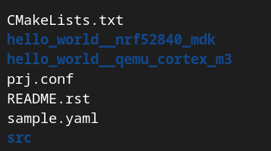
Build
输入west build -h 可以获得一些帮助提示，类似于很多linux命令的help页面
最简单的构建app的方法就是切换到项目目录下，输入west build -b <BOARD>命令
可以使用west config build.board <BOARD>设定默认构建项目时的参数
可以使用west config build.dir-fmt “customer_fmt_string”来设定默认的构建目录
west config build.dir-fmt “{app}__{board}”
可以使用west build -t来指定要构建的目标
west buiild -t footprint可以获取elf内的rom/ram.json数据
可以使用-v指令查看详细的构建步骤
west –v build -b <BOARD> <app>

Slide 2
Build
可以在west命令后面通过加--来临时性地给CMake传递更多参数
west build –b <BOARD> -- -G’Unix Makefiles’来指定CMake生成makefile并使用make来构建项目
west build –b <BOARD> -- -DDTC_OVERLAY_FILE=xxx.overlay来指定使用的的devicetree overlay文件
west build –b <BOARD> -- -DOVERLAY_CONFIF=xxx.conf来指定使用的Kconfig文件
如果想要永久性地给west传递参数，需要使用west config build.cmake-args设定一些参数
west config build.cmake-args -- -DCMAKE_VERBOSE_MAKEFILE=ON
west config build.cmake-args -- -DCMAKE_EXPORT_COMPILE_COMMANDS=ON ( CMAKE_EXPORT_COMPILE_COMMANDS — CMake 3.24.2 Documentation )

Slide 3
Build
Option | Description
build.board | String. If given, this the board used by west build when --board is not given and BOARD is unset in the environment.
build.board_warn | Boolean, default true. If false, disables warnings when west build can’t figure out the target board.
build.cmake-args | String. If present, the value will be split according to shell rules and passed to CMake whenever a new build system is generated.
build.dir-fmt | String, default build. The build folder format string, used by west whenever it needs to create or locate a build folder. The currently available arguments are: board: The board name source_dir: The relative path from the current working directory to the source directory. If the current working directory is inside the source directory this will be set to an empty string. app: The name of the source directory.
build.generator | String, default Ninja. The CMake Generator to use to create a build system.

Slide 4
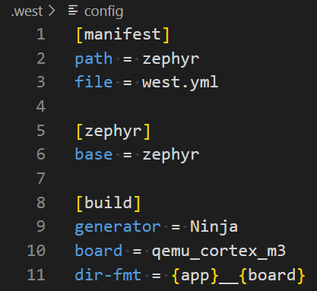
Build
前文介绍的cmd其实只是在用命令行的方式把参数写入.west/config文件：

Slide 5
Devicetree( Introduction to devicetree )
A devicetree is a hierarchical data structure primarily used to describe hardware.
Zephyr uses devicetree in two main ways:
to describe hardware to the Device Driver Model
to provide that hardware’s initial configuration
There are two types of devicetree input files: devicetree sources and devicetree bindings. The sources contain the devicetree itself. The bindings describe its contents, including data types. The build system uses devicetree sources and bindings to produce a generated C header. The generated header’s contents are abstracted by the devicetree.h API, which you can use to get information from your devicetree.
Devicetree sources
Devicetree sources
devicetree.h
Devicetree bindings

Slide 6
Devicetree( Introduction to devicetree )
The API itself is based on C macros. The macro names all start with DT_.
Some information defined in devicetree is available via CONFIG_ macros generated from Kconfig. This is often done for backwards compatibility, since Zephyr has used Kconfig for longer than devicetree, and is still in the process of converting some information from Kconfig to devicetree.

Slide 7
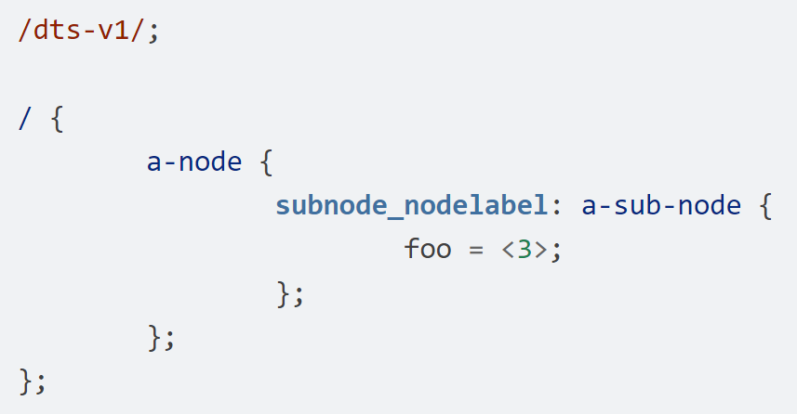
Devicetree( Syntax and structure )
As the name indicates, a devicetree is a tree. The human-readable text format for this tree is called DTS (for devicetree source), and is defined in the Devicetree specification.
The /dts-v1/; line means the file’s contents are in version 1 of the DTS syntax, which has replaced a now-obsolete “version 0”.
The tree has three nodes:
A root node: /
A node named a-node( /a-node ), which is a child of the root node
A node named a-sub-node( /a-node/a-sub-node ), which is a child of a-node

Slide 8
Devicetree( Syntax and structure )
Devicetree nodes can also have properties. Properties are name/value pairs. Property values can be any sequence of bytes. In some cases, the values are an array of what are called cells. A cell is just a 32-bit unsigned integer.
Node a-sub-node has a property named foo, whose value is a cell with value 3. The size and type of foo‘s value are implied by the enclosing angle brackets (< and >) in the DTS.

Slide 9
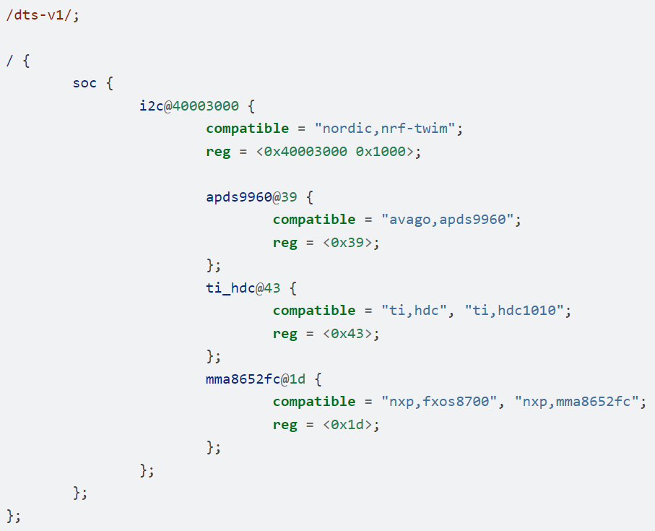
Devicetree( Syntax and structure )
In practice, devicetree nodes usually correspond to some hardware, and the node hierarchy reflects the hardware’s physical layout.
For example, let’s consider a board with three I2C peripherals connected to an I2C bus controller on an SoC, like this:
represents an I2C controller whose register map base address is 0x40003000.
/
SoC
A I2C device named ti_hdc has I2C address 0x43.
I2C Bus Controller
I2C peripheral 1
I2C peripheral 2
I2C peripheral 3

Slide 10
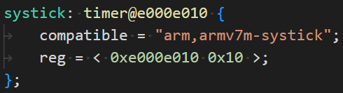
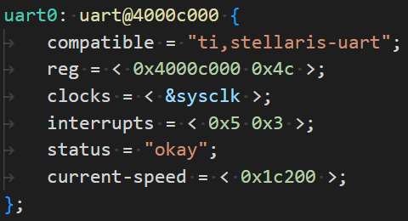
Devicetree( Important properties )
Item | Description | Example
compatible | The name of the hardware device the node represents. The recommended format is "vendor,device“ or a sequence of these.
reg | Information used to address the device. The reg property is a sequence of (address, length) pairs.
status | Only the values "okay" and "disabled" are currently relevant to Zephyr; use of other values currently results in undefined behavior.
interrupts | Information about interrupts generated by the device, encoded as an array of one or more interrupt specifiers.

Slide 11
Devicetree( Writing property values )
Type | How to write | Example
string | Double quoted | a-string = "hello, world!";
int | between angle brackets (< and >) | an-int = <1>;
boolean | for true, with no value (for false, use /delete-property/) | my-true-boolean;
array | between angle brackets (< and >), separated by spaces | foo = <0xdeadbeef 1234 0>;
uint8-array | in hexadecimal without leading 0x, between square brackets ([ and ]). | a-byte-array = [00 01 ab];
string-array | separated by commas | a-string-array = "string one", "string two", "string three";
phandle | between angle brackets (< and >) | a-phandle = <&mynode>;
phandles | between angle brackets (< and >), separated by spaces | some-phandles = <&mynode0 &mynode1 &mynode2>;
The prefix ‘p’ may means pointer.

Slide 12
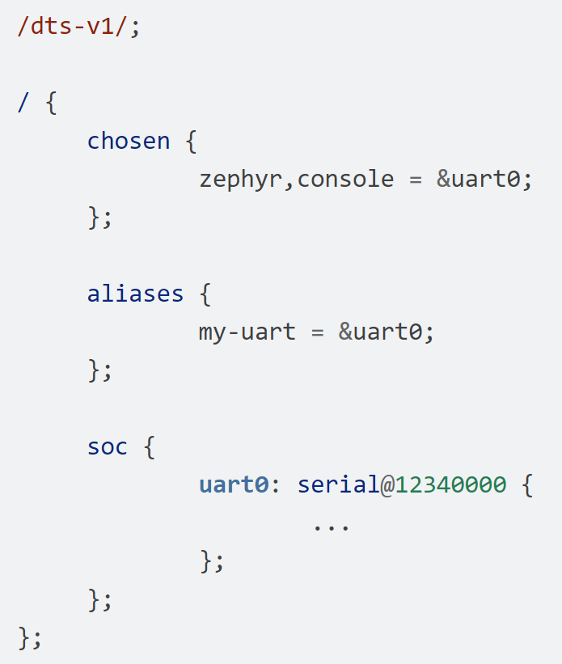
Devicetree( Aliases and chosen nodes )
The /aliases and /chosen nodes do not refer to an actual hardware device. Their purpose is to specify other nodes in the devicetree.
The /chosen node’s properties are used to configure system- or subsystem-wide values.
Property | Purpose
zephyr,console | Sets UART device used by console driver
zephyr,itcm | Instruction Tightly Coupled Memory node on some Arm SoCs
zephyr,dtcm | Data Tightly Coupled Memory node on some Arm SoCs
zephyr,flash | A node whose reg is sometimes used to set the defaults for CONFIG_FLASH_BASE_ADDRESS and CONFIG_FLASH_SIZE
zephyr,sram | A node whose reg sets the base address and size of SRAM memory available to the Zephyr image, used during linking
zephyr,bt-c2h-uart | Selects the UART used for host communication in the Bluetooth: HCI UART

Slide 13
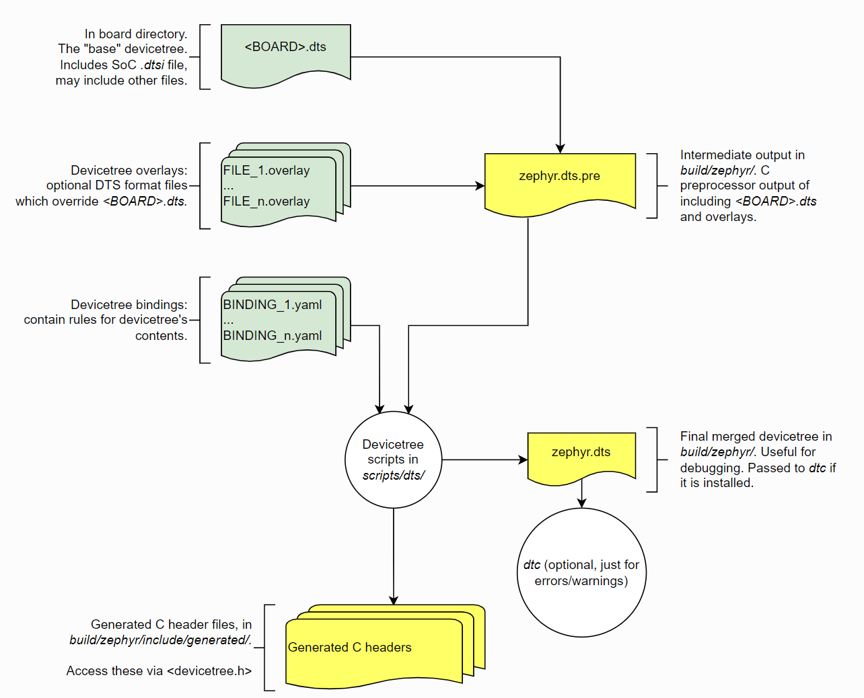
Devicetree( Input and output files )
Sources( .dts )
boards/<ARCH>/<BOARD>/<BOARD>.dts
Includes( .dtsi )
dts/common/skeleton.dtsi
Overlays( .overlay )
dts/<ARCH>/…/<SOC>.dtsi
Bindings( .yaml )
dts/bindings/…/binding.yaml

Slide 14
Devicetree( Devicetree bindings )
A devicetree on its own is only half the story for describing hardware, as it is a relatively unstructured format.
A devicetree binding declares requirements on the contents of nodes, and provides semantic information about the contents of valid nodes.
Zephyr devicetree bindings are YAML files in a custom format.
Devicetree nodes are matched to bindings using their compatible properties.
The build system uses the information of each node in the binding file both when validating the node’s contents and when generating macros for the node into the generated devicetree_generated.h header file.
If a node has more than one string in its compatible property, the build system looks for compatible bindings in the listed order and uses the first match.

Slide 15
Devicetree( Where bindings are located )
The build system looks for bindings in dts/bindings subdirectories of the following places:
the zephyr repository
your application source directory
your board directory
any directories in the DTS_ROOT CMake variable
any module that defines a dts_root in its build settings
The build system will consider any YAML file in any of these, including in any subdirectories, when matching nodes to bindings. A file is considered YAML if its name ends with .yaml or .yml.
The binding files must be located somewhere inside the dts/bindings subdirectory of the above places.
For example, if my-app is your application directory.
my-app/dts/bindings/serial/my-company,my-serial-port.yaml => be found
my-app/my-company,my-serial-port.yaml => be ignored
Notes:
zephyr/dts/bindings/interrupt-controller/arm,v7m-nvic.yaml
zephyr/dts/bindings/interrupt-controller/interrupt-controller.yaml
zephyr/dts/bindings/base/base.yaml
zephyr/dts/bindings/base/pm.yaml

