Slide 1

BIG DATA PROGRAMMING 2020 FINAL exam
Anurag Singh
Bina Khatnani
Vinay Mullapudi

Slide 2
the Library
Module:
This module implements pseudo-random number generators for various distributions.
Almost all module functions depend on the basic function random(), which generates a random float uniformly in the semi-open range [0.0, 1.0).
Functions:
random.randrange(stop): Return a randomly selected element from range(start, stop, step). This is equivalent to choice(range(start, stop, step)), but doesn’t actually build a range object.
random.shuffle(x[, random]): Shuffle the sequence x in place.
random.sample(k): Return a k length list of unique elements chosen from the population sequence or set. Used for random sampling without replacement.

Slide 3
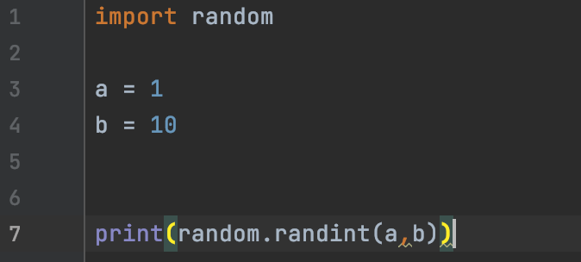
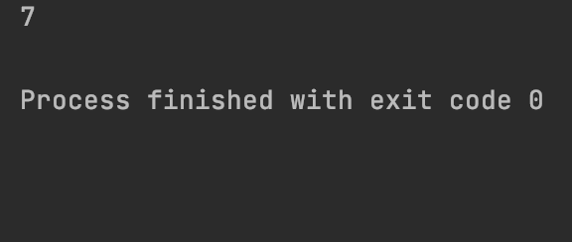
The function
random.randint(a, b)
Takes arguments ‘a’ and ‘b’. Returns a random integer N such that a <= N <= b.
Alias for randrange(a, b+1).
output

Slide 4
The Flow
Start
randint()
randrange()
_randbelow
__init__
subclass()
getrandbits
randbelow_with_getrandbits()
Random Number
exit

Slide 5
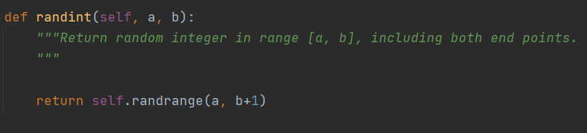
The function
random.randint(a, b)
Takes two integer arguments ‘a’ and ‘b’.
Returns randrange function which in-turn returns a random integer N such that a <= N <= b.

Slide 6
The function
Takes three integer arguments ‘start’, ‘stop’ and ‘step’.
Returns N such that, ‘start’ <= N <= ‘stop’ -1.
‘start’ is optional and is ‘0’ by default, ‘stop’ is mandatory and ‘step’ is optional and is ‘1’ by default.

Slide 7

The function
_randbelow is calling __init__subclass() and generating random number.

Slide 8
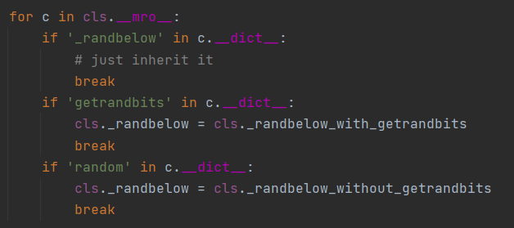
The function
__init__subclass() is using cls.__mro__ and .__dict__ function to locate ‘_randbelow’ within the class and assigns it to _randbelow_with_getrandbits().

Slide 9
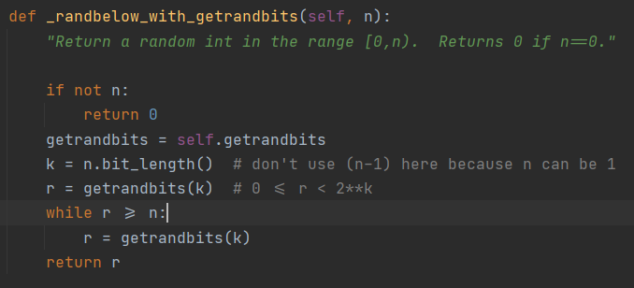
The function
_randbelow_with_getrandbits takes argument ‘n’ to calculate the bit length of ‘n’.
Then getrandbits(), takes in this bit length as argument and returns an integer which is less than ‘n’ as shown.

Slide 10
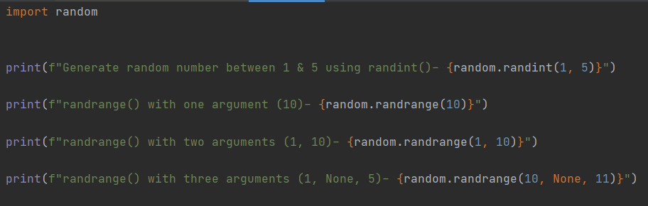
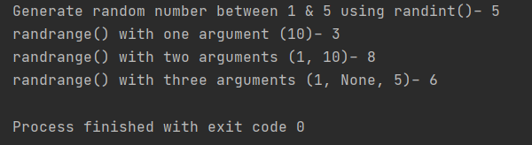
Example
Code Snippet
Output

Slide 11
Q&A

