Slide 1


Slide 2
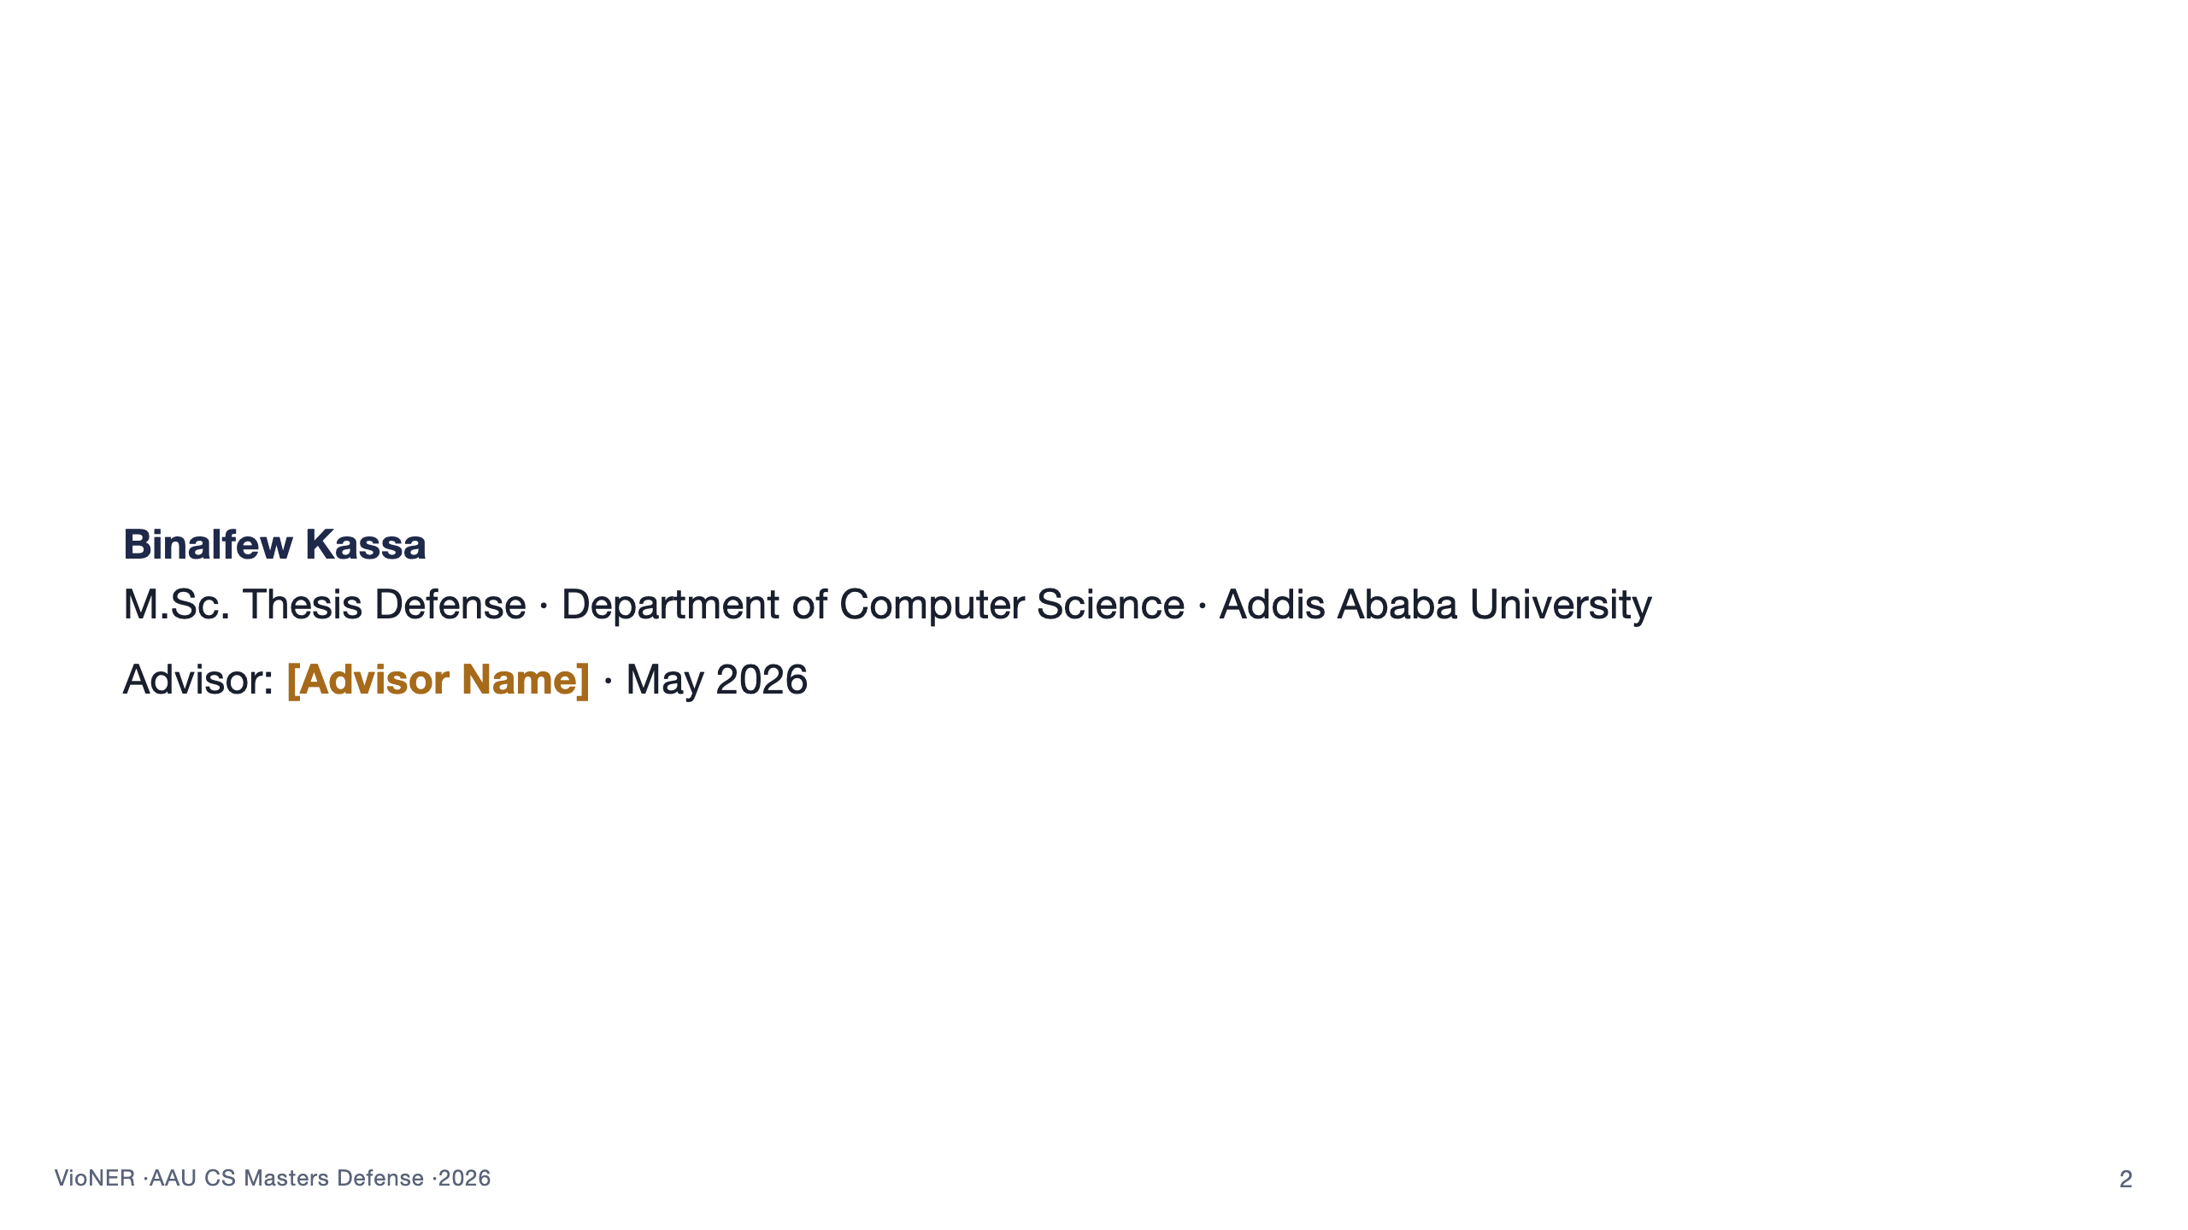
Notes:
Open with the title. Greet the panel by name. One sentence: "Good morning, distinguished examiners. I'm Binalfew Kassa, and the work I'll be presenting today builds an end-to-end system for extracting structured information about violent events in Africa from English-language news reports." Pause. Do NOT read the title slide. Move to outline within 30 seconds.

Slide 3
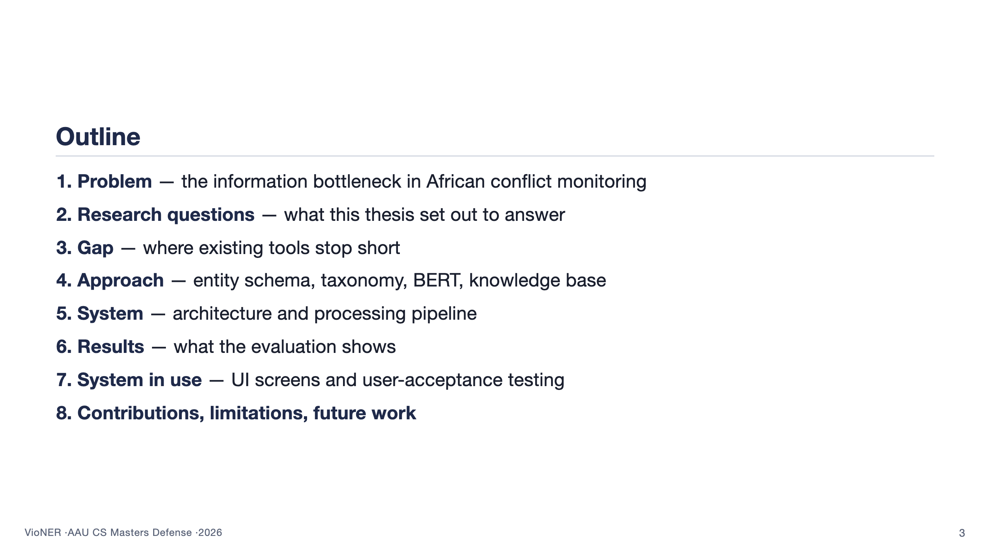
Notes:
Walk the panel through the structure in roughly 45 seconds. Emphasise that the talk has three centres of gravity: the problem framing, the methodological choices, and the evaluation. Mention that there is a backup deck after slide 39 with deeper detail on anything they want to drill into. Cue them to interrupt with clarifying questions even during the talk. Then move on. Do not linger.

Slide 4
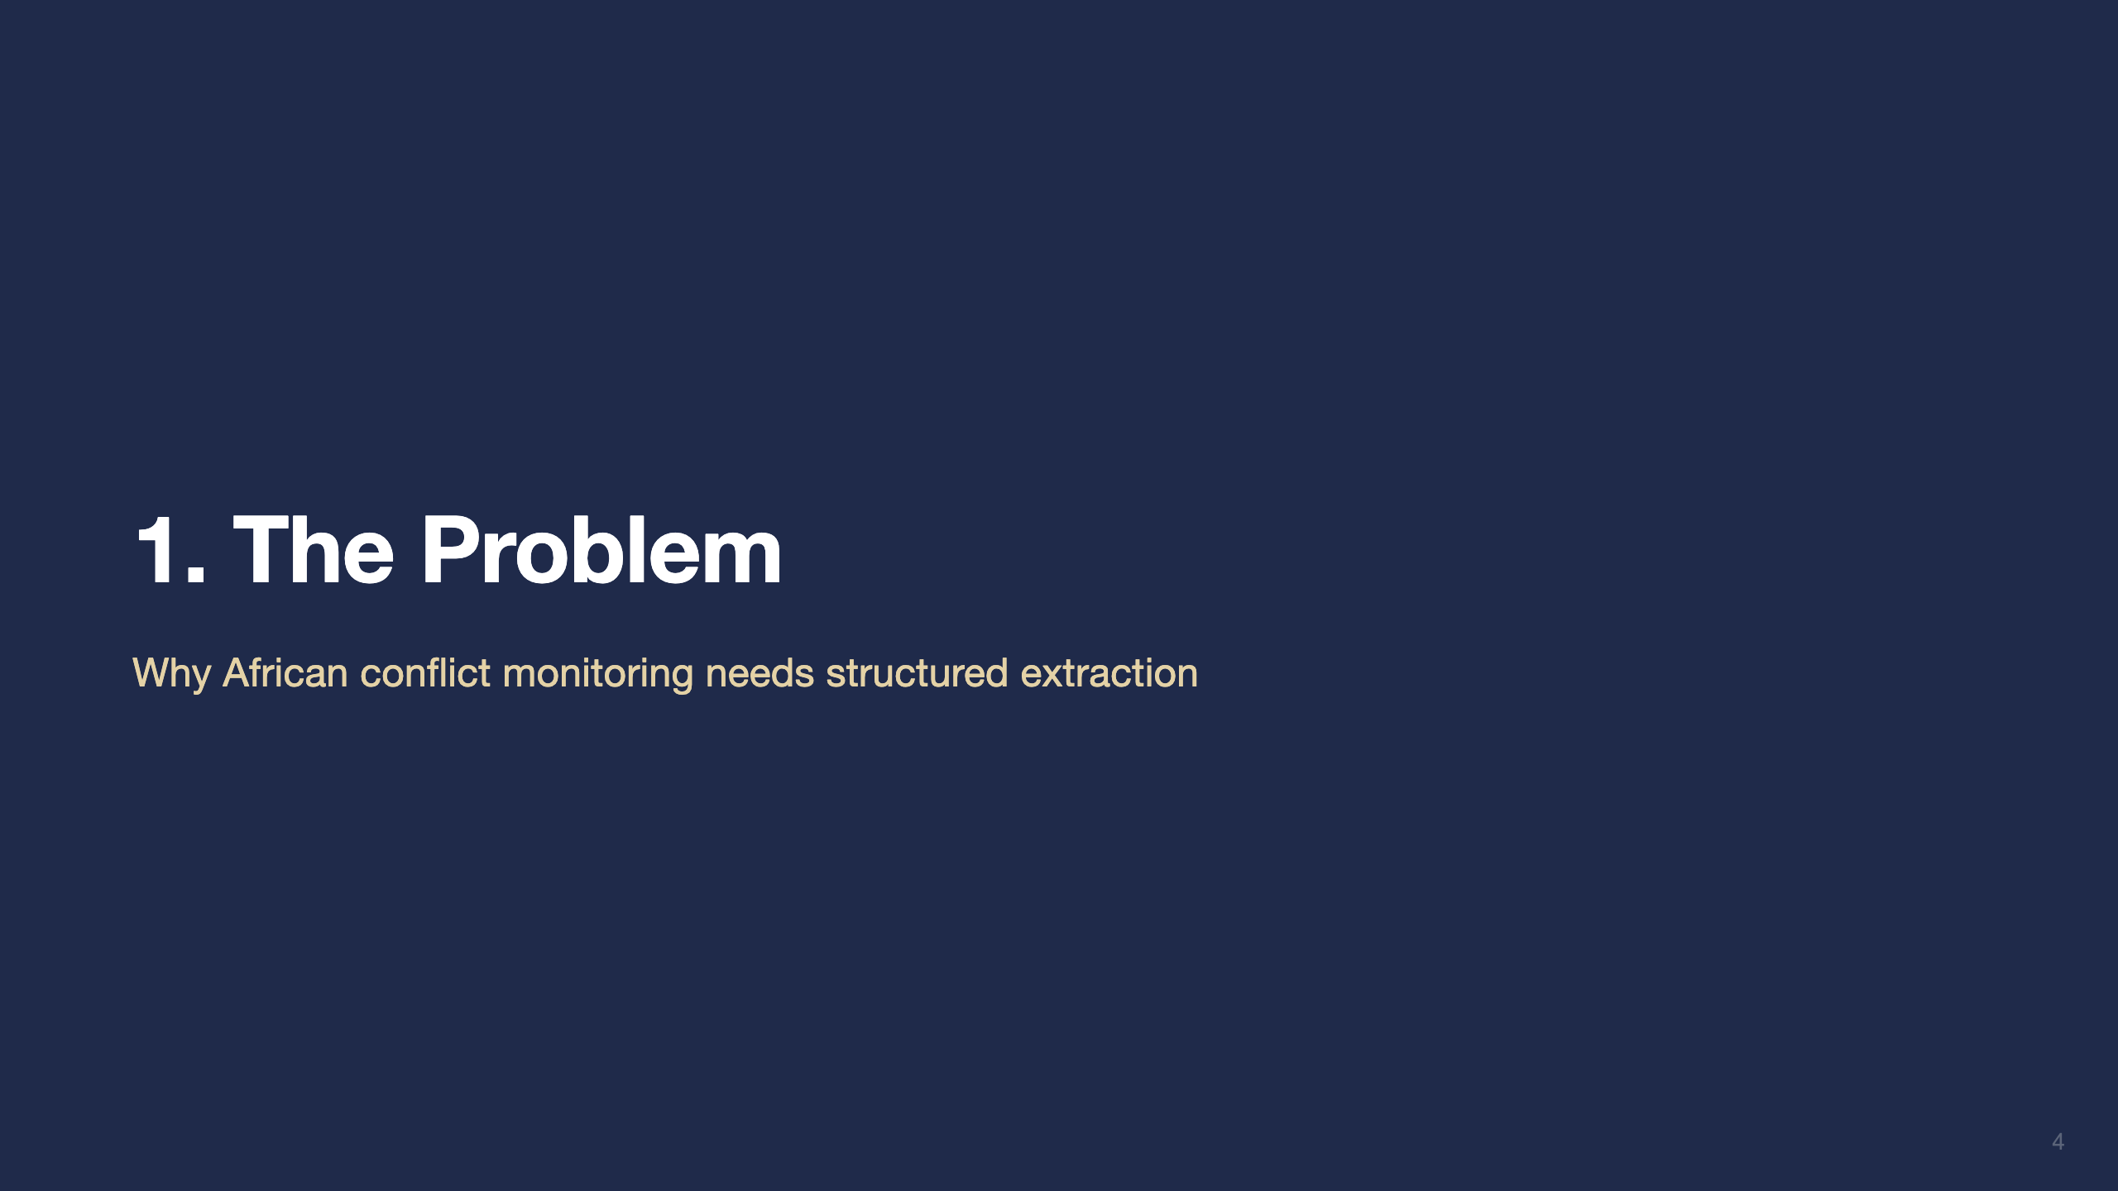

Slide 5
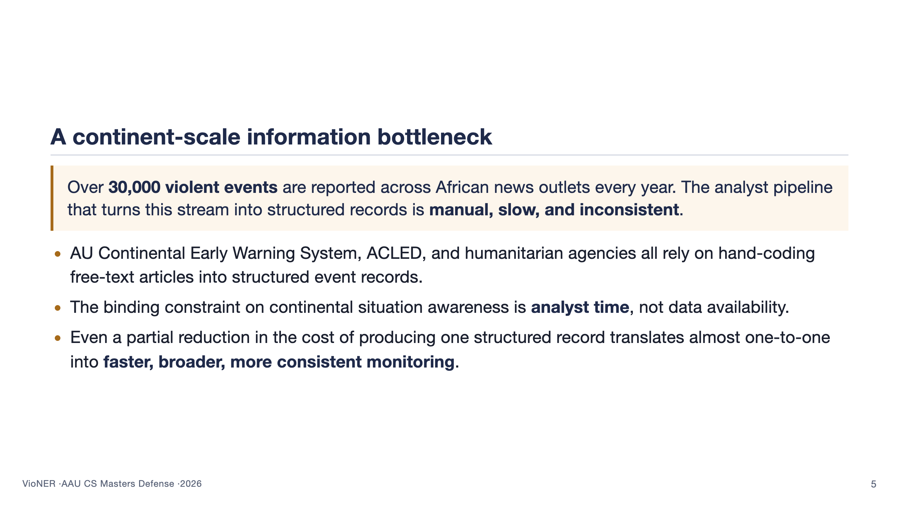
Notes:
This slide sets the stakes. The panel needs to believe two things by the end of it: (1) the problem is real, large, and operational — not just academic; (2) reducing analyst time is the right place to apply machine learning. Mention AU-CEWS by name because it grounds the problem in an actual continental institution. Don't get drawn into ACLED-vs-GDELT methodology comparisons here — that's the related-work slide's job. Aim for 60 seconds.

Slide 6
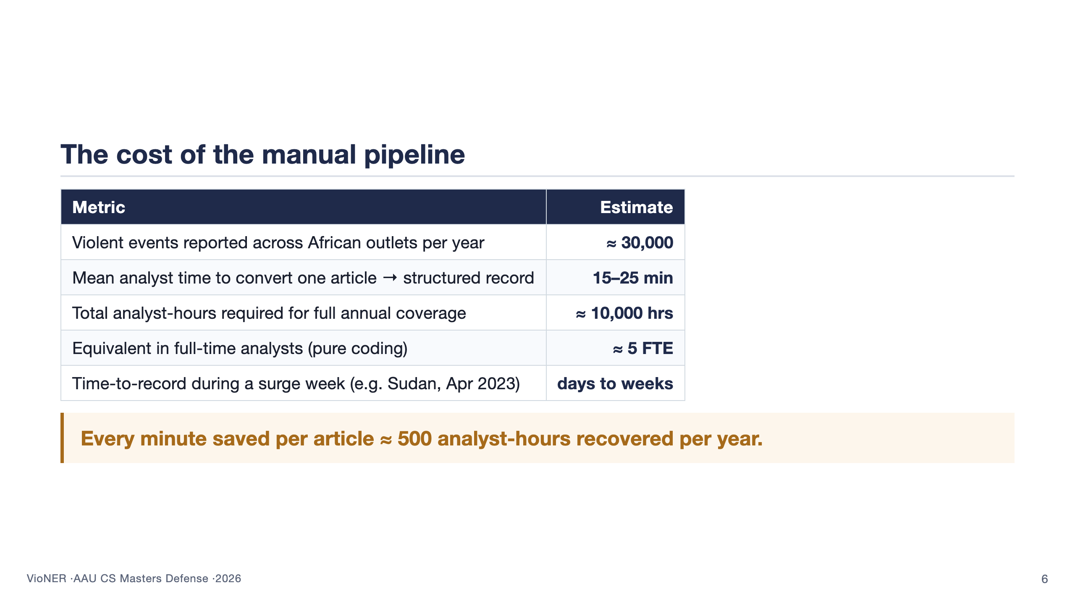
Notes:
This slide quantifies the bottleneck. Without it, "the analyst is slow" is just an assertion; with it, the panel sees the scale. Walk down the table one row at a time, pausing on the FTE number. The closing italic line is the leverage argument — automation here is high-leverage precisely because the manual work is so repetitive. Around 65 seconds.

Slide 7
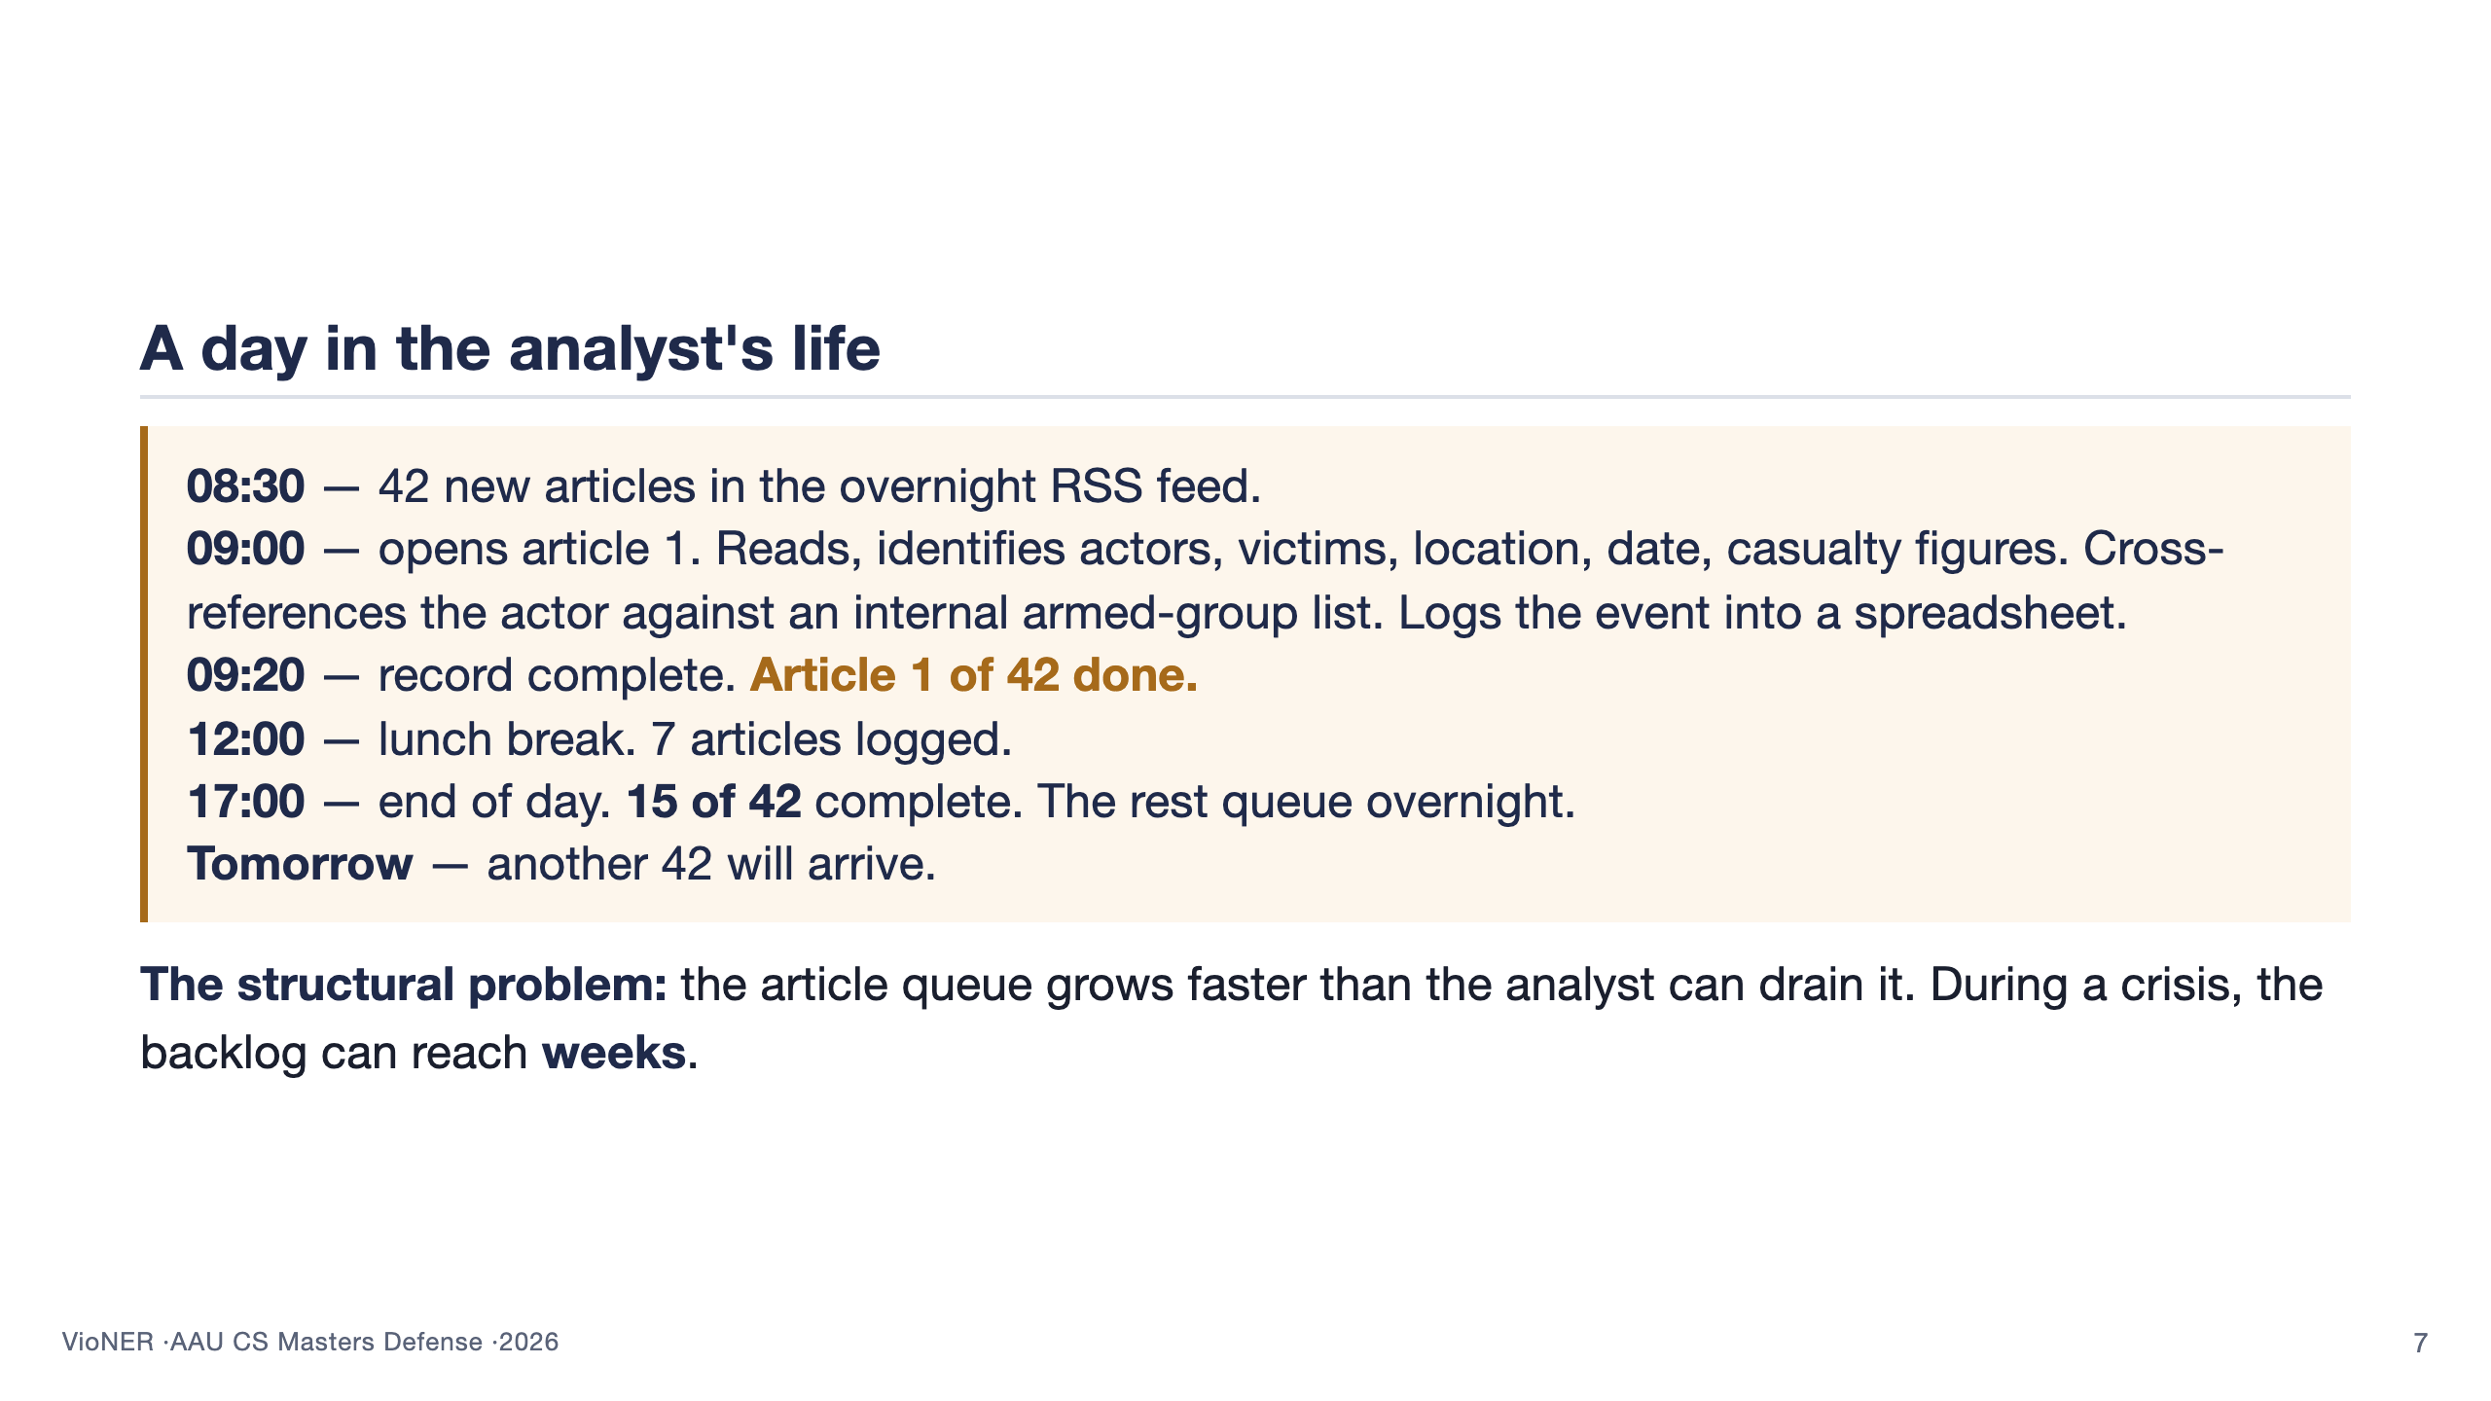
Notes:
This slide humanises the problem. The bullet timeline reads like a diary — let the panel feel the workday. Read each timestamp aloud, briefly. The closing bottom line names the structural problem: it is not that any individual analyst is slow; it is that the inbound rate exceeds any sustainable analyst rate. VioNER is the response to that structural mismatch. Around 70 seconds.

Slide 8
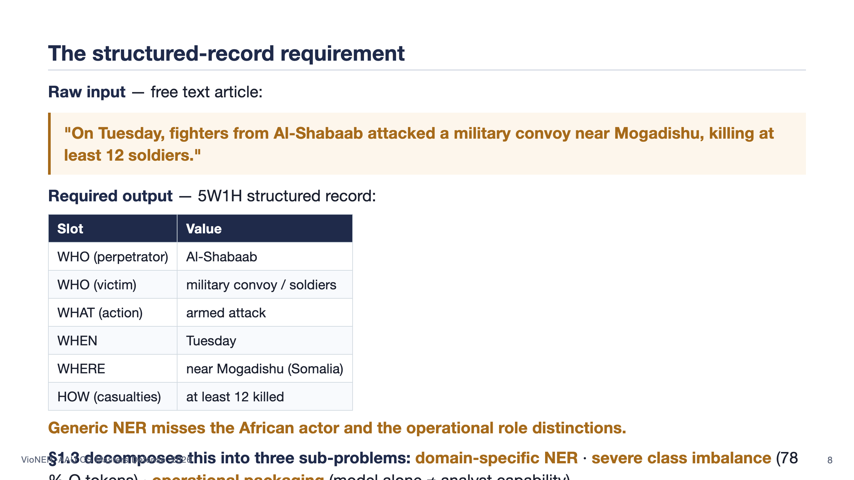
Notes:
This is the slide that makes the problem concrete. Read the example sentence verbatim — it lands harder than paraphrasing it. Walk the table top to bottom slowly; one beat per row. Land the punchline: generic off-the-shelf NER tagged Al-Shabaab as ORGANISATION (technically correct, operationally useless) and missed the convoy as a victim entirely. Then read the §1.3 line below the caption SLOWLY — it tees up the methodology slide that comes after the RQs. Around 80 seconds.

Slide 9


Slide 10
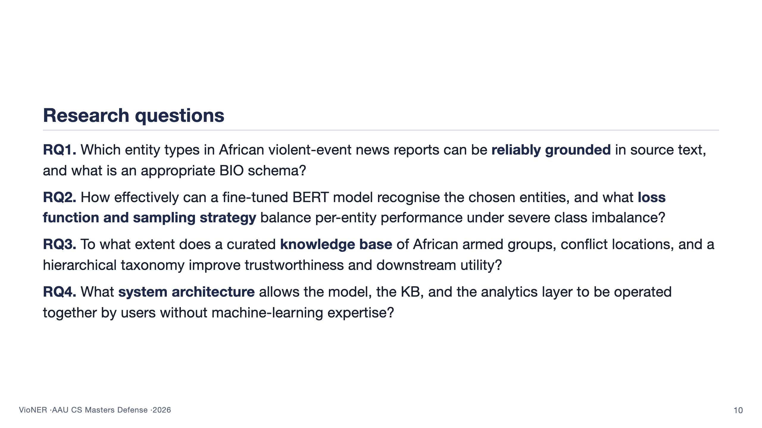
Notes:
Four questions, one per beat. RQ1 is about schema design — what we even try to tag. RQ2 is the modelling core — how well the model performs. RQ3 is the KB layer — what curated knowledge buys beyond the model alone. RQ4 is the systems contribution — the often-skipped step that turns a model into an operational capability. Tell the panel that every result slide later in the talk will be marked with the RQ it answers, so they can track the evidence. About 90 seconds.

Slide 11
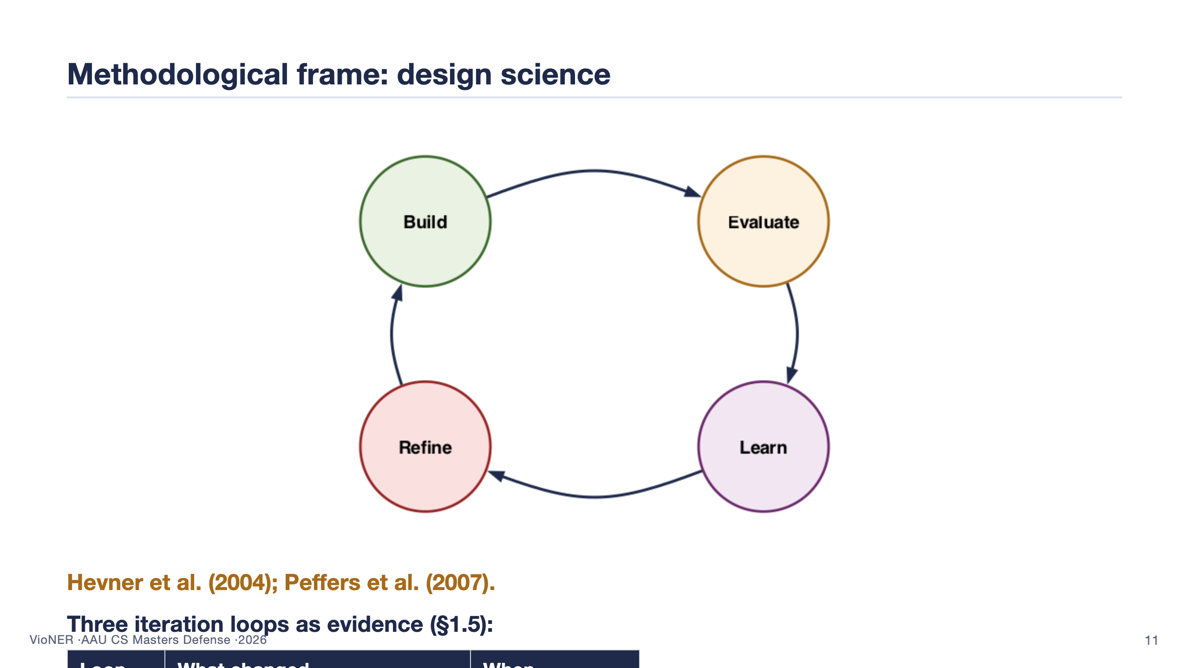
Notes:
This is the slide that answers "what is your methodological frame and why is it design science." Three beats. (1) Point at the cycle figure on the left: this is the Hevner/Peffers design-science loop — build an artefact, evaluate it, learn from the evaluation, refine, and go around again. The contribution is the artefact, evaluated empirically at each stage. That is the textbook definition. (2) Show the iteration table on the right — three concrete loops over five months, each closed by hard evidence rather than preference. The corpus loop: full ACLED gave WORSE rare-entity F1 than a stratified subset because of phrasing repetition; that was the empirical signal that drove the redesign. The schema loop: the November grounding pilot showed EVENT_TYPE could be located verbatim in only 58 percent of cases — that killed the 26-entity schema and led to the 8-entity version. The loss loop: the focal-vs-CE ablation in section 6.6 quantified the benefit at 11 F1 points on VICTIM. (3) Close: this is not a single-shot build. It is an iterated artefact, with iteration evidence reported in the thesis. That is what makes the methodology defensible as design science rather than just engineering. About 95 seconds.

Slide 12


Slide 13
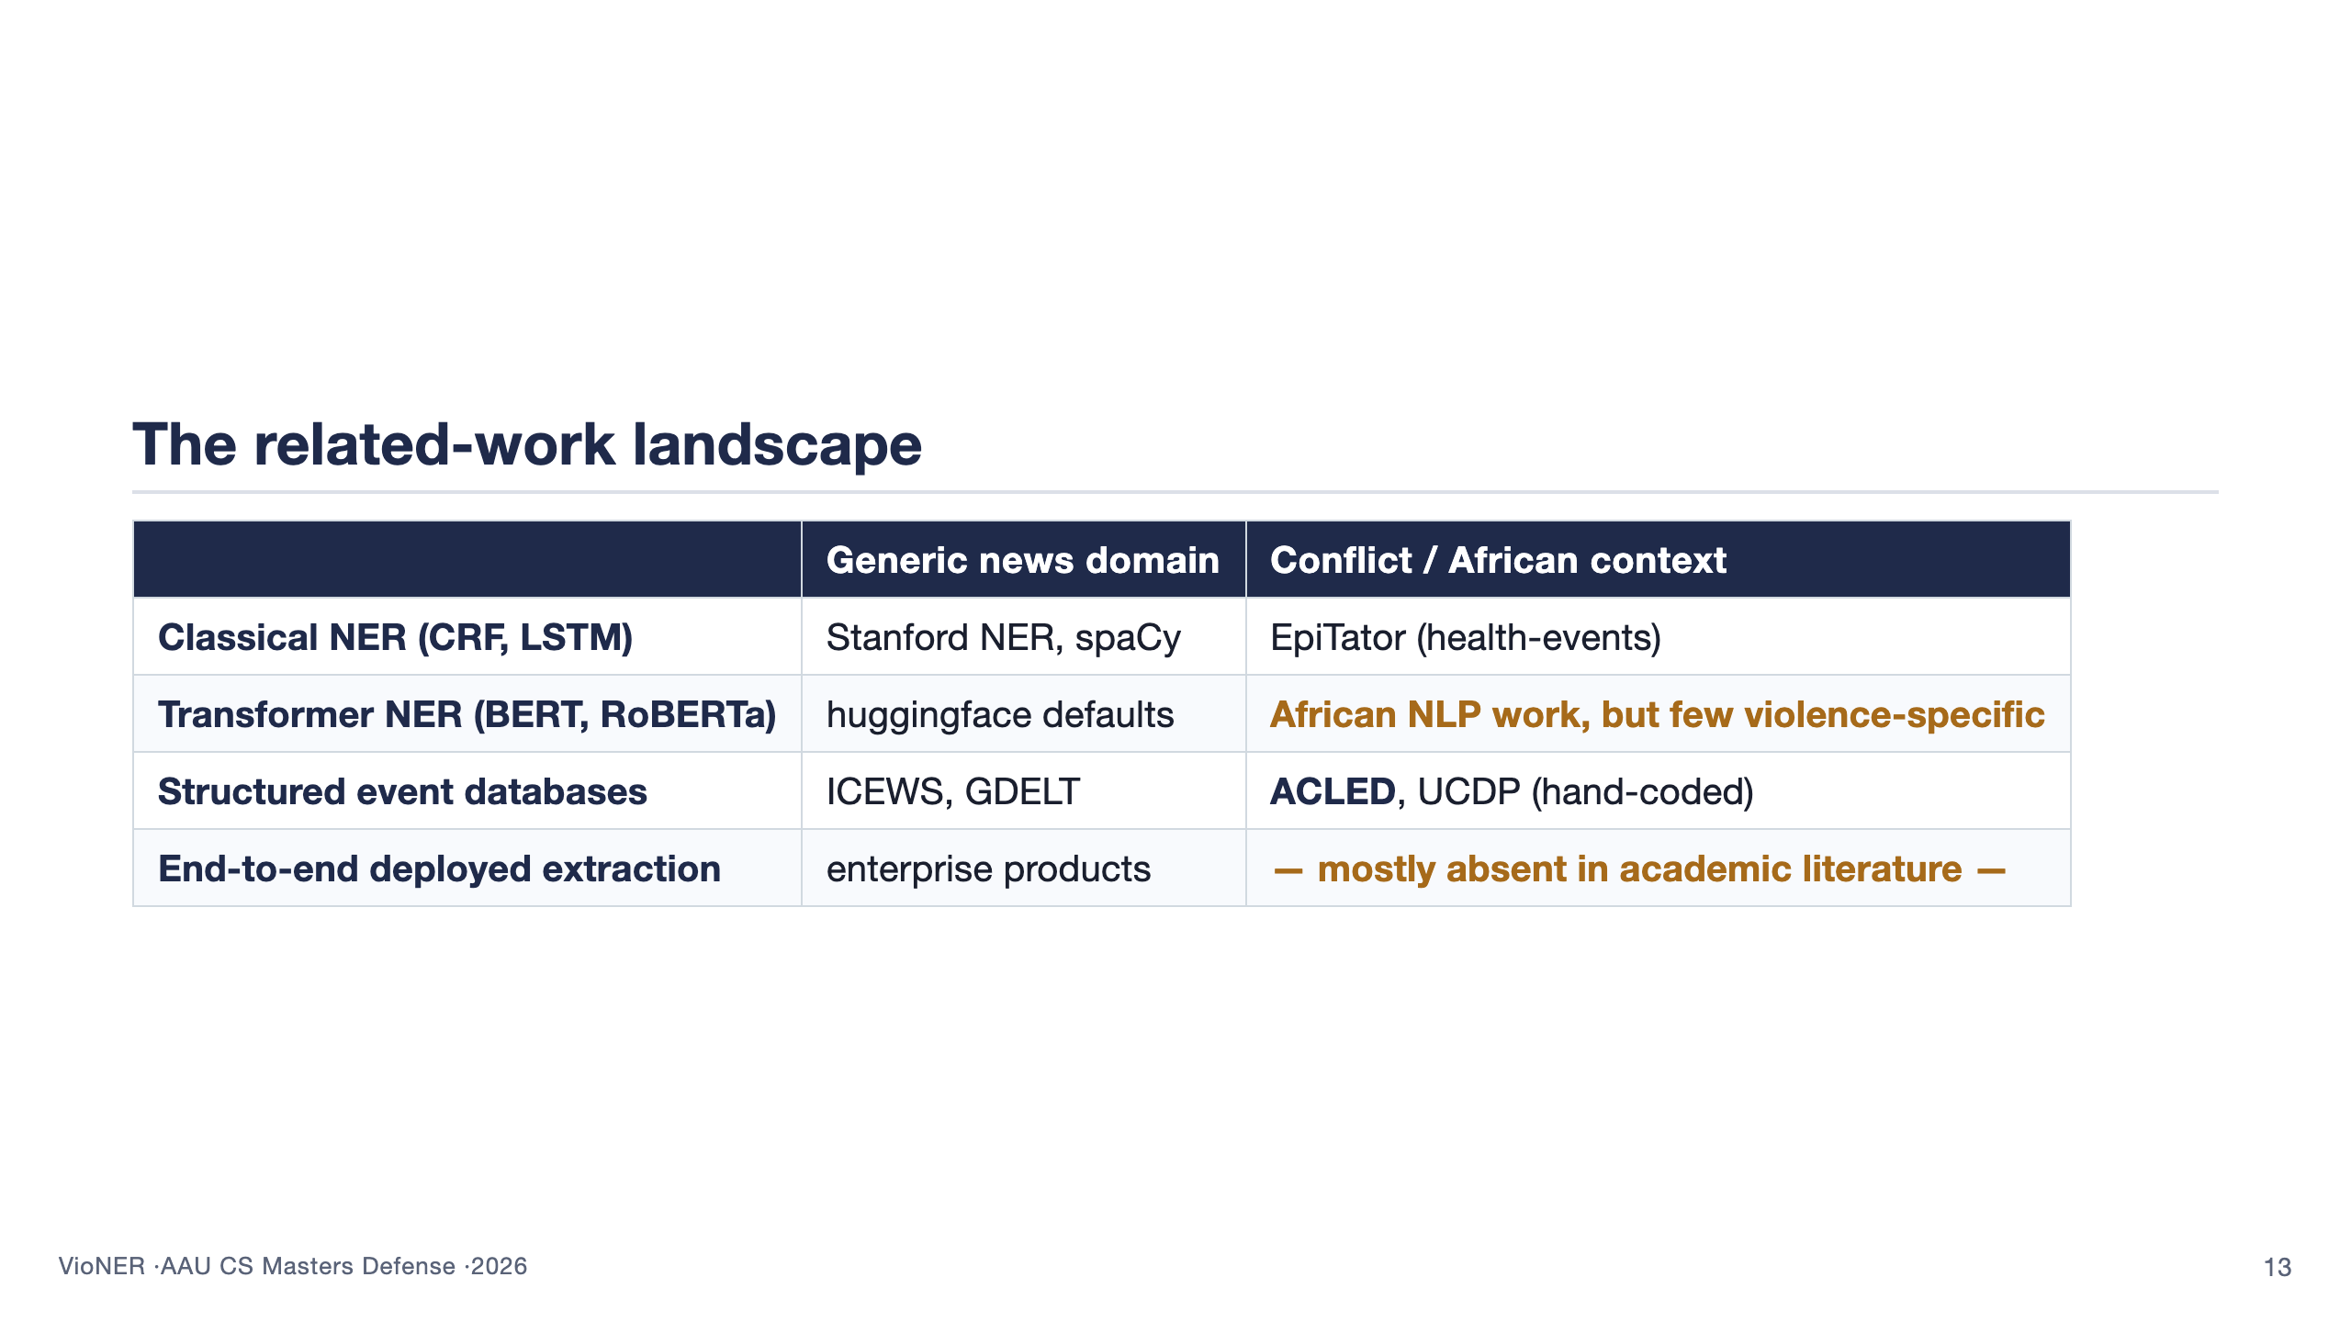
Notes:
This 2x2 is the most efficient way to position the work. Walk across the rows top-to-bottom. The two cells that matter are bottom-right (ACLED/UCDP are hand-coded, which is exactly the bottleneck this thesis attacks) and the empty cell below it (academic event-extraction work in the African context stops at the model boundary; the operational packaging is missing). VioNER fills that empty cell. Do not name competitors aggressively — examiners often have favourites. About 80 seconds.

Slide 14
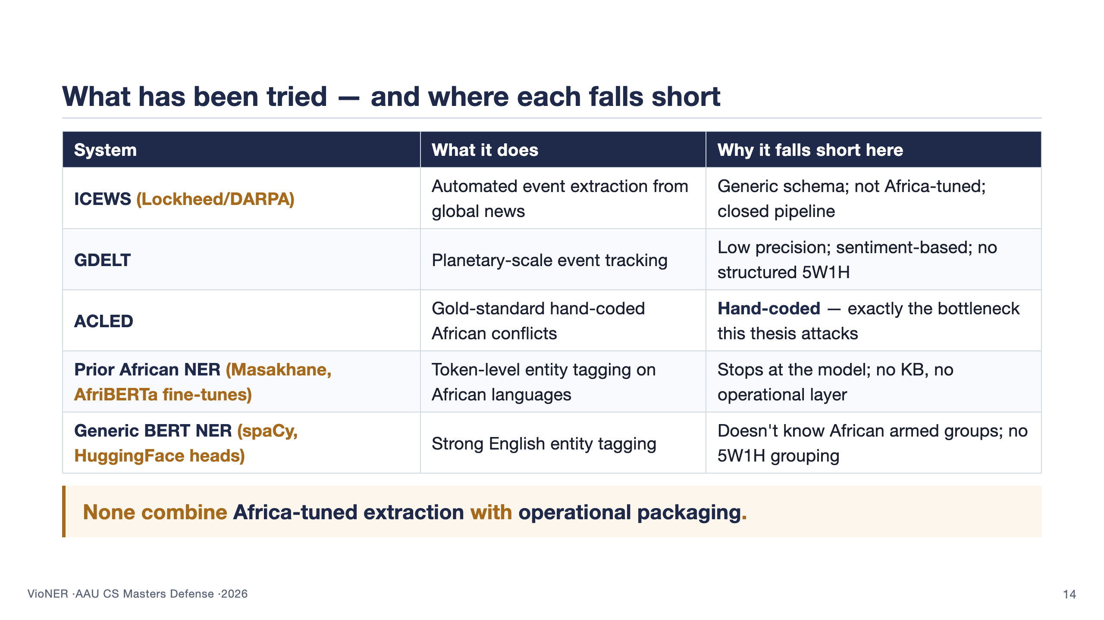
Notes:
This slide shows the panel that prior work has been surveyed thoroughly. Walk row by row. Pause briefly on ACLED — it is the closest cousin to this work, and its strength (gold-standard quality) is also its weakness (it requires the very manual labour this thesis tries to reduce). The italic bottom line is the wedge: no existing system gives you BOTH the African specificity AND the operational packaging. About 75 seconds.

Slide 15
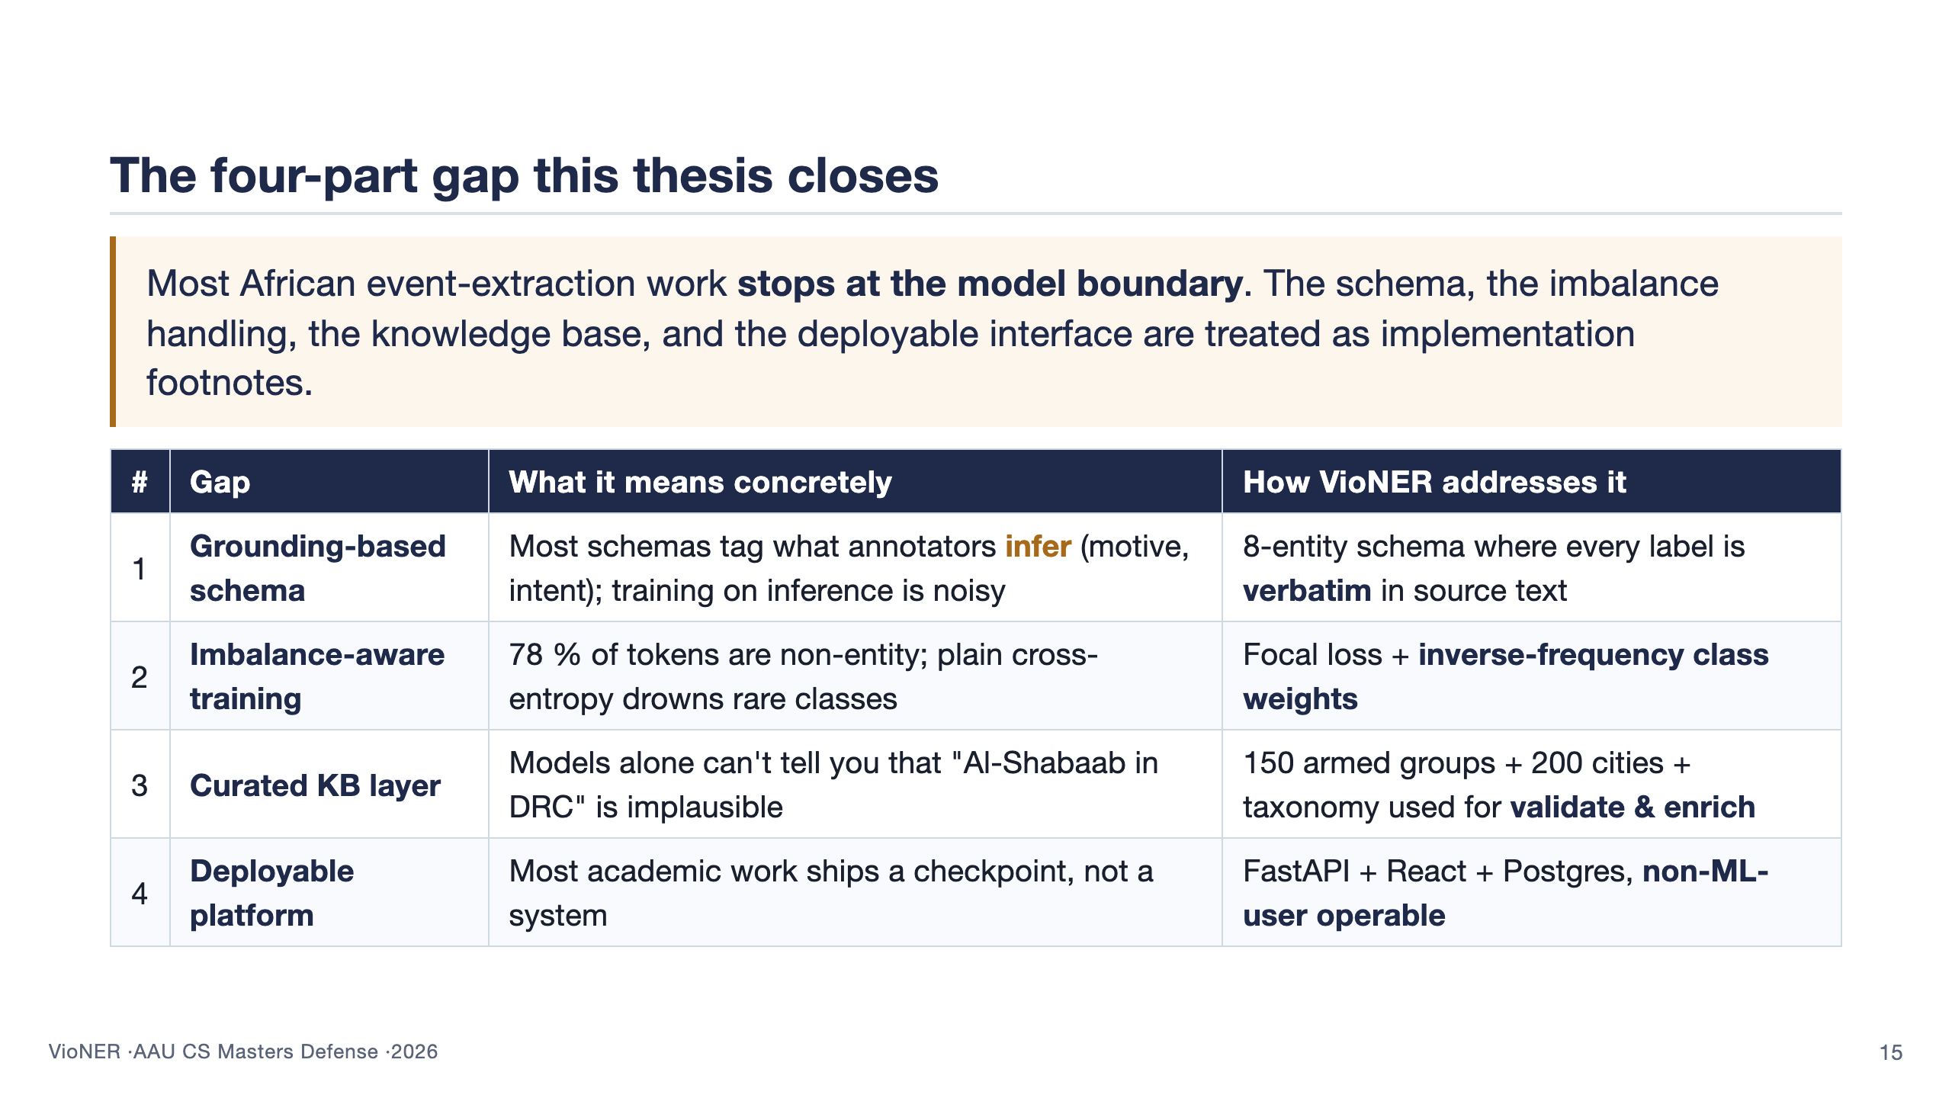
Notes:
This is the slide that names what's new, with one row per gap. Read each row top to bottom: gap name (bold) → what the gap means in concrete terms → how this thesis closes it. The four rows are the four substantive contributions of the thesis, each tied to a piece of the system the panel will see in the approach section. About 85 seconds.

Slide 16
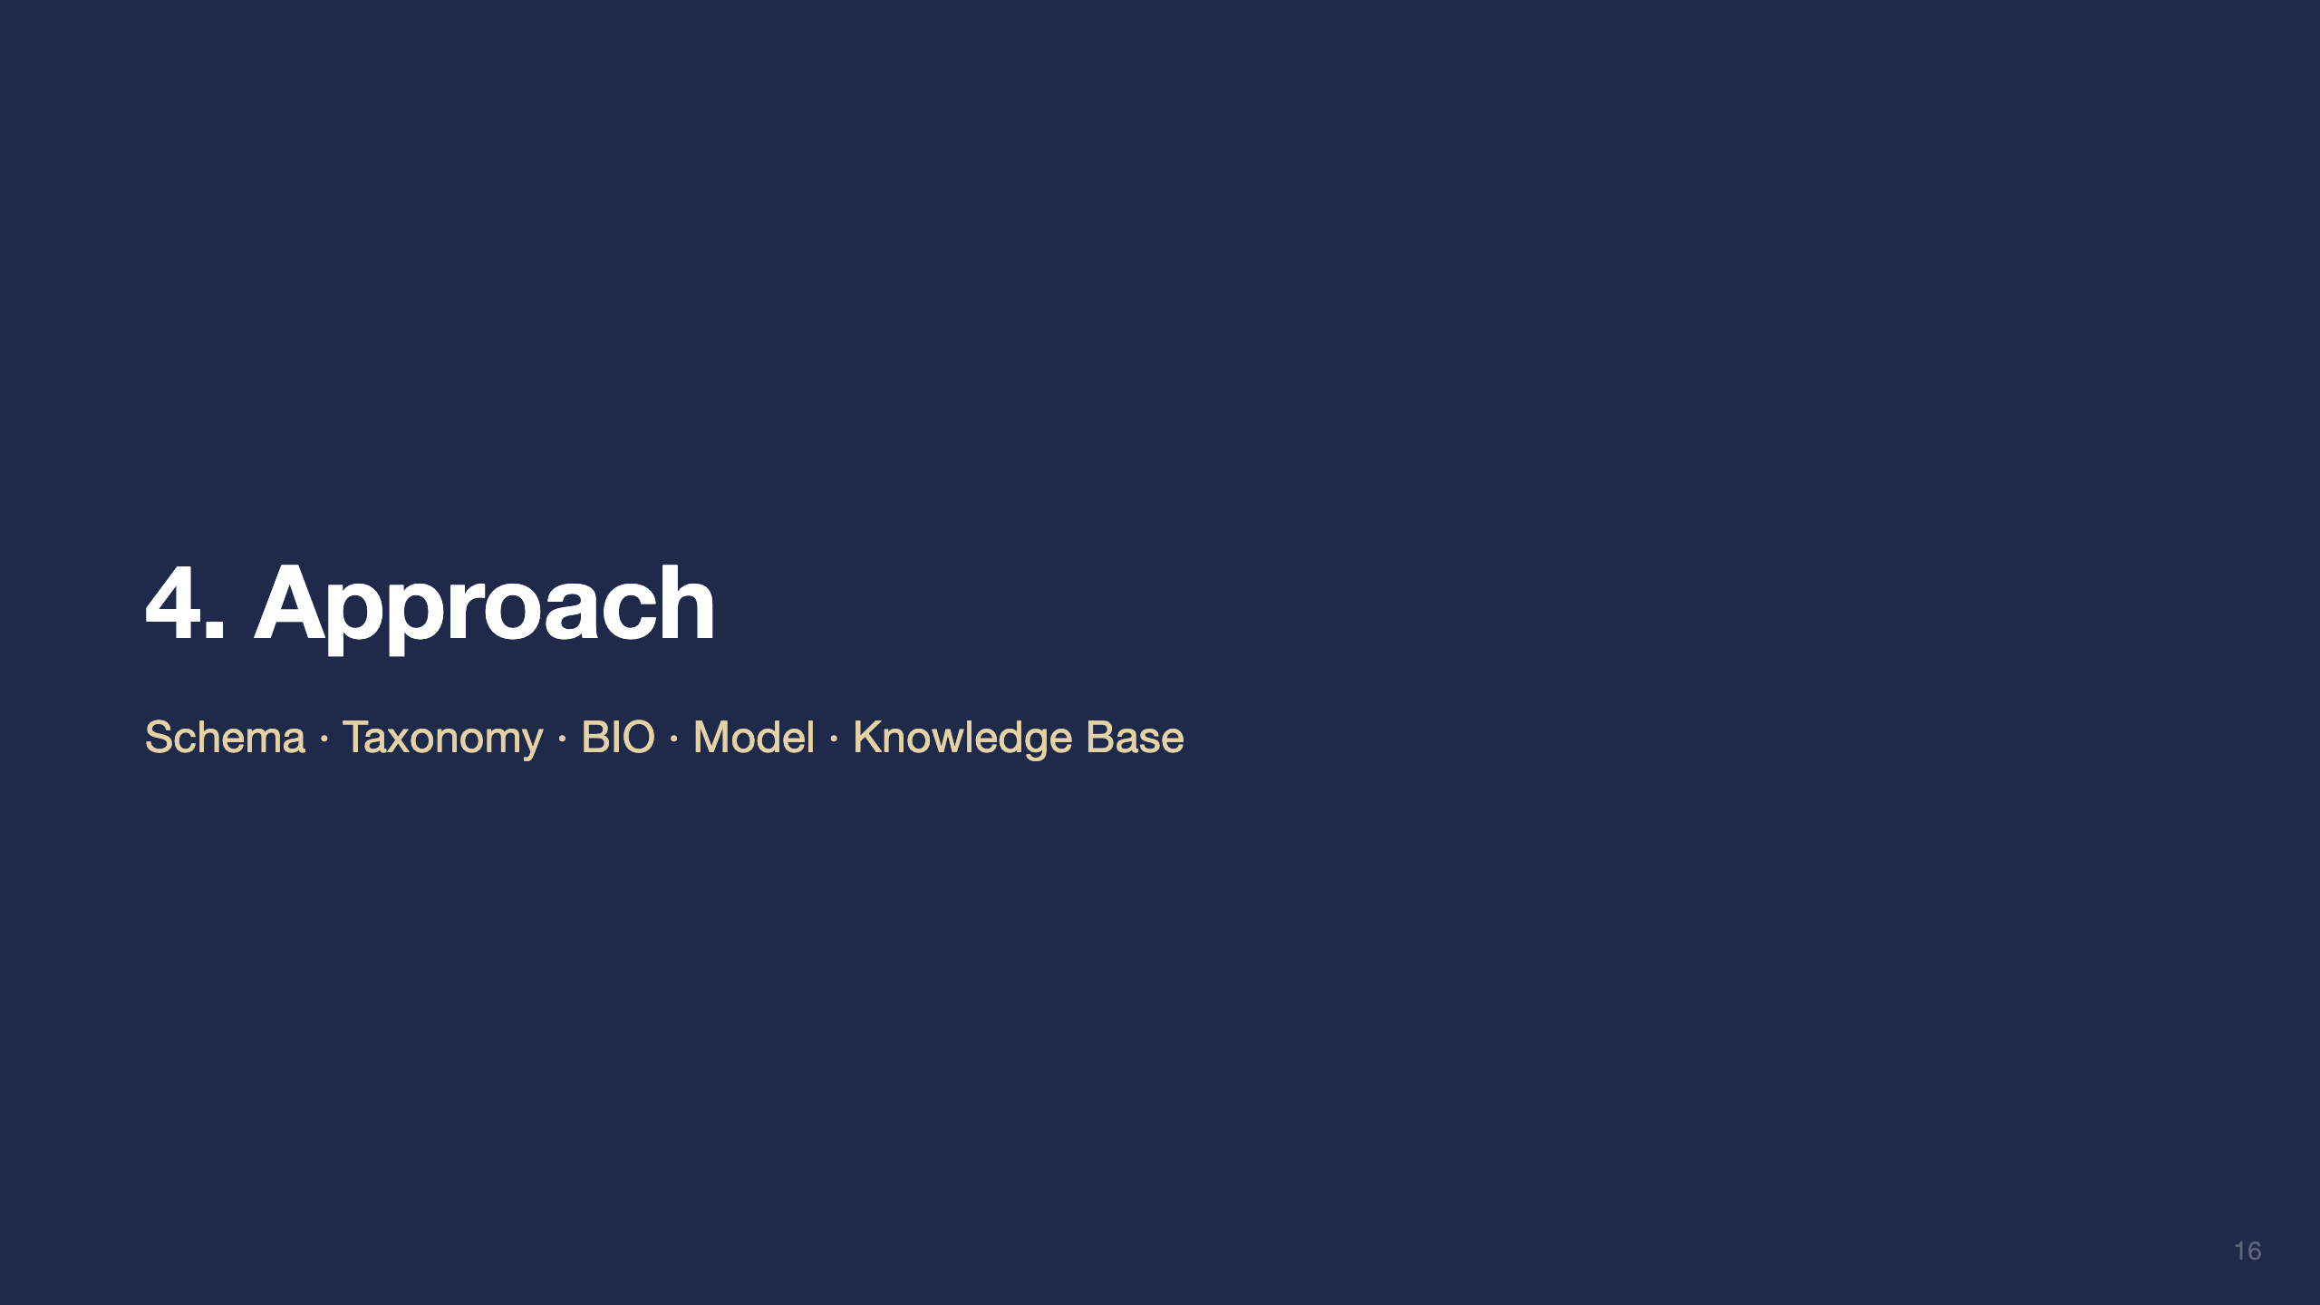

Slide 17
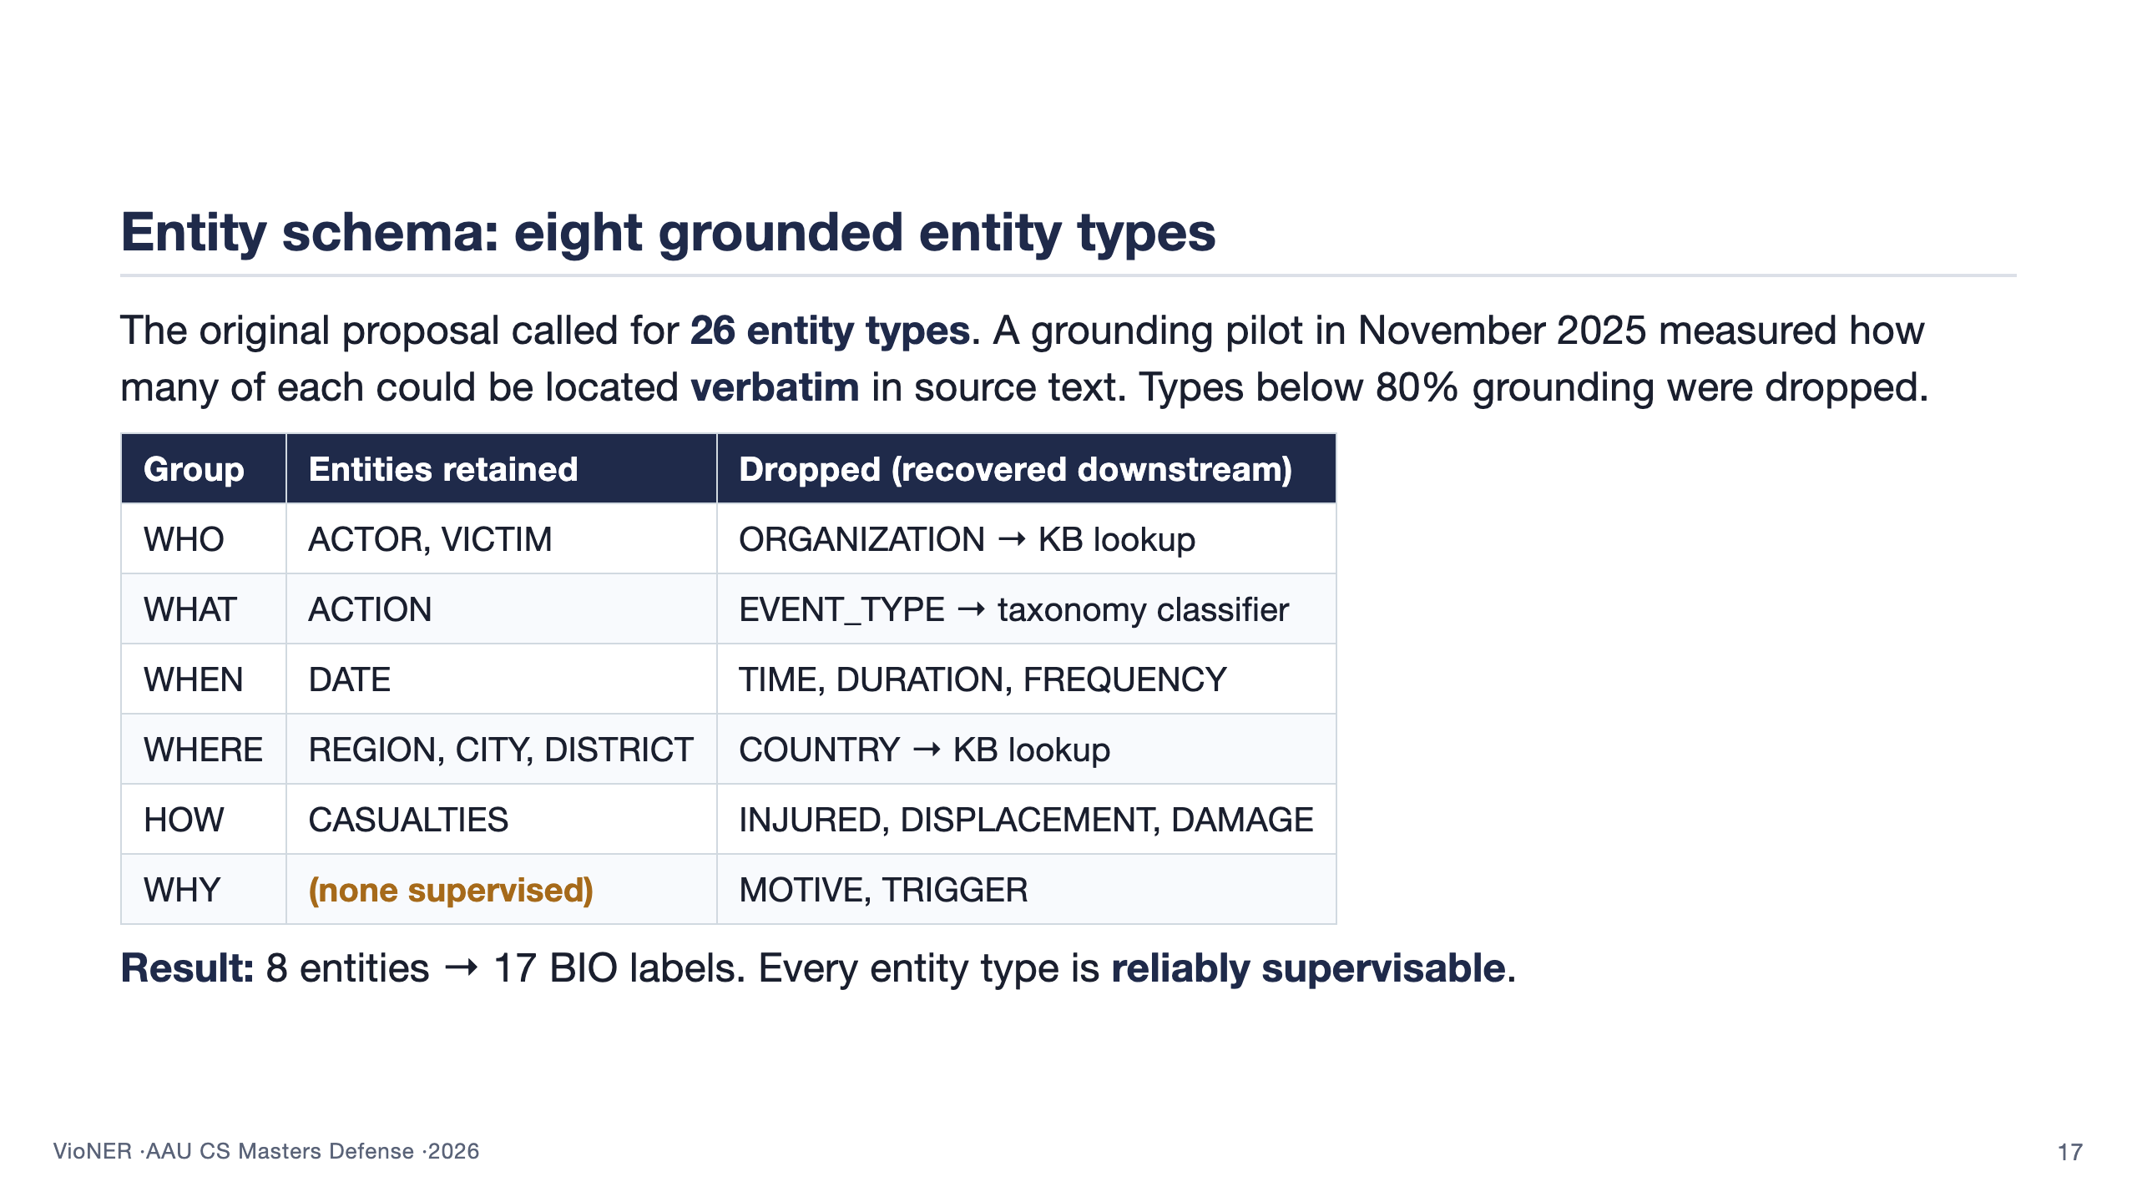
Notes:
This slide answers RQ1. The story to tell: I started with the proposal's 26-type schema, ran a grounding pilot, and discovered that types like MOTIVE and TRIGGER were almost never present verbatim — annotators were inferring them from context. Training on inferred-not-grounded labels would have introduced systematic noise. So those types were dropped from the NER schema and recovered downstream: EVENT_TYPE from the action verb plus the taxonomy classifier; COUNTRY from a KB lookup off the most-specific WHERE entity. Eight grounded entities train cleanly, and the taxonomy and KB pick up the rest. The panel may push on this — "you reduced the schema; isn't that a weakening of the contribution?" Reply: it's a strengthening, because every label now has a ground-truth signal. 100 seconds.

Slide 18
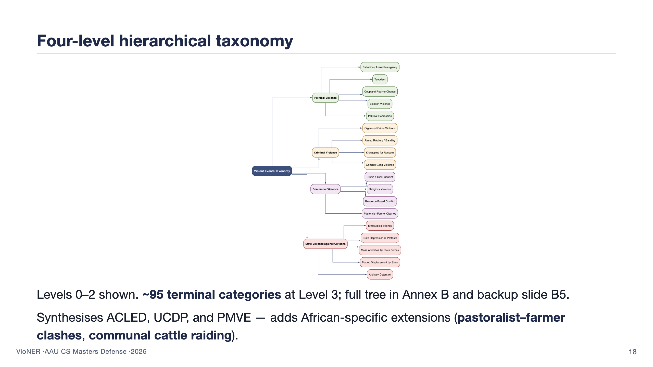
Notes:
Show the figure. Walk left to right: the root (Violent Events Taxonomy), the four Level-1 families (Political, Criminal, Communal, State), then the Level-2 children. Tell the panel that the taxonomy isn't just a relabelling of ACLED — it adds two African-specific categories that none of the existing frameworks cover at this granularity. Pastoralist-farmer clashes alone account for a measurable fraction of Sahel reporting and don't sit cleanly in ACLED's "Violence against civilians" bucket. The L3 leaves are in Annex B; you can flip to backup B5 if asked. 80 seconds.

Slide 19
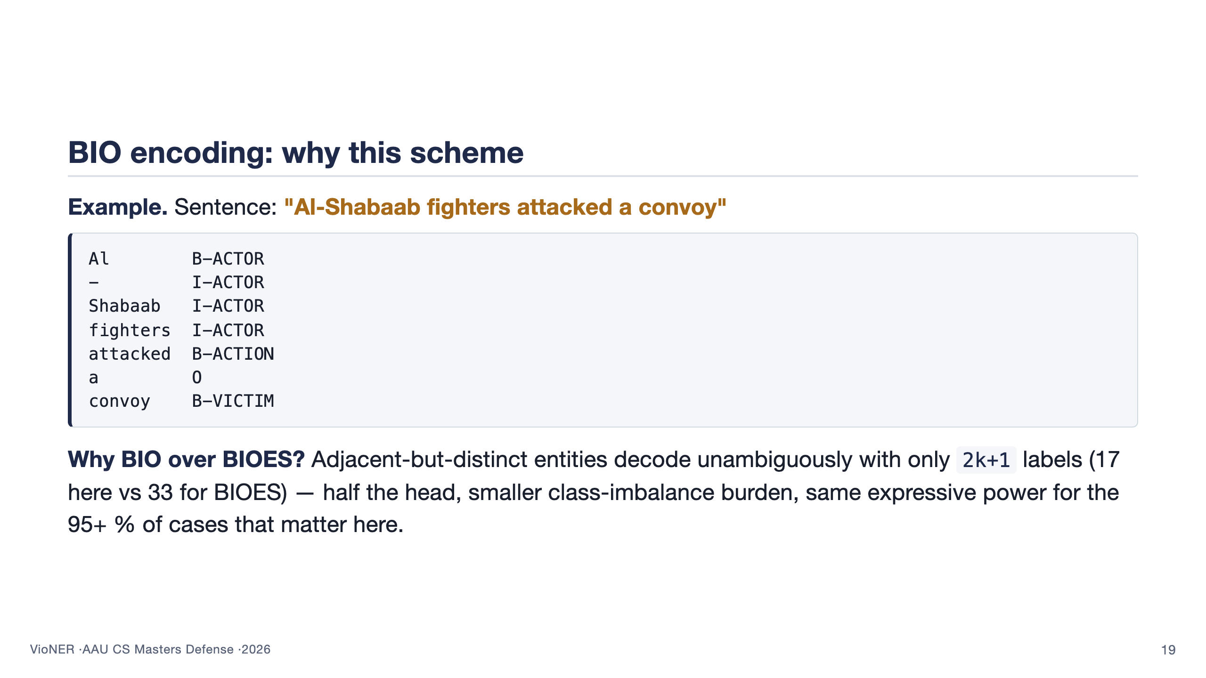
Notes:
This is the slide that addresses advisor comment C444. The panel may not care deeply about BIO vs BIOES, but if they ask, the answer is precise: BIOES (begin/inside/outside/end/single) doubles the label space without giving us anything we need, because African news reports almost never have adjacent same-type entities with no intervening token. BIO is sufficient and trains faster. Read the code block carefully — the I-ACTOR continuation across the hyphen is the kind of case students often get wrong, and showing it right signals you've thought about this. 70 seconds.

Slide 20
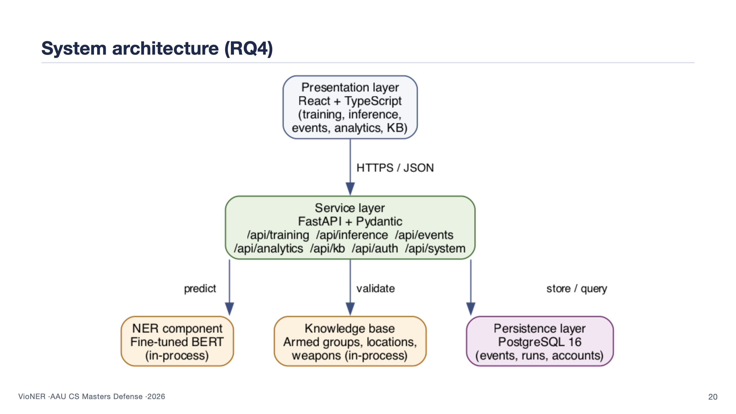
Notes:
Walk down the stack. React + TypeScript at the top — this is what the analyst sees. FastAPI in the middle — a thin Python service exposing seven route groups (training, inference, events, analytics, KB, auth, system). The NER component and the knowledge base are loaded once into the FastAPI process so inference is in-memory and fast. PostgreSQL at the bottom holds the persistent state: stored events, training runs, user accounts. Docker Compose orchestrates the whole thing for reproducible local deployment. The clean separation is what lets the panel believe a non-ML user can drive it. 70 seconds.

Slide 21
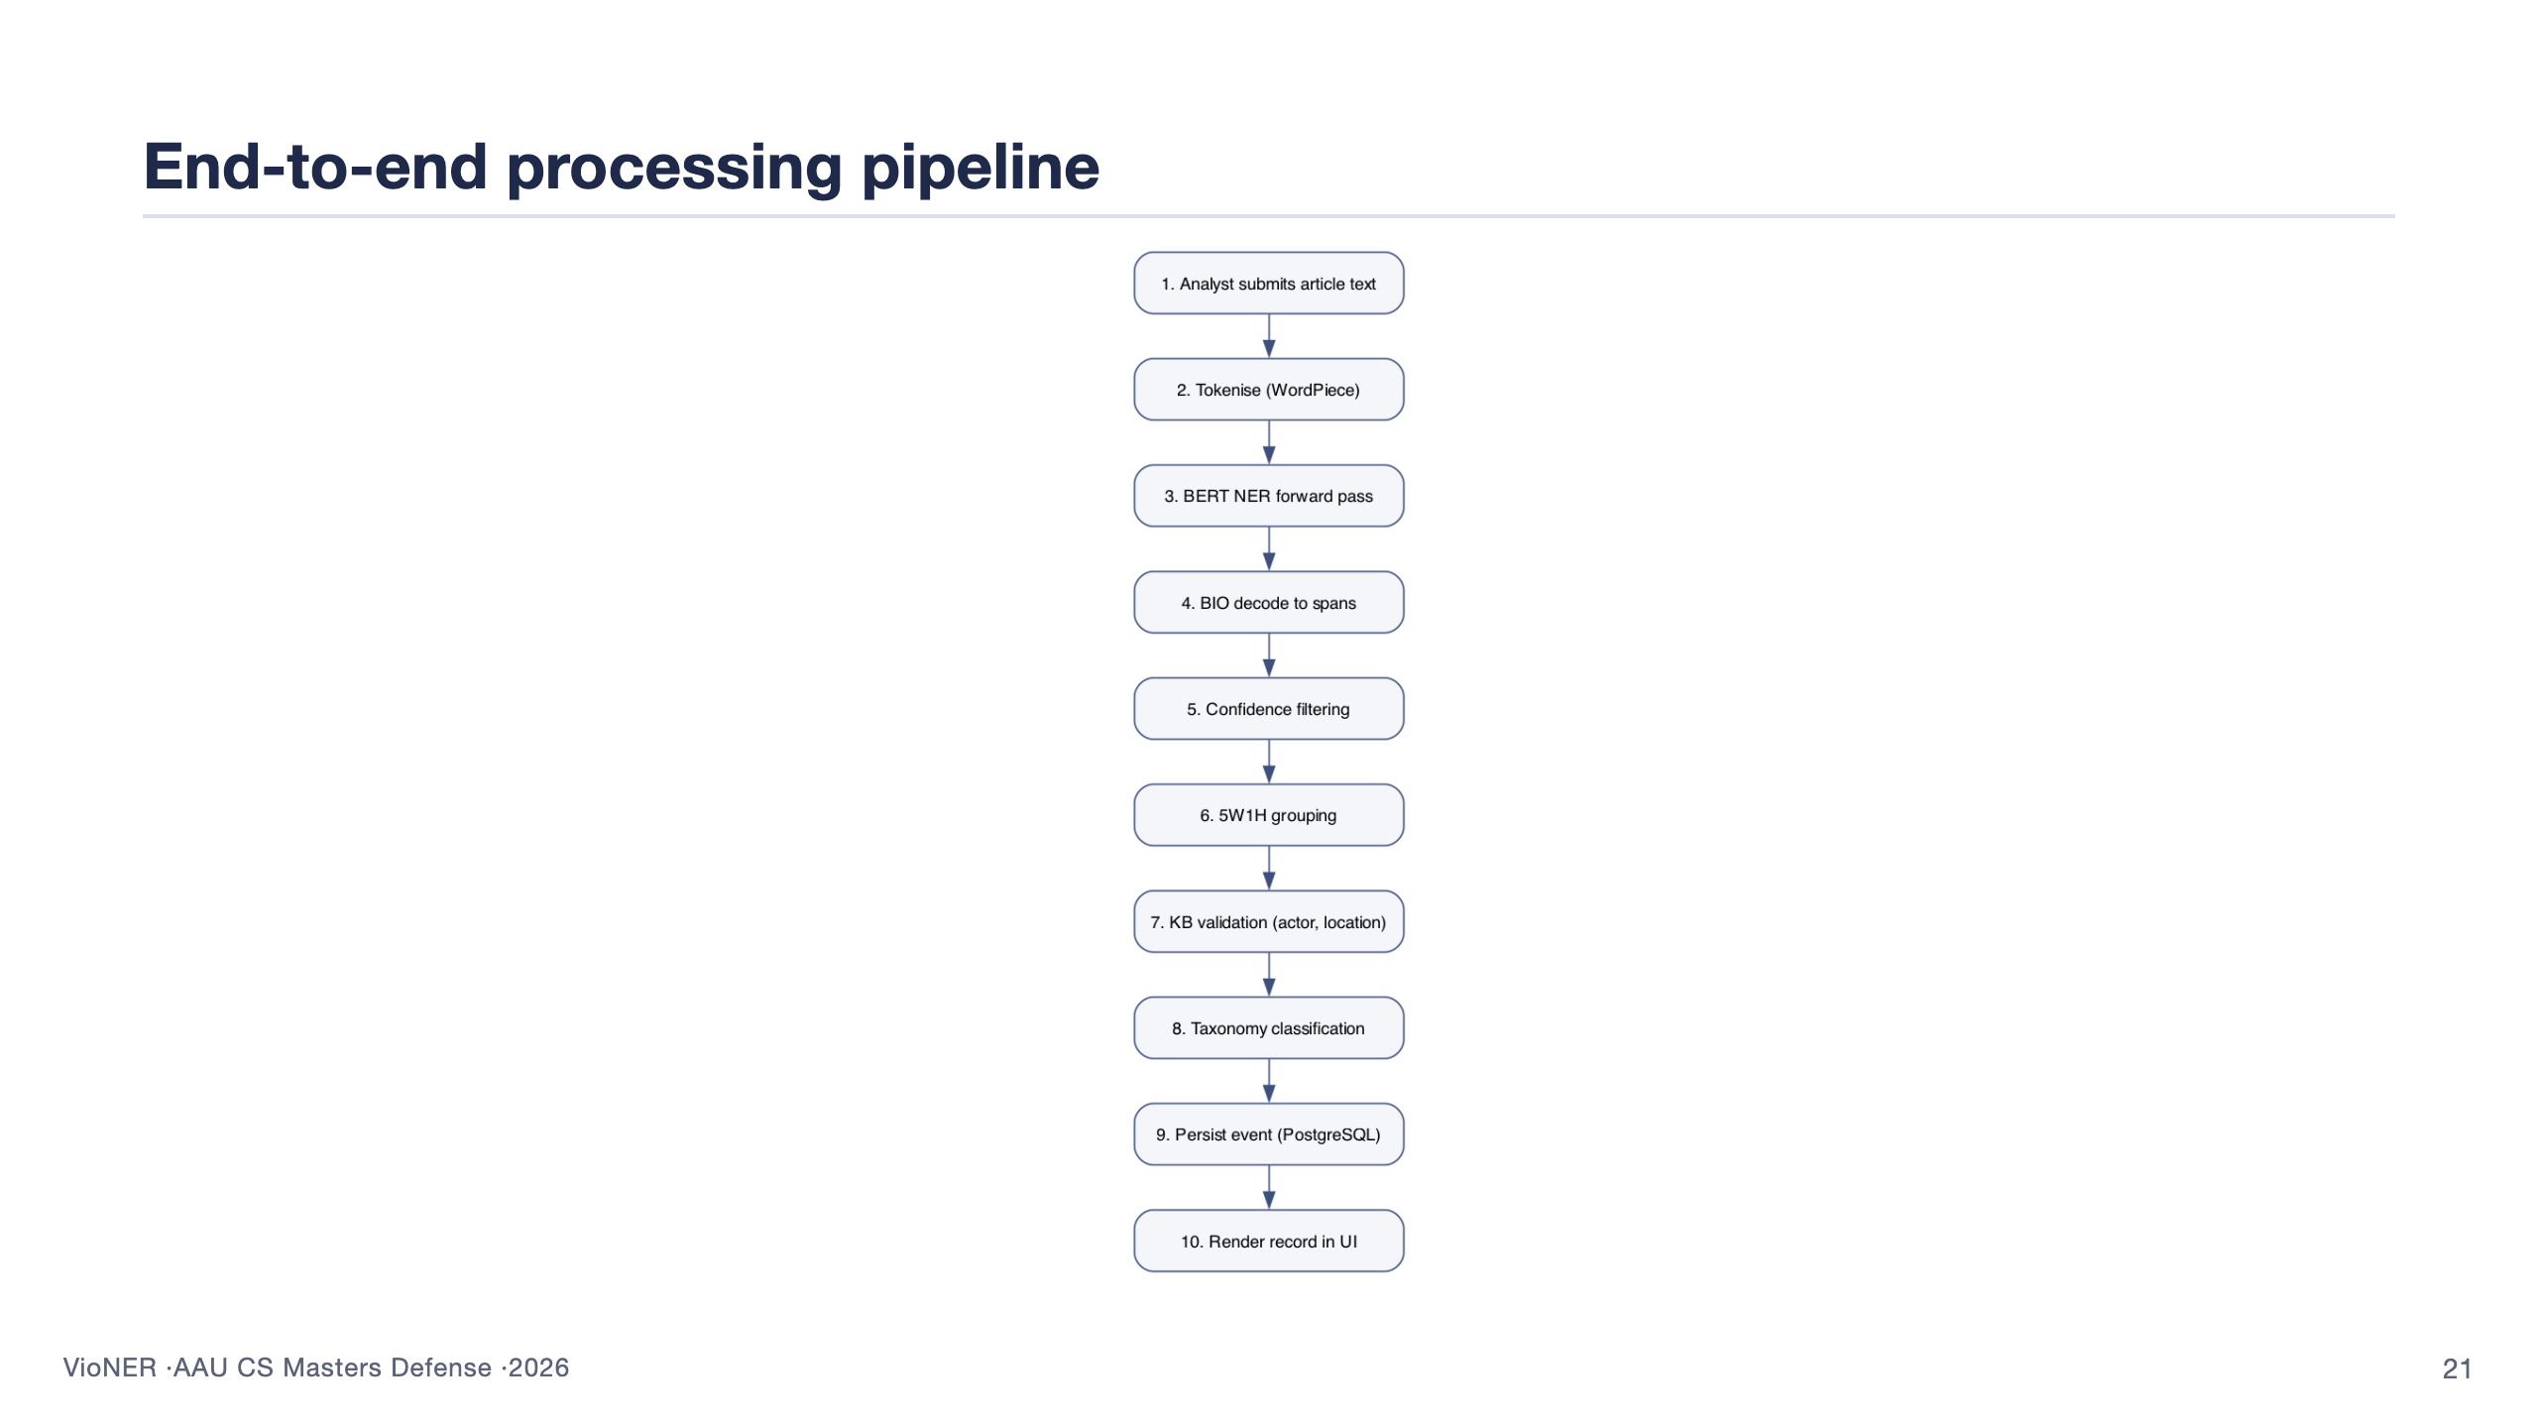
Notes:
This is the per-document story. The analyst pastes an article. Step 2: WordPiece tokenisation produces the input the BERT head expects. Step 3: forward pass returns per-token softmax distributions over 17 labels. Step 4: BIO decode collapses token tags into spans. Step 5: confidence filtering drops spans whose averaged subtoken probability sits below a per-category threshold. Step 6: 5W1H grouping aggregates spans by category. Step 7: the KB validates ACTOR and CITY against curated reference data. Step 8: the taxonomy classifier assigns a Level-1 to Level-3 path from the ACTION verb. Step 9: persist. Step 10: render. End-to-end on CPU is ~150 ms per typical article. 90 seconds.

Slide 22
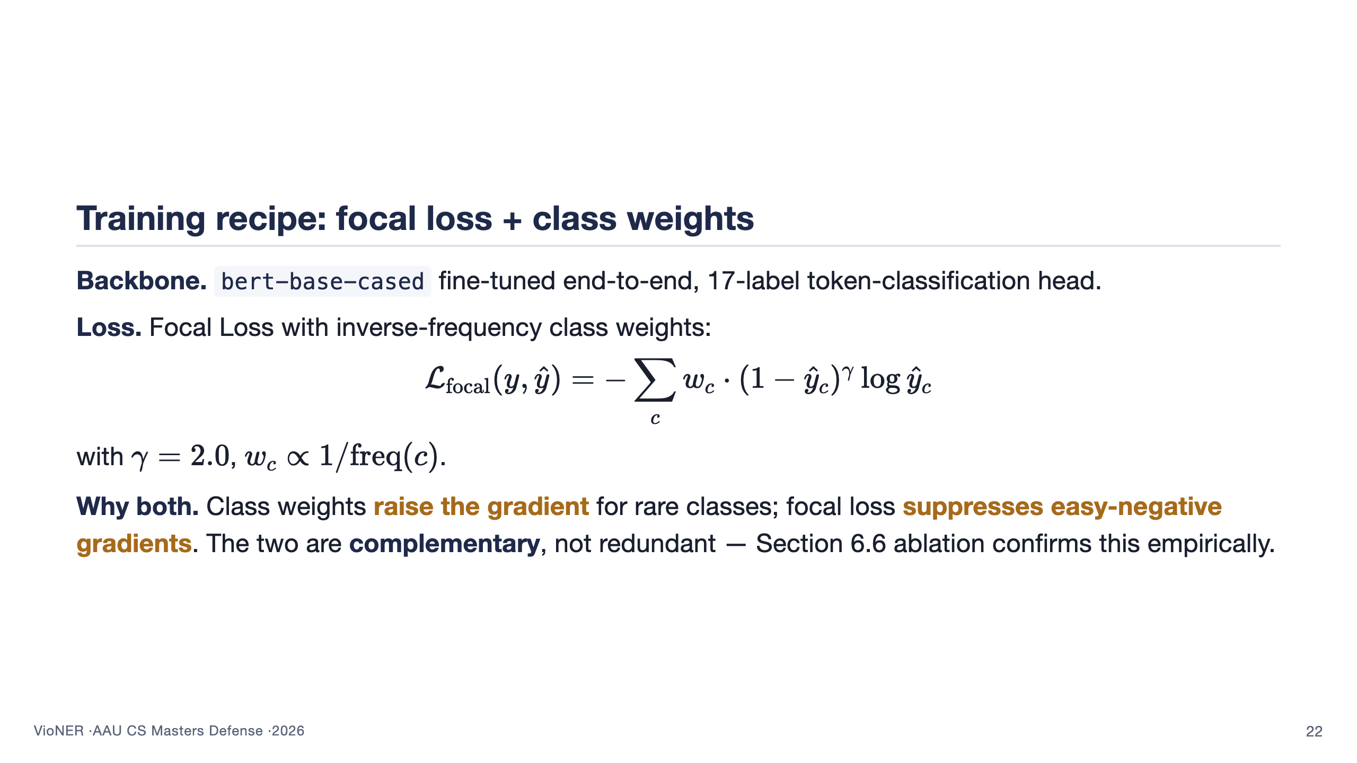
Notes:
Loss function is the technical heart of the work. The intuition: 78% of all tokens are O (outside any entity). Plain cross-entropy treats those as equal to actual entity tokens, so the gradient signal for rare classes like VICTIM gets drowned out. Class weights scale up the rare-class gradients. Focal loss further down-weights the easy correct O predictions so the model spends more capacity on hard cases. Crucially, in the ablation on slide 29, focal alone gets us partway, weights alone get us partway, but the combination gets us further than either — they are complementary. This is RQ2's headline answer. 100 seconds.

Slide 23
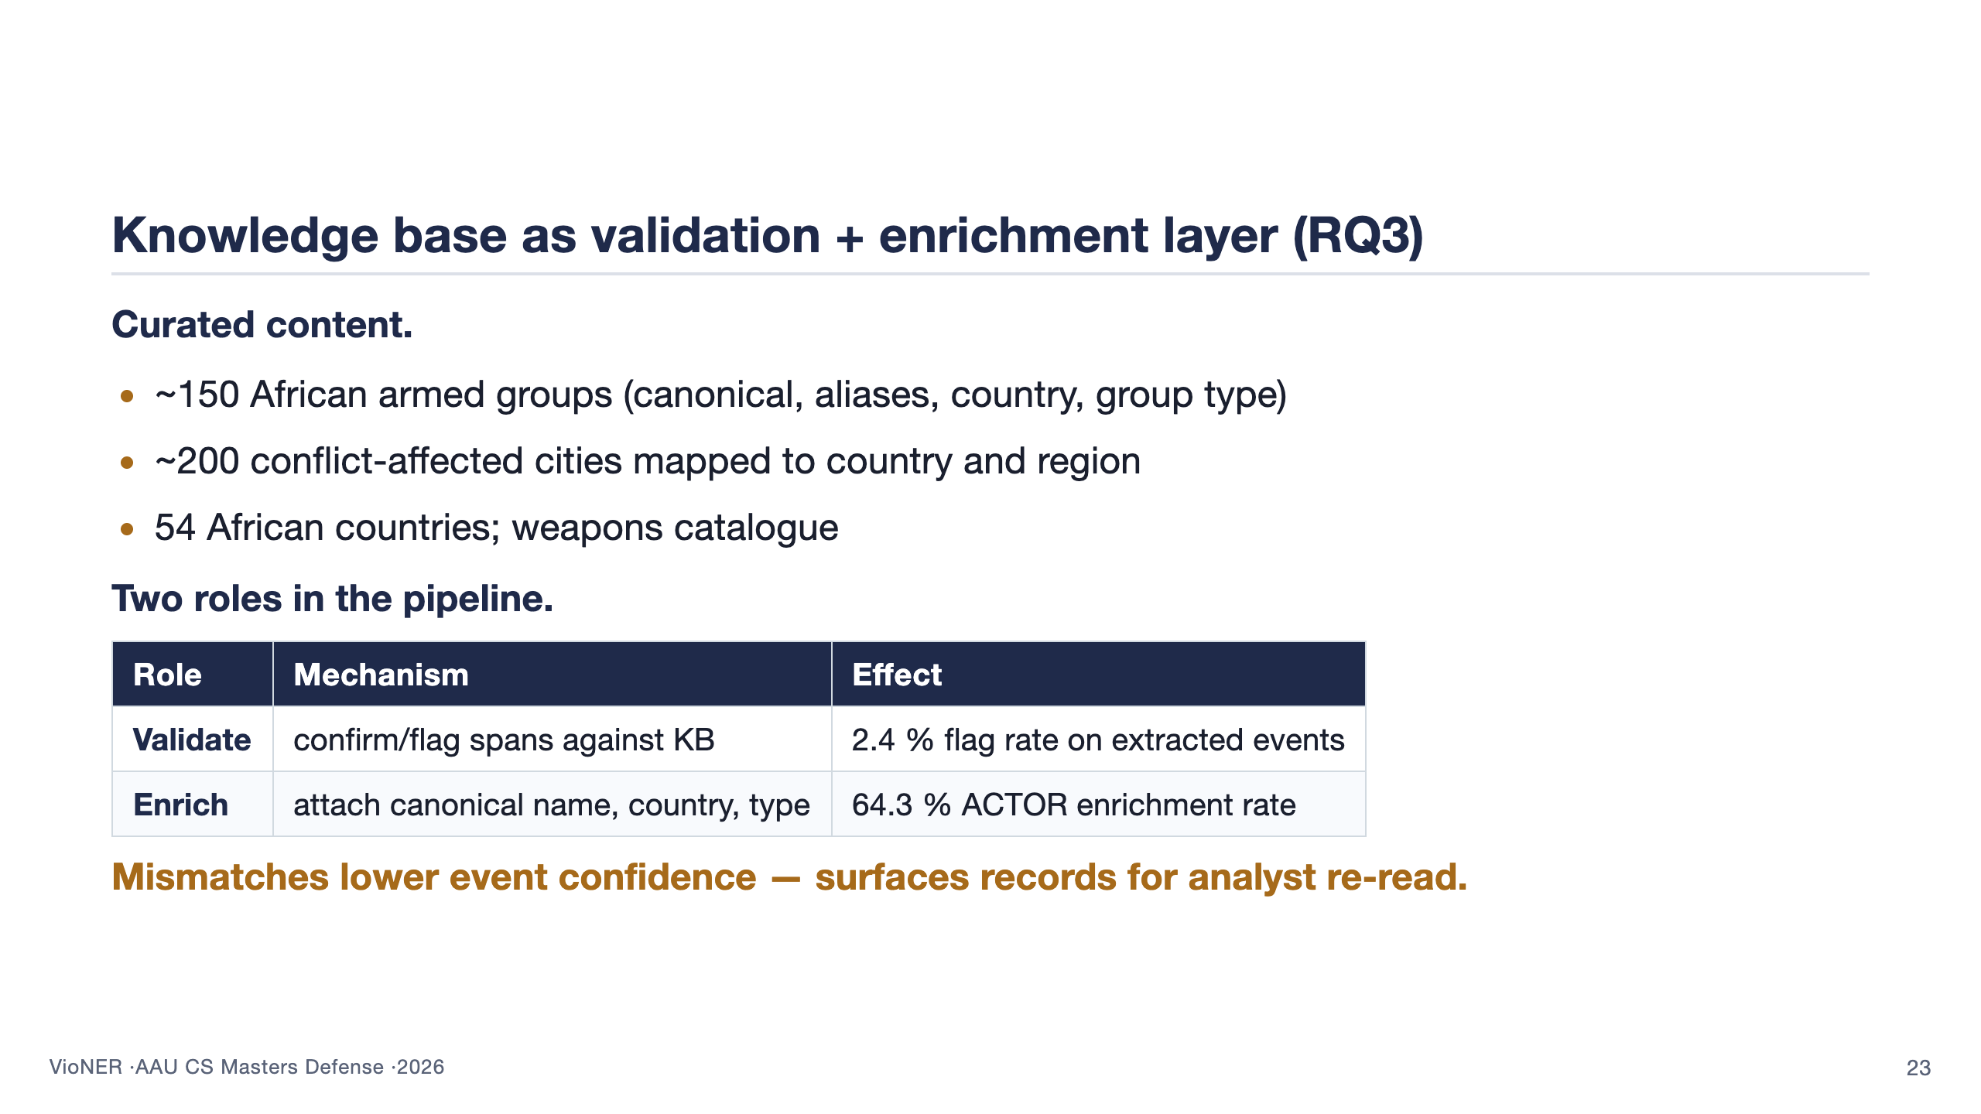
Notes:
This slide answers RQ3. The KB is the layer most papers skip. It plays two roles. First, validation: when the model extracts "Al-Shabaab fighters" and "Goma" in the same sentence, the KB knows Al-Shabaab operates in Somalia, not eastern DRC; the validator flags the event as geographically implausible. That flag rate is 2.4 % — small in aggregate but exactly the events an analyst should re-read. Second, enrichment: "Al Shabaab", "al-shabaab", "Al-Shabaab militants" all canonicalise to a single key — 64.3 % of ACTOR mentions get enriched this way, which is what lets the analytics layer count correctly. 100 seconds.

Slide 24
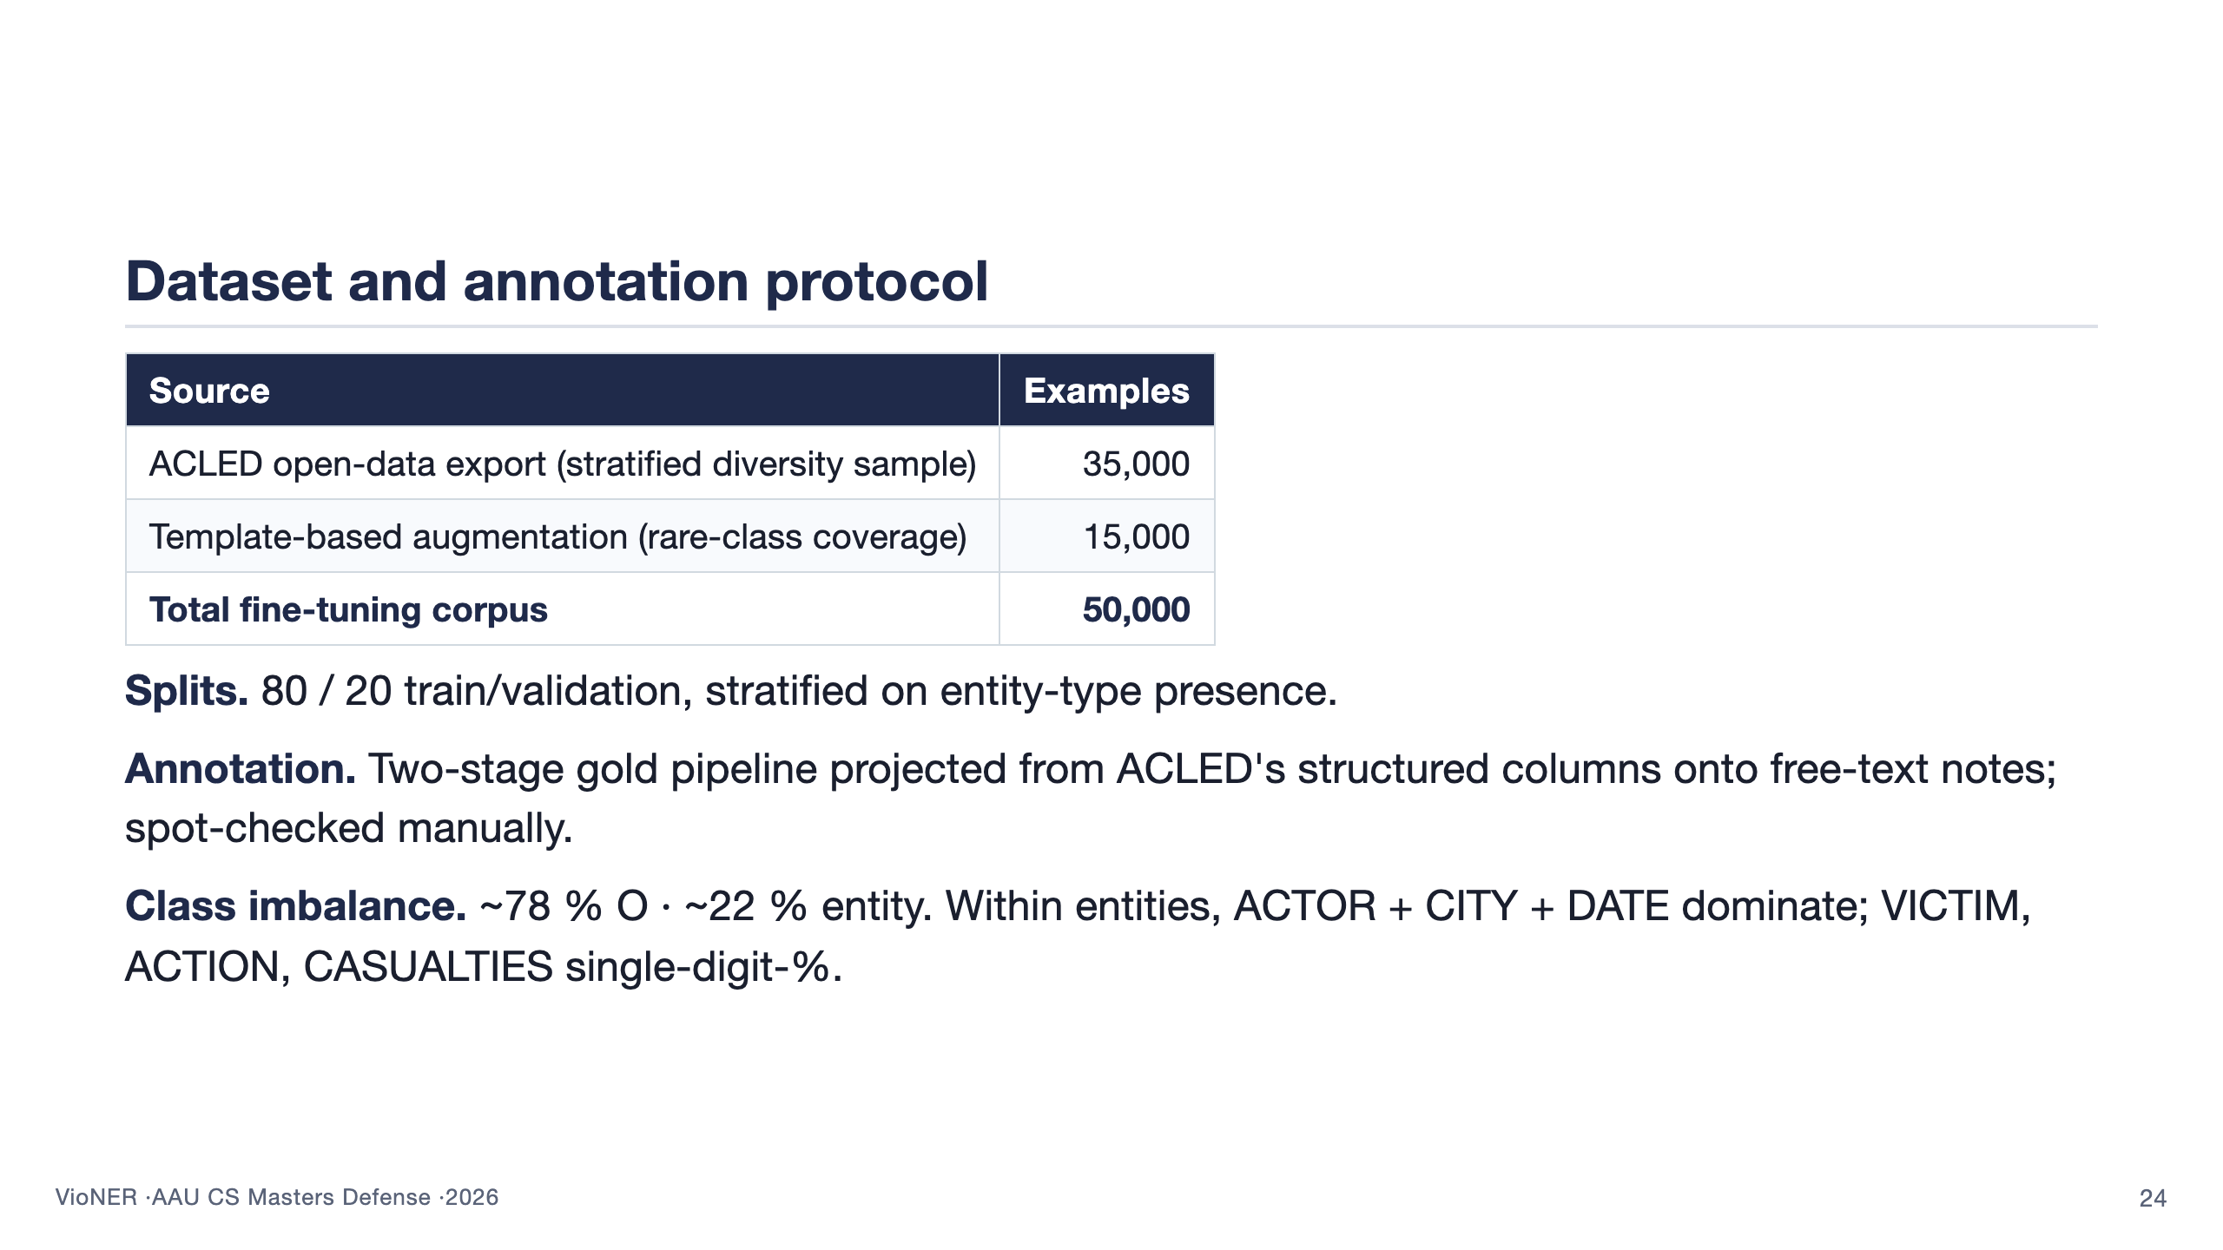
Notes:
Three honest beats here. (1) Where the data comes from: ACLED open data, filtered by stratified diversity sampling rather than naive random sampling, because the full 212,000-event extract had so much repetition of common phrasings that rare entities got drowned out — that was the empirical trigger for the corpus loop you saw on the methodology slide. (2) Why augmentation: template-based filling of the rare-class gap, ~15k synthetic examples to lift VICTIM, ACTION, CASUALTIES off the floor. (3) Class imbalance: the central modelling challenge — 78 % outside tokens, with the operationally most important entities being the rarest. This is what motivates focal loss + class weights from the training-recipe slide. Cue the next slide: "the natural question is whether 50,000 examples is enough and whether they are clean enough — that is the data-quality slide next." 90 seconds.

Slide 25
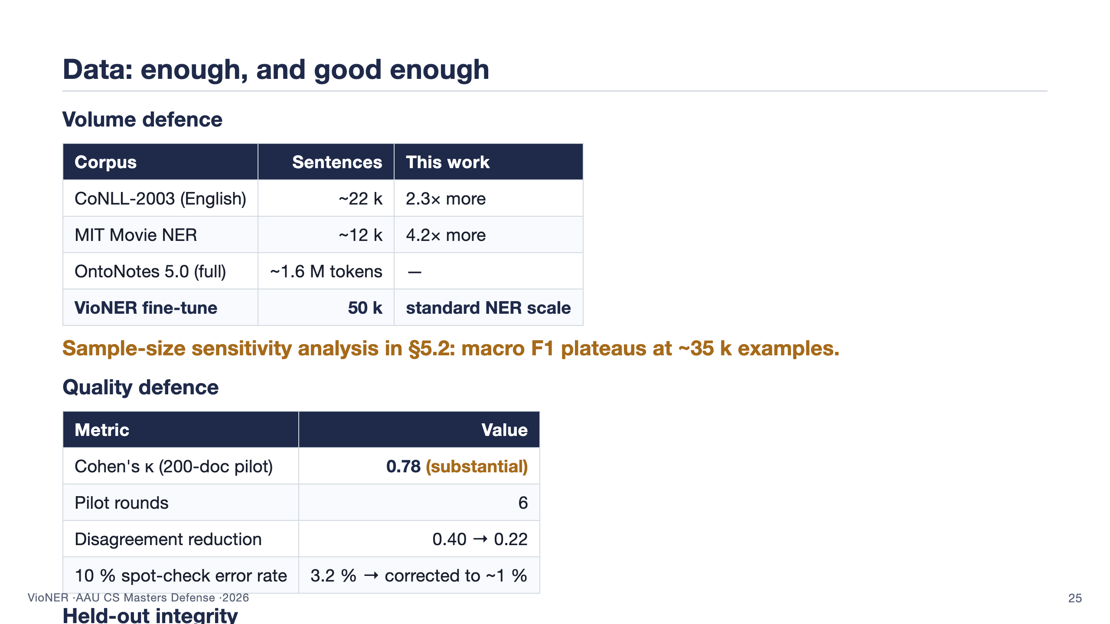
Notes:
This is the data-rigor slide. Two columns. (1) Volume defence on the left: the question the panel will ask is "is 50k examples enough or too few." Answer: 50,000 fine-tuning examples is more than 2x CoNLL-2003 (the canonical English NER benchmark) and 4x MIT Movie NER (a similar narrow-domain NER task). It's smaller than OntoNotes 5.0, which has 1.6M tokens, but OntoNotes is a general-domain corpus of an entirely different scale and purpose. Critically: section 5.2 reports a sample-size sensitivity analysis where macro F1 plateaus around 35,000 examples — beyond that, additional data gives diminishing returns. 50k is on the right side of that plateau. (2) Quality defence on the right: Cohen's kappa of 0.78 on a 200-document pilot, which is substantial agreement on the Landis-Koch scale. Six pilot rounds were needed to get there — the guidelines went from 9 pages to 31 pages over those rounds, mostly disambiguating edge cases. A 10% stratified spot-check of the final corpus found 3.2% label errors which were corrected; residual error after correction is estimated at ~1% by re-spot-checking. (3) Bottom: held-out integrity. The 80/20 split is at the article level not the sentence level, so no article appears in both halves. Articles are hashed and deduplicated BEFORE the split. The augmentation template pools are also partitioned — train templates and validation templates do not overlap. The panel asks "could information leak" and the answer is no, by construction. 95 seconds.

Slide 26
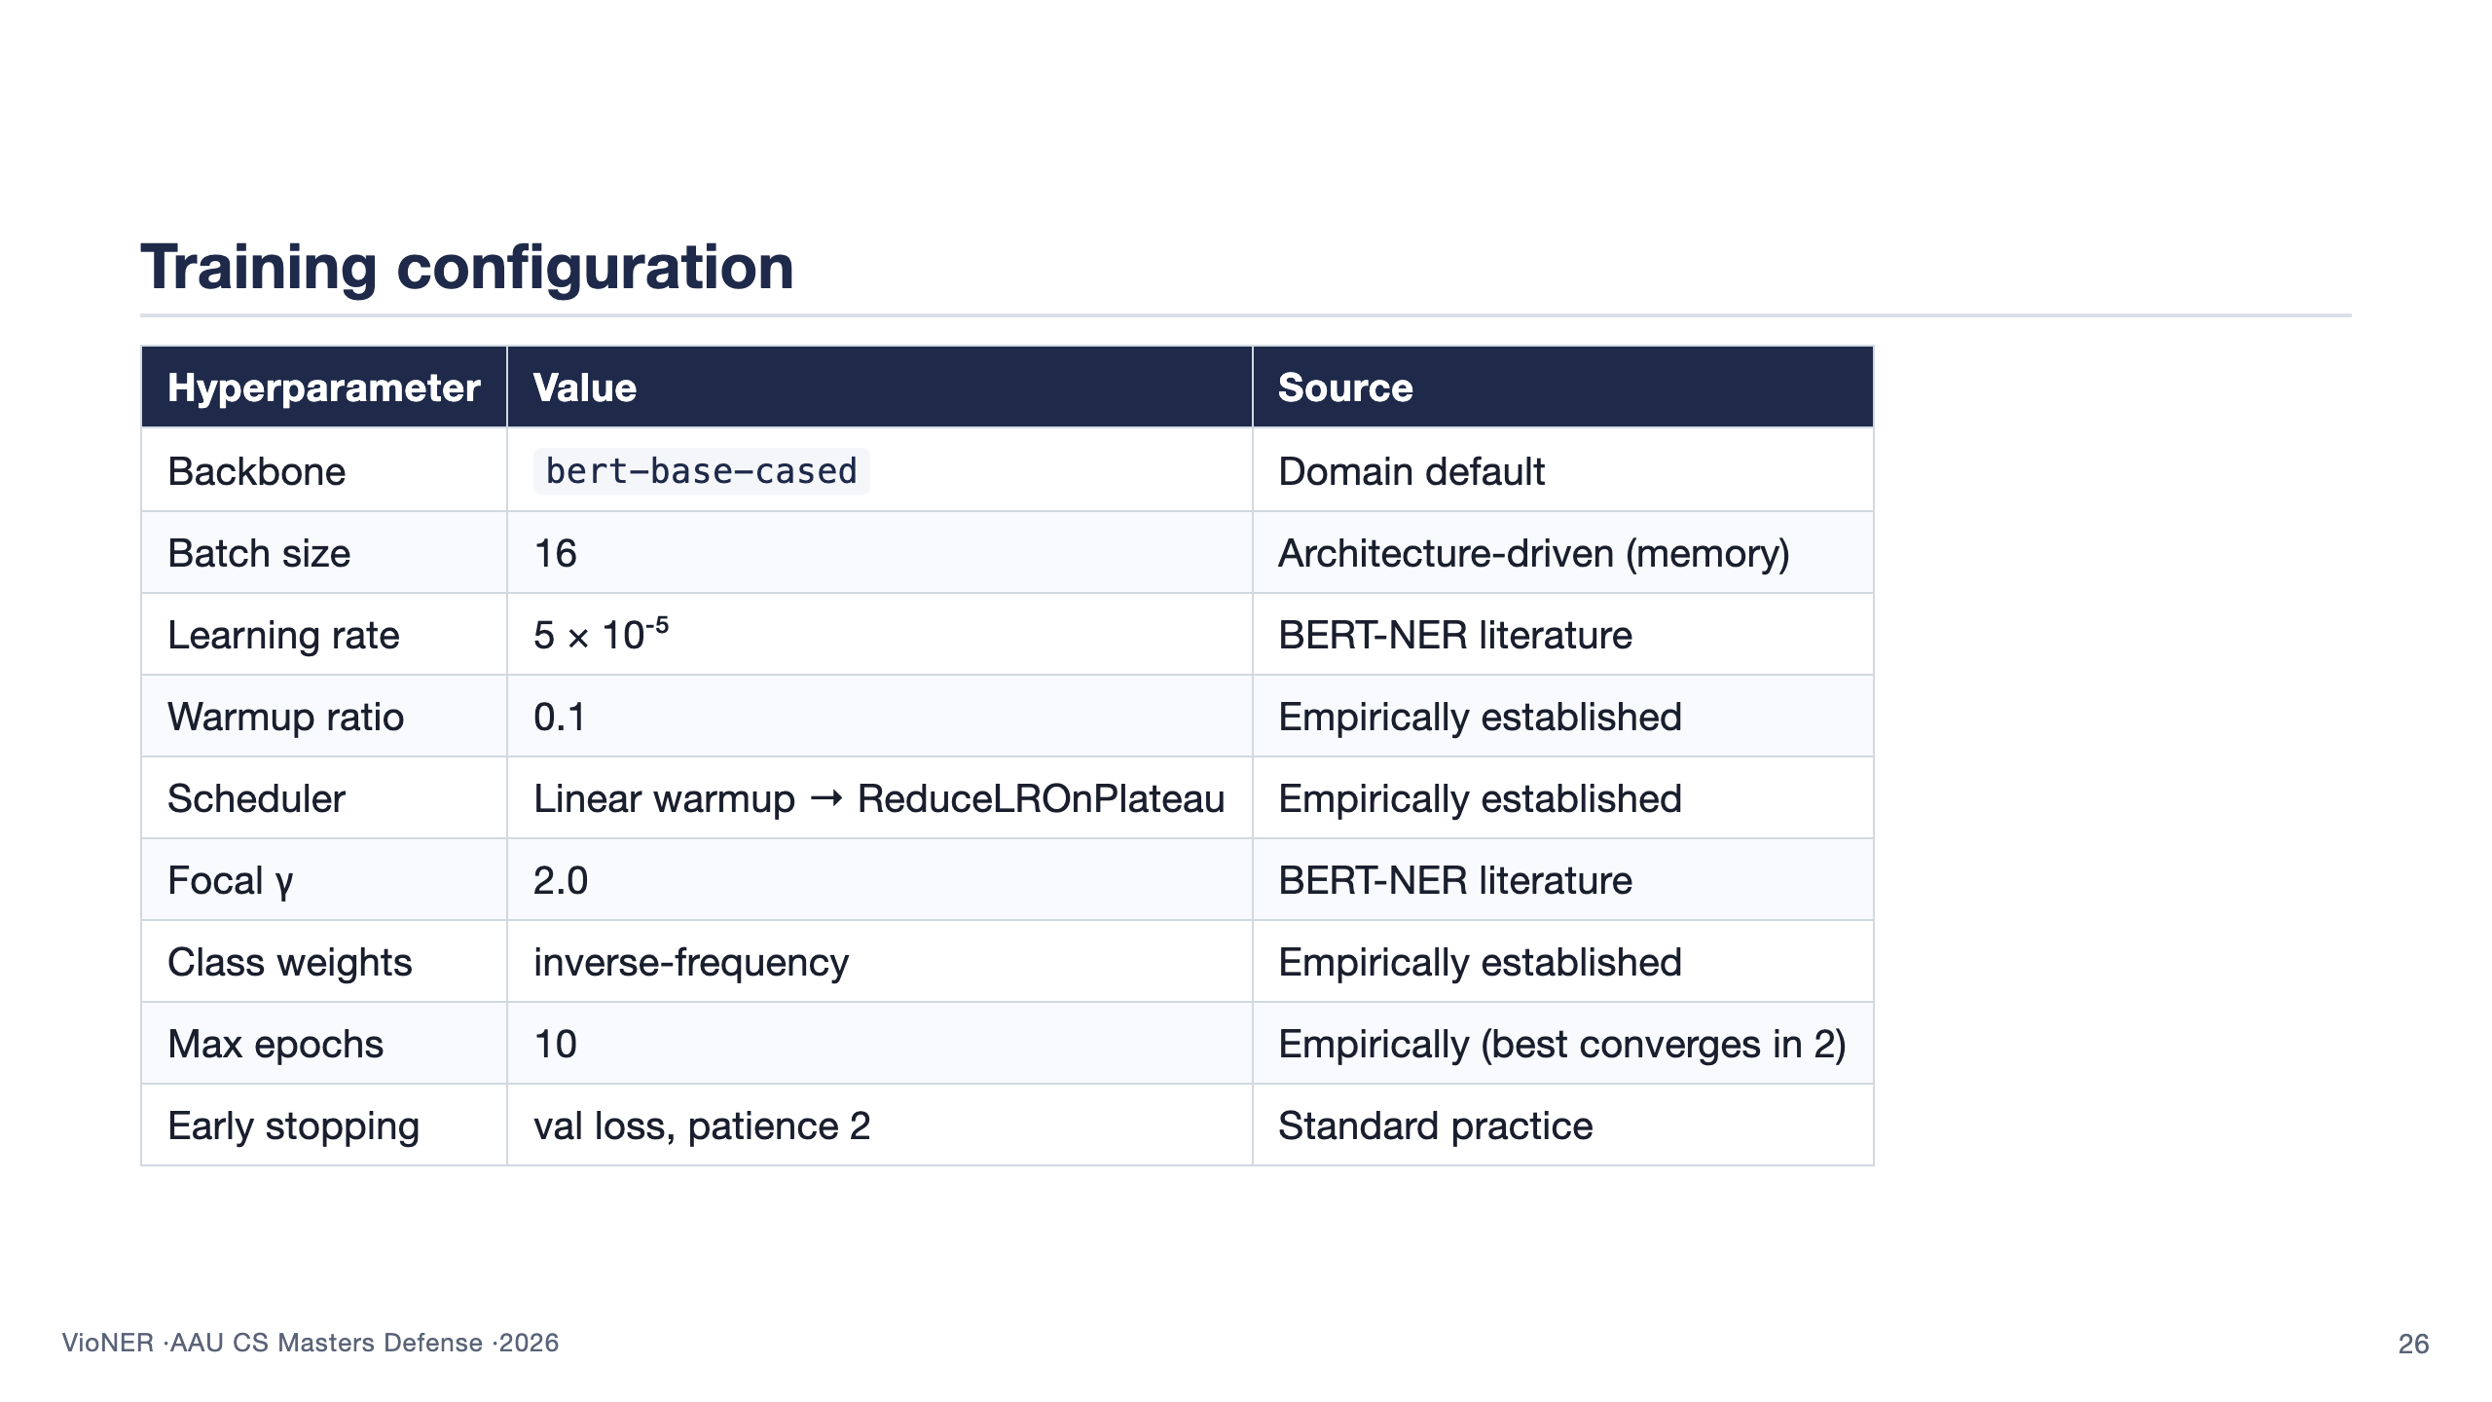
Notes:
Show the table briefly. Tell the panel that values are categorised by source — defaults inherited from BERT-NER literature, architecture-driven choices like batch size, and values that came from empirical grid search. This is the slide that closes advisor comment C472. The full hyperparameter table is in backup B1 if they want to drill in. Crucially, the best model converges in 2 epochs — short training runs make it cheap to iterate. 75 seconds.

Slide 27


Slide 28
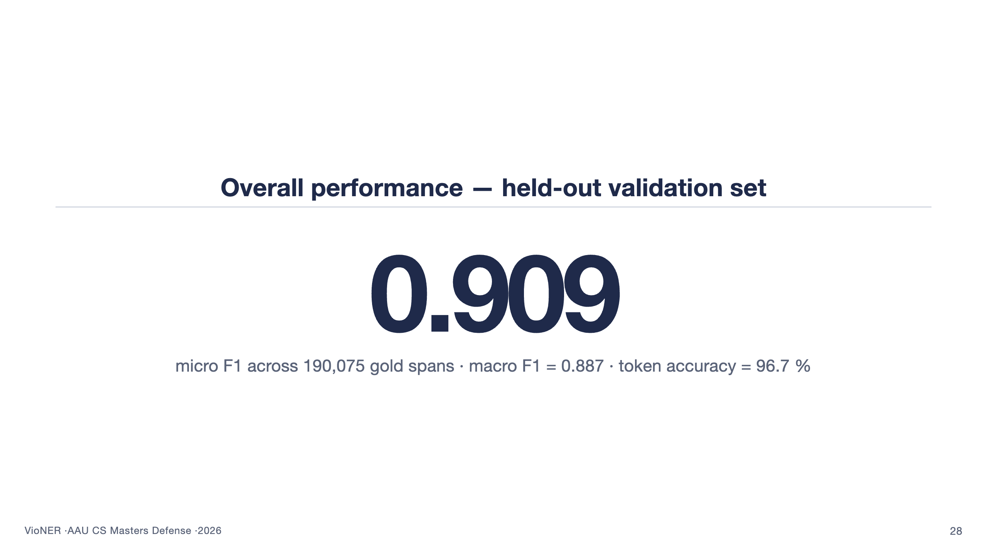
Notes:
This is the headline number. Read it slowly. 0.909 micro F1 on a held-out 10,000-example validation set with 190,075 gold spans. Macro F1 is 0.887, which is the right number for assessing balance — because the macro average weights every entity type equally, including the rare ones. Token accuracy is 96.7 %, but that's the least informative of the three because the O class dominates. Don't oversell this slide. Move on within 30 seconds — the per-category breakdown on the next slide is what actually answers RQ2.

Slide 29
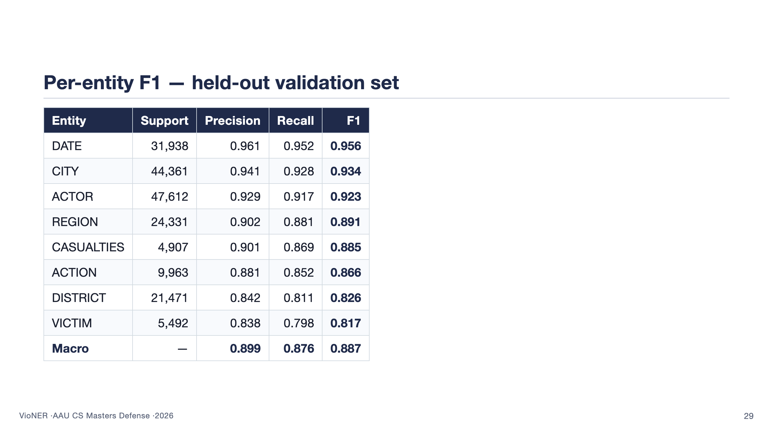
Notes:
Walk the table top to bottom. DATE wins by a clear margin — date expressions follow a small set of recognisable patterns. ACTOR, CITY, DATE form a strong cluster: distinctive surface forms and rich training distribution. Then a middle tier — REGION, CASUALTIES, ACTION around 0.87-0.89, with compositional irregularity the main drag. The bottom of the table is the honest story: DISTRICT at 0.826 loses to mutual confusion with CITY and REGION; VICTIM at 0.817 is both the rarest entity and the one with the most variable phrasing ("civilians", "ten villagers including women and children", "Christian worshippers"). The macro F1 of 0.887 is the number to remember: every entity, including the rarest, is usable operationally. 100 seconds.

Slide 30
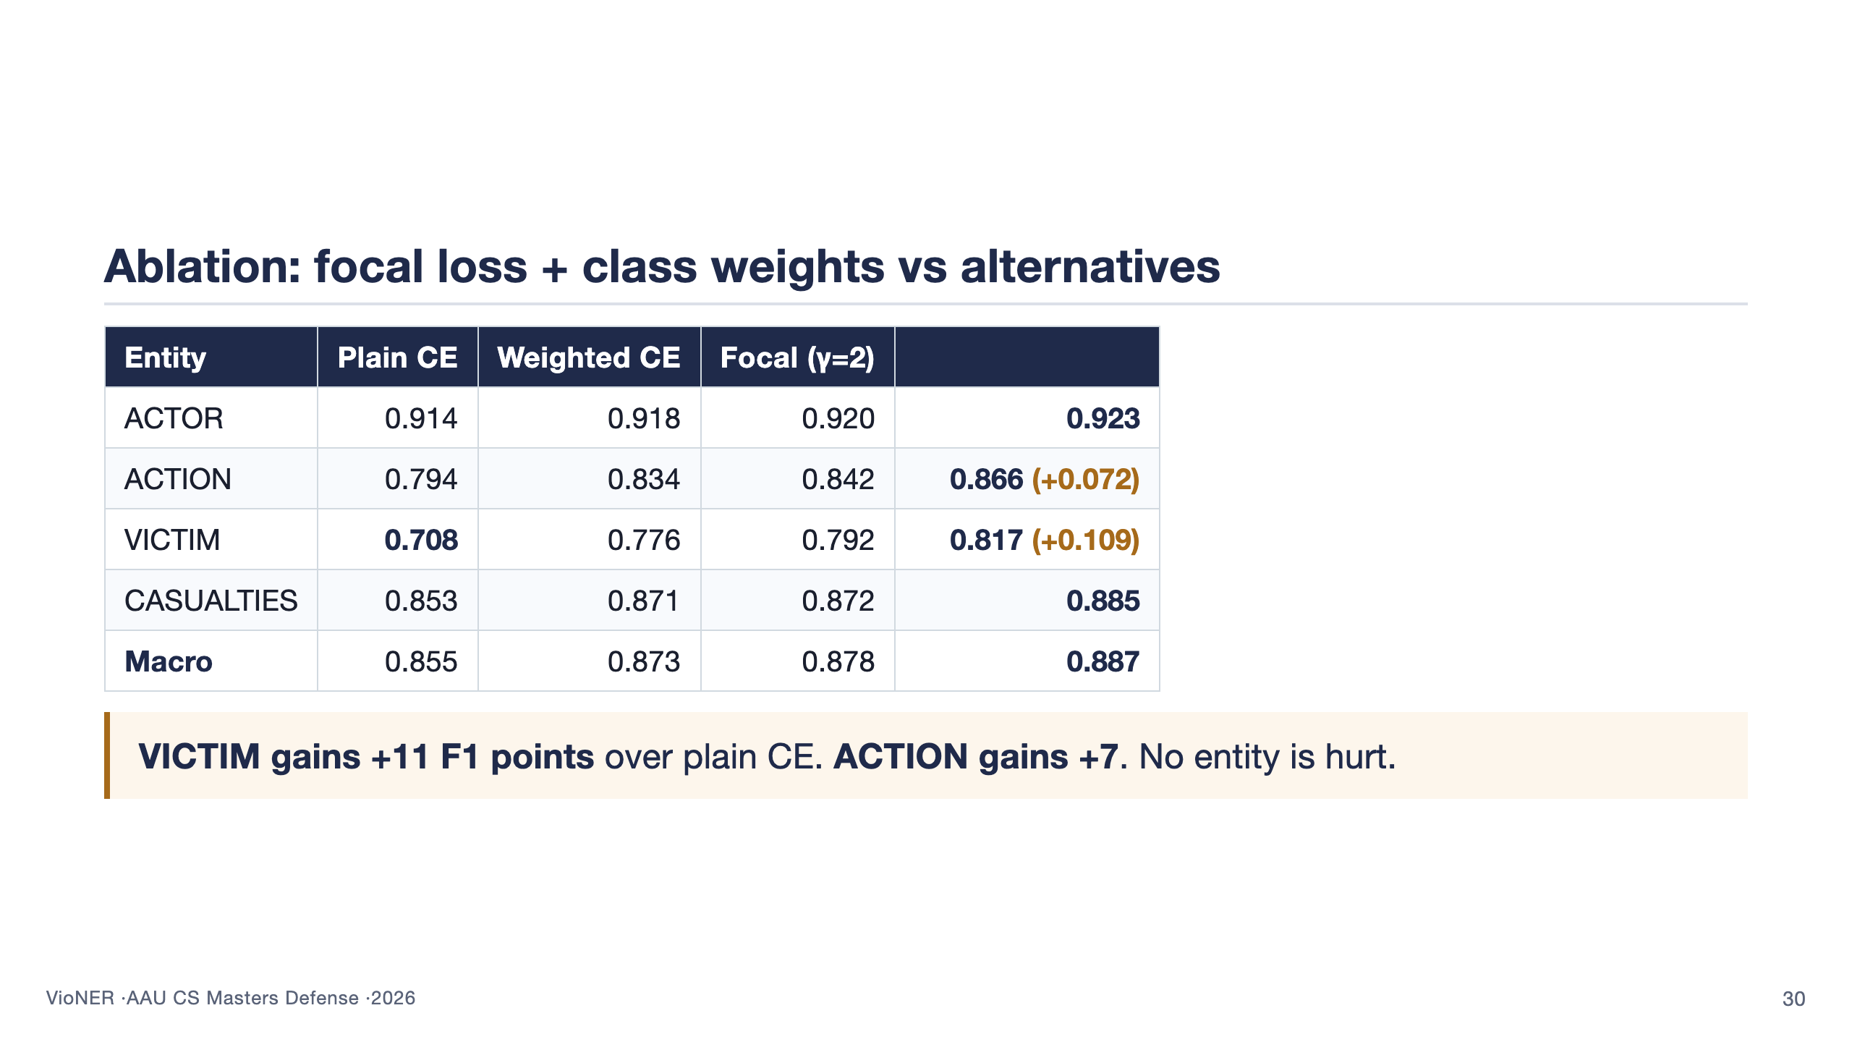
Notes:
This is the ablation that answers RQ2 directly. Show that the combination of focal loss with inverse-frequency class weights isn't just decoration — it materially moves the entities that matter most operationally. VICTIM is up 10.9 F1 points; ACTION is up 7.2. The bonus point is that NO entity is hurt by this loss choice — focal loss doesn't trade common-class accuracy for rare-class accuracy, which would have been a regression. Each ingredient on its own helps a little; the two together help more than the sum of parts. That complementarity is what justifies the slightly more complex loss in production. 90 seconds.

Slide 31
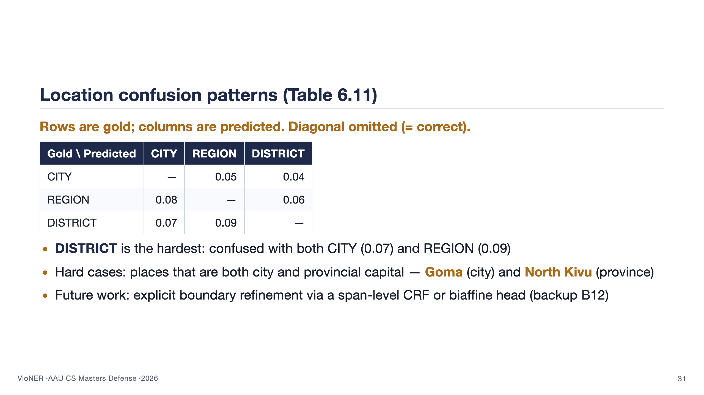
Notes:
The error analysis ran over 300 validation events that the model got wrong. The single biggest error category — 38 % — is boundary mismatch: right entity type, wrong span ("12 civilians" instead of "at least 12 civilians"). The second biggest is location-type confusion, which is what this table shows. DISTRICT is the toughest because many African districts share names with their main city or with the region they sit in. Goma is the canonical example — it's a city, a district capital, and effectively the centre of North Kivu province all at once. The model defaults to CITY for ambiguous cases, which is more often right than wrong, but it produces a consistent stream of confusions. The fix is in future work: a span-level CRF on top of the BERT representations. 90 seconds.

Slide 32


Slide 33
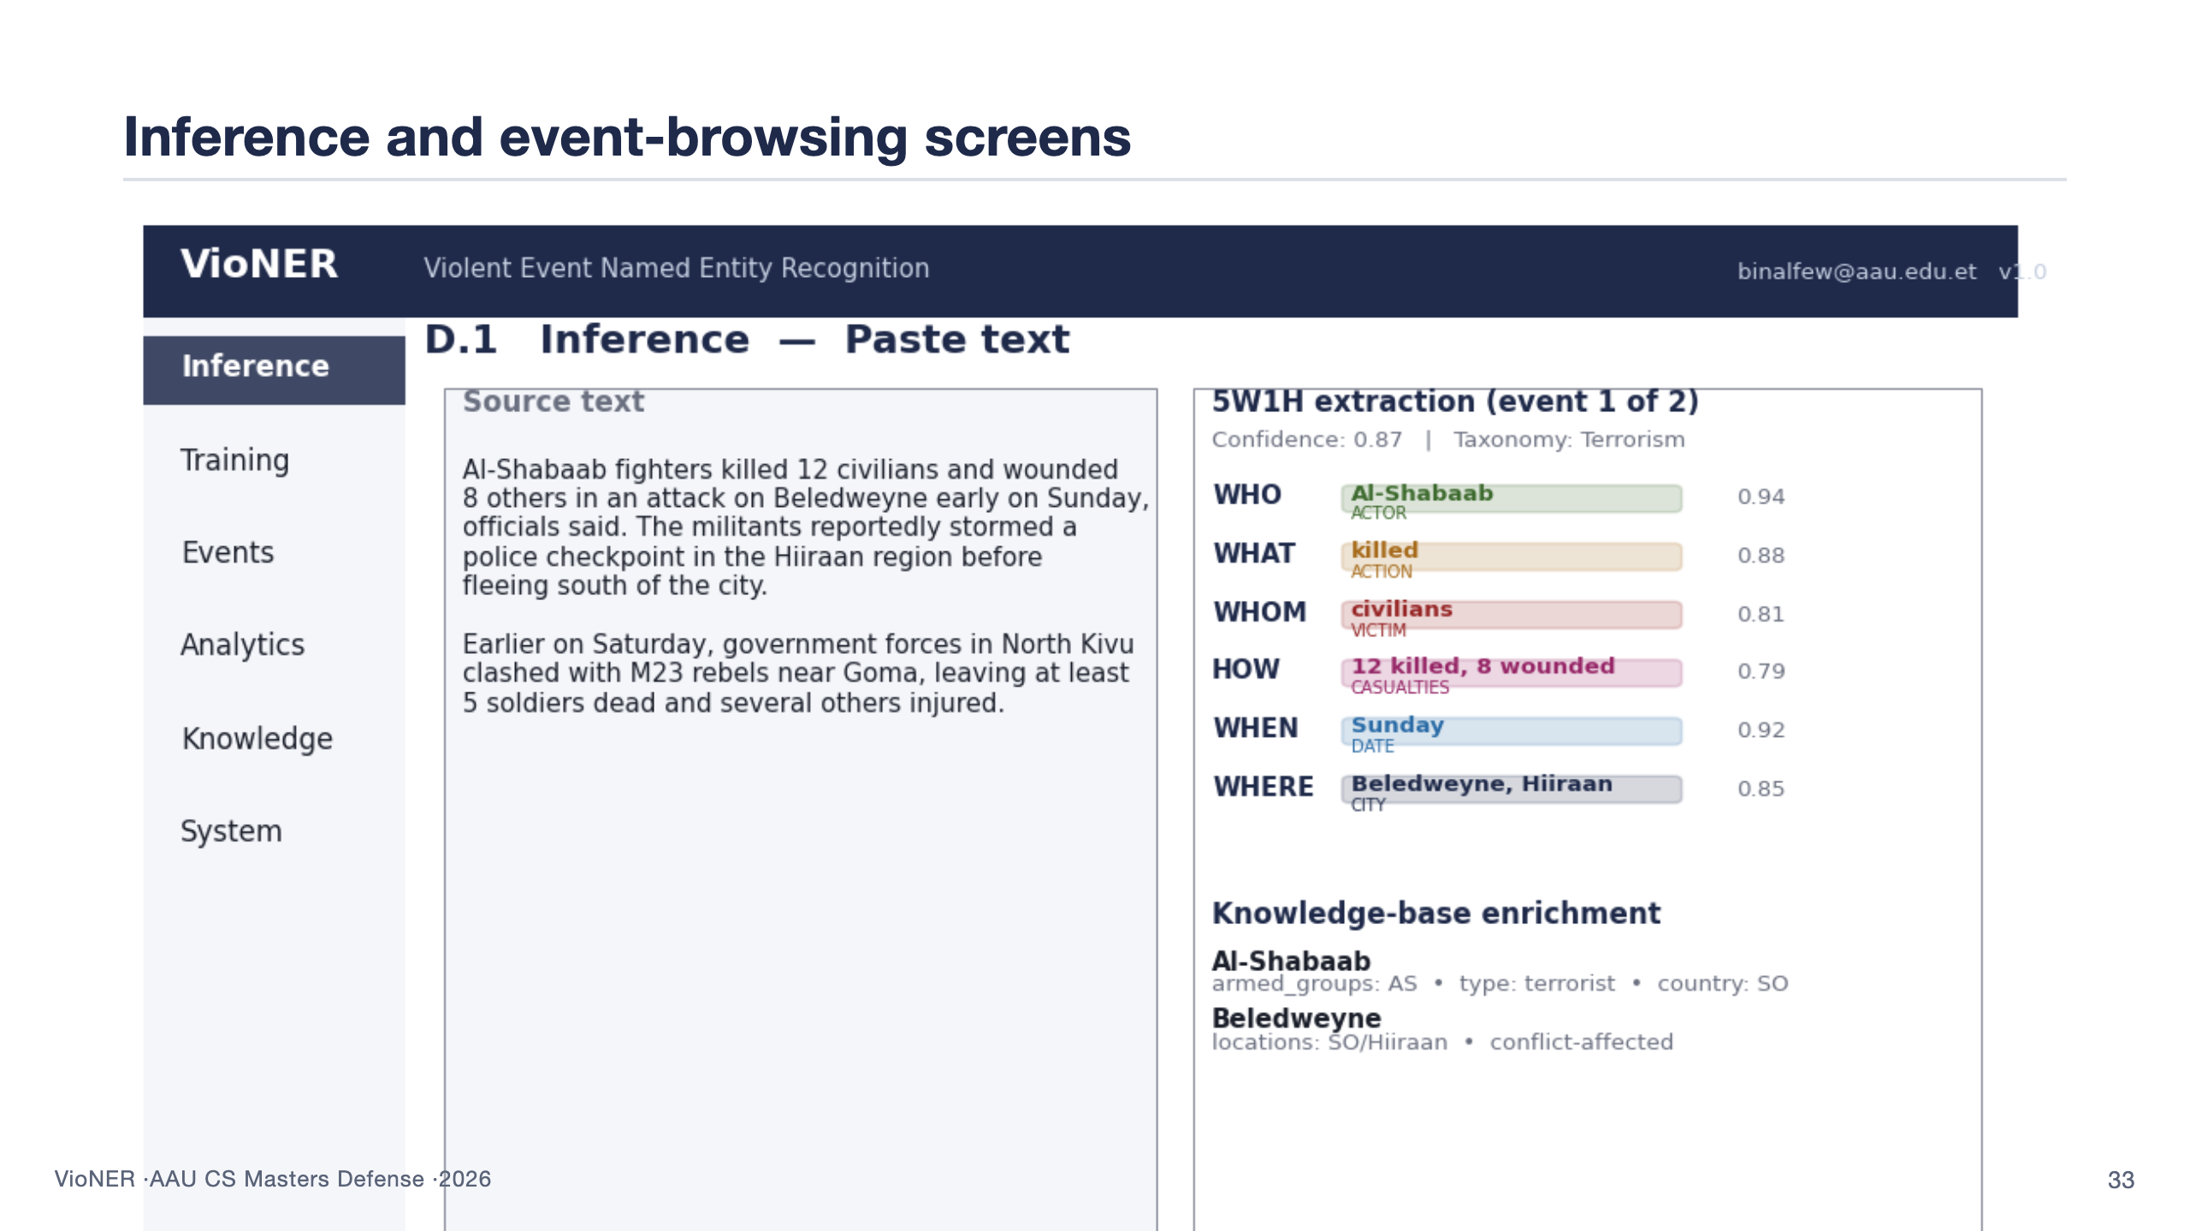
Notes:
Walk through both screens quickly. D.1 — analyst pastes an article into the left pane, gets colour-coded entity chips on the right, grouped by 5W1H category. This is the screen that closes the loop on the analyst's primary task. D.5 — once events are persisted, the analyst can filter by date range, country, taxonomy level, perpetrator. Pagination, sortable columns, exportable CSV. These screens were tested in UAT and scored 4.6 / 5 on the "5W1H structuring was clear" item. 80 seconds.

Slide 34
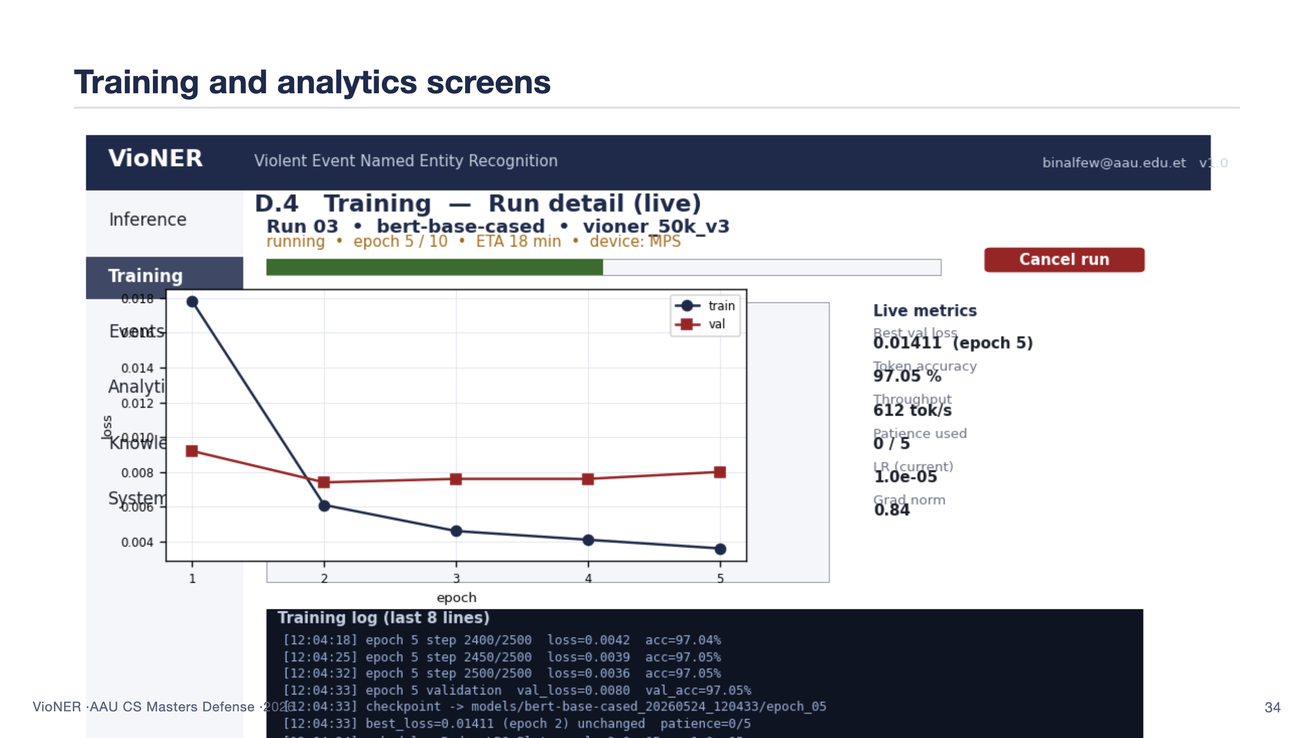
Notes:
D.4 — a non-ML user kicks off a training run, picks the dataset, the loss function, hyperparameters. They watch the loss curve update via WebSocket as epochs complete. The training service runs the job asynchronously; the user can navigate away and come back. D.7 — analytics dashboard pulls aggregated stats from the event store: events per country, per taxonomy bucket, per actor, per month. This is the screen that turns the extracted records back into operational insight. Both screens were demonstrated in UAT with positive responses; the most common request was an exportable PDF brief from D.7, which is now in future work. 90 seconds.

Slide 35
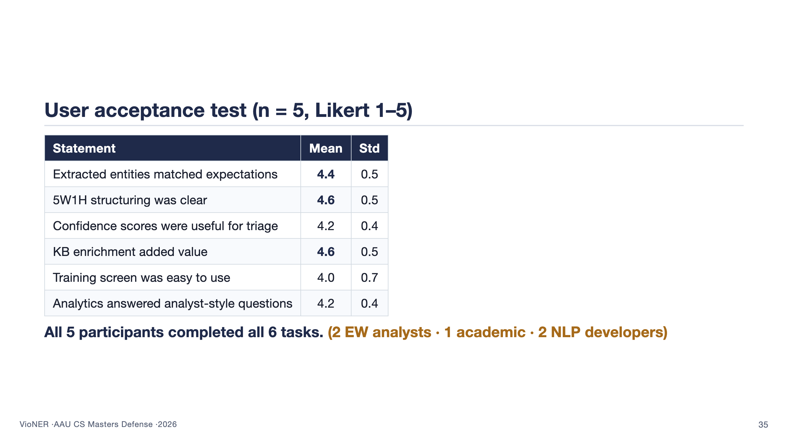
Notes:
This is the slide that closes RQ4. Five participants — two early-warning analysts (the primary intended audience), one academic conflict researcher (secondary), and two NLP developers unfamiliar with the application domain (a fairness check). All five completed all six tasks: run inference on three supplied articles, browse the event store, run an analytics query, train a model on a supplied dataset, monitor training to completion, review a flagged event. The Likert numbers all clear 4.0. The two highest items — 5W1H structuring clarity (4.6) and KB enrichment value (4.6) — are exactly the two things this thesis claims as differentiating contributions. The lowest is training-screen ease at 4.0; constructive feedback there fed directly into future work. 100 seconds.

Slide 36
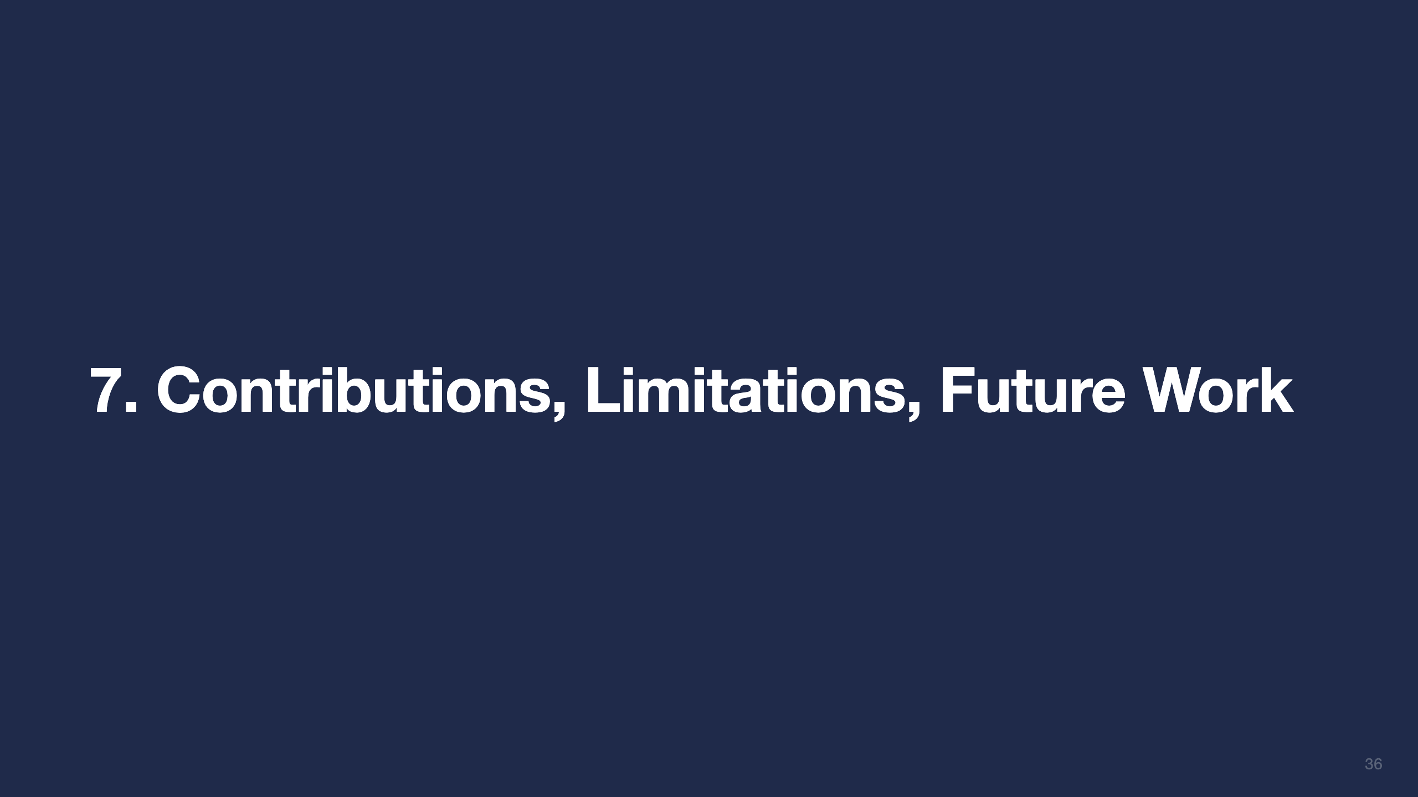

Slide 37
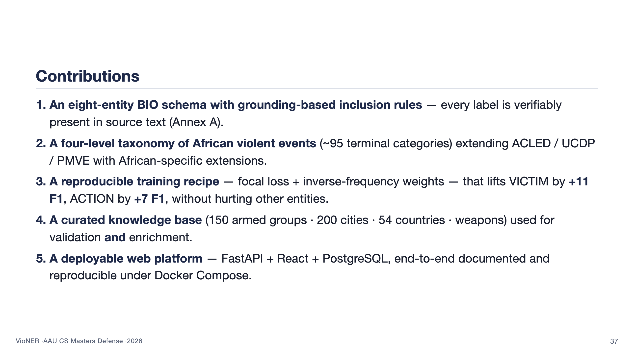
Notes:
This is the slide that gets quoted in the panel's decision. Each item is a self-contained artefact: the schema, the taxonomy, the training recipe, the knowledge base, the system. Tell the panel which artefacts are reusable beyond this dissertation — all five, but especially the taxonomy and the KB, which any other researcher working on humanitarian protection, conflict early-warning, or peace and security analysis can pick up without rebuilding. The fifth item — the system — is the contribution the related-work landscape on slide 12 said was missing. 100 seconds.

Slide 38
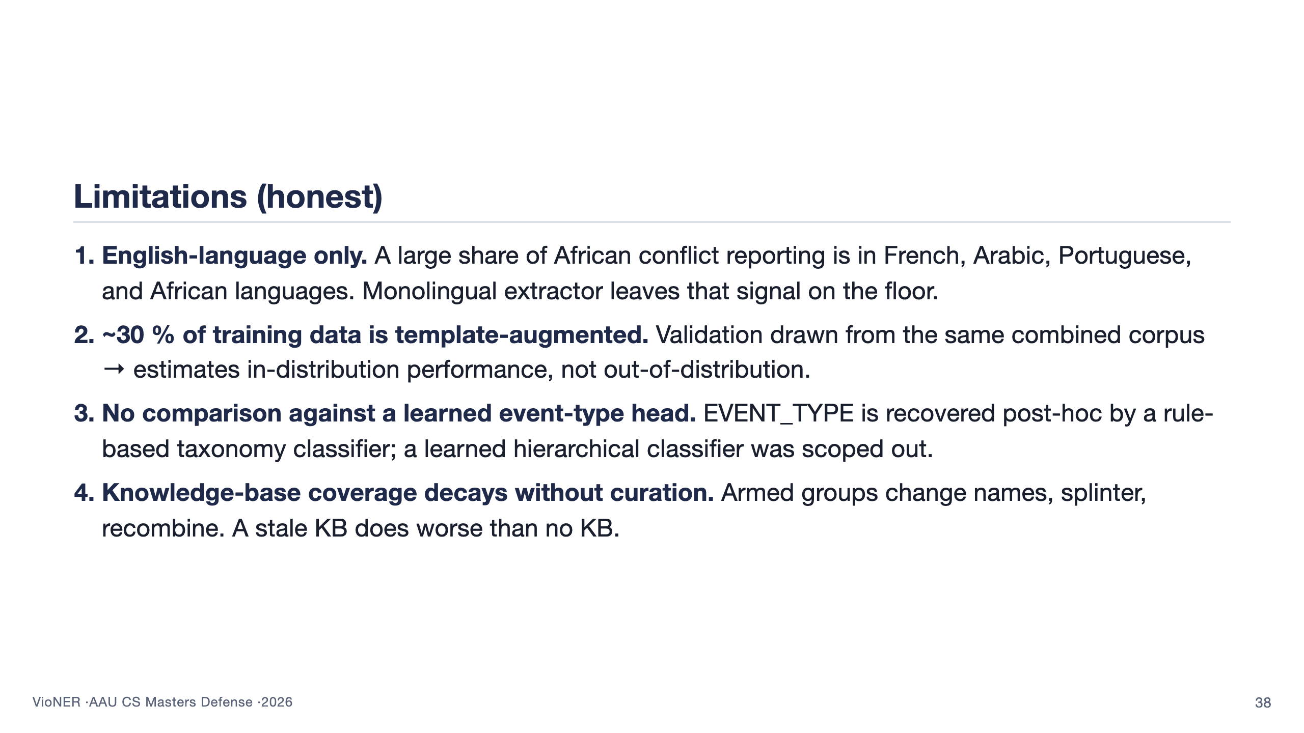
Notes:
This is the most important slide for surviving Q&A. Owning the limitations first disarms hostile questions later — examiners cannot attack what you have already conceded. Be specific. English-only is the biggest gap, multilingual extension is the first item in high-priority future work. Template augmentation: be honest that 30 % synthetic is a real caveat — the validation metrics are a fair estimate of in-distribution performance, but don't guarantee out-of-distribution behaviour on social media or translated text. The third item is the one a panel methodologist will probe most aggressively — the learned hierarchical classifier was scoped out, but is the second high-priority future-work item. 110 seconds.

Slide 39
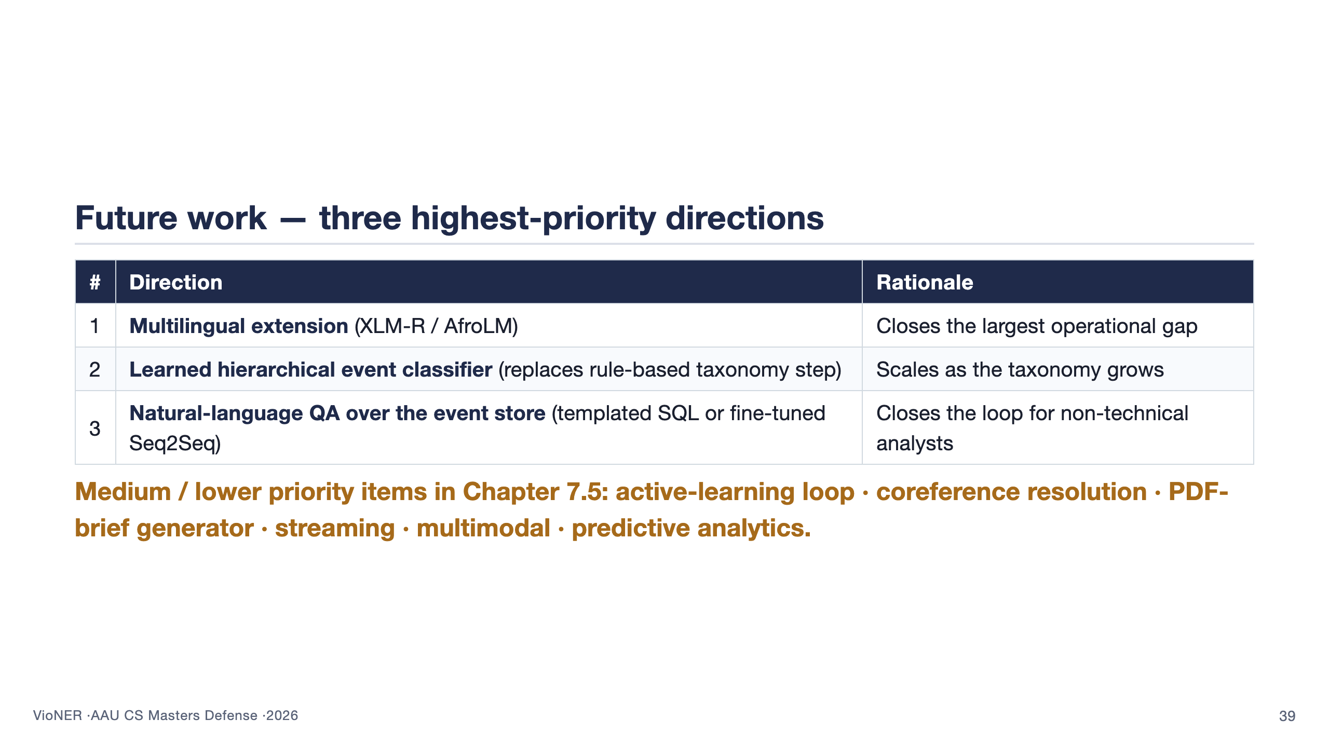
Notes:
Three priorities, each tied back to a limitation. Multilingual is item 1 because it closes the biggest operational gap — about half of African conflict reporting is in non-English languages. Item 2, the learned hierarchical classifier, addresses limitation 3 and would scale as the taxonomy grows beyond ~95 leaves. Item 3, natural-language QA, is the user-facing capability that closes the loop for non-technical analysts who want to ask "show me all events attributed to JNIM in the last 30 days" without writing SQL. The fact that the future work is mostly incremental engineering rather than fundamental research is itself a contribution claim: the hard methodological choices were made in this thesis. 90 seconds.

Slide 40


Slide 41

Notes:
Thank the panel by name. Invite questions. Let the silence sit — do not rush to fill it. When the first question lands, breathe before answering; the worst defense answers are the ones rushed in the first three seconds. If you don't know the answer, say so explicitly and offer what you do know; bluffing is the single most damaging behaviour in a defense. Remember: backup slides B1–B12 follow this one. If a question needs supporting evidence, name the backup slide and present it. End of main deck.

Slide 42


Slide 43
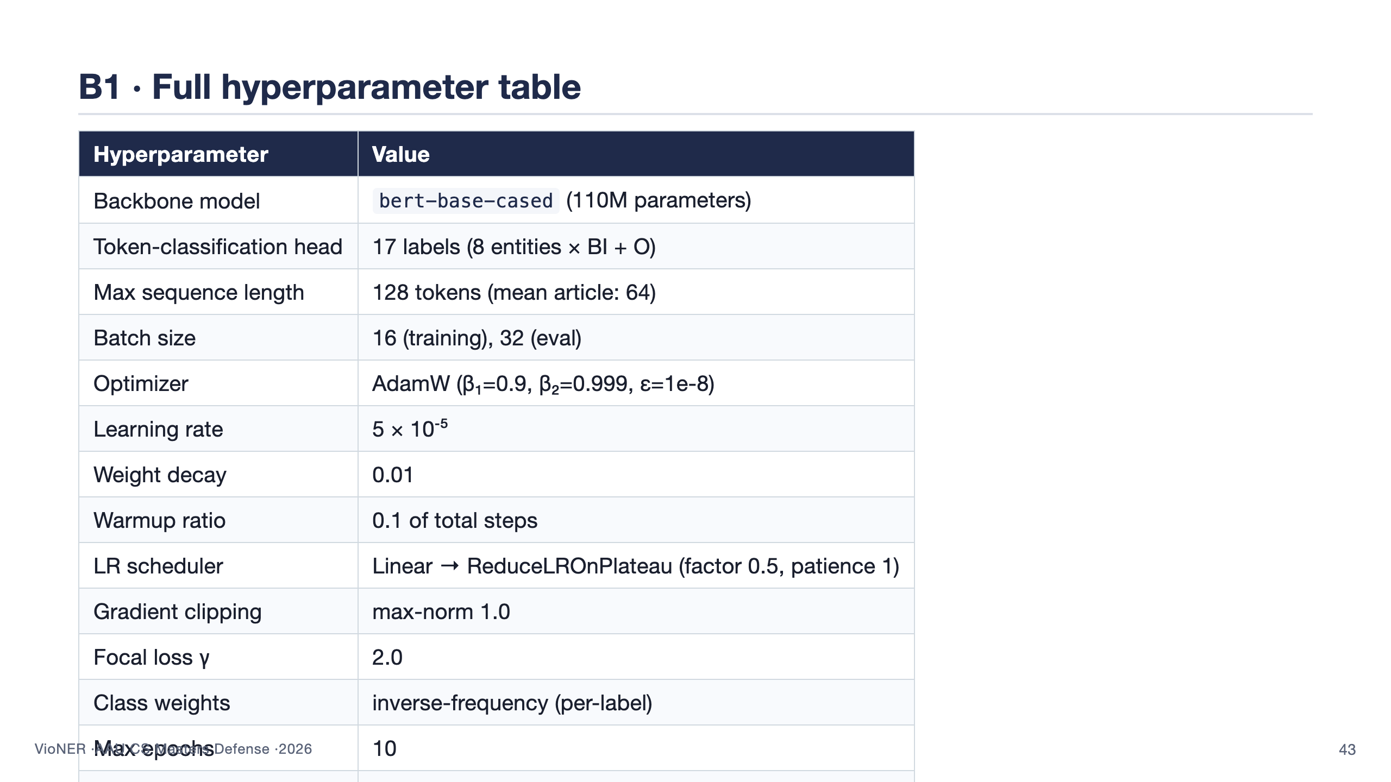

Slide 44
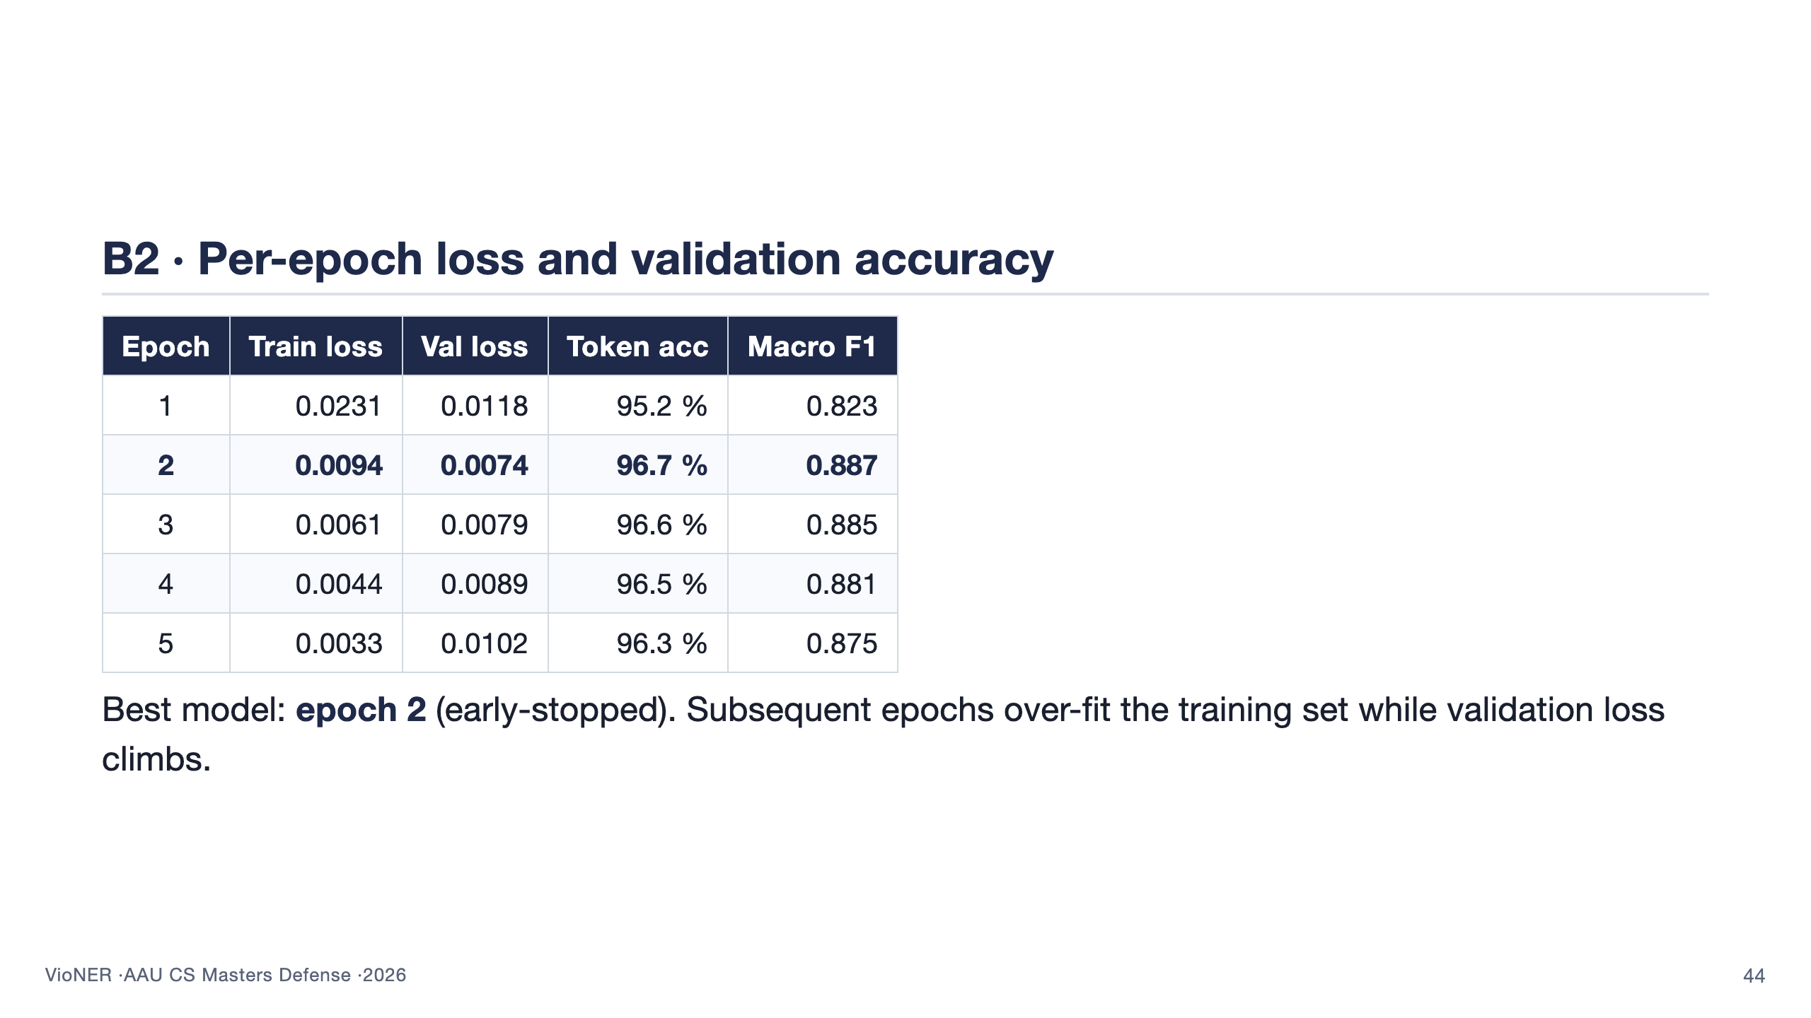

Slide 45
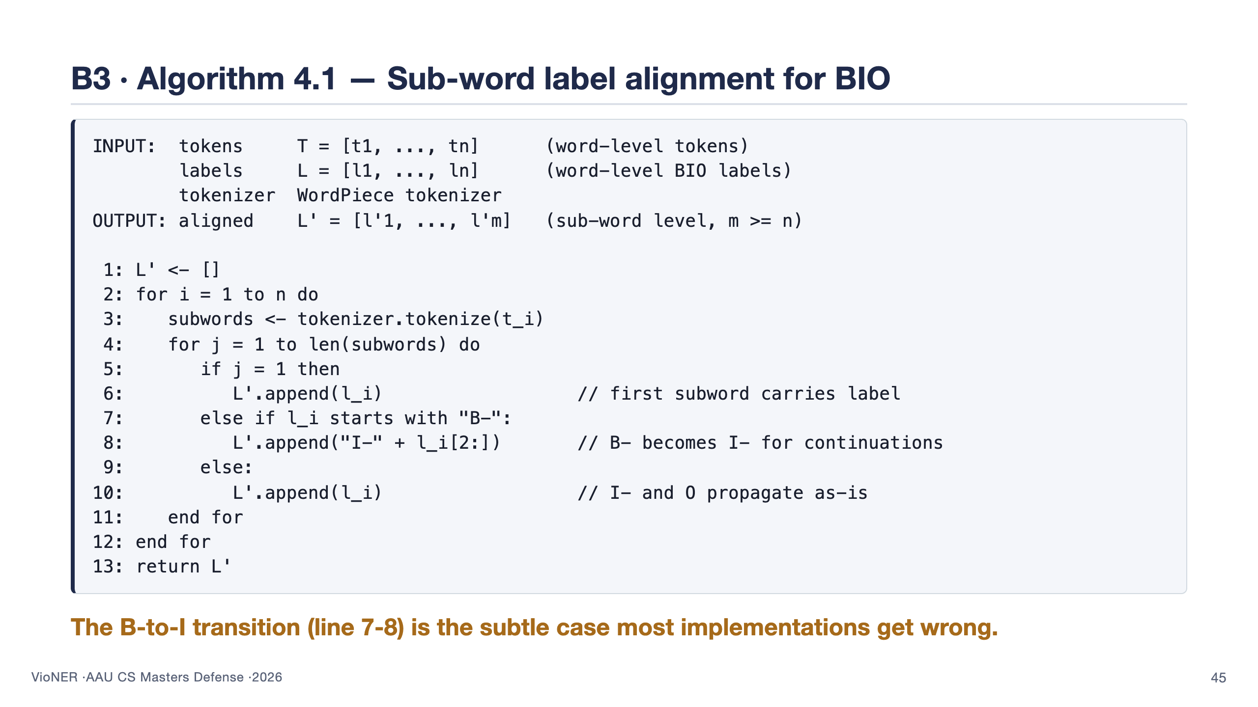

Slide 46
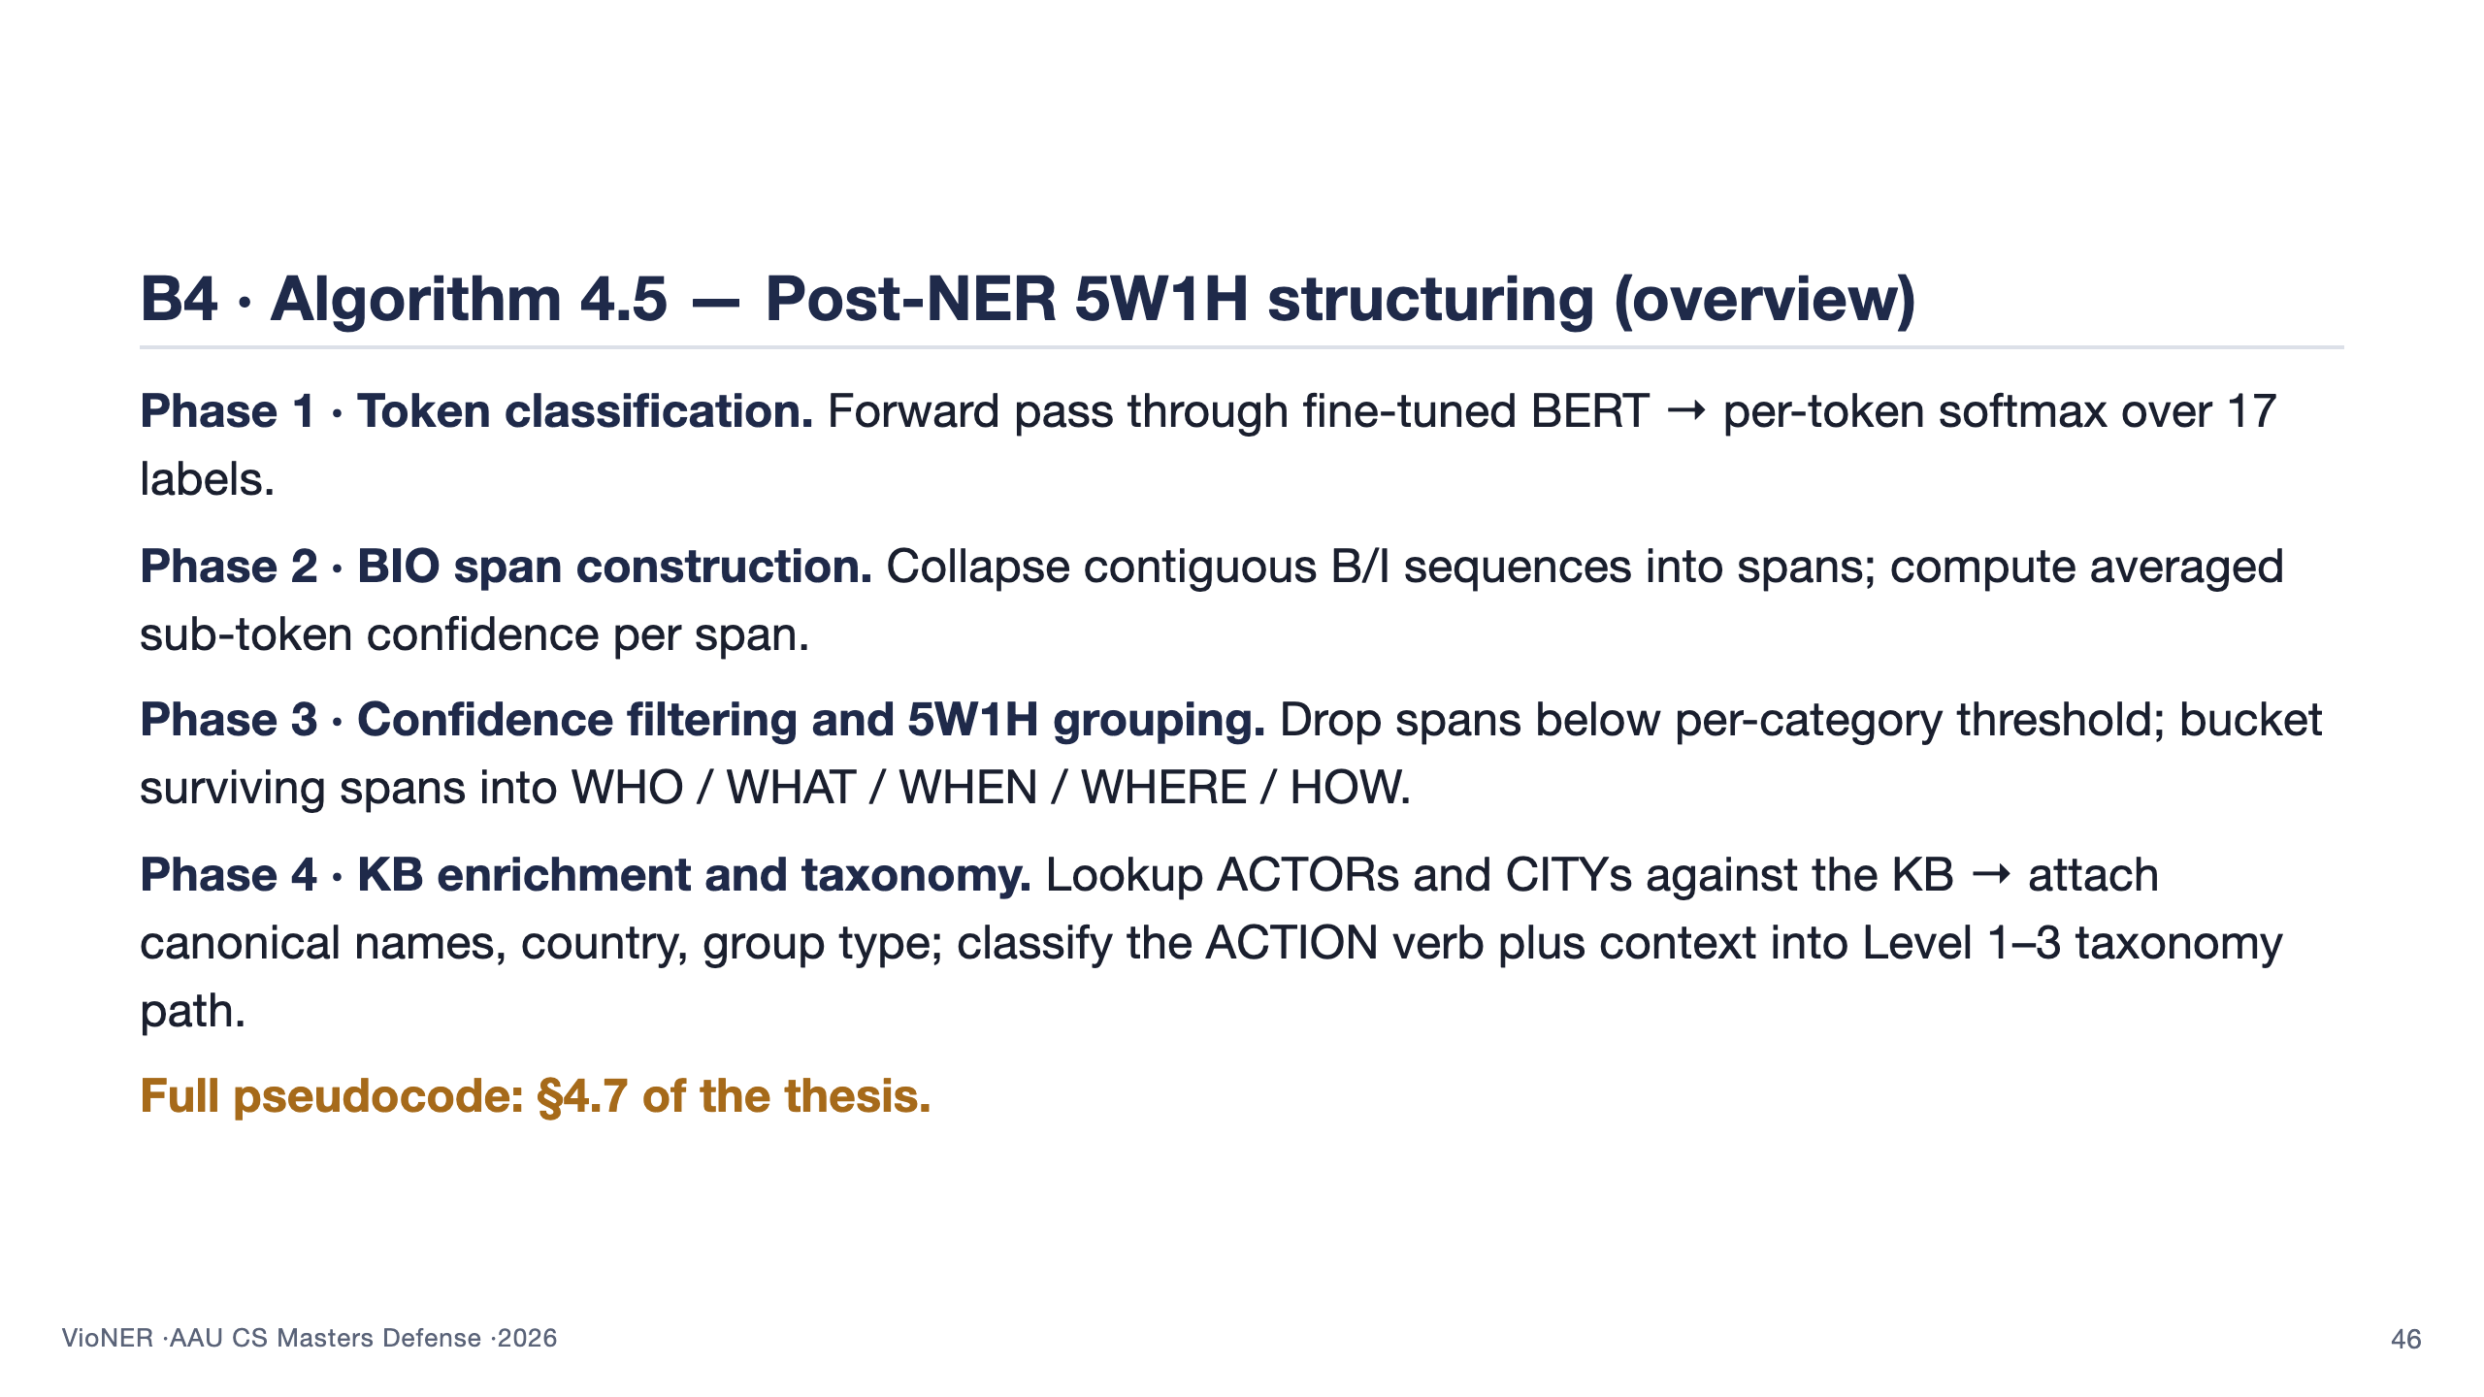

Slide 47
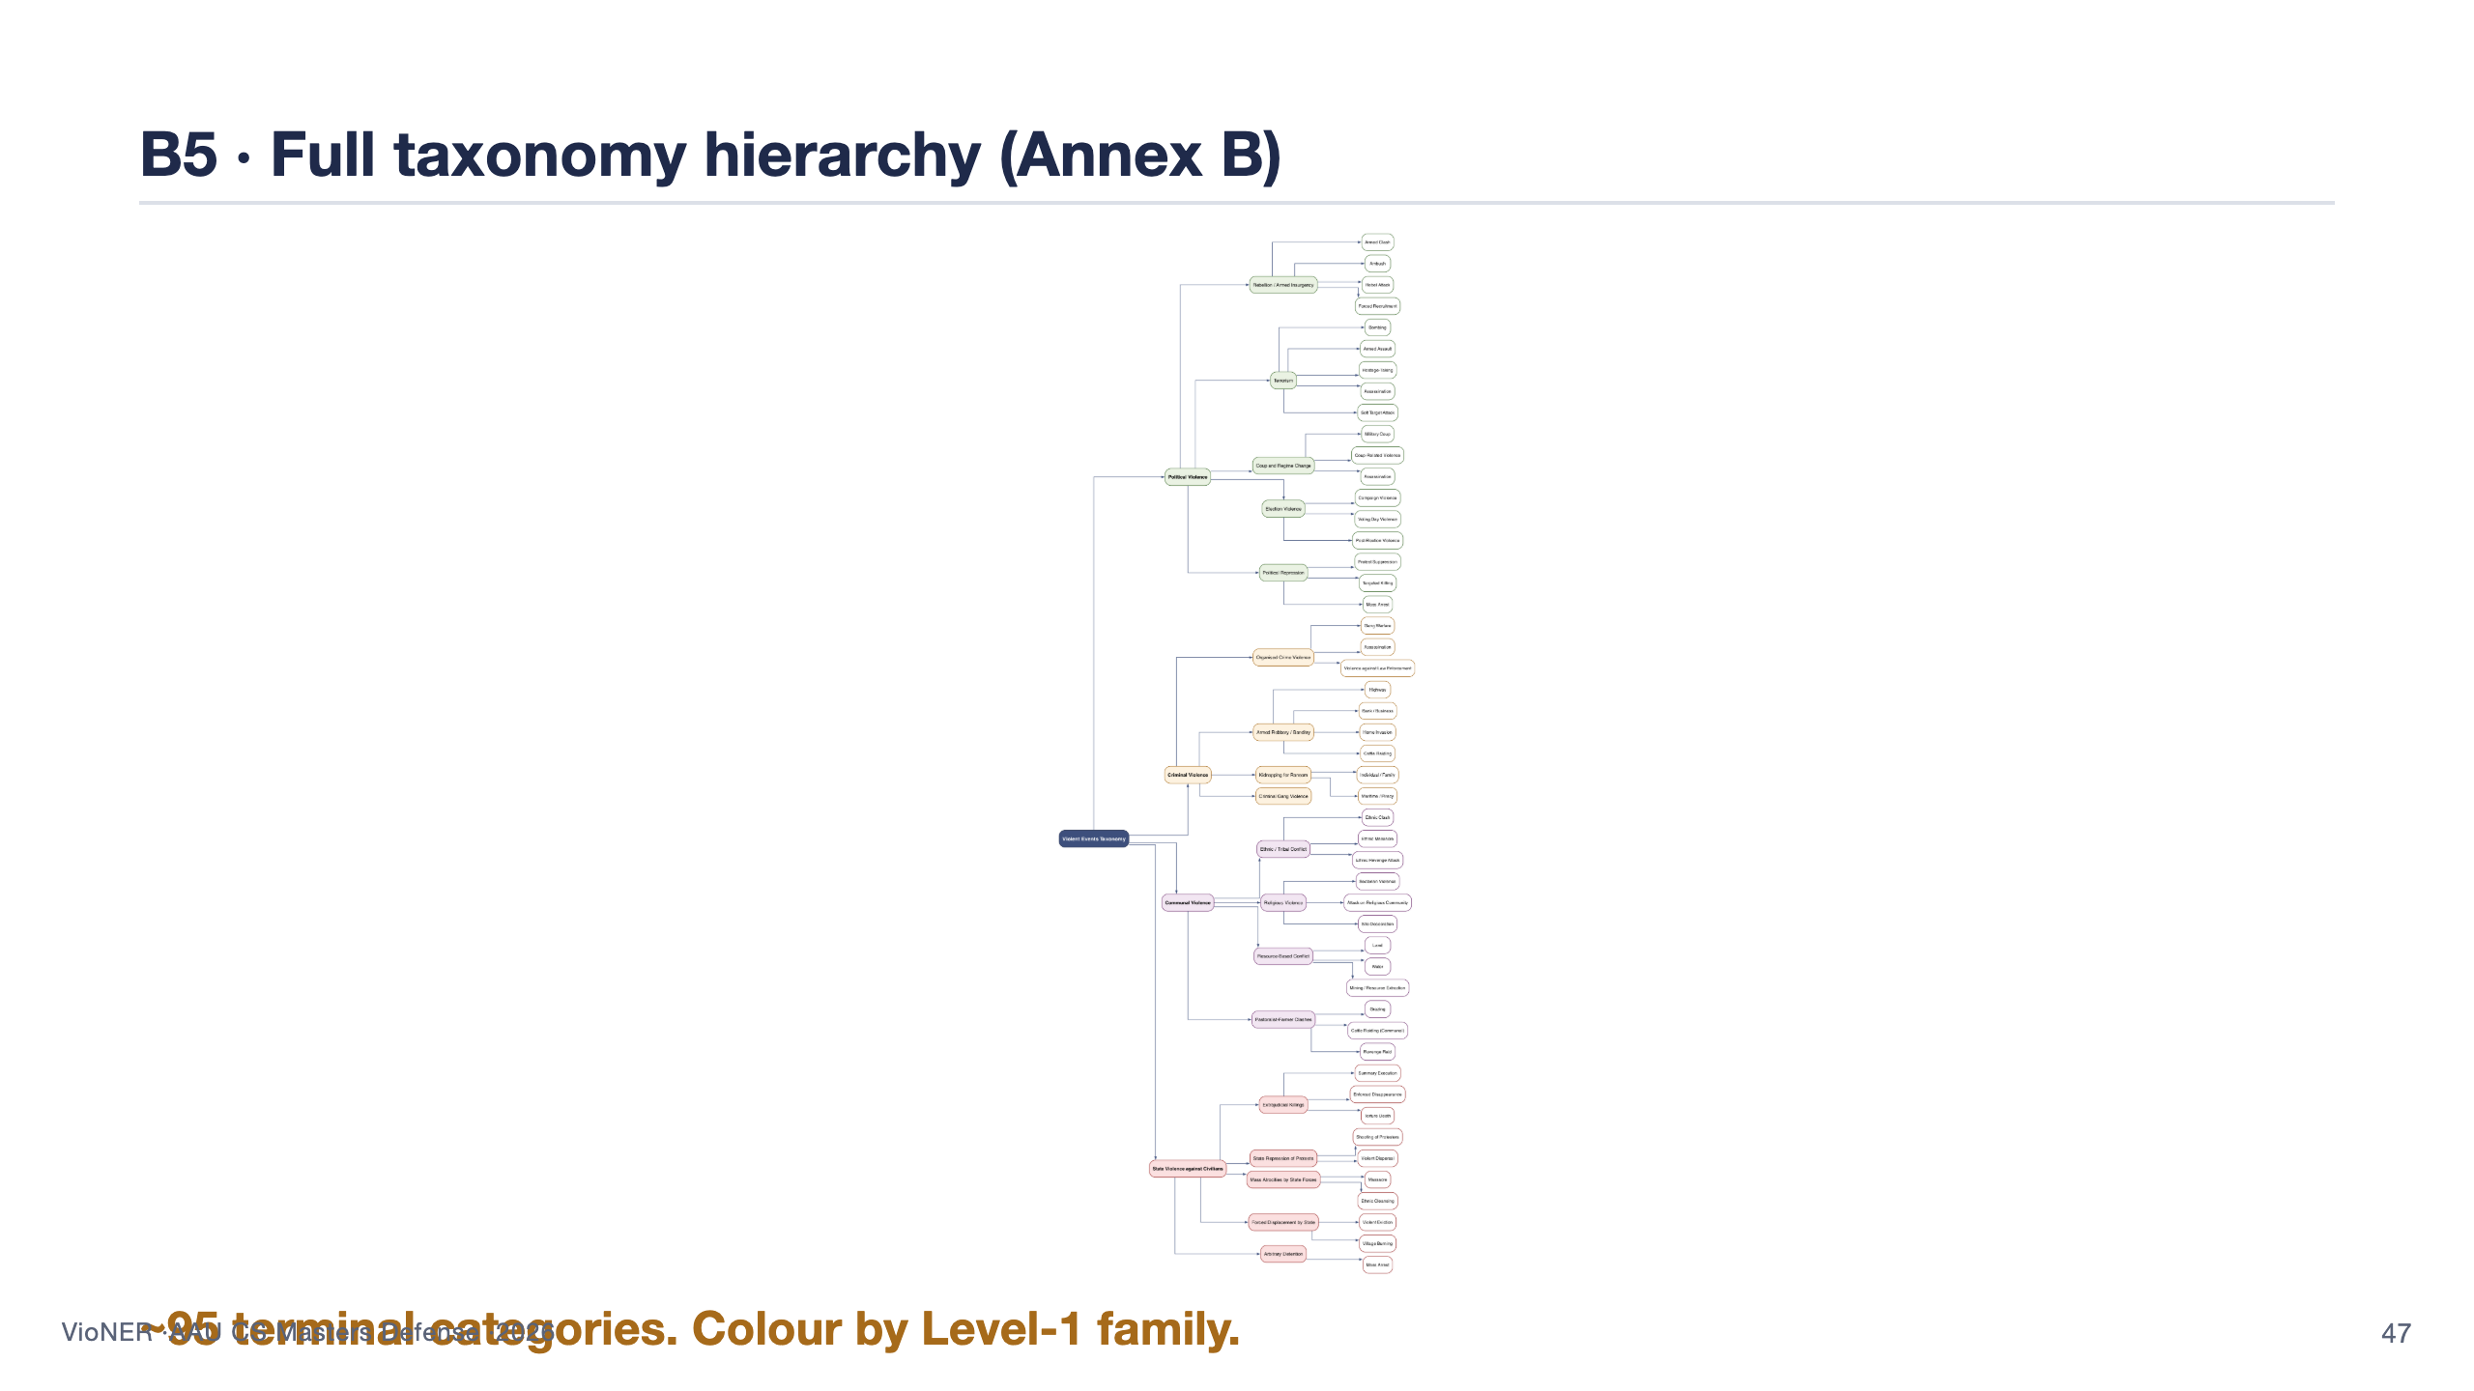

Slide 48
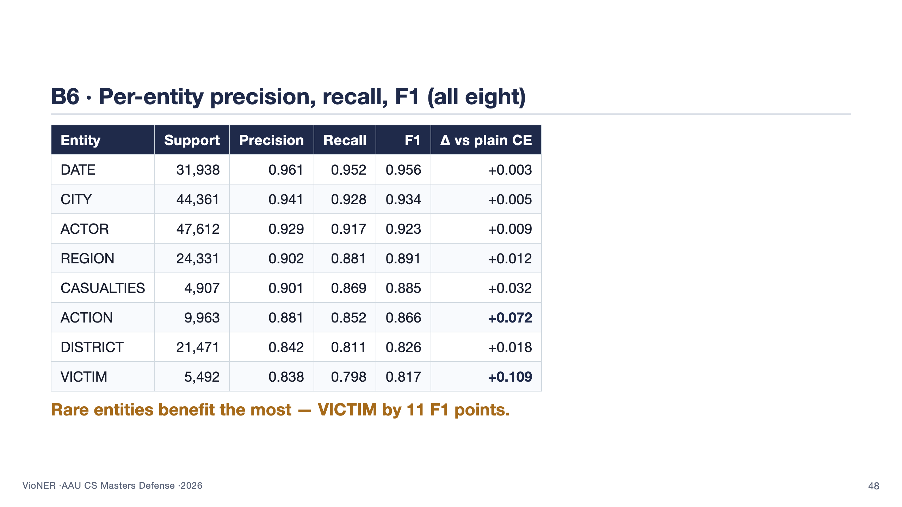

Slide 49
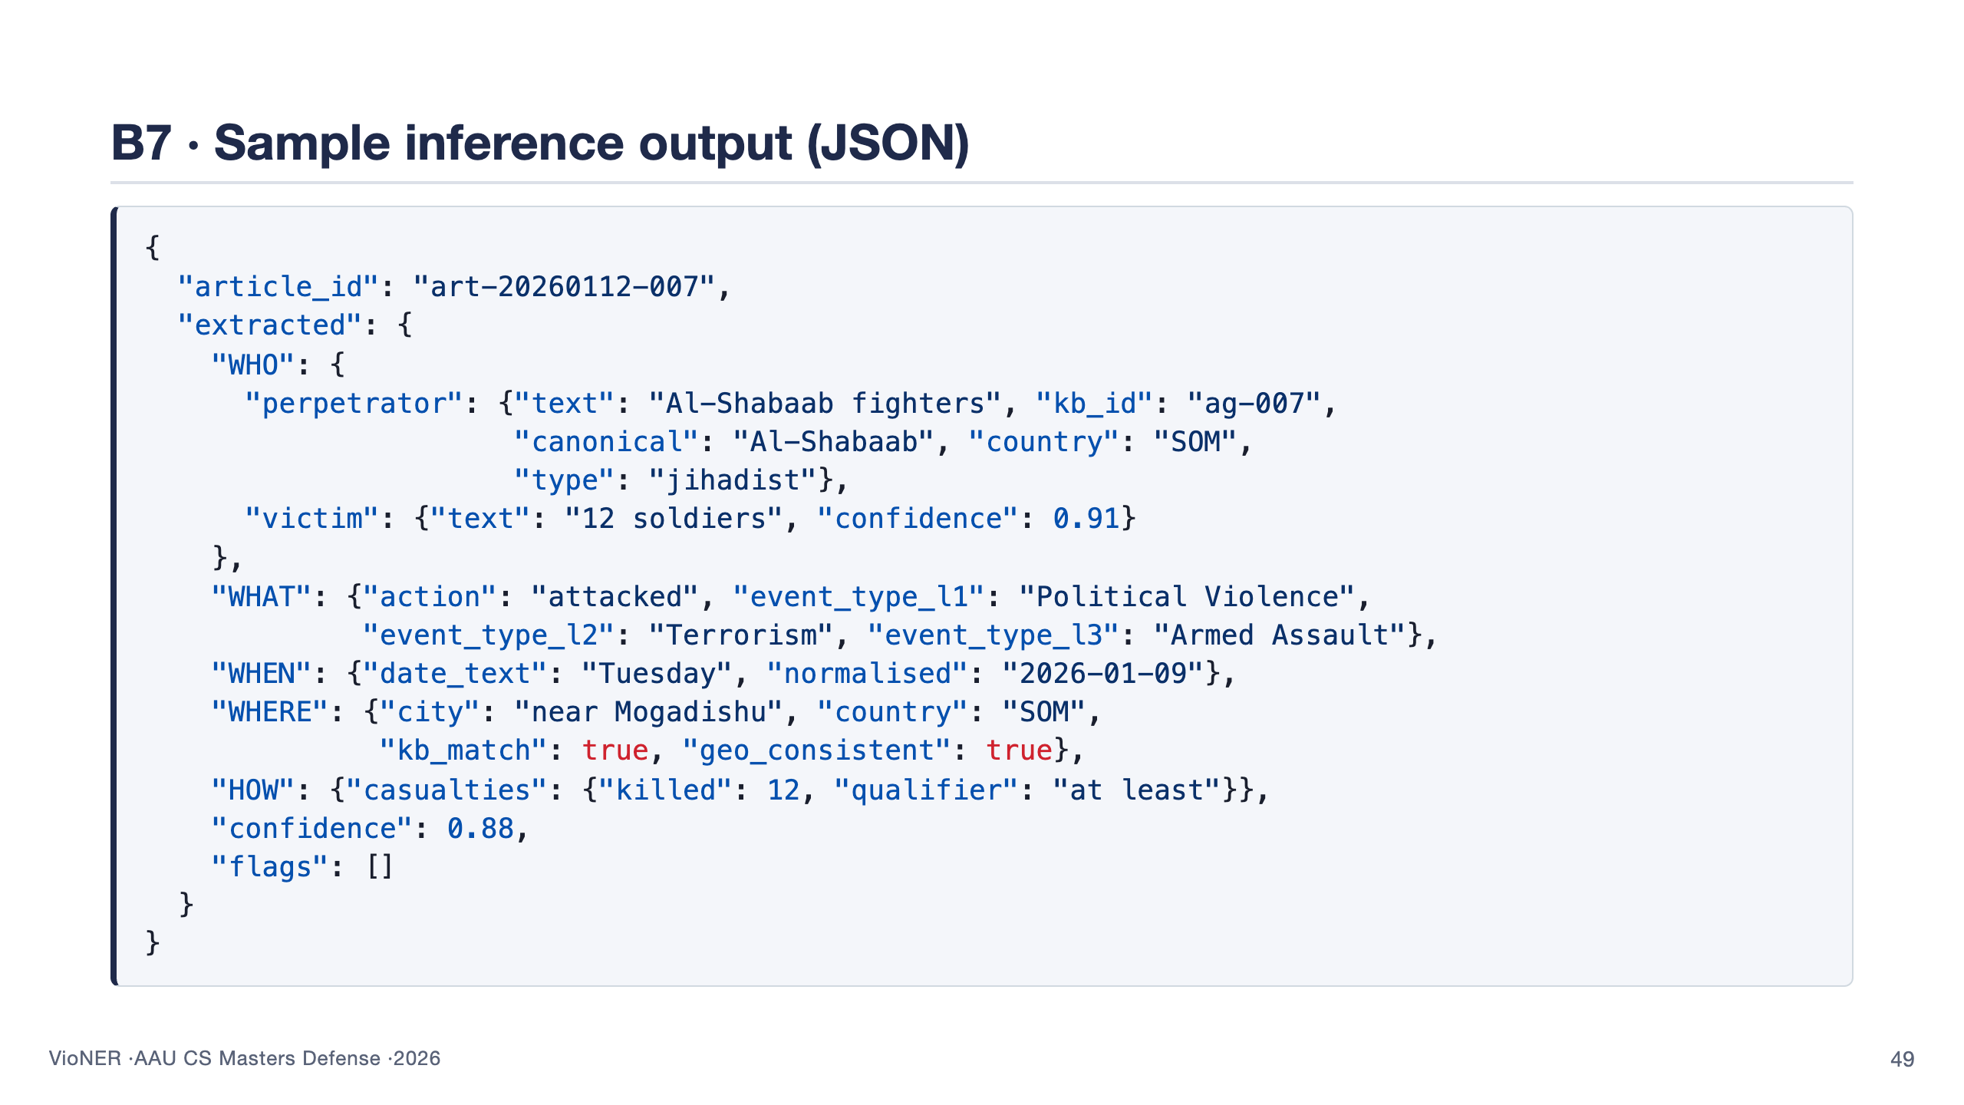

Slide 50
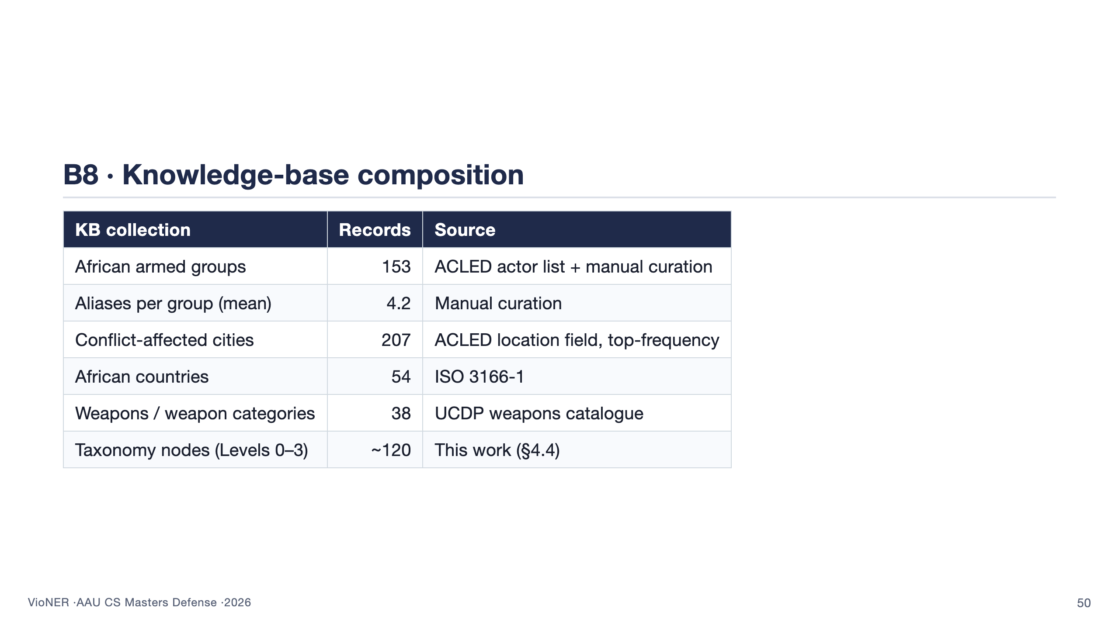

Slide 51
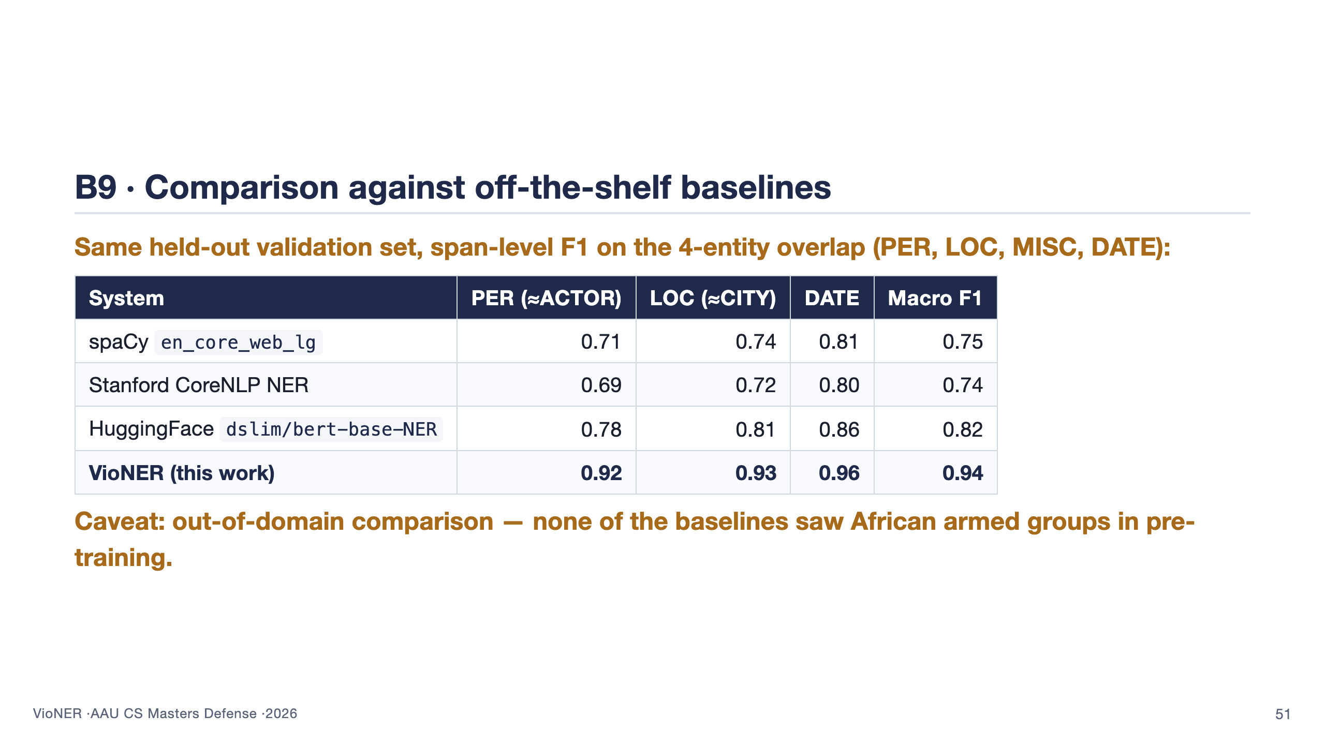

Slide 52
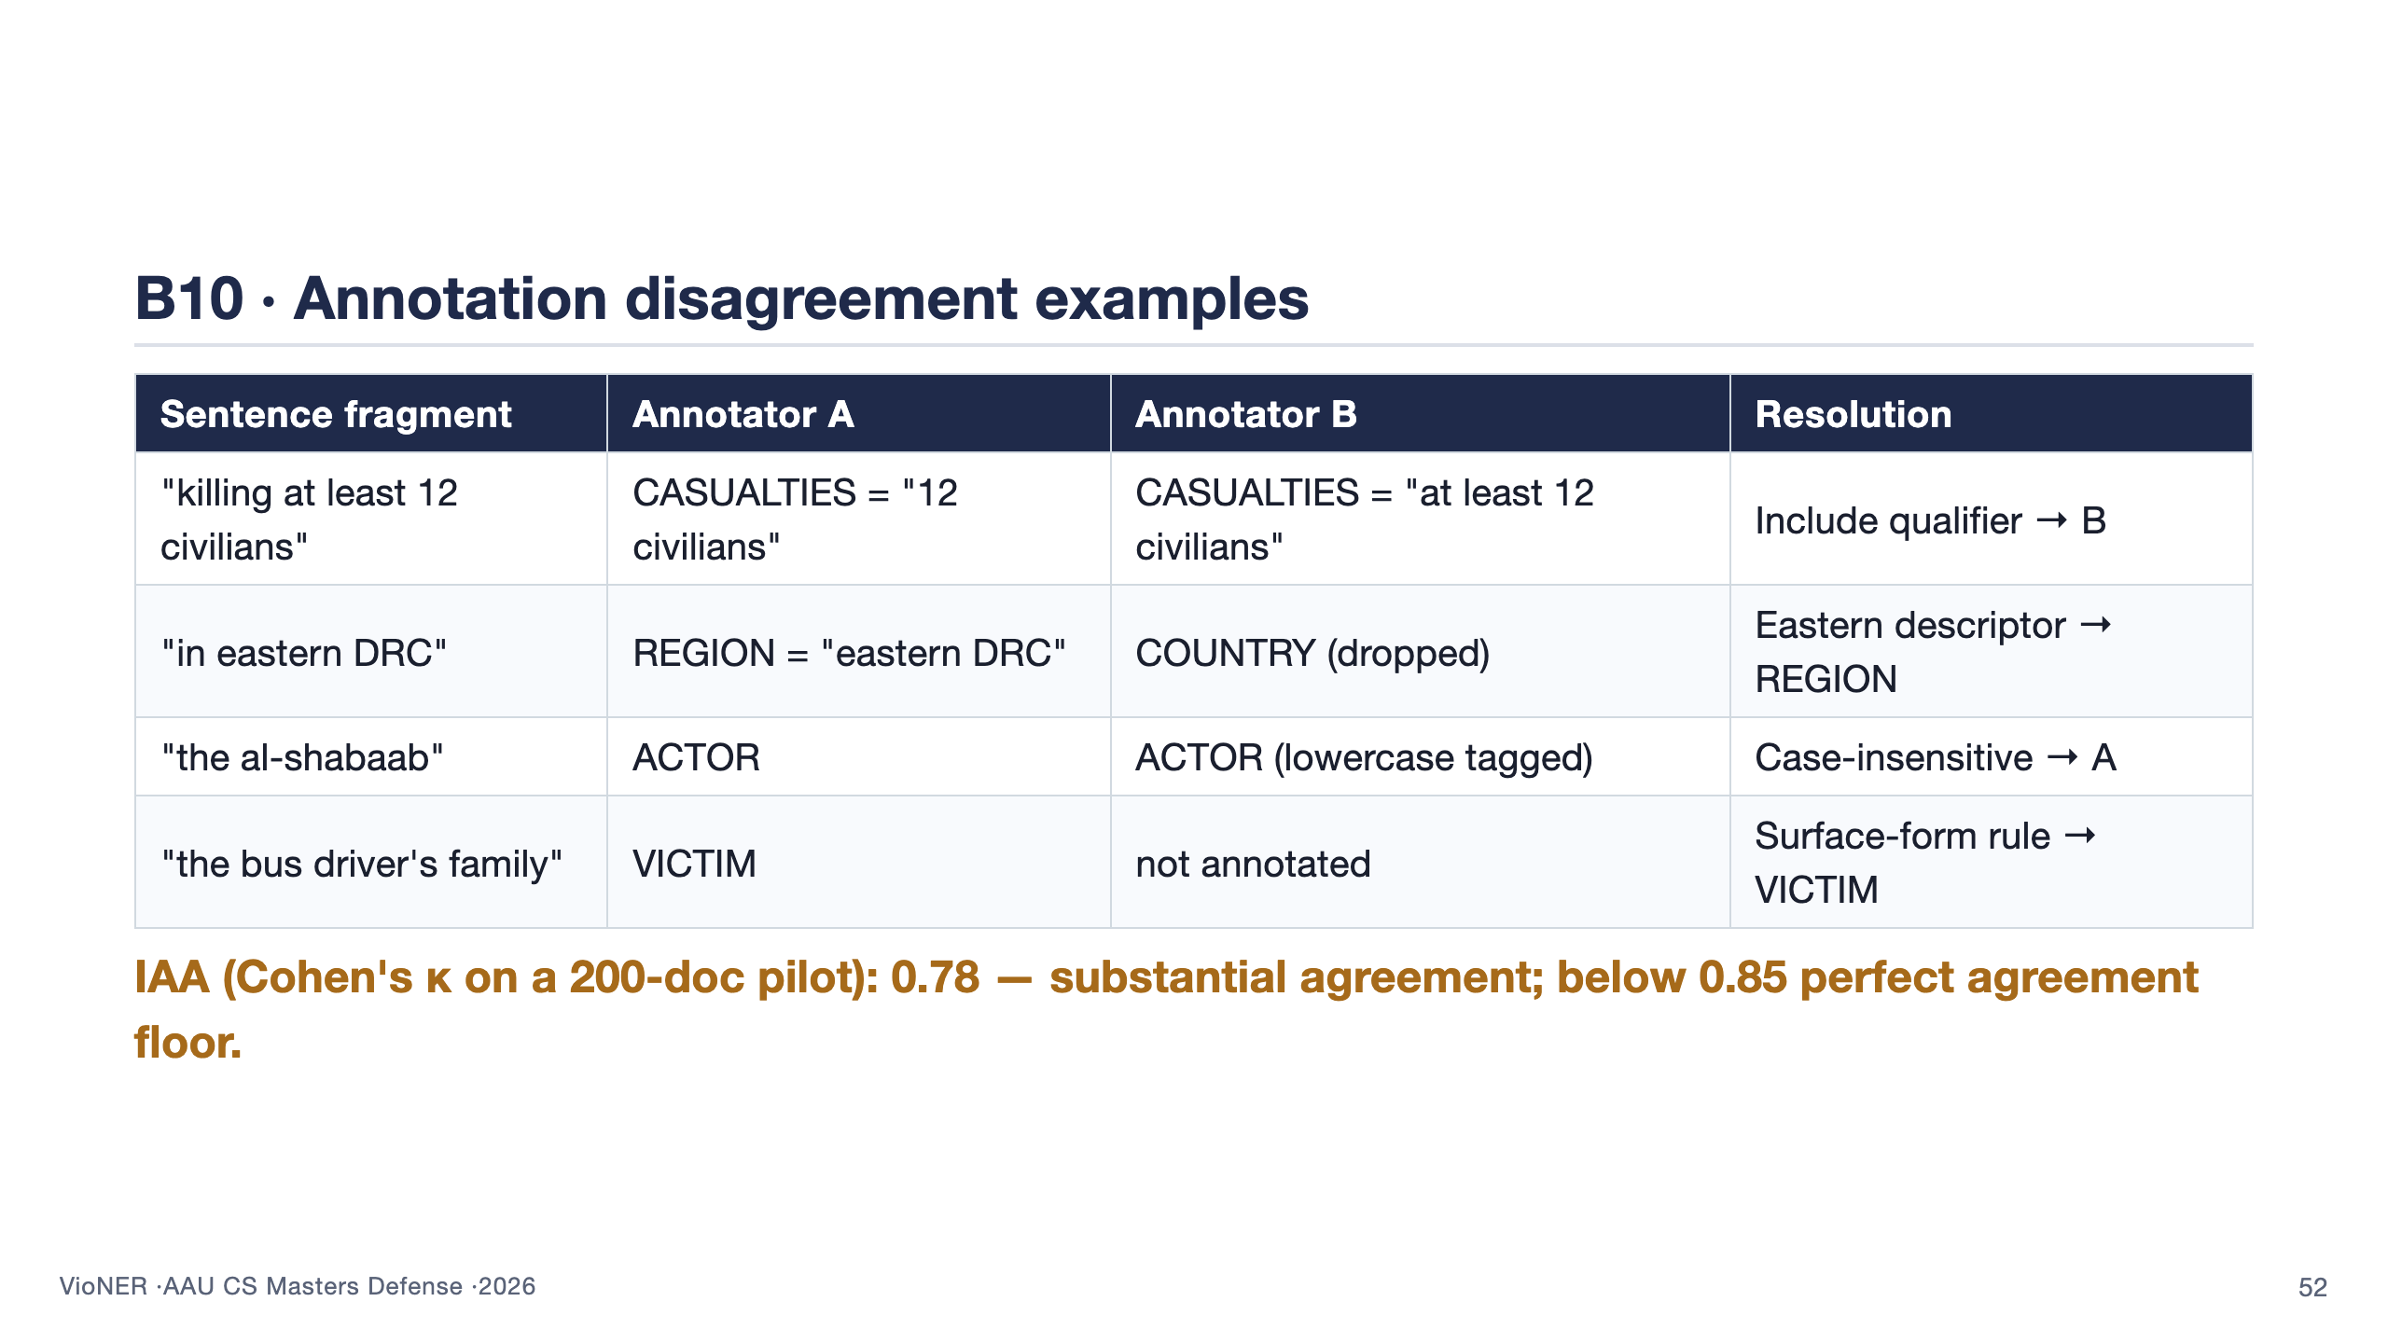

Slide 53
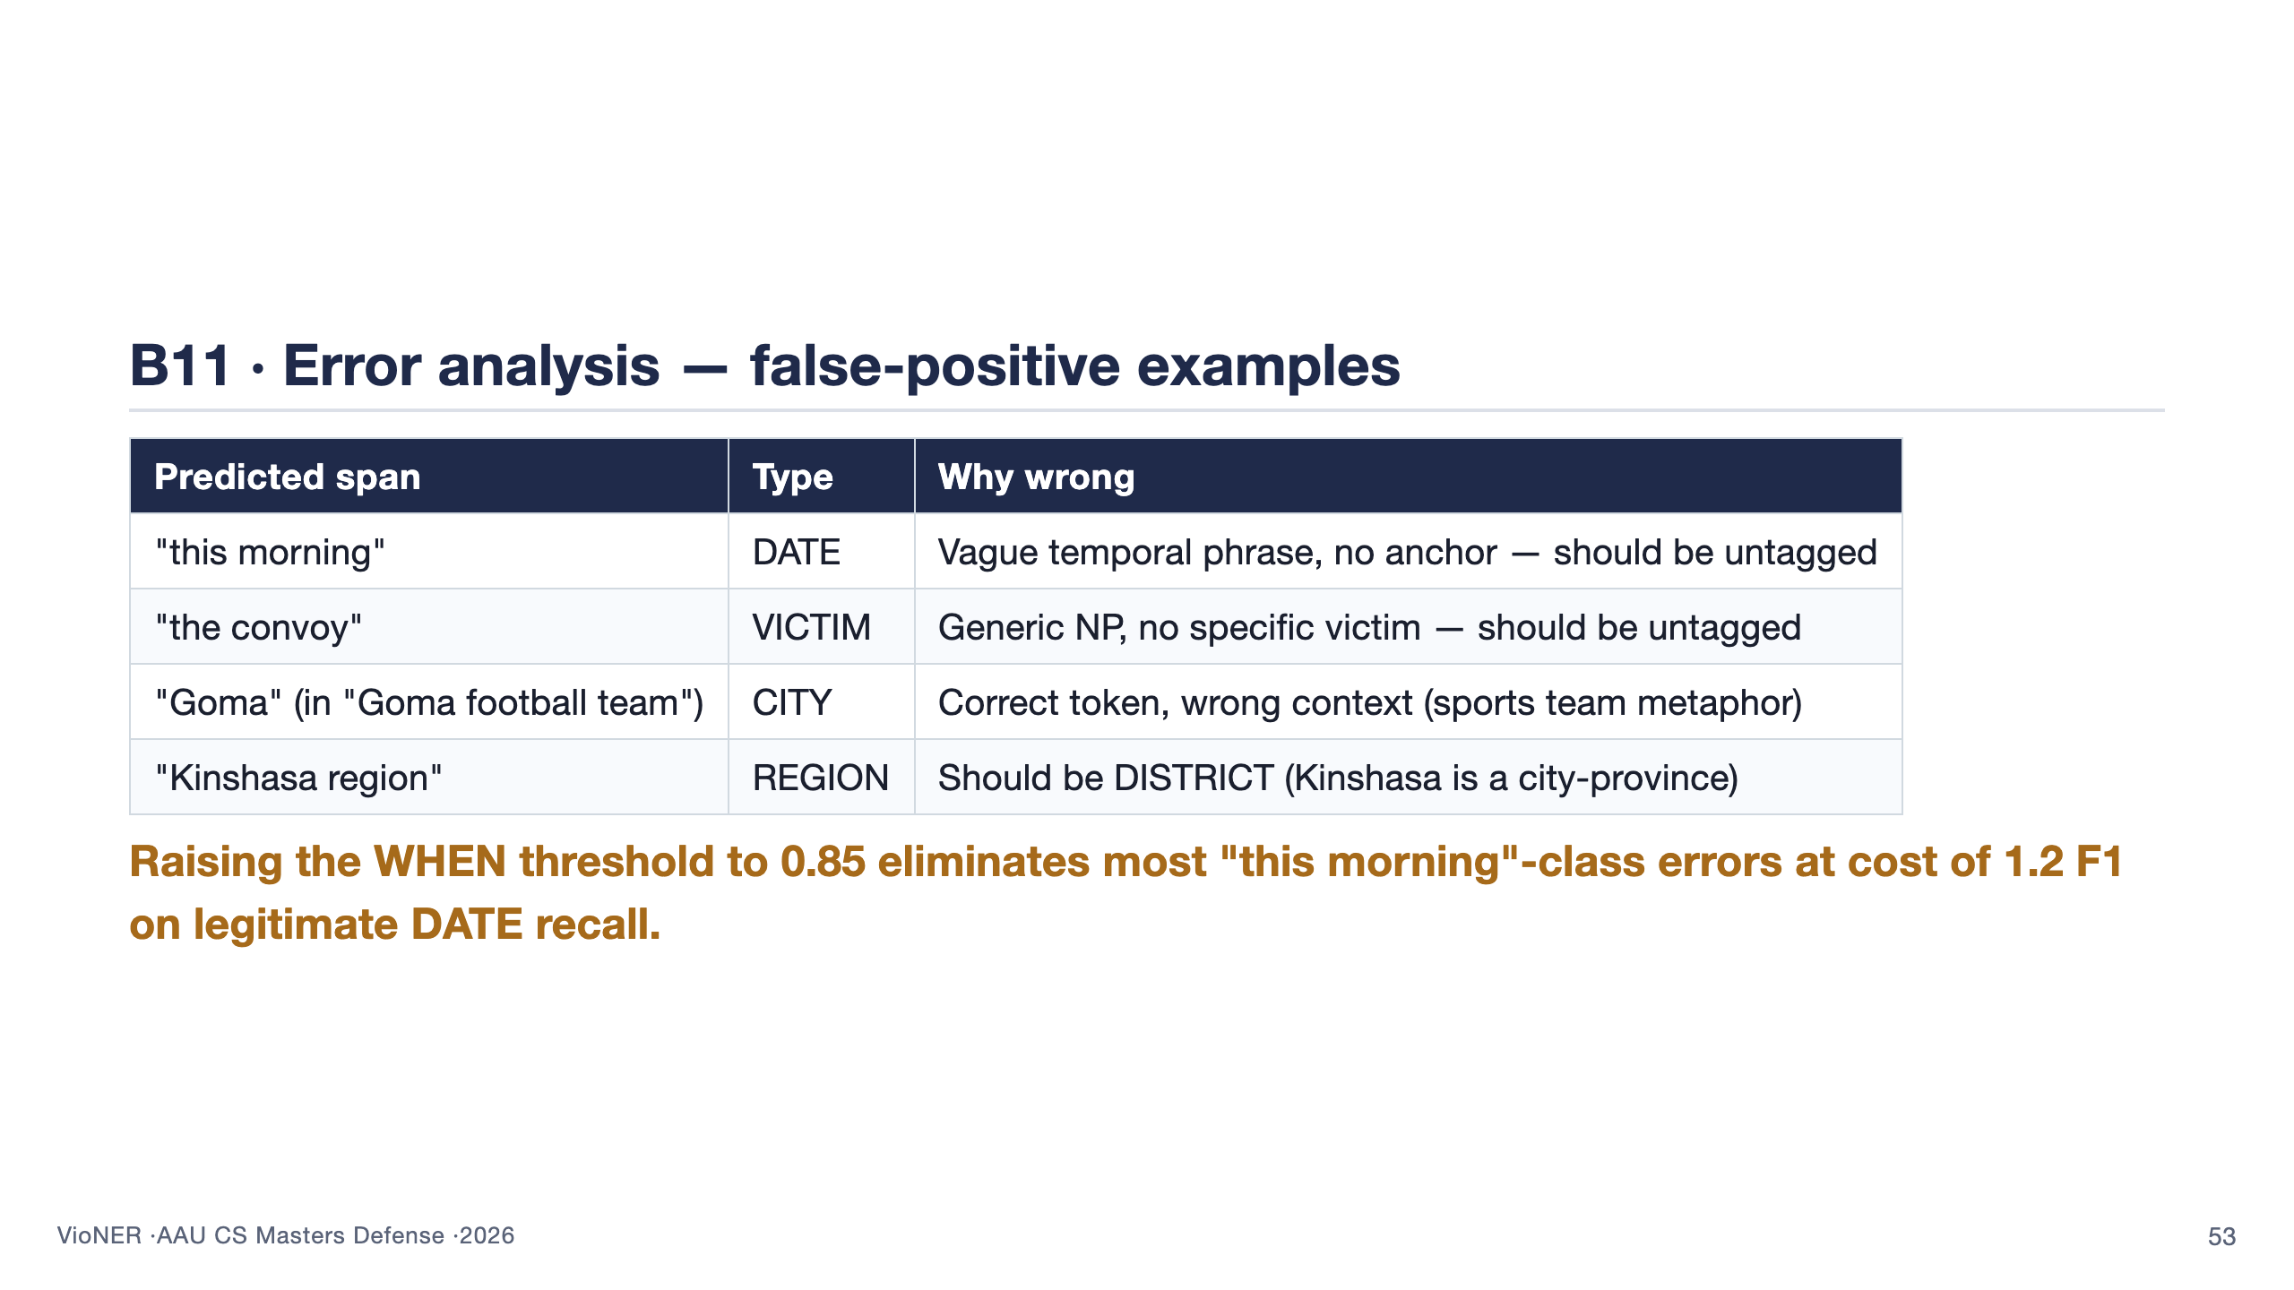

Slide 54
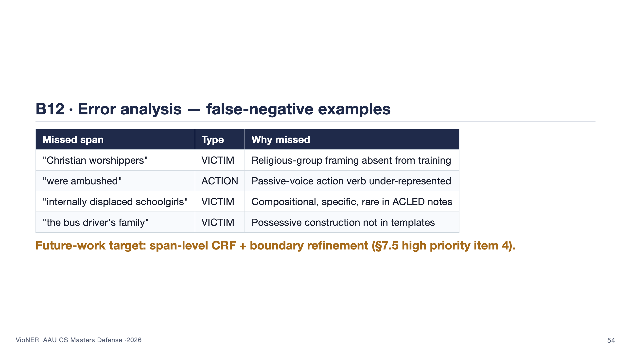

Slide 55
