Slide 1
Rhythm Music Store
DATABASE DESIGN AND MAINTENANCE

Slide 2
The Team
Akhil Manual
Athira Tomy
Binali Patel
Praveen Babu
Reshma Nair
24 November 2021

Slide 3
Introduction
The DB design holds all data related albums, products, customers, orders etc.
Data divided into smallest entities/tables
Tables normalized to third form
Well-defined relationships among entities
Easy and fast retrieval of data, covering common scenarios

Slide 4
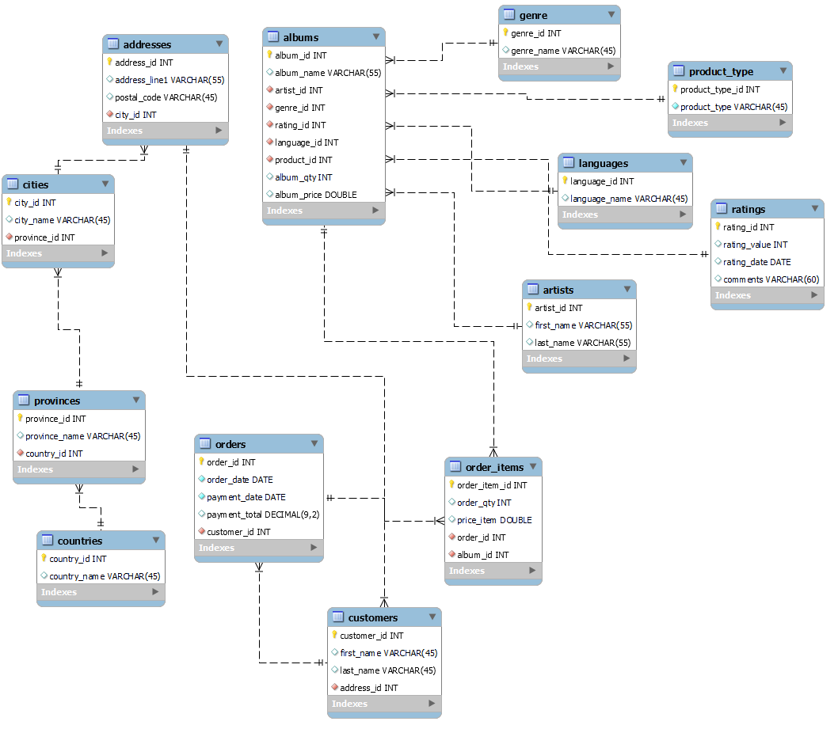

Slide 5
General Scenarios
Display a list of clients that spent more than the average spent by clients in the past month.
The top sold products and least sold products over a week.
The maximum price of products in the same genre (for example, rock, pop, country, hip-hop). Use GROUP BY to list all the genres and their maximum price.
List how many customers the system has by location (Country, Province, and City), and then sort them.
List how many products the store has sold for a particular month.
List how many distinct albums each singer has.
List how many copies of an album are available of a particular singer.

Slide 6
Specific Scenarios
Display which customer has ordered which album and the total payment given by the customer.
List all customers and show their city name and check customers from Toronto city using the IF function.
Create Procedure to display payment total of orders for customer_id =1.
Create view to update the columns in the table order_items.
Trigger on countries table to update the country_name for a specific country_id.

Slide 7
Summary
Simplified solution to store data.
Effectively handles scenarios related to day-to-day operations.
Clearly defined relationships.
Helps in easier business analysis and planning.
Easy retrieval and modification of data.

Slide 8
Thank you

