Slide 1
What is Programming
It is the implementation of logic to facilitate specified computing operations and functionality.
A well defined set of instructions that performs a specific task(computer program)
It tells a computer how to perform a task.
It uses semantics and syntax for developing an application.
Thus, it requires application domains, algorithms and programming language expertise.

Slide 2
Syntax
It defines about the structure or grammar of language.
It answers the question: how do I construct valid a sentence?
In case of English Language,
sentence can be: I eat rice. (subject + verb + object.)
In C# programming,
<data type> variable_name;
int a=5;

Slide 3
Semantics
It defines meaning of sentence.
It answers the question: is this sentence valid?
If so, what does the sentence mean? For example:
In English, I eat rice.
In programming,
int a=5, b=7;
a+b;

Slide 4
Object Oriented Programming
Object-oriented programming allows for simplified programming.
It is a technique to think real world entities of problem in terms of objects.
Object maps the software model to real world concept.
The four primary concepts of object-oriented programming are encapsulation, abstraction, inheritance, and polymorphism
Its benefits include reusability, refactoring, extensibility, maintenance and efficiency.

Slide 5
Class
It is a template definition of methods and variables in a particular kind of object.
It is simply an abstract model used to define a new data types and which represents a blue print of objects.
A class may contain any combination of encapsulated data (fields or members variables), operations that can be performed on data(methods) and accessors to data(properties).

Slide 6
Object
Objects are conceptually similar to real-world objects
An object is a software bundle of related state and behavior.
Software objects are often used to model the real-world objects that find in everyday life.
Three properties of an object:
Identity: the property of an object that distinguishes it from other objects.
State: describes the data stored in the object.
Behavior: describes the methods in the object's interface by which the object can be used

Slide 7
Contd..
Real-world objects share two characteristics: They all have state and behavior. Dogs have state (name, color, hungry) and behavior (barking, wagging tail).
An object stores its state in fields (variables in some programming languages) and exposes its behavior through methods (functions in some programming languages).
An object is an instance of class and allocate memory.
An object is a location in memory having a value and referenced by an identifier.

Slide 8
Encapsulation
The wrapping up of data and function into a single unit(class) is called encapsulation.
Encapsulation means that a group of related properties, methods, and other members are treated as a single unit or object.
Data is not accessible to the outside world and functions which are wrapped in the class can access it.
Function provide interface between the object’s data and the program.
This insulation of data from direct access by program is called data hiding.

Slide 9
Abstraction
It refers for representing essential features without including the background details of explanations.
It is the process of extracting classes. It defines entity in simple term ignoring the element in detail.
Eg Student
Name: Bibek, Address: Baneshowor and Mobile:98414141
If we hide all data

Slide 10
Inheritance
It is the process by which objects of one class acquire properties of objects of another class.
Inheritance describes the ability to create new classes based on an existing class.

Slide 11
Polymorphism
Polymorphism means that you can have multiple classes that can be used interchangeably, even though each class implements the same properties or methods in different ways.
Simply it means one name ,multiple forms

Slide 12
How do programming
Analyze the business problem
Represents business entities(classes)
Define properties(data): that hold data of object
Define methods(actions/behavior): that performs some actions

Slide 13
DotNet framework
It is a software framework developed by Microsoft for developing applications that runs primarily on Microsoft Windows.
The .NET Framework consists of the Common Language Runtime(CLR) and the .NET Framework class library.

Slide 14
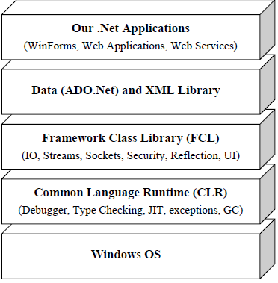

Slide 15
Common language runtime(clr)
It is the foundation of the .NET framework.
Which is responsible for the execution of all applications. Applications are developed using the.NET library.
It is a framework layer that resides above the OS and handles the execution of all the DotNet applications.
Programs don’t directly communicate with the OS but go through the CLR.
It manages memory, thread execution, code execution, code safety verification, compilation, and other system services.

Slide 16
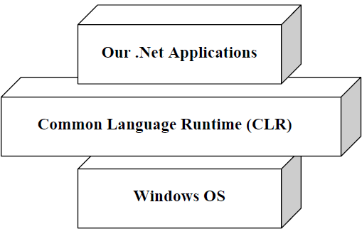

Slide 17
MSIL(Microsoft Intermediate Language) or IL
All .NET source code is converted to an intermediate code known as MSIL which is interpreted by the CLR.
MSIL is OS and hardware independent code. This MSIL is converted to binary executable code(native code) at the point where the software is installed.

Slide 18

Just-In-Time(JIT) compiler
It compiles the IL code to native executable code(.exe or .dll) that is designed for specific machine and OS.

Slide 19
Assemblies
An assembly is the basic unit of deployment in .NET and it is also the container for all types.
It contains compiled types with their IL code, runtime resources, and information to assist with versioning, security, and referencing other assemblies.
It comprises a single Windows Portable Executable file(with .exe extension in case of application, or .dll extension in case of reusable library.
It also contains meta information which describes the program’s types, members, and attributes.

Slide 20
The Framework Class Library(FCL)
It provides the core functionality of .Net Framework architecture.
It includes a huge collection of reusable classes, interfaces, and value types that ease and optimize the development process and provide access to system functionality.
This library is categorized into different modules and can access to Windows application, Web development, Network programming ,IO etc.

Slide 21
Common Type System(CTS)
It defines how types are declared, used and managed in the CLR.
It is also an important part of the runtime's support for cross-language integration.
The common type system performs the following functions:
Establishes a framework that helps enable cross-language integration, type safety, and high-performance code execution.
Provides an object-oriented model that supports the complete implementation of many programming languages.

Slide 22
Contd..
Defines rules that languages must follow, which ensures that objects written in different languages can interact with each other.
Provides a library that contains the primitive data types (such as Boolean, Byte, Char, Int32, and UInt64) used in application development.

Slide 23
Common Language Specification(CLS)
It is a set of basic language features that .Net Languages needed to develop Applications and Services.
It is a subset of the CTS. The CLS establishes the minimum set of rules to promote language interoperability.
Microsoft has defined CLS, which are nothing but guidelines, that language should follow so that it can communicate with other .NET languages in a seamless manner.

Slide 24
Integrated development environment (IDE)
It is a programming environment integrated into a software application that provides comprehensive facilities to computer programmers for software development.
It contains a GUI builder, a text or code editor, a compiler and/or interpreter and a debugger.
It normally consists of a source code editor, build automation tools and a debugger. Several modern IDEs integrate with Intelli-sense coding features
Visual Studio, Net Beans and Eclipse are all examples of IDEs.

