Slide 1

TOPIC : MSRIT HELP
TEAM NAME : BINARY BEASTS
TEAM MEMBERS : NEERAJ PHADKE
ABHISHEK KAUSHIK

Slide 2
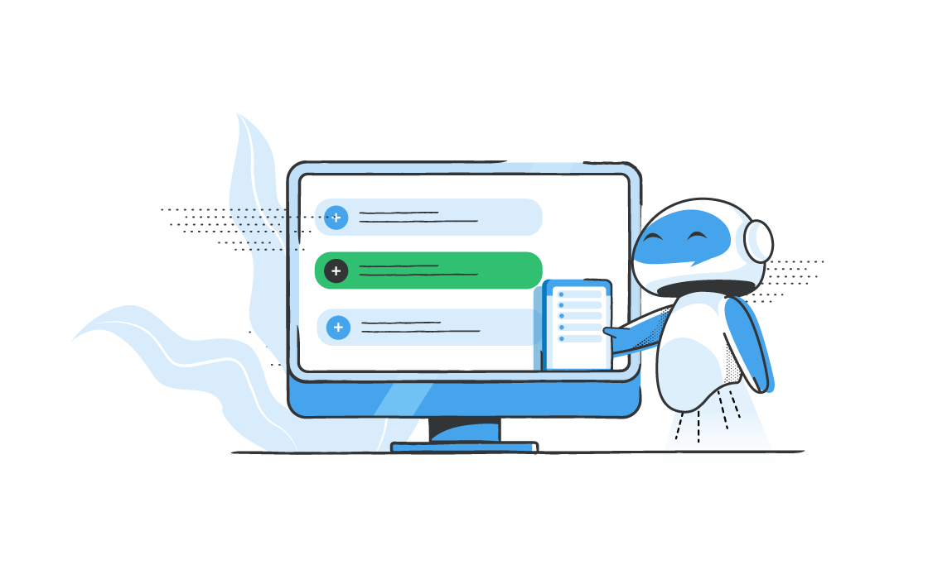
AI Chatbot For MSRIT
01
Idea/Approach Details
Explaining all the functionalities of our chatbot and all the tasks it can do .
02
Working and Technology Stack
Explaining how the chatbot’s frontend and backend works .
03
Use Case and Future Scope
Exploring the great possibility and future scope of the chatbot .

Slide 3

IDEA AND APPROACH :
As freshers we faced difficulties in finding authentic resources as they were scattered across the sites.
It would have been easier if we could get all the information at one place!
So we came up with the idea of a CHATBOT which solves this problem !
Our “interactive” chatbot is capable to answer general queries of the user in a span of few seconds instead of searching and doodling throughout the website .

Slide 4
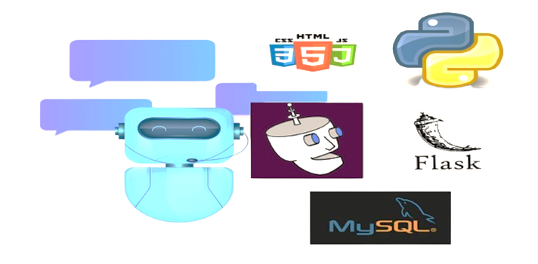
TECH STACK :

Slide 5
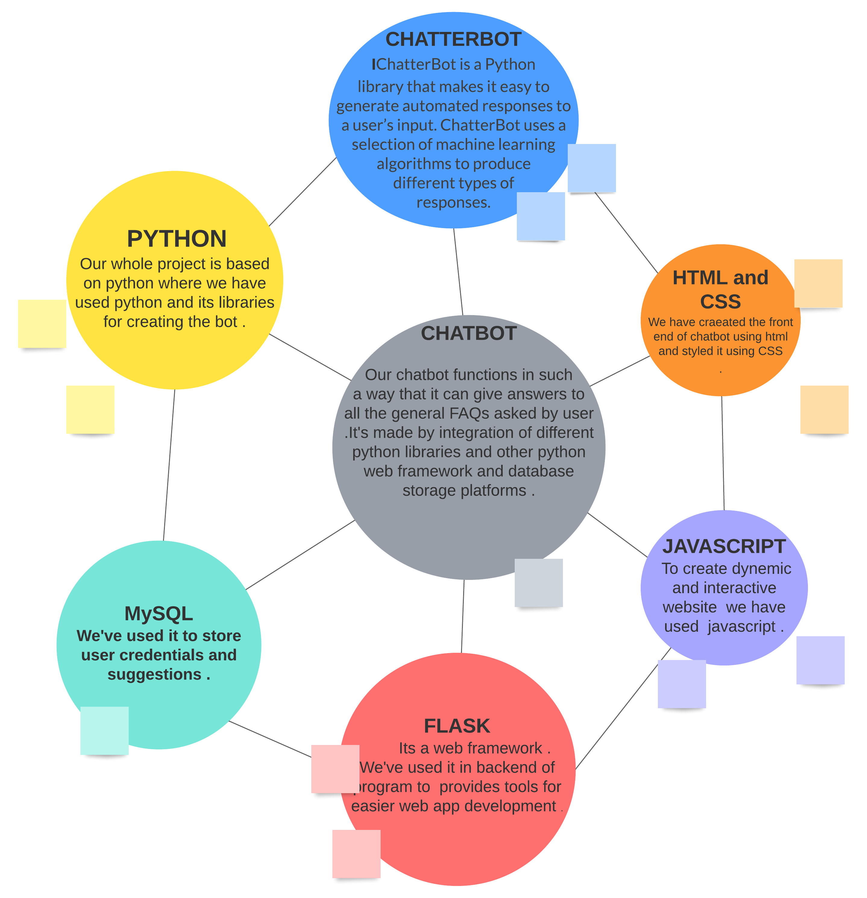
WORKING :

Slide 6
USE CASES :
It can help freshers to explore various aspects of college including academics and extra cirricular activities both .
It can be use by any college club to resolve various frequently and commonly asked questions related to the club .
It can be used by the external visitors to get better info related to college .
It could be trained on a data set of FAQs about the college such as information about admissions campus resources and events .

Slide 7
FUTURE SCOPE :
We can train it more to make it more efficient to answer different questions .
We can further modify it according to the various needs of the user.
It can be further modified to answer more complex questions .
The chatbot can be designed to handle variety of inputs such as text , voice and even images to make it as user friendly as possible.
It can be integrated with existing college systems such as student information system or the calendar of events to provide up to date and accurate information .

Slide 8
THANK YOU

