Slide 1
LAMEGAME: Need for speediorite
Aaron Gonzales
Weston Ortiz
Hans Henry Weeks
Paige Stephen Romero
Robert ‘Dan’ Nicholson

Slide 2
Overview
Original Design:
Space shooter, lasers, powerups, explosions, etc.
Final Design:
Mario Kart-esque Space Shooter
Players compete to collect SpaceGems in a hectic asteroid field surrounding the planet Javac, detering each other with space lasers

Slide 3
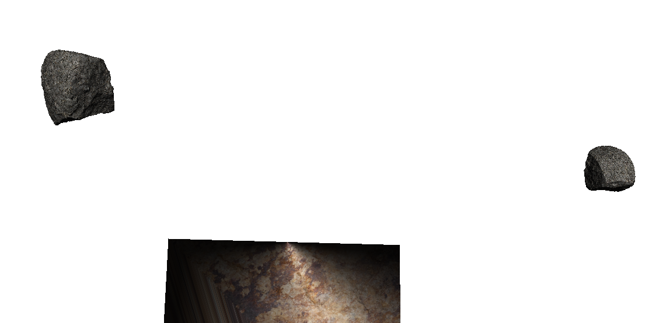
We started with…

Slide 4
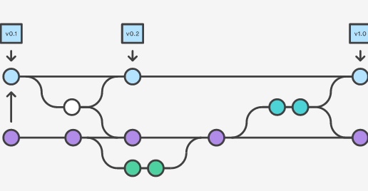
Workflow
Figure source: https://www.atlassian.com/git/tutorials/comparing-workflows/feature-branch-workflow

Slide 5
Contributions
Hans
Server/Client model
Paige
Graphics
Dan
UX/UI
Weston
Physics
Aaron
“Integration”/Project management/Floater

Slide 6
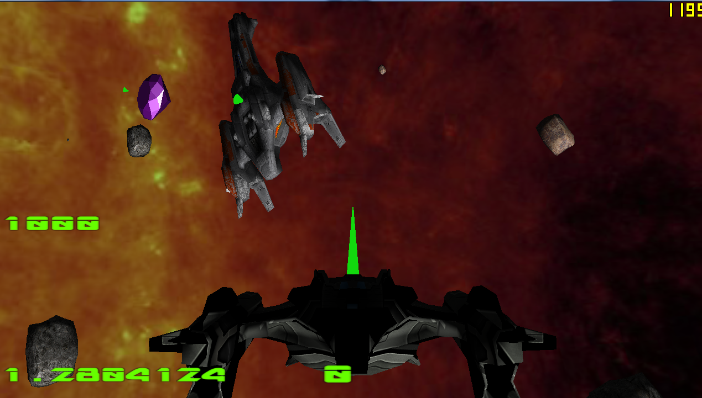
After considerable effort…

Slide 7
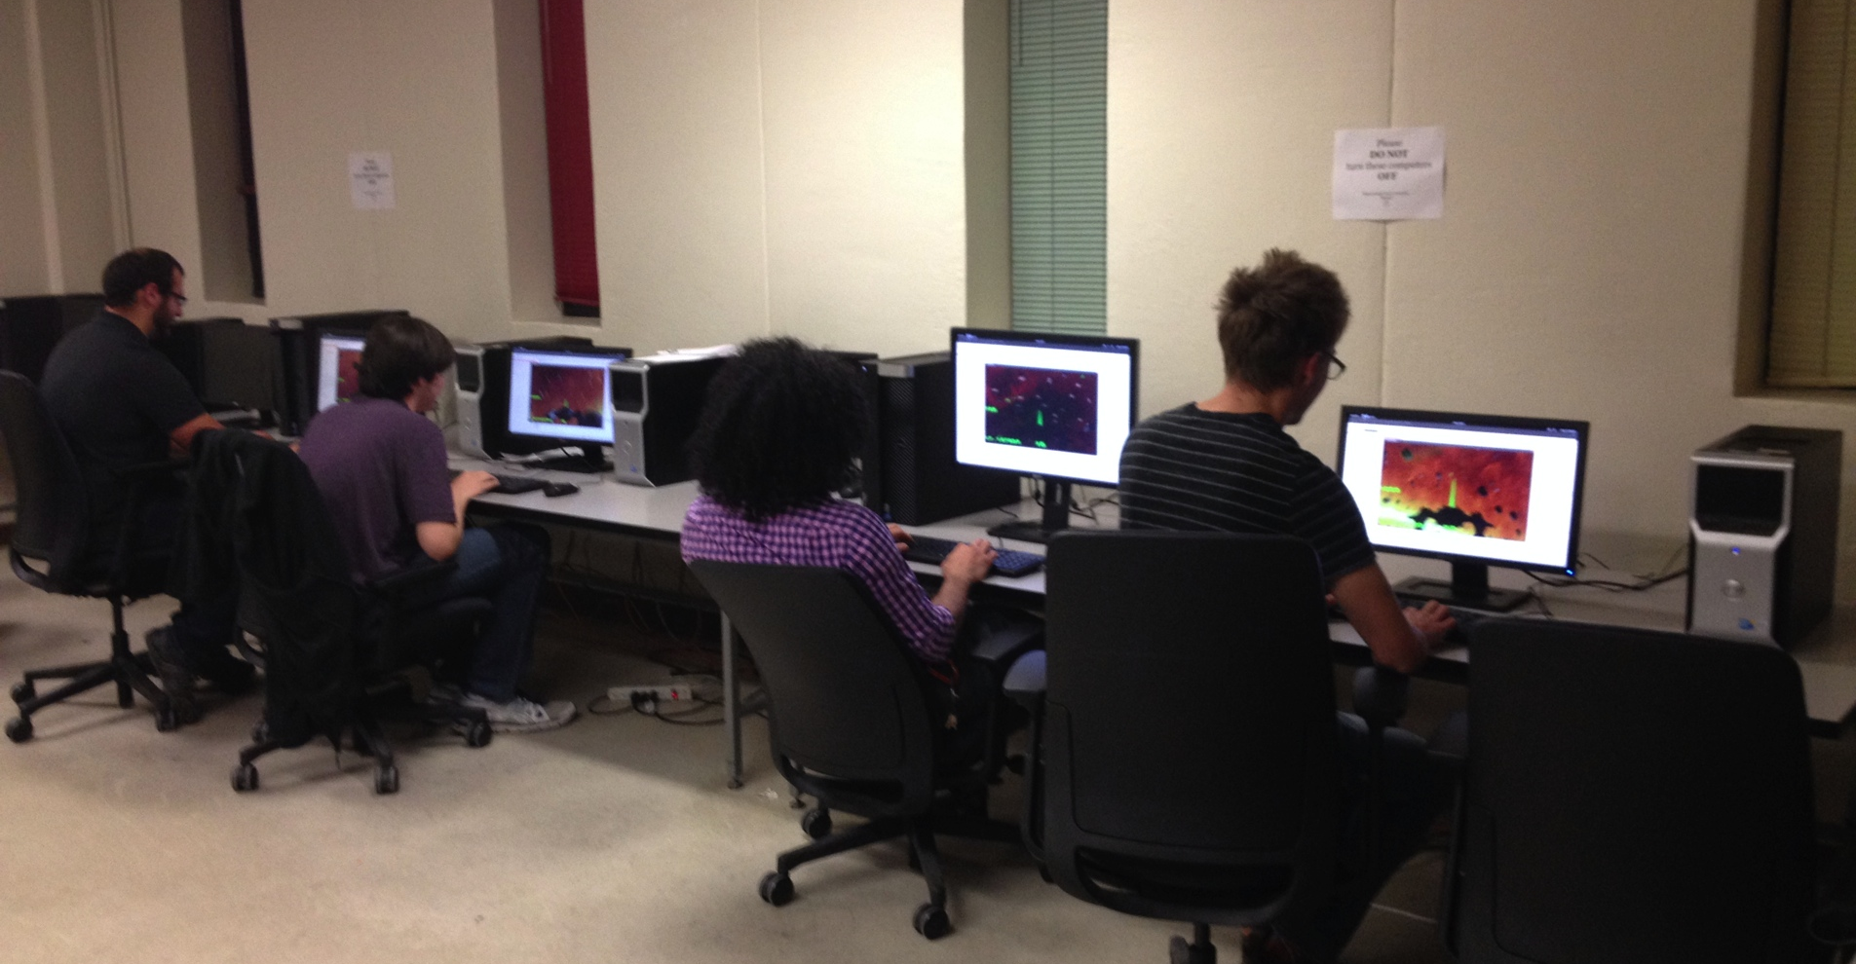
Everyone loves it

Slide 8
DEMO

