Slide 1

P . Nanda kishore Reddy

Slide 2
MY topic is about

Slide 3


Slide 4


Slide 5
ABBRIVATION OF SALT SPEECH APPLICATION LANGUAGE TAGS

Slide 6
INTRODUCTION
Speaking and listening is so fundamental that people take it for granted. Everyday people ask questions. They give instructions. Speaking and listening are necessary for learning and training, for selling and buying, for persuading and agreeing, and for most social interactions. For the majority of people, speaking and understanding spoken speech is simply the most convenient and natural way of interacting with other people.

Slide 7
So, is it possible to speak and listen to a computer ?
Yes
Emerging technology enables users to speak and listen to the computer now. Speech recognition converts spoken words and phrases into text, and speech synthesis converts text human-like spoken words and phrases.
While speech recognition and synthesis have long been in the research stage, three recent advances have enabled speech recognition and synthesis technologies to be used in real products and services:
(1) faster, more powerful computer technology,
(2) improved algorithms using speech data captured from the real world, and
(3) improved strategies for using speech recognition and speech synthesis in conversational dialogs enabling users to speak and listen to the computer.

Slide 8
need for speaking and listening to a computer
Speech applications enable users to speak and listen to a computer despite physical impairments such as blindness or poor physical dexterity. Speaking enables impaired callers to access computers. Callers with poor physical dexterity (who cannot type) can use speech to enter requests to the computer.
The sight-impaired can listen to the computer as it speaks. When visual and/or mechanical interfaces are not an option, callers can perform transactions by saying what they want done and supplying the appropriate information. If a person with impairments can speak and listen, that person can use a computer to bypass the limitations of small keyboards and screens. As devices become smaller, our fingers do not. Keys on the keypad shrink often to the point where people with thick fingers press two or more keys with one finger stroke. The small screens on some cell phones may be difficult to see, especially in extreme lighting conditions. Even PDAs with QWERTY keyboards are awkward.

Slide 9
if the device has no keyboard !
Many devices have no keypad or keyboard. For example, stoves, refrigerators, and heating and air conditioning thermostats have no keyboards. These appliances may have a small control panel with a couple of buttons and a dial. The physical controls are good for turning the appliance on and off and adjusting its temperature and time.
Without speech, a user cannot specify complex instructions such as, “turn the temperature in the oven to 350 degrees for 30 minutes, then change the temperature to 250 degrees for 15 minutes, and finally leave the oven on warm.” Without speech, the appliance cannot ask questions such as, “When on Saturday morning do you turn the heat on ?” Any sophisticated dialog with these appliances will require speech input. And speech can be used with rotary phones, which do not have a keypad.

Slide 10
Real life Scenario's like…
While people work with their hands and eyes separately
Speaking and listening are especially useful situations where the caller’s eyes and/or hands are busy. (Although is it not recommended that you hold and use a cell phone while driving a car.)
at anytime during the day
Many telephone help lines and receptionists are available only during working hours. Computers can automate much of this activity by 24 hours a day, 7 days a week via a telephone by speaking and listening to a computer.
with instant connection without being on “hold”
using languages that do not lend to keyboarding .
to convey emotion.

Slide 11
Solution
for all the above mentioned speech application SALT(Speech Application Language Tag) is the better solution. Reuse of application logic, rapid development and speech+GUI application are the major benefits of SALT.

Slide 12
The SALT specification contains a small number of XML elements enabling speech output to the user, called prompts, and speech input form the user, called responses. SALT elements include:
<prompt>—presents audio recordings and synthesized speech to the user. SALT also contains a prompt queue and commands for managing the presentation of prompt on the queue to the user.
• Simple TTS prompt
<salt:prompt id = "Welcome">
Welcome to your SALT application.
What would you like to do?
</salt:prompt>
• Pre -recorded audio
<salt:prompt id = "RecordedPrompt">
<content href = "welcome.wav"/>
</salt:prompt>
<listen> recognizes spoken words and phrases. There are three listen modes:
Automatic—used for recognition in telephony or hands-free scenarios. The speech platform rather than the application controls when to stop the recognition facility.
Single—used for push-to-talk applications. An explicit stop from the application returns the recognition result.
Multiple—used for “open-microphone” or dictation applications. Recognition results are returned at intervals until the application makes an explicit stop.

Slide 13
Tags :_
<grammar>—specifies the words and phrases a user might speak
<dtmf>—recognizes DTMF (telephone touch-tones)
<record>—captures spoken speech, music, and other sounds
<bind>—integrates recognized words and phrases with application logic
<smex>—communicates with other platform components
<xmlns:salt> defines a namespace
<salt: prompt> defines a speech prompt
Document needs to be loaded in SALT 1.0 compatible browser. Methods such as Start() initiate SALT tags. It would say "Hello World” using a text-to-speech engine

Slide 14
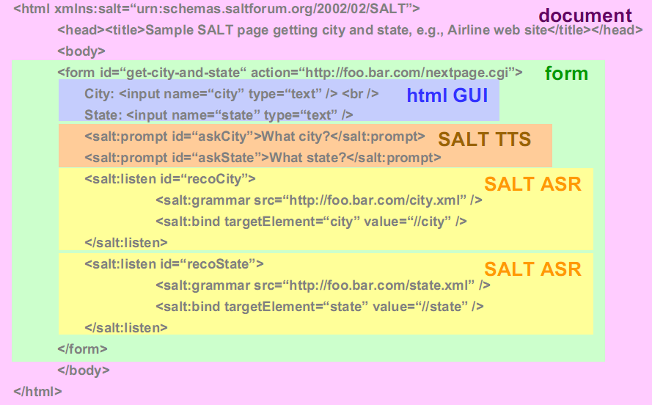

Slide 15
EXAMPLE:
</html> html xmlns:salt = "http://www.saltforum.org/2002/SALT">
<input name = "txtBoxCity type = "text" />
………….
<input name = "buttonCityListen" type = "button"
onClick = "listenCity.Start();"/>
……………
<! - Speech Application Language Tags -->
<salt:listen id = "listenCity">
<salt:grammar name = "g_city" src = "city.grxml" />
<salt:bind targetelement = "txtBoxCity" value = "//city" />
</salt:listen>
</body>

Slide 16
architectures for salt applications
Users interact with telephony applications using a telephone, cell phone, or other mobile device with a microphone and speaker. The hardware architecture for telephony applications, illustrated in
contains:
Web server—contains HTML, SALT and embedded scripts. The scripts control the
dialog flow, such as the order for playing audio prompts to the caller.
Telephony server—connects the IP network (and the speech server) to the
telephone network
Speech server—contains a speech recognition engine which converts spoken speech into text, a speech synthesis engine which converts text to human-sounding speech, and an audio subsystem for playing prompts and responses back to the user.
Client devices—device to which to user listens and speaks, such as for example mobile telephone

Slide 17
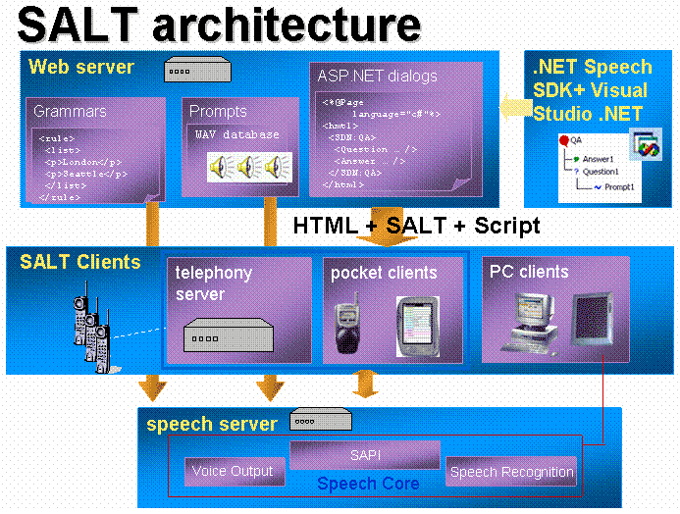

Slide 18
The various servers may be combined or replicated depending upon the workload. And the telephony server could by replaced by internet connections to speech-enabled desktop devices, bypassing the telephone communication system entirely.
Some mobile devices—and most desktop devices—have screens and input devices such as keyboard, mouse, and stylus. These devices support multimodal applications, which support more than one mode of input from the user, including keyed text, handwriting and pen gestures, and spoken speech.

Slide 19
APPLICATIONS THAT CAN BUILD WITH SALT
SALT can be used to add speech recognition.
Synthesis and telephony capabilities to HTML or XHTML based applications.
Making them accessible from telephones or other GUI–based devices such as PCs, telephones, tablet PCs and wireless personal digital assistants (PDAs).

Slide 20
conclusion
It is not clear at when this article was written if SALT will overtake and replace VoiceXML as the most widely used language for writing telephony applications. It is also not clear if SALT or some other language will become the preferred language for developing multimodal applications. The availability of high-level design tools, code generators, and system development environments that hide the choice of development language from the speech application developer may minimize the importance of programming language choice.
This presentation discussion on the Web-based distributed computing environment and elaborates how SALT can be used to implement multimodal dialog systems. How advanced dialog effects can be realized in SALT is also discussed.

Slide 21

ANY DOUBTS
Guys

Slide 22
Thank you !

