Slide 1
Experiment Plan and Framework for LLM Testing with Suricata Rules
Optimizing Accuracy, Cost, and Consistency

Slide 2
Existing Problems/Pain Points
Hallucination:
LLM generates incorrect or fabricated mappings, especially when the context is ambiguous or insufficient. Requires manual review, increasing the time and effort for validation. Ex: Execution Hypothesized by the LLM output which is not in MITRE ATTACK techniques
Output Truncation:
Long Suricata rule messages or prompts exceeding the context limit cause incomplete responses.
Context Loss:
Relevant parts of the input can be deprioritized in larger contexts, leading to suboptimal outputs.
Higher Model Costs:
Superior models like GPT-4 with larger context windows incur significant API costs. Larger batch sizes and context sizes further increase costs.
Limited Dataset Variety for Testing:
The test dataset is relatively small, with insufficient variation across rule types. Larger and more diverse datasets (100–500 alerts) are needed to generalize.
Consistency Challenges:
LLM outputs can vary across multiple runs for the same input, impacting reliability.
Embedding Limitations:
Using embeddings for context optimization might not always align perfectly with LLM predictions.
Trade-offs between accuracy and token savings require thorough evaluation.

Slide 3
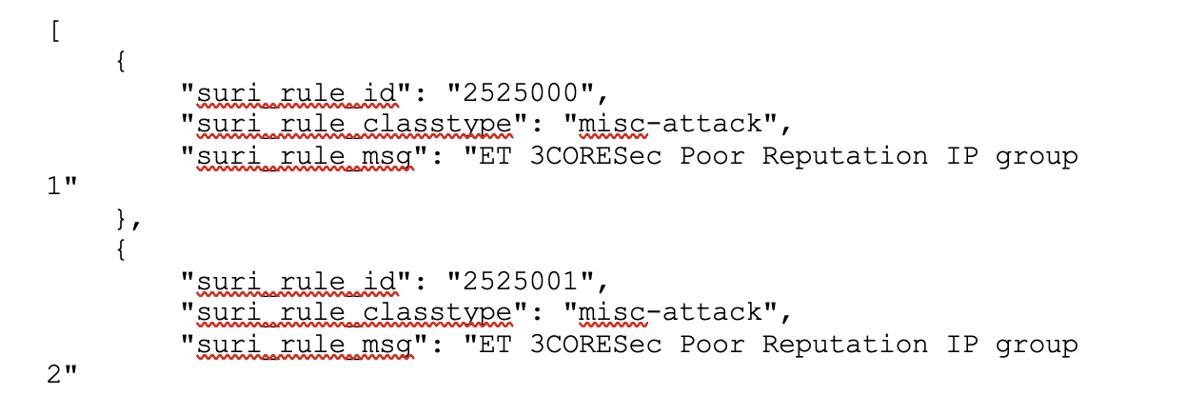
Dataset Extraction
Total Rules Processed: 40,576
Last Extracted SID: 2103157
Skipped Entries: Commented-out rules (#alerts) and malformed lines.
Number of Rule Files: 50 files.
MITRE Techniques: 50 mapped techniques.
Overview:
A Python program designed to parse .rules files and extract fields (suri_rule_id, suri_rule_classtype, suri_rule_msg).
Outputs consolidated JSON in the required format.
Features:
Extracts key fields:
suri_rule_id: Unique Rule ID.
suri_rule_classtype: Rule Classification Type.
suri_rule_msg: Description of the rule.
Handles bulk processing (multiple files) and deduplication.
Configurable to process a single file or an entire directory.
Logs processing details for transparency

Slide 4
LLM Experiments
Phase 1: Baseline Testing
Ran LLM on 50 initial test rules for 52 MITRE ATT&CK techniques.
Recorded outputs for various OpenAI models.
Performed accuracy vs. cost vs. consistency comparison using different hyperparameters.
Compared results with ground truth and developed a basic proof-of-concept.
Phase 2: Test Set Generation and Annotation
Created a diverse test set of 515 rules from 55 Suricata rule files.
Developing a Salude web app to enable cybersecurity SMEs to label LLM-generated Suricata rule mappings for 300 MITRE techniques.
Phase 3: Embedding and Hierarchical Agent Development
Building a vector embedding database for embedding retrieval across 300 MITRE rules.
Creating a set of hierarchical agents for advanced testing and evaluation

Slide 5
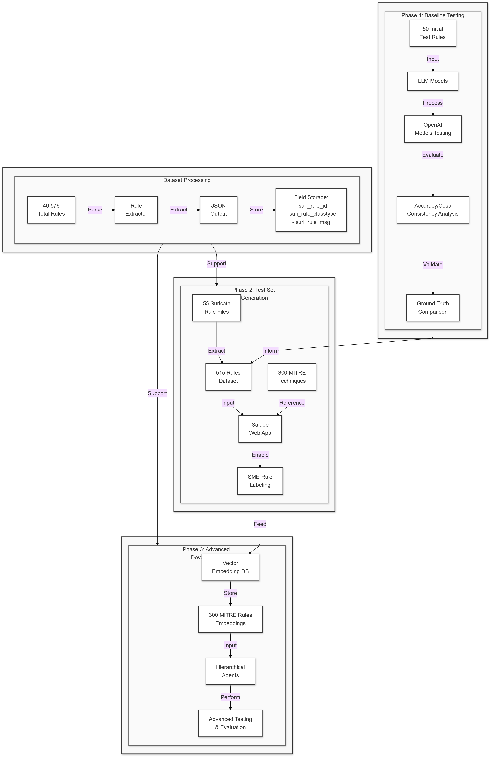
LLM Methodology

