Slide 1
Experiment Plan and Framework for LLM Testing with Suricata Rules
Optimizing Accuracy, Cost, and Consistency

Slide 2
Current Problems/Pain Points
Hallucination:
LLM generates incorrect or fabricated mappings, especially when the context is ambiguous or insufficient. Requires manual review, increasing the time and effort for validation. Ex: Execution Hypothesized by the LLM output which is not in MITRE ATTACK techniques
Output Truncation:
Long Suricata rule messages or prompts exceeding the context limit cause incomplete responses.
Context Loss:
Relevant parts of the input can be deprioritized in larger contexts, leading to suboptimal outputs.
Higher Model Costs:
Superior models like GPT-4 with larger context windows incur significant API costs. Larger batch sizes and context sizes further increase costs.
Limited Dataset Variety for Testing:
The test dataset is relatively small, with insufficient variation across rule types. Larger and more diverse datasets (100–500 alerts) are needed to generalize.
Consistency Challenges:
LLM outputs can vary across multiple runs for the same input, impacting reliability.
Embedding Limitations:
Using embeddings for context optimization might not always align perfectly with LLM predictions.
Trade-offs between accuracy and token savings require thorough evaluation.

Slide 3
Current Problems/Pain Points
Difficulty in Measuring Performance:
Standard metrics like accuracy may not fully capture the quality of predictions (e.g., partial matches or semantic alignment). Due to the difference in the LLM output wordings provided by the GPT model
Human review or similarity scoring is required for evaluation. Especially when running it for production to prevent waste API Calls.
Scalability Concerns:
Running experiments with 40,000 rules requires significant computational resources.
Latency in Larger Batches:
Processing large batches increases execution time, which may not be practical for real-time applications. finding the optimal batch size is critical.
Request for an OPENAI API key and account for help in testing and conducting the experiments.
Using the OPEN dataset which has a lesser set of rules so would make sense to decide if we want to go with a Suricata PRO or OPEN set before proceeding with the set of experiments to ensure consistency.
Mapping one Suricata rule to multiple MITRE Techniques.(This problem we will )

Slide 4
Current Problems/Pain Points
Original Test Set having Execution(Some execution tactic id’s that were present in the test set were coming wrong when we were trying to test them):
Solution: I fixed it!
Validation Against Provided Techniques:
Added a check to ensure mitre_technique_id is in the provided list of techniques.
If the ID is invalid (e.g., "Execution"), the function retries with stricter constraints.
Retry Logic:
If the first mapping fails validation, the function retries by explicitly re-prompting the AI to select only from the valid techniques list.

Slide 5
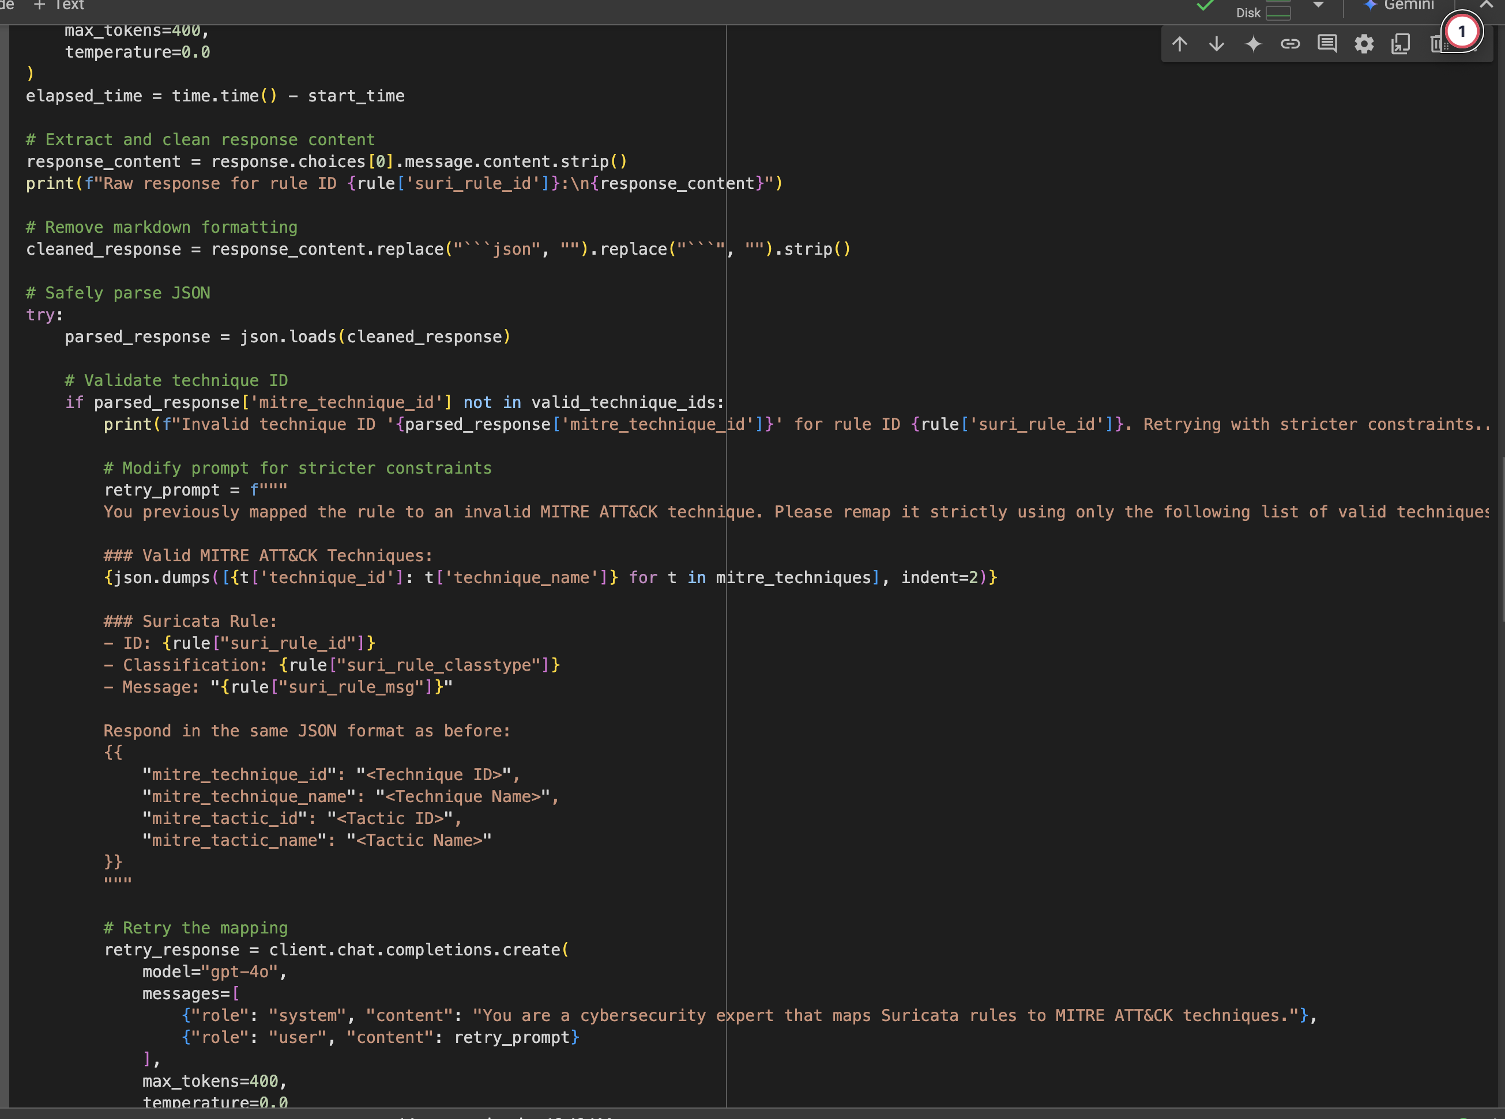
Current Problems/Pain Points

Slide 6
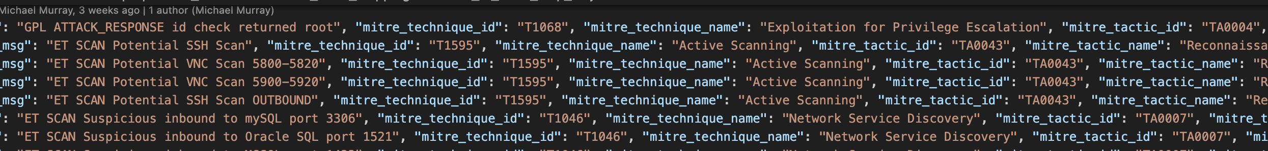
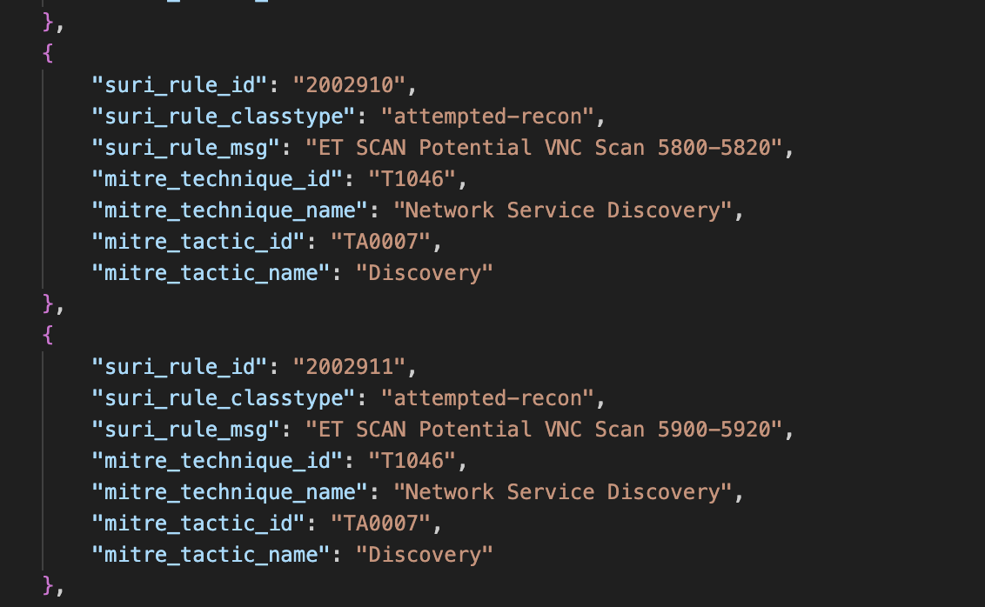
Current Problems/Pain Points
The Reconnaissance active scanning should be more specific to Discovery. Its a little open ended as a results. It can also create a lot of issues in the future mappings: The rule message ("ET SCAN Potential VNC Scan 5800-5820") and classification ("attempted-recon") suggest network-wide scanning activity, which aligns more with Reconnaissance (TA0043) and Active Scanning (T1595). The use of "SCAN" and the specified port range point to scanning behaviour rather than service-specific discovery. But I feel we use reconnaissance where we want use generalized output. It should be Discover

Slide 7
Current Problems/Pain Points
How Context Affects the Classification:
Reconnaissance (TA0043):
If the activity is broad and external, such as scanning across an entire network to locate any systems running VNC (ports 5800-5820), it aligns with Reconnaissance.
Context: The attacker does not yet have access to the network and is gathering general information.
Discovery (TA0007):
If the activity is targeted and internal, such as identifying specific details about VNC services on a particular system (e.g., version, configuration), it aligns with Discovery.
Context: The attacker already has access to the network or system and is trying to gather detailed information.
Why Context Matters:
Broad scans across multiple hosts: This points to Reconnaissance.
Detailed examination of a specific system: This points to Discovery.
Example: If the Suricata rule detects scans targeting VNC configurations on individual hosts, it could map to "Discovery." But if it detects network-wide scans to find open VNC ports, it fits "Reconnaissance."

Slide 8
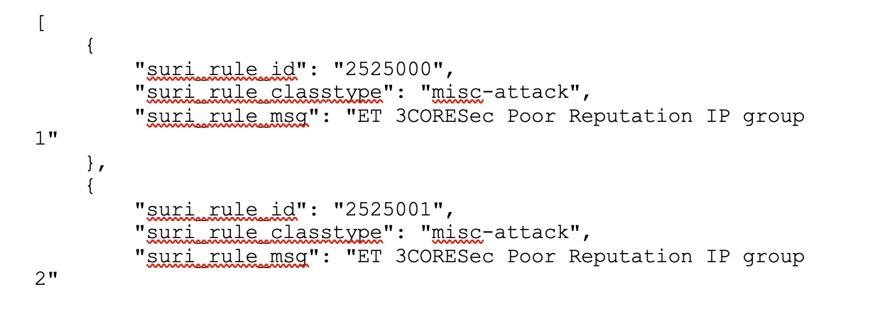
Dataset Extraction
Total Rules Processed: 40,576
Last Extracted SID: 2103157
Skipped Entries: Commented-out rules (#alerts) and malformed lines.
Number of Rule Files: 50 files.
MITRE Techniques: 50 mapped techniques.
Overview:
A Python program designed to parse .rules files and extract fields (suri_rule_id, suri_rule_classtype, suri_rule_msg).
Outputs consolidated JSON in the required format.
Features:
Extracts key fields:
suri_rule_id: Unique Rule ID.
suri_rule_classtype: Rule Classification Type.
suri_rule_msg: Description of the rule.
Handles bulk processing (multiple files) and deduplication.
Configurable to process a single file or an entire directory.
Logs processing details for transparency

Slide 9
Experiment Setup
1.1 Initial Dataset Selection
Select the first 10 or 100 Suricata rules as the sample set.
Ensure each rule contains suri_rule_msg and corresponding MITRE mapping (ground truth).
1.2 Experimental Goals
Evaluate the accuracy and consistency of LLM outputs.
Measure cost-efficiency based on API usage.
Identify optimal batch size, prompts, and context sizes.
Analyze cost estimation for running 40,000 rules.
Compare MITRE Techniques MAPPINGS included vs excluded in the prompt to solve the Hallucination problems.

Slide 10
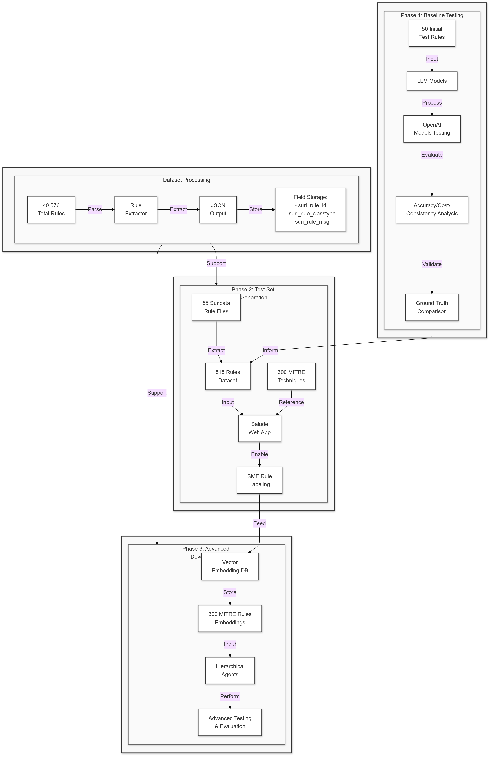
LLM Methodology

Slide 11
LLM Testing Framework
Experiment Phases:
Phase 1: Baseline Testing (Run LLM on first 10 rules, record outputs, compare with ground truth, create a testing set).
Phase 2: Batch Size Optimization (Batches of 10 and 20 rules; analyze accuracy, cost, and consistency with different models and context sizes).
Phase 3: Similarity Testing with Embeddings (Top-5 techniques retrieved, accuracy vs baseline).

Slide 12
Testing Metrics
Key Metrics
Prediction Accuracy (% correct predictions).
Consistency (outputs stable across runs).
Cost (API usage based on batch size and tokens and prompts(With and without MITRE Techniques)).
Execution Time(Maybe not important) (batch vs individual).
Reconciliation
Human intervention: Manual review of 10% predictions.
Similarity Score for reconciliation?(Will have to think about a reconciliation framework if we plan to have something automated as we don’t have a labelled set reconciliation I believe should not be possible other than human intervention but we can still explore later on)

Slide 13
Experiment Repetition
Stability Check
Repeat LLM runs multiple times, and compare the results.
Rule-Based Testing
Test 10 rules to 500 rules.
Measure cost, accuracy, breaking points, token size, temperature, different models and prompts
I want to experiment by changing the output to.json in the playground and see the performance

Slide 14
Tables and Graphs
Tables:
ChatGPT Models vs Accuracy
Batch Size Rule Optimization
Batch Size Rule vs Accuracy, Token Size, API Cost, Execution Time
Embedding Retrieval Accuracy (With vs Without)
Cost vs Accuracy (With vs Without MITRE Techniques)
Graphs:
Accuracy vs Cost
Batch Size vs Token Consumption
Cost vs Accuracy (Embedding vs No Embedding)

Slide 15
Suggested Experimentation Order
Develop an accuracy measurement script.
Baseline Testing (ChatGPT Models).
Batch Size Optimization.
Token Size Analysis.
Cost vs Accuracy (With and Without MITRE Techniques).
Accuracy vs Embedding Retrieval.
Repeated Runs for Consistency Testing.

Slide 16
LLM Hyperparameter Tuning
Response Format: Plain Text, JSON
Temperature(0-2) Controls the randomness of responses. (Examine with this.)
Lower values (e.g., 0.2) make the output more deterministic and focused.
Higher values (e.g., 1.0) introduce more randomness, making responses creative but potentially less consistent.
Max Tokens(0-16383) Will experiment with this Sets the maximum length of the AI's response. Higher values allow longer responses, while lower values can restrict verbosity.
Top P (Nucleus Sampling):(0-1) We can experiment with this: since we want it be diverse but specific as well. Adjusts the diversity of responses. The AI considers the top p probability mass of tokens for a generation.
A value of 1.0 means no filtering (full spectrum of possibilities).
Lower values limit the AI to higher-probability responses for more focused outputs.
Frequency Penalty:(0-2) 0 in our case since tokens can repeat Penalises repetitive use of tokens based on their frequency.
Higher values reduce repetition in responses.
Presence Penalty:(0-2) For us 0 is best Encourages or discourages introducing new topics in responses.
Higher values make the AI more likely to explore new ideas rather than staying within previously discussed topics.

Slide 17
I want to do this now
Create a script to measure the accuracy and generate the graphs
Solve the Execution MISMATCH we are getting(TRY WITH TWO PROMPTS INCLUDING and excluding the MITRE TECHNIQUES for 10 samples). Cost vs API calls and Accuracy.
I think to sovle the problemof getting execution we will need to include a response type of an llm agent which will take the MITRE mapping for every input as it seems to be losing out on context later on
Then I want to try with 10 vs 100 with Optimal Prompts and see the Cost vs API call.
Baseline Testing (ChatGPT Models)-Select the Best GPT model.
Then, try to build an Expense Calculation matrix to see the expected cost for the 40,000 rules

Slide 18
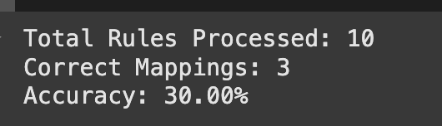
Accuracy calculation-GPT4o
{ "suri_rule_id": "2011465", "ground_truth": { "mitre_technique_id": "T1190", "mitre_technique_name": "Exploit Public-Facing Application", "mitre_tactic_id": "TA0001", "mitre_tactic_name": "Initial Access" }, "llm_output": { "mitre_technique_id": "T1059", "mitre_technique_name": "Command and Scripting Interpreter", "mitre_tactic_id": "TA0002", "mitre_tactic_name": "Execution" }
Multiple Mapping are present which changes the evaluation. So how do we take the correct evaluation metric?
It confuses between Reconnaissance and Discovery a lot due to a lack of context, T1595 vs. T1046: Broad scans vs. specific service discovery.

Slide 19
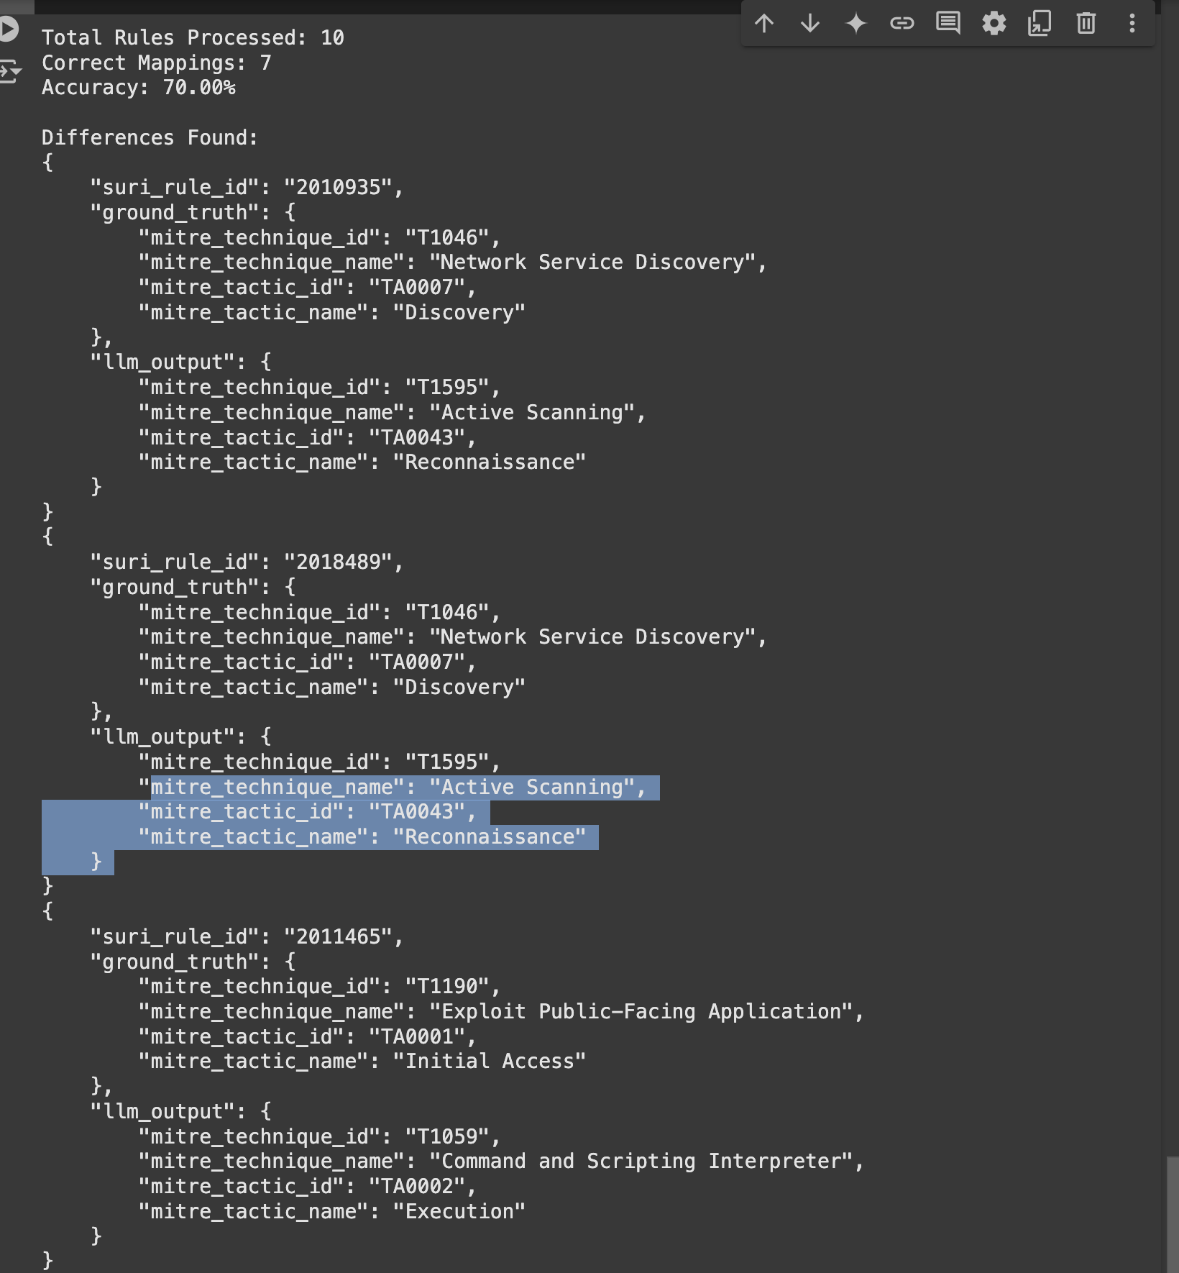
Accuracy calculation-GPT4o
Discover and Reconnaissance errors due to lack of the context the Execution is right, so the actual accuracy is 80% with this approach.
I can try to solve this but I think some discrepancy would be there since the Rule messages like "NMAP OS Detection Probe" can appear to relate to either scanning (T1595) or discovery of services (T1046). So according to me can be interpreted as either but I am open to discussion.. As without context

Slide 20
Accuracy
Model Accuracy Remarks
GPT-4o 80% High accuracy with consistent results.
GPT-4 90% Higher accuracy but wrongly processed as in GPT-4o.
GPT-4o-mini 80% Same errors as initially reproduced.
GPT-3.5-Turbo 80% Similar to GPT-4o, same initial errors.
GPT-4o-latest 60% Lower accuracy; same "Recon vs Discovery" classification errors.
GPT-4-Turbo 60% Similar to ChatGPT-4o-latest with lower accuracy.
O1 Reasoning N/A Different implementation approach; requires code and agent adjustments for compatibility.

Slide 21
Expense calculation(This is very tentative as its not
the most optimized version in terms of accuracy etc)
Category | Cost per 10 Rules | Cost for 40,000 Rules
Input (gpt-4) | $0.10 | $400.00
Output (gpt-4) | $0.03 | $120.00
Input (gpt-4o) | $0.19 | $760.00
Output (gpt-4o) | $0.03 | $120.00
Cached Input (gpt-4o) | $0.01 | $40.00
Model | Total Cost
GPT-4 | 520$
GPT-4o | 920$
The "Cached Input" represents previously processed data reused by the system, resulting in significantly reduced costs.(GPT-4 vs GPT-4o)

Slide 22
Expense calculation(This is very tentative as its not
the most optimized version in terms of accuracy etc)
Model | Input Cost (10 Rules, $) | Output Cost (10 Rules, $) | Total Cost (10 Rules, $) | Estimated Total Cost (40,000 Rules, $)
gpt-4o-mini-2024-07-18 | 0.01 | 0.01 | 0.02 | 80.00
chatgpt-4o-latest | 0.06 | 0.01 | 0.07 | 280.00
gpt-4-turbo-2024-04-09 | 0.12 | 0.02 | 0.14 | 560.00

Slide 23
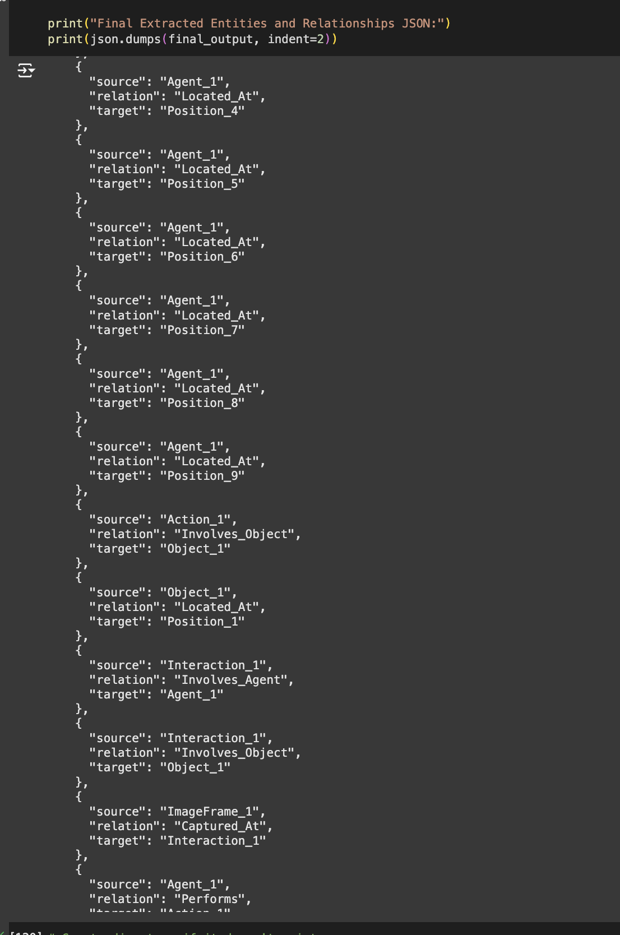

Slide 24
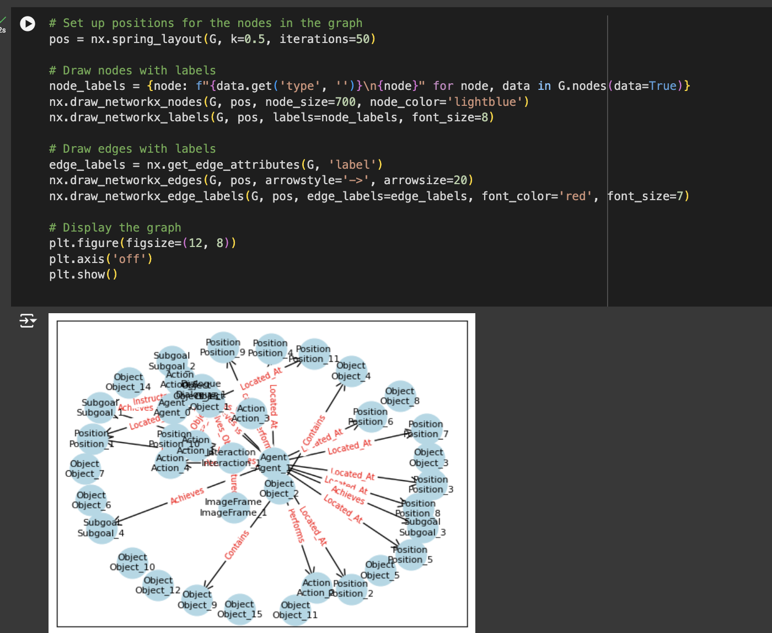

Slide 25
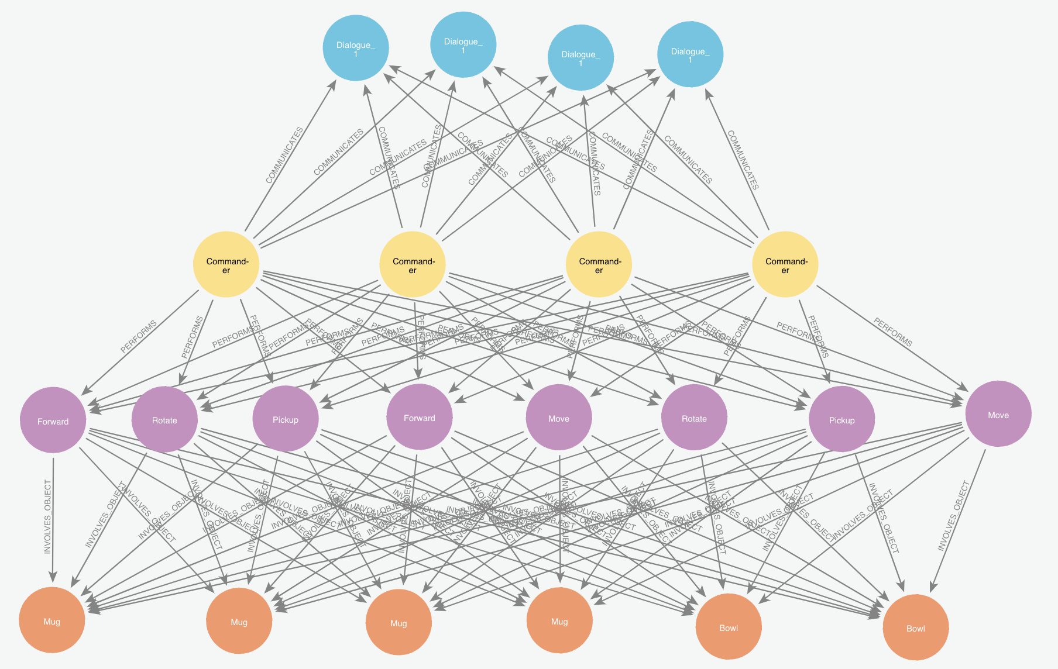

Slide 26
