Slide 1
Tank Level Control using Fuzzy Logic

Slide 2
Background
Water Level is highly important in industrial applications
Boilers in nuclear plants, etc..
Fuzzy Logic an example of Intelligent Control
Intelligent Control: class of control techniques that use AI computing approaches like ML, Neural Networks. Etc.
It is an excellent choice as mimics human control logic
Helps in converting real time problems into linguistic variables
PID is a very traditional controller that has focusses on reducing error using differentiator, integrator and proportional gains

Slide 3
Benefits Of Fuzzy Logic
employ modes of reasoning that are approximate rather than exact.
Accurately model nonlinear functions of arbitrary complexity
Perform better than the conventional PID controllers.
convenient way to map an input space to an output space.
simple to design and implement.
conceptually easy to understand , flexible

Slide 4
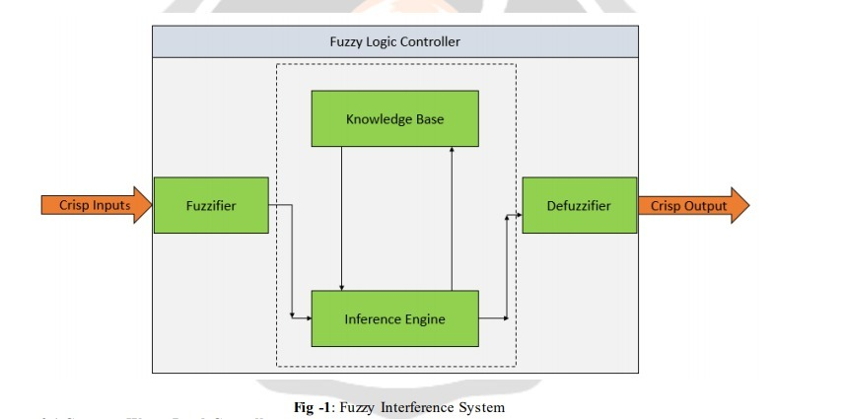
Fuzzy Logic
Notes:
Fuzzy controller Relates the state variables to action variables.
Constructed to implement the known heuristic.
Usually works with more than two input signals, the system error e(k) and the change rate in the error Δe(k).
These variables take on linguistic values which are expressed as Fuzzy subsets of the universe.
Means of control working with sentences rather than equations .
Mapping relationship using IF-THEN formalism .To sum it up, fuzzification is the transformation of numerical data from the input to linguistic terms

Slide 5
Fuzzy Logic - Fuzzification
An input variable is converted into a fuzzy variable
Each fuzzy variable consists of a group of fuzzy sets.
The fuzzification interface involves the following functions:
i) Measures the value of input variables;
ii)Performs a scale mapping
iii)Performs the function of fuzzification

Slide 6
Fuzzy Logic- Fuzzy Rules
A fuzzy system is characterized by a set of linguistic statements.
It consists of a ‘database’ and a ’rule base’.
it is easy to implement ‘rule of thumb ‘experiences and heuristics syntax of the form:
If <fuzzy proposition>, then <fuzzy proposition >
fuzzy propositions are of the form, ‘x is Y’ or ‘x is not Y’
(x being a scalar variable and Y being a fuzzy set associated with that variable)

Slide 7
Fuzzy Logic- Fuzzy Interface
Fuzzy Inference kernel is the fuzzy logic system
human decision making based on fuzzy concepts
Here, fuzzy logic principles are used to combine rules from rule base into a mapping from fuzzy input sets to fuzzy output sets.

Slide 8
Fuzzy Logic- Defuzzification
Scale mapping
Defuzzification
De-fuzzifier produces a crisp output for our fuzzy logic system

Slide 9
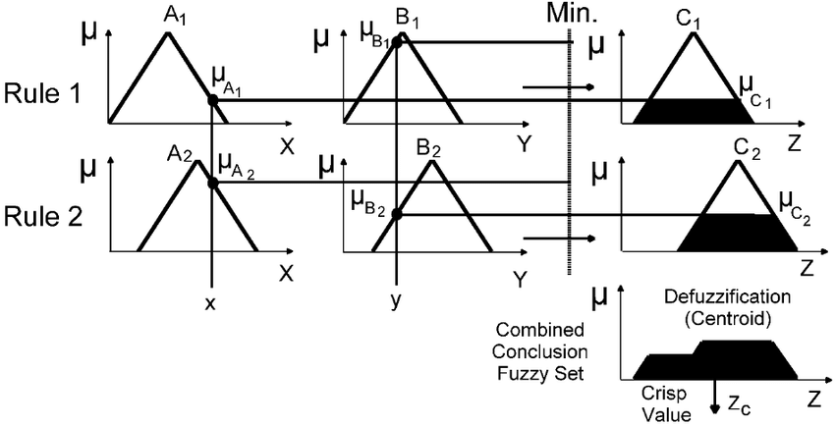
Type Of Fuzzy System Used:
Mamdani System:
Involves considerable mathematical load
More intuitive, more human like manner representation

Slide 10
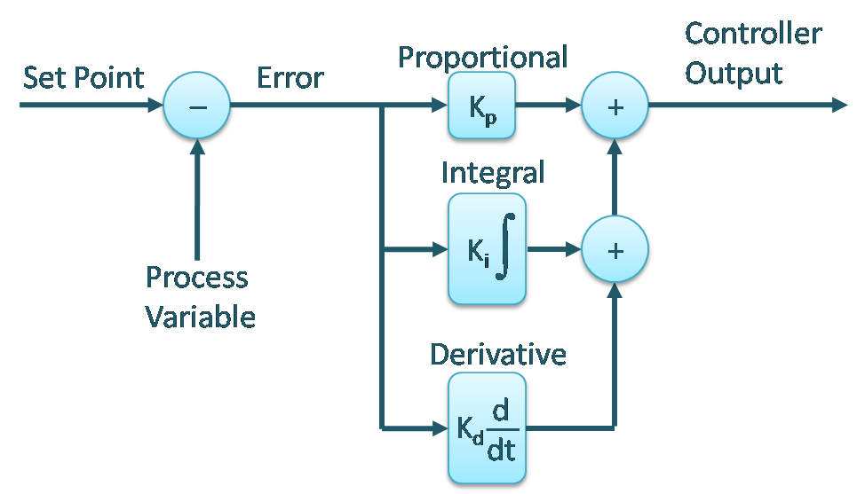
PID

Slide 11
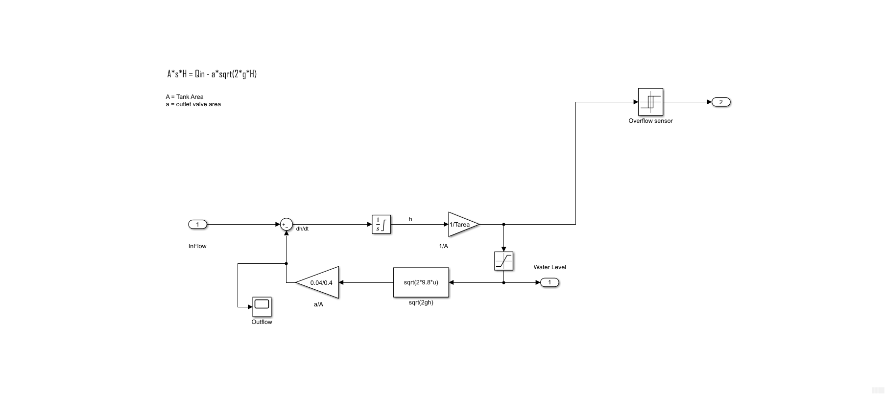
Tank Modelling
Height | 10 m
Tank Base Area | 0.4m^2
Outflow Valve Area | 0.04m^2
Type | Continuous

Slide 12
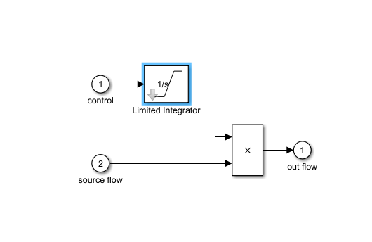
Valve Modelling
Maximum Valve Flow Rate | 2m^3/sec
Valve Type | Integrating

Slide 13
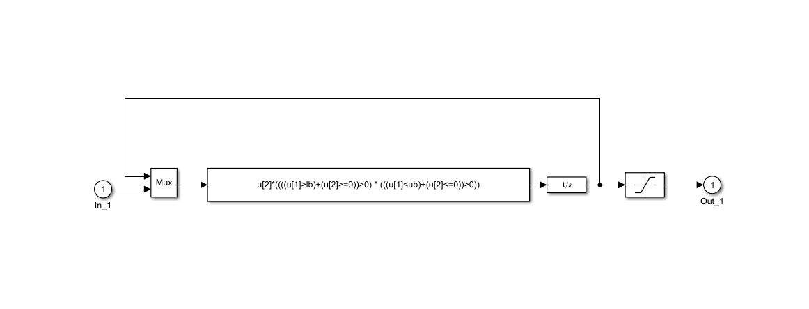
Valve Modelling

Slide 14
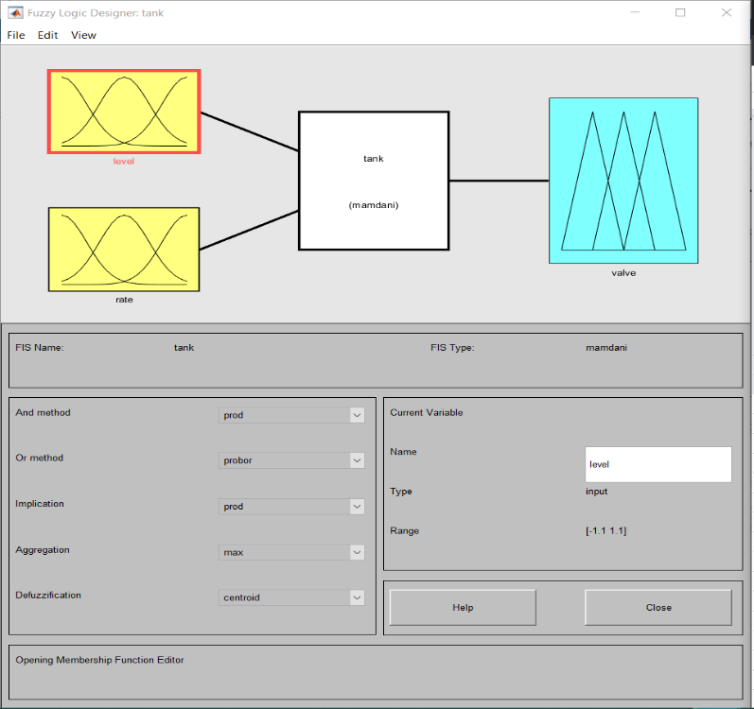
Design of Fuzzy Logic Controller
FIS TYPE: Mamdani
AND Method: PRODUCT
OR Method: PROBOR
IMPLICATION: PROD
AGGREGATION: MAX
DEFUZZIFICATION: CENTROID
No. Of Inputs: 2 No. Of Outputs: 1
Input – 1: Error in Level of Water
Range: [-1.1,1.1]
Input – 2: Rate of change of level of water in tank
Range: [-0.35,0.35]
Output – 1: Controller signal [-1.1,1.1]

Slide 15
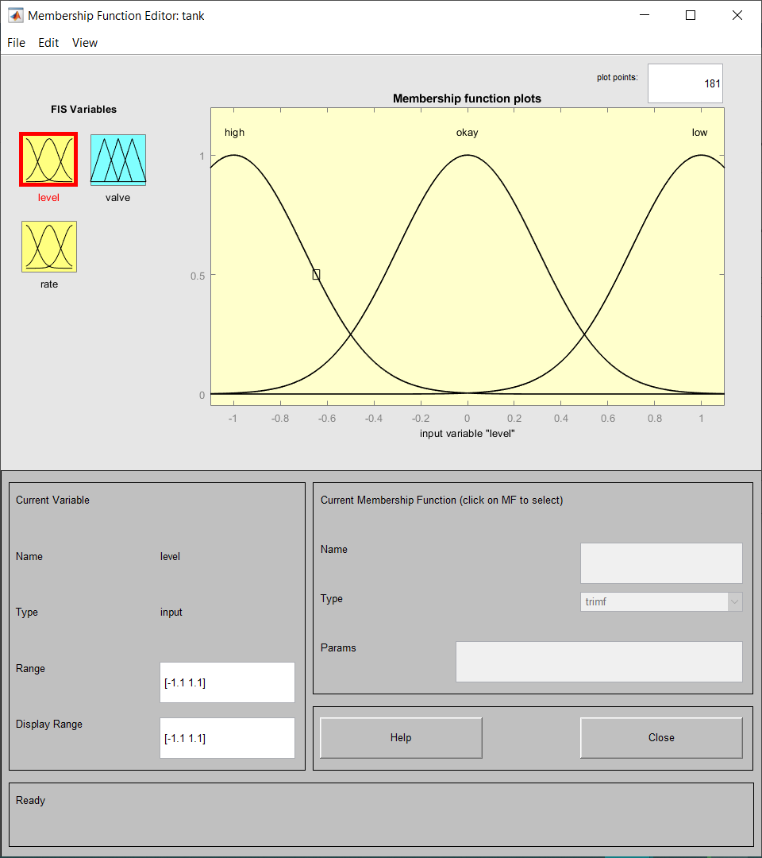
Membership Functions- I/P -1
The membership functions and ranges are given for INPUT-1:(Error in Level of Water)
3 Fuzzy Variables
Gaussmf – High, Okay, Low
[0.3 -1] – High
[0.3 0] – Okay
[0.3 1] - Low

Slide 16
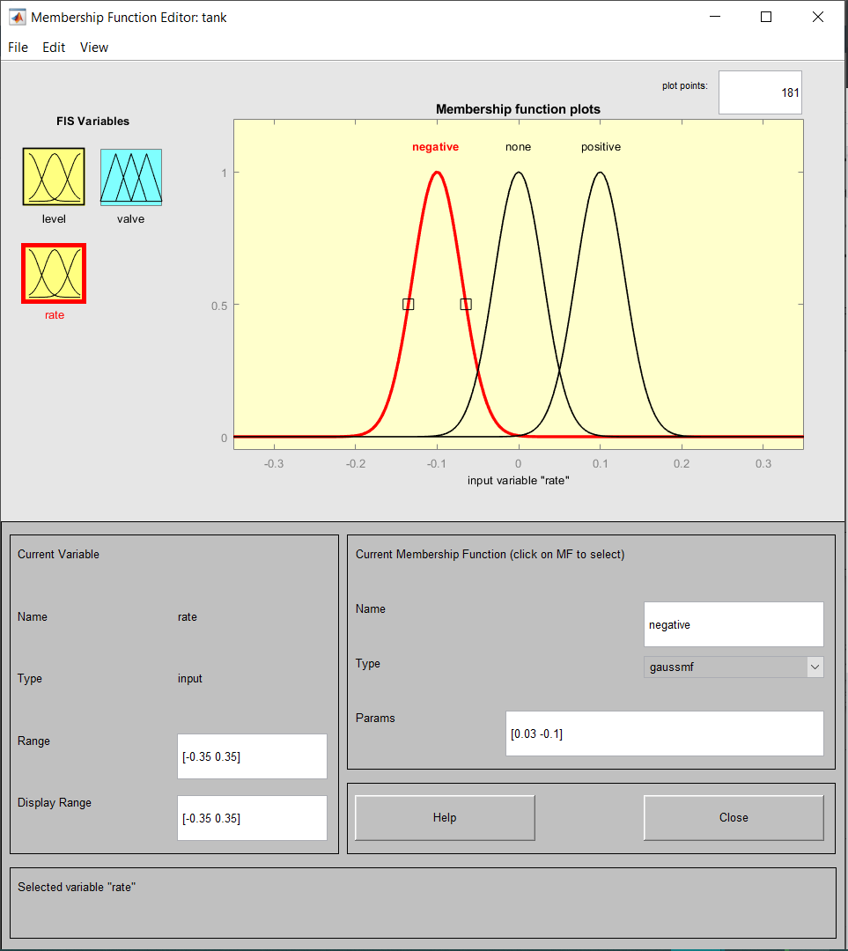
Membership Functions- I/P -2
The membership functions and ranges are given for INPUT-2 : (Rate of change of level of water in tank)
3 Fuzzy Variables
Gaussmf- Negative, none, Positive
Negative : [0.03 -0.1]
None : [0.03 0]
Positive : [0.03 0.1]

Slide 17
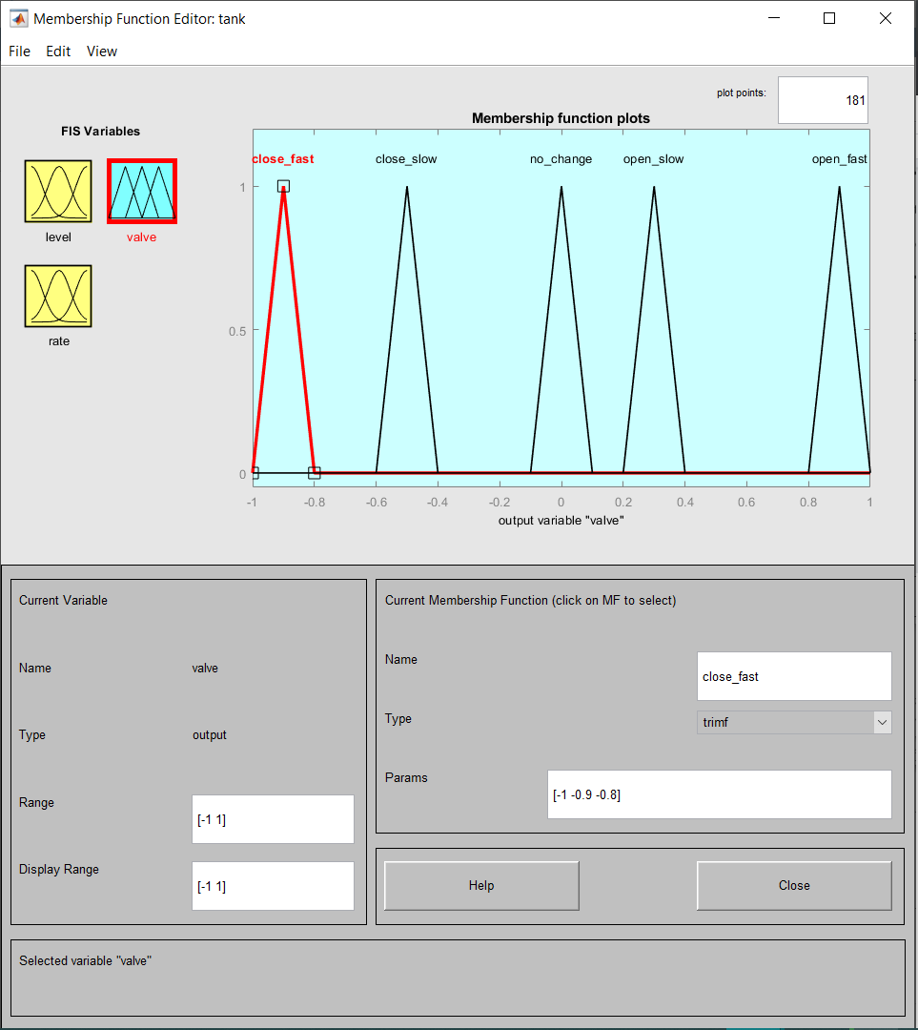
Membership Functions- O/P -1
The membership function and ranges are given for OUTPUT.
5 Fuzzy Variables
Trimf- close_fast, close_slow, no_change, open_slow, open_fast
Close_fast: [-1 -0.9 -0.8]
Close_slow: [-0.6 -0.5 -0.4]
No_change: [-0.1 0 0.1]
Open_slow: [0.2 0.3 0.4]
Open_fast: [0.8 0.9 1]

Slide 18
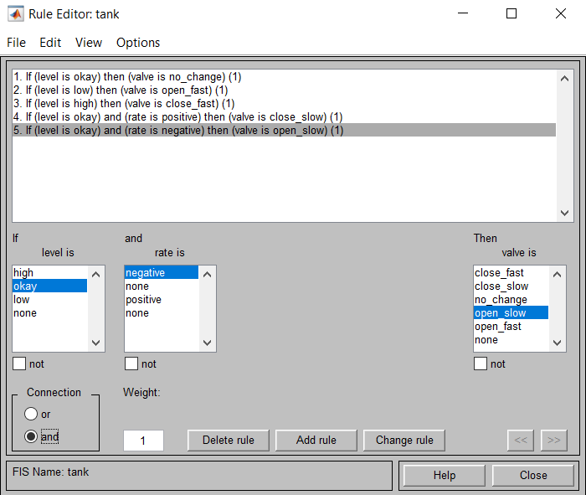
Fuzzy Rule base

Slide 19
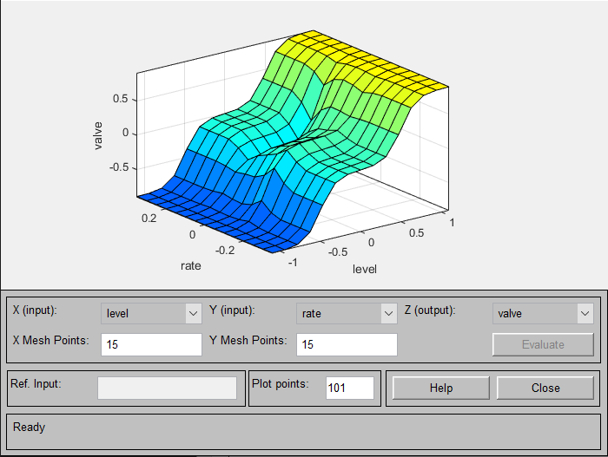
Fuzzy Rules Surface

Slide 20
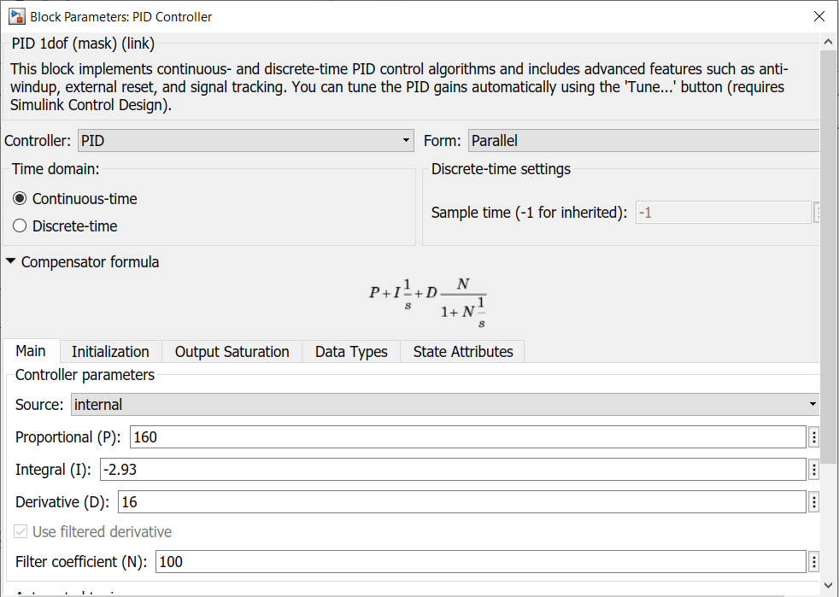
Design Of PID Controller
Proportional Gain: 160 Integral Gain: -2.93
Derivative Gain: 16
Parallel PID used

Slide 21
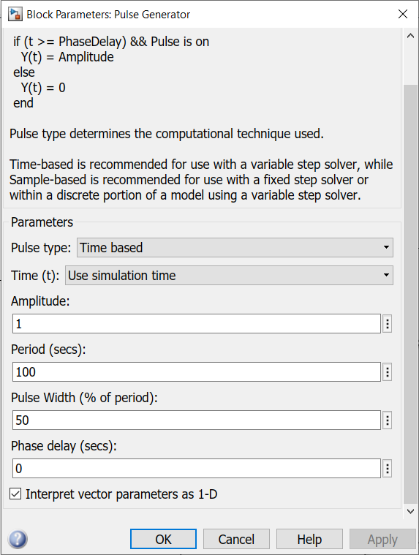
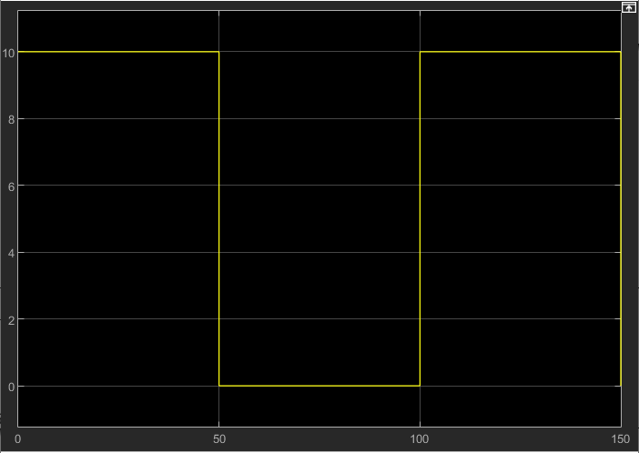
Simulations – Input Signal

Slide 22
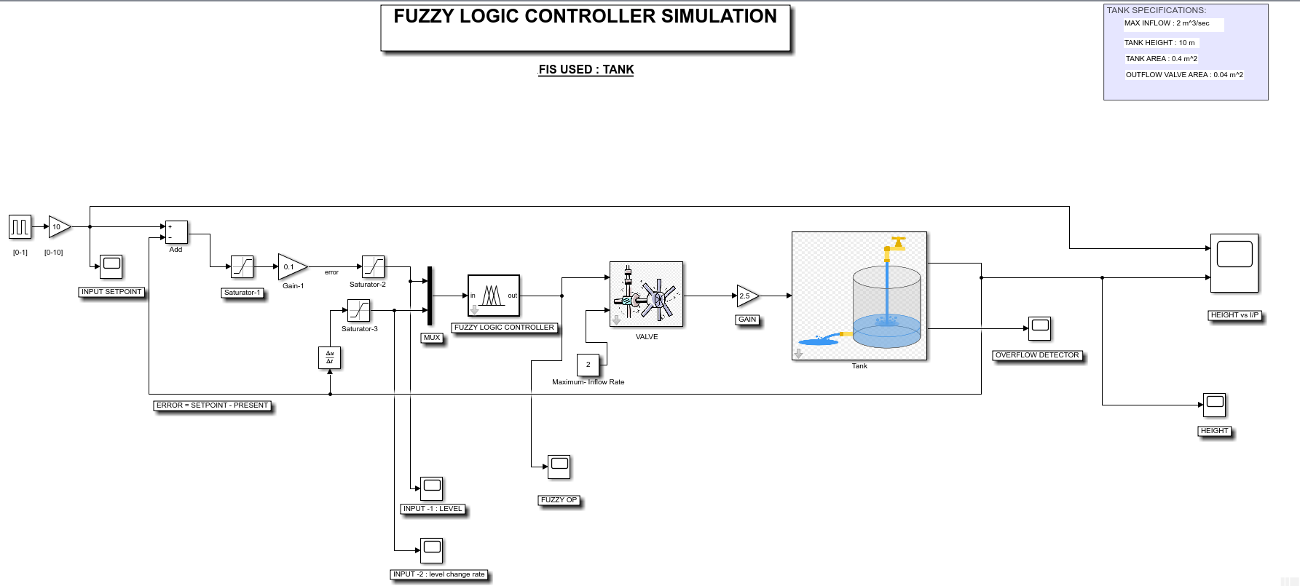
Simulation – Fuzzy Logic

Slide 23
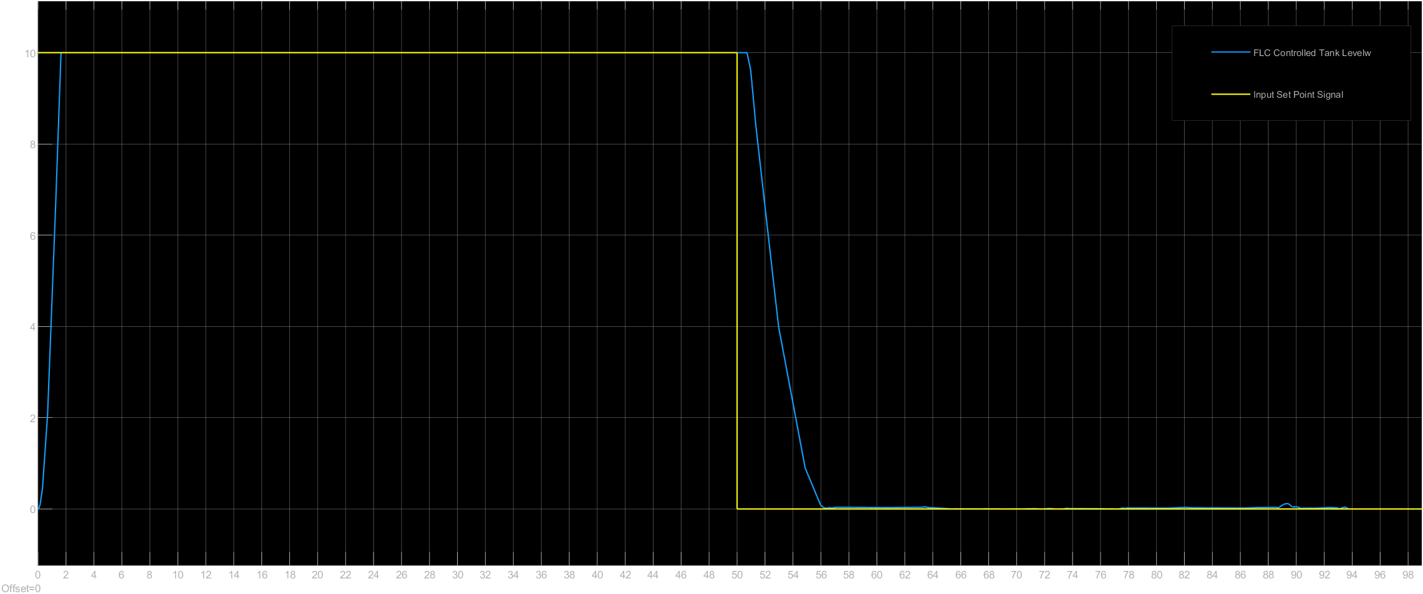
Simulation – Fuzzy Logic

Slide 24
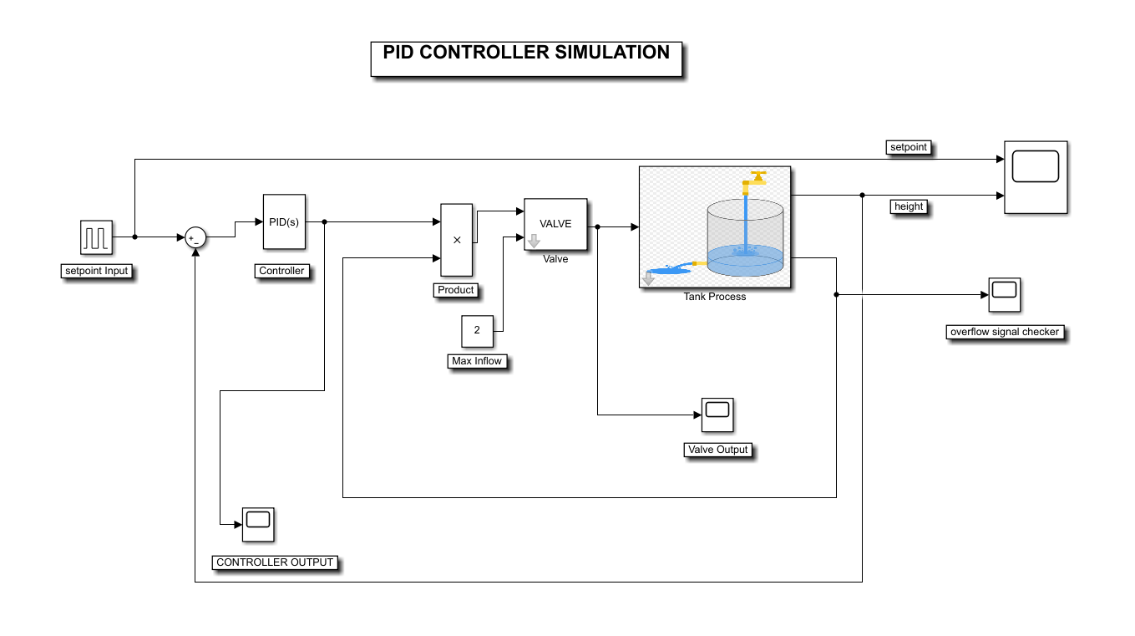
Simulation - PID

Slide 25
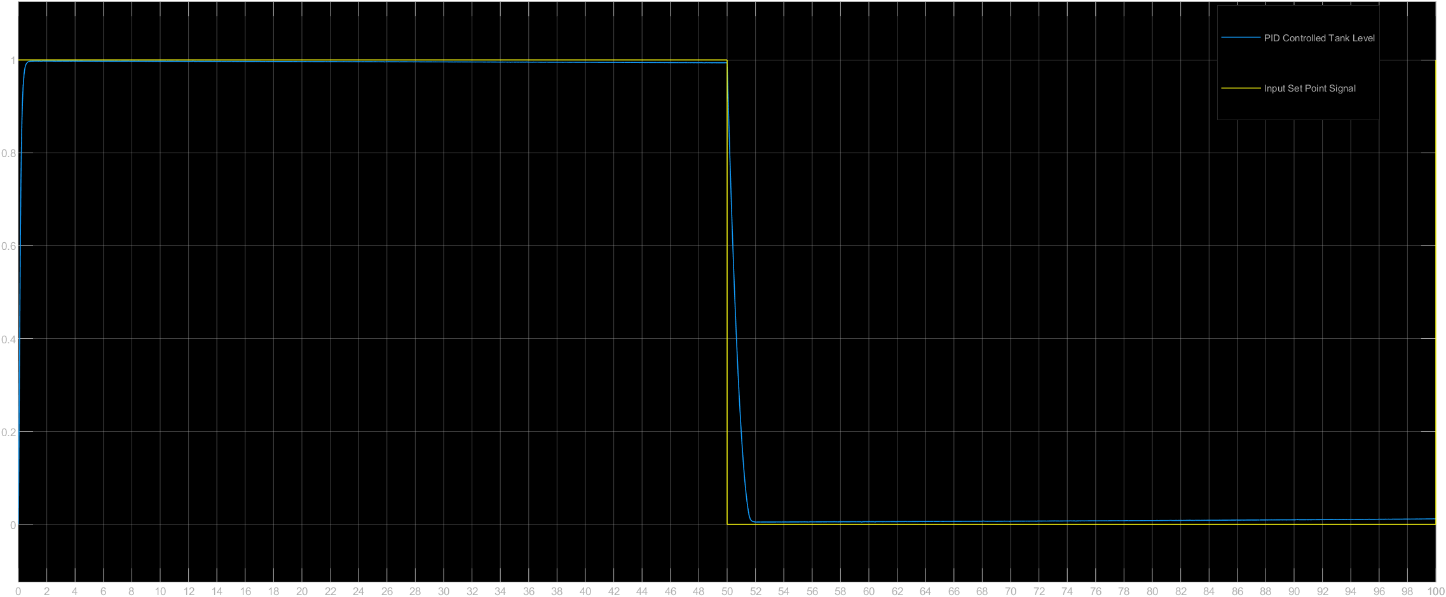
Simulation - PID

Slide 26
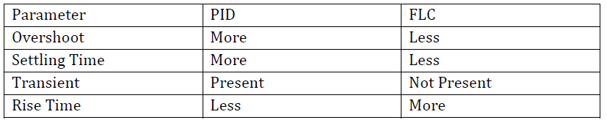
Comparisons
Fuzzy logic Controller has :
Better stability
Small overshoot
Fast response
FLC is thus conceived as a good solution for constant water level controlling application

Slide 27
Future Scopes
This unconventional control approach can be used in boiler water level and also temperature control applications of nuclear/thermal power plants.
Fuzzy Logic Control can also be implemented in a microcontroller with additional set of rules for more accurate control and can be used in various applications in industry and household.
The controller can also be tested with periodically varying liquid level tracking applications

Slide 28
THANK YOU
-Group 4

