Slide 1
BE Teammate
PRODUCT OVERVIEW · 2026
TEAMS-NATIVE
TOOL-USING
AUDITABLE
PER-PERSON PRIVATE
MEMORY
RUNBOOKS
AI teammates that work inside Microsoft Teams — with tools, memory, and a paper trail.
teammate.binaryelements.com
01

Slide 2
Work is everywhere. Answers are not.
WHY NOW
01
02
03
Context is scattered
Knowledge walks
Changes are risky
Mail, chat, files and systems each hold a piece. People repeat themselves to every new tool.
The fix lives in one person's head. When they leave, the procedure leaves with them.
A bot that can act needs a gate, a record, and a way for a person to say no.
BE Teammate puts a teammate in the conversation — with the context and the controls.
BE Teammate · Binary Elements
02

Slide 3
A teammate, not a chat window
THE SHAPE
Person
Teams
Bot
Tools & memory
Answer or action
In Teams
With a persona
With tools
With memory
People talk where they already work. No new app to open.
Each bot has a role, a tone and clear boundaries.
Mail, calendar, files, web, databases, servers, APIs and MCP.
Learns the person, the team and the procedure.
BE Teammate · Binary Elements
03

Slide 4
Two kinds of teammate
THE PORTFOLIO
SB
Service bots
PA
Personal assistants
Shared by a team or department. Depth for a domain.
One per allowed person. Private by default.
Runbooks and shared notes
Connections to real systems
Changes need a confirmation card
Examples: IT, finance, HR, sales
Only in the owner's 1:1 chat
Acts as the owner in Microsoft 365
Own memory and learnings
Separate Personal assistants section
Same engine, different privacy and scope.
BE Teammate · Binary Elements
04

Slide 5
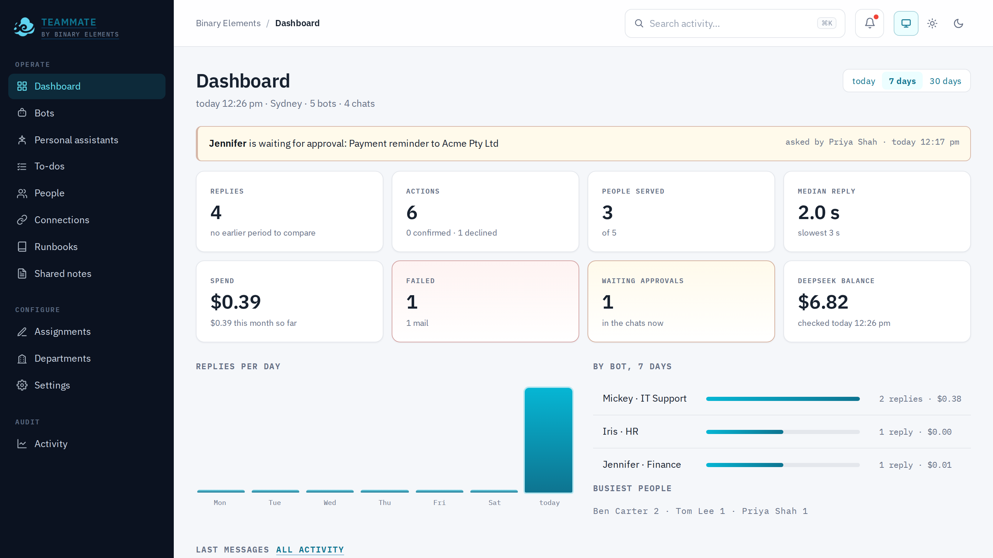
One admin surface for the whole fleet
OPERATE · CONFIGURE · AUDIT
OPERATE
Dashboard
Bots
Personal assistants
To-dos
People
Connections
Runbooks
Shared notes
CONFIGURE
Assignments
Departments
Settings
AUDIT
Activity
Operate, configure, audit — the same screen for every bot.
BE Teammate · Binary Elements
05

Slide 6
The capabilities
01
What a teammate can know, reach, change, remember and report.

Slide 7
Service bots: depth for a team
BE TEAMMATE
01
02
03
Knows the procedure
Reaches the systems
Asks before changing
Runbooks and shared notes are searched before the bot acts. It quotes the evidence.
SSH, SQL, HTTP and MCP connections, scoped per bot and per action.
Read-only checks run freely. Changes need a person and a card.
IT support
Finance
HR
Customer service
Sales
Project coordination
The bot reads the runbook, then follows it.
BE Teammate · Binary Elements
07

Slide 8
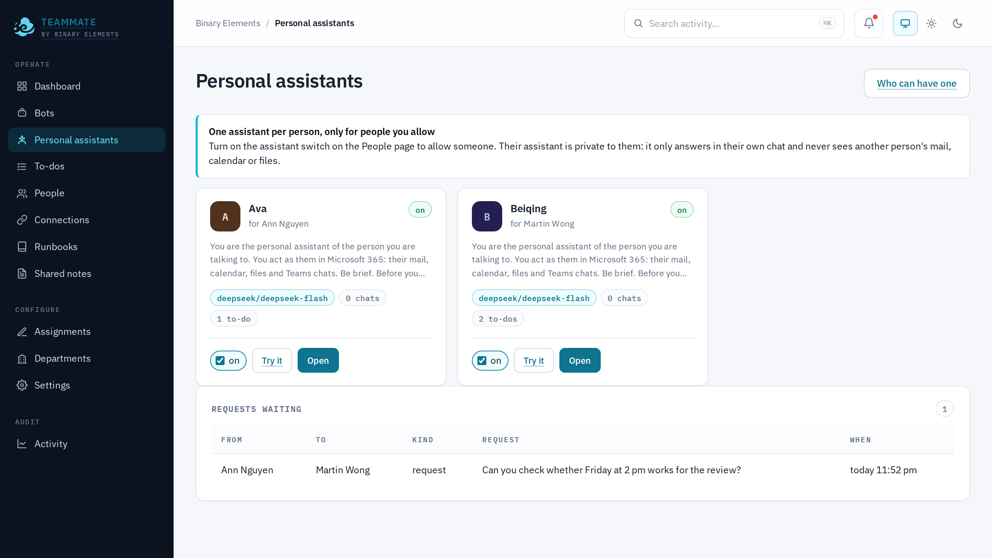
Personal assistants: one owner, one assistant
BE TEAMMATE
Only for people you allow
Private 1:1 chat
Acts as the owner in Microsoft 365
Own memory and learnings
Separate section, not mixed into Bots
Ava for Ann · Beiqing for Martin — each with its own name, model and scope.
BE Teammate · Binary Elements
08

Slide 9
The bot reads the runbook before it acts
BE TEAMMATE
01
02
03
04
Upload
Review
Test
Use
Drop in a markdown runbook.
The model reads it back: what it understood, what is missing.
Open a bot's test chat with the first message filled in.
It lives in shared notes under troubleshooting/.
Shared notes
Runbooks
The company knowledge base: searchable, versioned, editable, and available to every bot.
A procedure with symptoms, checks, evidence and escalation. A file, not a per-system workflow.
BE Teammate · Binary Elements
09

Slide 10
Reach the systems, not the whole company
BE TEAMMATE
SSH
SQL
HTTP
MCP
Servers and network devices. Read-only or change.
Postgres, MySQL and SQL Server. Query with a scoped account.
Internal APIs with headers and secrets.
Any MCP server, including OAuth sign-in.
Per-bot access · encrypted secrets · host-key pinning · revoke for every bot
BE Teammate · Binary Elements
10

Slide 11
Safe by default: the gate and the card
SAFETY
01
Classify
CHANGE
Read or change, by tool and target.
Mickey wants to restart the SBC
02
Ask
ssh_change · sbc-01 · asked by Ben Carter
A change gets a card in the chat.
Expires in 10 minutes
03
Approve
Only the asker, an admin or a head can say yes.
Approve
Decline
04
Audit
The decision, the person and the time are recorded.
If the gate cannot decide, it asks. If nobody approves, nothing happens.
BE Teammate · Binary Elements
11

Slide 12
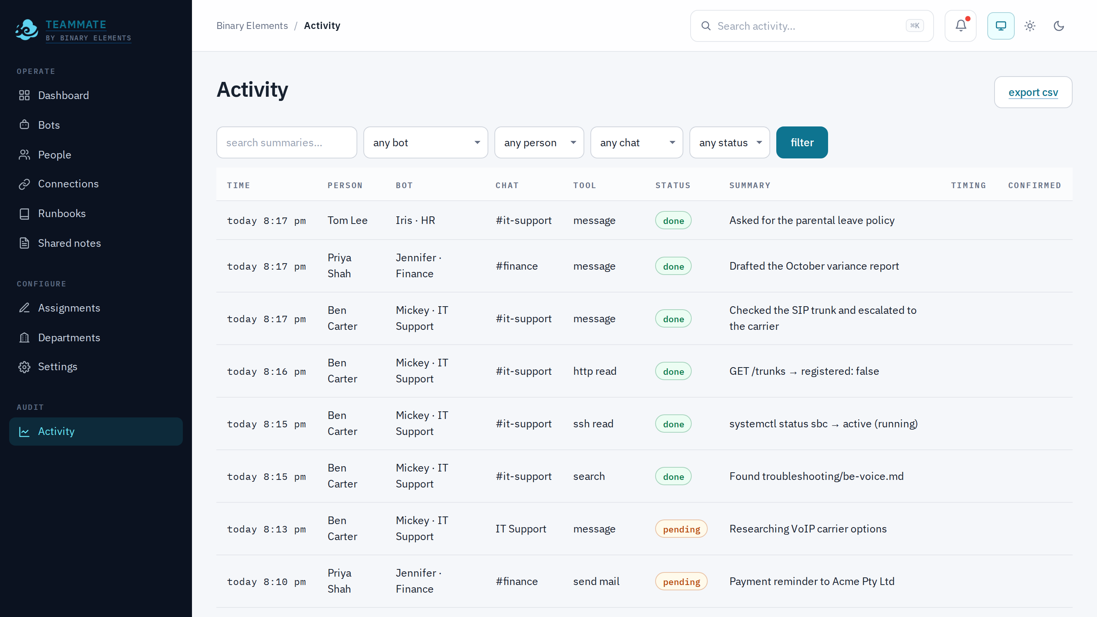
Every answer has a receipt
BE TEAMMATE
Messages
Tool calls
Confirmations
Cost
Who asked, which bot, which chat.
Name, input, status and timing.
Who approved or declined.
Per turn, per bot, per period.
Time | Person | Bot | Status | Summary
9:41 | Ben | Mickey | done | Checked the SIP trunk
9:38 | Priya | Jennifer | done | Drafted the variance report
9:28 | Jennifer | Jennifer | waiting | Payment reminder
9:24 | Mickey | Mickey | declined | Restart the SBC
Every turn, every tool, every decision.
Filter, export CSV, and see the timing of every turn.
BE Teammate · Binary Elements
12

Slide 13
Memory that scales without stuffing the prompt
BE TEAMMATE
CORE
RETRIEVED FOR THIS MESSAGE
Learnings
BE Voice: check the SIP trunk registration first
A small set of short rules. Always in the prompt. Corrections and preferences.
Carrier escalation: send the trunk id and SIP code
Melbourne firewall owner is Tom
LONG TAIL
Memory items
Prefer read-only checks on shared systems
Facts, procedures and preferences. Postgres full-text search; the top 12 relevant items per turn.
Never the whole table. The model sees only what matters now.
BE Teammate · Binary Elements
13

Slide 14
The bot reviews its own day
BE TEAMMATE
01
Review
02
Learn
03
Act
Activity, transcripts, denials and failures.
learn / update / forget; remember / update / forget.
Propose for approval, or apply and post to the group.
Modes
SAVED
Off
No reflection.
Yesterday's reflection
Propose
Learnings wait for an admin.
Caught the SBC restart, replaced the old rule, added a read-only check. Posted to the group.
Auto
Learnings apply; the bot posts what it learnt.
Per bot, per owner, at the chosen hour. One reflection per day.
BE Teammate · Binary Elements
14

Slide 15
Work that runs on its own
BE TEAMMATE
01
02
03
Reminders
Repeating routines
Background jobs
One-off, in a chat. 'Remind me at 3 pm.'
Cron: weekdays 9 am, every Monday, and so on.
Long research runs beside the chat and posts when done.
50 model calls for a chat turn · 100 for a background job · grant or confirm changes
BE Teammate · Binary Elements
15

Slide 16
Assistants can ask each other
BE TEAMMATE
with a boundary
Ava
Beiqing
Ann's assistant
ask_assistant
Martin's assistant
wants to add a to-do for Martin.
adds it, then tells Martin.
request body only
Low-risk todo
Anything else
No shared memory
Added immediately to the recipient's list.
Waits for the recipient owner's yes.
Only the request body; every request is audited.
To-dos: add, list, complete, update, delete in chat; admin To-dos page for the company.
BE Teammate · Binary Elements
16

Slide 17
The admin hears about it first
BE TEAMMATE
Alerts
DAILY · 8:00
Low DeepSeek balance
Daily report
Below the threshold you set.
Replies 42 · Actions 18 · Spend $1.24
Failed actions
Failures 2 · Balance $6.82
Tool, connection or mail failures.
Approvals waiting
Top bot: Mickey · 20 replies
A card still waiting after 10 minutes.
Busiest: Ben Carter · 8
Dashboard link
From teammate-admin@eml.binaryelements.com
Recipients and the hour live in Settings → Alerts.
BE Teammate · Binary Elements
17

Slide 18
The right model for the job
BE TEAMMATE
DeepSeek Flash
DeepSeek V4 Pro
Qwen
The value default. Fast, cheap and capable.
Hard troubleshooting and research.
A second provider. Alternative and fallback.
DEFAULT
HARD CASES
FALLBACK
OpenAI-compatible engine · per-bot model · provider profiles · fallback · no vendor lock-in
The DeepSeek balance is visible on the dashboard and in Settings.
BE Teammate · Binary Elements
18

Slide 19
Built for the questions security will ask
TRUST
01
02
03
Fail-closed gate
Confirmation cards
Full audit
Unsure means ask, never guess.
Changes need a named person.
Every call, decision and cost.
04
05
06
Secrets encrypted
Per-person privacy
SSO / OIDC
Never shown to the model.
The PA only sees its owner's chat.
Microsoft sign-in; admins and heads.
The assistant only sees its owner's 1:1 chat and Graph token. No cross-person memory.
BE Teammate · Binary Elements
19

Slide 20
What changes for the business
BE TEAMMATE
01
02
03
Faster answers
Less repetition
Safer changes
First-line resolution without waiting for a specialist.
The same question does not need the same person.
A card and a record before anything changes.
04
05
06
Knowledge retained
Full visibility
Per-person privacy
Runbooks and memory survive staff turnover.
Spend, failures, approvals and activity in one place.
Personal assistants without a shared inbox.
One teammate per team; one assistant per person.
BE Teammate · Binary Elements
20

Slide 21
Start small, prove it, expand
BE TEAMMATE
01
02
03
04
Connect
Configure
Pilot
Measure
Teams, a provider key, Microsoft 365.
One bot, one runbook, one connection.
One team, 30 days, real questions.
Resolution time, deflection, failures, spend.
Then add the next team and the next runbook.
BE Teammate · Binary Elements
21

Slide 22
Put a teammate in the conversation
BE TEAMMATE
BE Teammate · Binary Elements
Teams-native
Safe by default
Auditable
Per-person private
teammate.binaryelements.com
Book a 30-day pilot.
BE Teammate · Binary Elements
22

