Slide 1
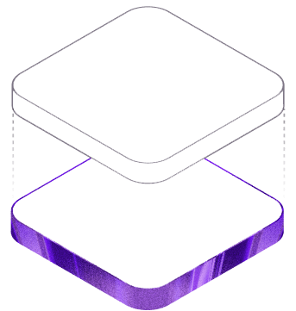
IBM BOB 2.0 HACKATHON
BridgeForge
Detect contract drift.
Synchronize dependent artifacts automatically.
An AI-powered API contract synchronization layer built around IBM Bob Shell.
Node.js / Express
Chokidar Watcher
IBM Bob Shell
React Dashboard
Backend
Bob
Docs
source of truth
sync agent
updated
Cross-stack auto-sync prototype

Slide 2
THE PROBLEM
API contract drift hides inside normal refactors
A one-field backend change can instantly make downstream artifacts disagree with the source of truth.
A “small” backend change
API docs go stale
Human-readable examples and tables still describe the old field.
products.js
const {
title
, price } = req.body;
↓ rename
const {
productName
, price } = req.body;
OpenAPI diverges
Machine-readable schemas no longer match the implementation.
Clients can mismatch
Frontend code may still bind to the previous response shape.
The backend is correct immediately. Everything that still expects `title` is now at risk.
The hard part is not changing the API — it is finding every dependent artifact.
Teams coordinate manually
Developers hunt through files, tickets, and reviews to repair drift.
Hidden coupling
BridgeForge targets the gap between “code changed” and “everything downstream caught up.”

Slide 3
THE SOLUTION
Turn IBM Bob into an automated synchronization layer
BridgeForge monitors backend changes, invokes Bob Shell, and updates dependent API documentation from the source of truth.
REAL AUTOMATION
Backend API
Watcher
IBM Bob Shell
Synchronized docs
Express routes
change contract
Node.js + chokidar
detects route changes
Headless `bob -p`
reads repo context
`docs/API.md`
`docs/openapi.json`
BOB CONTEXT
Changed file path + repository context → current contract → targeted doc edits
The prototype uses the backend implementation as the source of truth and asks Bob to update only the supported documentation artifacts.
VISUALIZATION LAYER
Contract drift
Blast radius
Before / after diff
Sync workflow
React/Vite dashboard explains impact; it is not the execution engine.

Slide 4
THE DEMO
One rename. Five visible stages.
The entire prototype is built around a repeatable `title → productName` API-contract change.
01
02
03
04
05
Healthy baseline
Backend refactor
Watcher detects
Bob synchronizes
Verify
`title` everywhere
`title → productName`
route file changed
API.md + OpenAPI
`productName` everywhere
Backend contract
Bob-updated artifacts
BEFORE
"title": "Widget A"
AFTER
"productName": "Widget A"
docs/API.md
Human-readable tables + examples
productName
docs/openapi.json
Machine-readable schema
productName
Source of truth restored across supported docs

Slide 5
THE EXPERIENCE
Make contract drift understandable, not invisible
The dashboard turns a backend mismatch into a visual story: what changed, what is affected, and what synchronization looks like.
BridgeForge — Cross-stack Auto-Sync
VISUALIZATION
Product Catalog
API Contract in Sync
Blast radius
API.md
Widget A
$9.99
Backend
stale → sync
Frontend
productName
visualized
Widget B
$19.99
OpenAPI
stale → sync
Before / after
Activity
- "title"
+ "productName"
docs/API.md • docs/openapi.json
[watcher] backend/routes/products.js changed
[bob] synchronizing docs...
[done] API contract updated
Workflow visualization — not live subagent telemetry

Slide 6
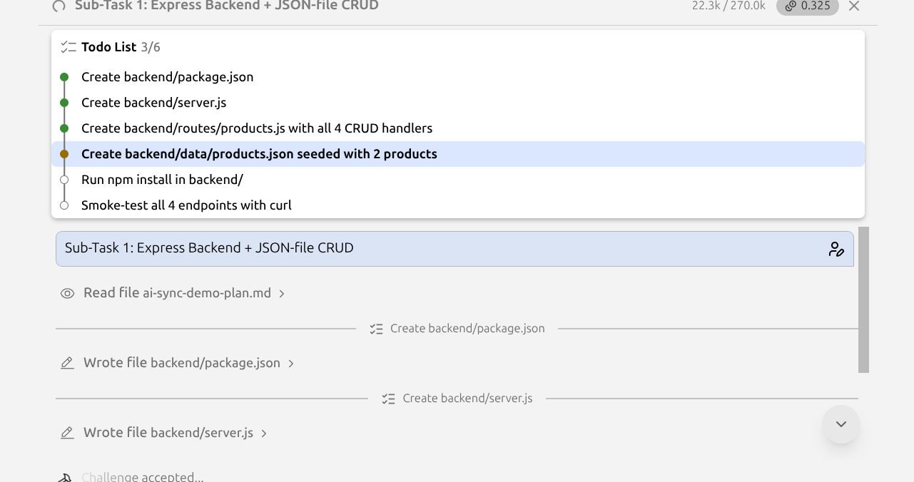
WHY IBM BOB
From interactive assistant to automation primitive
BridgeForge invokes Bob programmatically and gives it repository context so synchronization can start when the code changes — not only when a developer asks.
REAL TODAY
ACTUAL BOB SESSION
Repository context
Bob reads the changed backend source and relevant project files.
Headless invocation
The watcher calls a single `bob -p` task automatically.
Concrete edits
Bob updates `docs/API.md` and `docs/openapi.json`.
bob -p "Read backend/routes/products.js and synchronize API docs"
The key shift
Change → detection → Bob → synchronized artifacts
Actual Bob task session + headless invocation pattern used by BridgeForge
No manual chat prompt is required to start the workflow.

Slide 7
WHERE BRIDGEFORGE GOES NEXT
Docs today. Cross-stack synchronization tomorrow.
The prototype proves the trigger → context → AI edit loop; the same pattern can expand to more downstream consumers.
PROTOTYPE NOW
NEXT
VISION
Automated
Extend the blast radius
Cross-team auto-sync
Detect backend route changes
Frontend API bindings
Map dependencies across repos
Invoke IBM Bob Shell
Tests + fixtures
Delegate specialized repair tasks
Update API.md
Generated SDKs
Validate before applying changes
Update OpenAPI schema
Validation schemas
Keep contracts continuously aligned
BridgeForge makes contract drift visible — and starts fixing it automatically.
IBM Bob as the synchronization layer between code changes and dependent engineering artifacts.

