Slide 1
DATA 5300 Project 1
United Airlines Flight Delays Analysis
Notes:
Hi Everyone, Today, I’ll be presenting our analysis of United Airlines departure delays.The objective of this project was to investigate how flight departure delays are associated with different factors, including time of day, time of year, and weather conditions.Our goal was to identify patterns that could help airlines improve operational efficiency and customer satisfaction.

Slide 2
Agenda
Data and methodology
Findings of Time of Day and Time of Year
Findings of Weather-related factors
Conclusion
Notes:
We will go over the following topics: Summary of Data used and overall methodology. Then we will go over findings from statistical analysis for all 6 factors. Finally, we'll summarize the most notable findings and discuss potential operational improvements and limitations.

Slide 3
Data and Methodology
Used flights and weather datasets from nycflights13 library in R.
  flights: flights data for NY area airports in 2013
  weather: hourly weather data
Data Preparation
  Filtering and merging
    United Airlines flights
    Merged with hourly weather dataset
  Handling missing data
    Removed observations: 686 missing departure delays
    57,979 flights observations considered for analysis
Data Augmentation
  Late category → flights delayed by more than 0 minutes
  Very Late category → flights delayed by more than 30 minutes
Notes:
For this project, we used two datasets from the nycflights13 package in R.The flights dataset contains information about flights departing from three New York City-area airports in 2013, while the weather dataset contains hourly weather observations.We filtered the flight data to include only United Airlines flights and merged it with the weather data.During data preparation, we removed 686 flights with missing departure delay information, leaving us with 57,979 flights observations for analysis.We also created two categories to help us examine the severity of delays. A flight was classified as late if it departed more than 0 minutes after its scheduled departure time, and very late if it departed more than 30 minutes late.We then performed exploratory data analysis and used permutation tests to investigate whether the observed differences between groups were statistically significant.

Slide 4
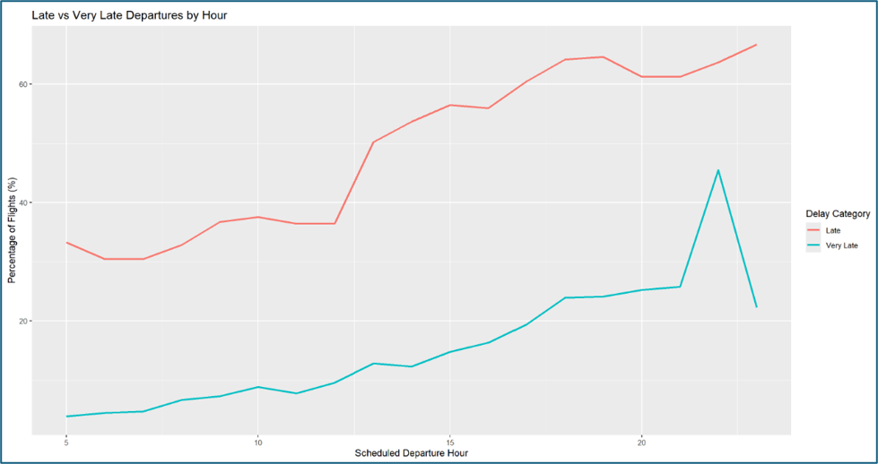
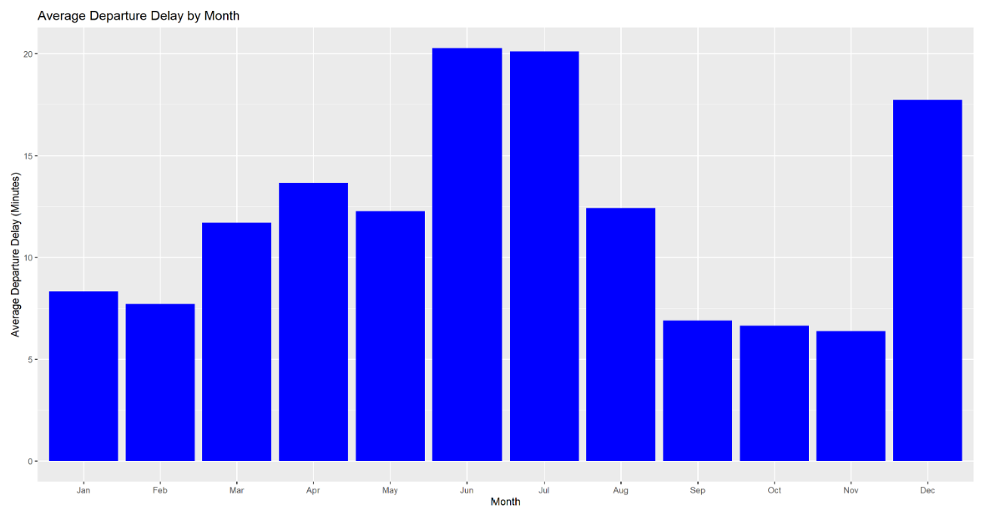
Findings
Time of Day
  Early morning: shorter average delays
  Evening: longer delays
  Difference in average delay: 18.16 minutes, Statistically significant
Time of Year
  June, July and December experienced notably longest average delays.
Notes:
First, we examined how departure delays varied throughout the day. As shown in the first chart, the proportion of late and very late departures generally increased as the day progressed. Early morning flights experienced fewer delays, while evening flights had considerably higher delay rates.
To investigate this further, we compared flights departing before noon with flights departing at 6 PM or later. We found that evening flights experienced average departure delays approximately 18.16 minutes longer than morning flights. Our permutation test provided statistically significant evidence of a difference between these groups.
Next, we looked at time of year.
The second chart shows that June and July had the highest average departure delays, at approximately 20 minutes. December also experienced notably longer delays compared with most other months.
By contrast, September, October, and November had relatively shorter average departure delays.
These findings suggest that both the time of day and time of year are associated with departure reliability.

Slide 5
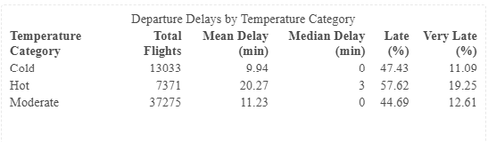
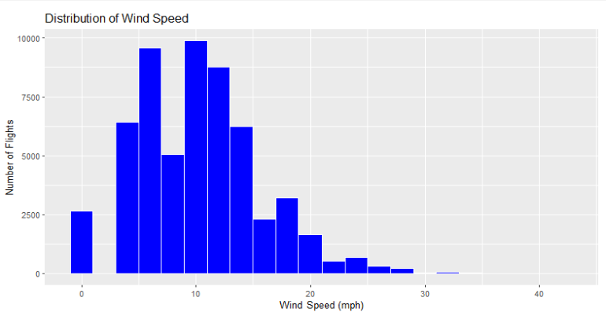
Findings
Temperature
  Cold (< 40F) vs Moderate (40F–80F) vs Hot (>80)
  Statistical evidence hot vs moderate
    12.93 percentage points higher late departures
    6.64 percentage points higher very late departures
Wind Speed
  Most flights departed under low to moderate wind conditions
  Difference between low and higher wind conditions were relatively small
Notes:
Next, we examined temperature and wind speed. For temperature, we divided flights into three categories: cold, below 40 degrees Fahrenheit; moderate, from 40 to below 80 degrees; and hot, 80 degrees or higher. As shown in the summary table, flights under hot conditions experienced longer average delays and higher proportions of late departures than flights under moderate conditions.
Specifically, hot conditions were associated with a 12.93-percentage-point higher rate of late departures and a 6.64-percentage-point higher rate of very late departures.
Both differences were statistically significant in our permutation tests.
For wind speed, the histogram shows that most flights departed under relatively low to moderate wind conditions.
Although flights experiencing higher wind speeds also had higher late-departure rates, the differences were relatively small compared with the differences observed for temperature.
This suggests that temperature showed a more notable difference in departure delays than wind speed in our analysis.

Slide 6
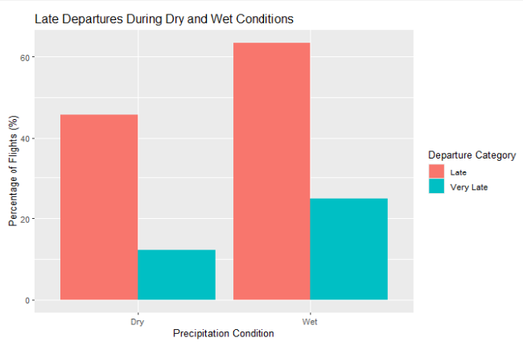
Findings
Precipitation
  Compared Dry vs Wet departures
  Significant difference in late departure
    17.7 percentage points higher late
    12.55 percentage points higher very late
Visibility
  Compared normal vs reduced visibility
  Statistically significant difference between normal and reduced visibility.
    Both late and very late had similar difference of 5.23 and 5.24 percentage points, respectively.
Notes:
We also examined precipitation and visibility. For precipitation, we compared flights departing under dry conditions with those departing when precipitation was recorded.
As the chart illustrates, flights under wet conditions experienced substantially higher late-departure rates.
Specifically, the proportion of late departures was 17.7 percentage points higher under wet conditions, while the proportion of very late departures was 12.55 percentage points higher.
Both differences were statistically significant.
For visibility, we compared flights with reduced visibility, meaning below 10 miles, against flights with visibility recorded at 10 miles.
Reduced visibility was associated with a 5.23-percentage-point higher rate of late departures and a 5.24-percentage-point higher rate of very late departures.
Although these differences were statistically significant, they were smaller than the differences observed for precipitation.
Overall, precipitation showed one of the most notable associations with departure delays among the weather-related factors examined.

Slide 7

Summary of findings
Most notable difference in departure delays
  Time of Day: Evening flights averaged 18.16 minutes more delays than morning
  Precipitation: Wet weather had 17.7 percentage points higher late rate than dry conditions
  Temperature: Hot temperature had 12.93 percentage points higher late rate than moderate temperature.
Time of year, wind speed and visibility were also associated with departure delays.
Notes:
To summarize, our analysis identified three factors associated with particularly notable differences in departure delays.
First, time of day: evening flights experienced average delays approximately 18 minutes longer than morning flights.
Second, precipitation: flights departing under wet conditions had a 17.70-percentage-point higher rate of late departures compared with dry conditions.
Third, temperature: flights departing under hot conditions had a 12.93-percentage-point higher late-departure rate compared with moderate conditions.
We also observed statistically significant differences associated with time of year, wind speed, and visibility.
These findings highlight conditions that may deserve further operational investigation.

Slide 8
Conclusion
Opportunities for operational improvements
  Investigate scheduling and staff allocations
  Review wet weather procedures
  Review hot temperature procedures
Limitation
  Analysis focused on limited data for one year and one geographical area.
Enhancements
  Expand dataset to include additional years, airports and airlines
  Include destination information or other operational factors
Notes:
Based on our findings, United Airlines could investigate opportunities to improve scheduling and staffing during evening hours, when departure delays tend to be longer.
The airline could also review its operational procedures during wet weather and periods of high temperatures to identify opportunities to improve departure reliability.
However, our analysis has limitations. We examined only United Airlines flights departing from New York City-area airports in 2013, so our findings may not generalize to other locations or years.
Additionally, our results show associations, not necessarily cause-and-effect relationships.
Future studies could include additional years, airlines, airports, and operational factors such as flight destinations and aircraft scheduling.
Overall, our analysis provides a starting point for using data to improve operational planning and the passenger experience.
Thank you.

