Slide 1
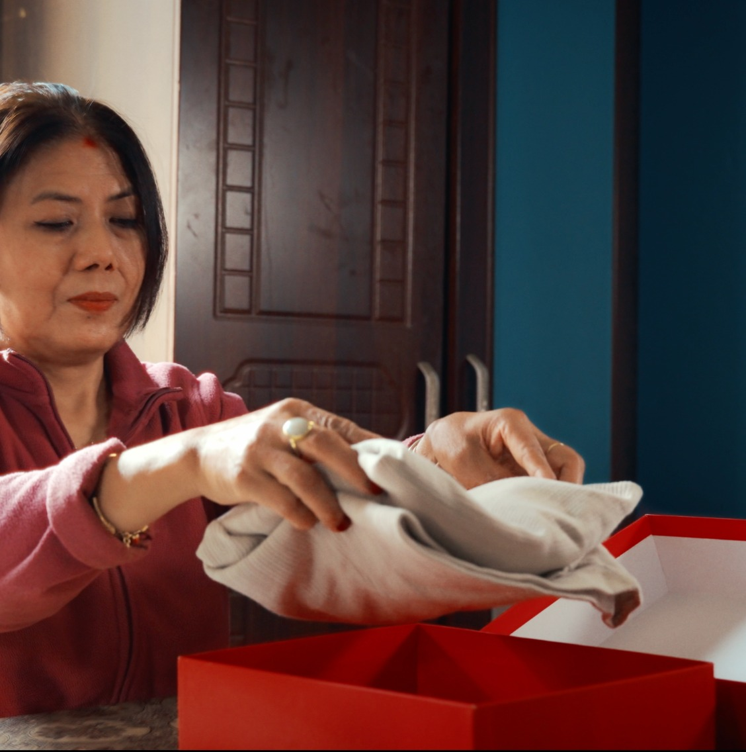
SM6P07NI DIGITAL MEDIA PROJECT
Distance
Doesn’t Matter
Dash Logistics TVC
Binay Bhattarai • 23048277
Dash Logistics TVC | Distance Doesn’t Matter
01

Slide 2

Project Overview
A short emotional TVC showing Dash as a bridge between people, not just parcels.
NO DIALOGUE
The TVC tells a simple story of a mother sending clothes, food, and a handwritten note to her son living away from home.
Final message
“Distance doesn’t break bonds.
Dash delivers what matters.”
Dash Logistics TVC | Distance Doesn’t Matter
02

Slide 3
Narrative Arc
A simple beginning–middle–ending structure designed for emotional clarity.
01
02
03
04
05
Mother packs care
Dash receives
Delivery journey
Son receives
Emotion lands
Clothes, food and note become emotional objects
Package leaves home through Dash
Scooter sequence makes the brand role visible
The package reaches him away from home
The note turns delivery into connection
Dash Logistics TVC | Distance Doesn’t Matter
03

Slide 4
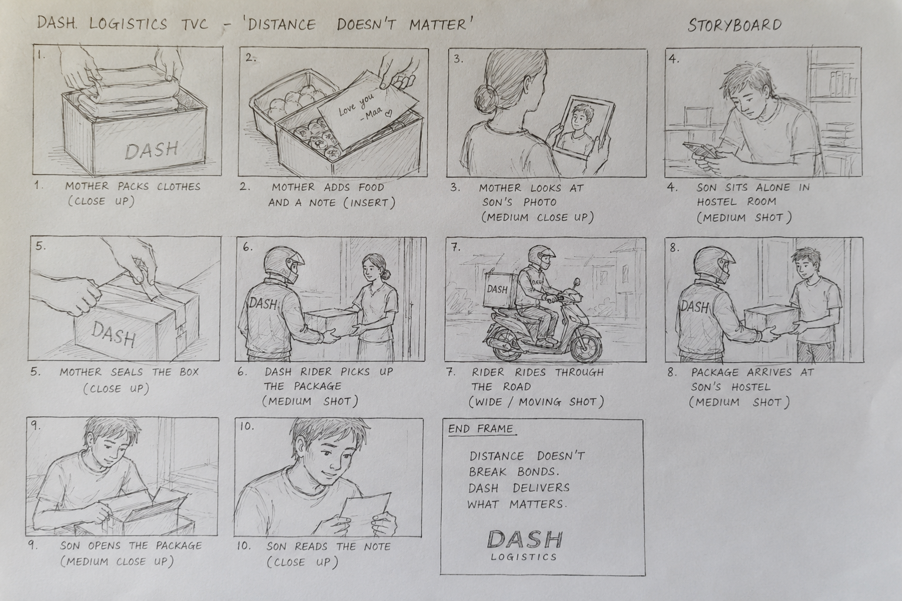
Research Direction
Research supported how the story is planned, filmed and edited without dialogue.
Emotional storytelling
Objects and reactions carry the meaning.
Camera movement
Stable shots for emotion; moving shots for delivery.
Lighting & colour
Warm home feeling contrasted with distance.
Sound design
Music and natural sounds replace dialogue.
Editing & pacing
Slow build, active delivery, quiet emotional finish.
Dash Logistics TVC | Distance Doesn’t Matter
04

Slide 5
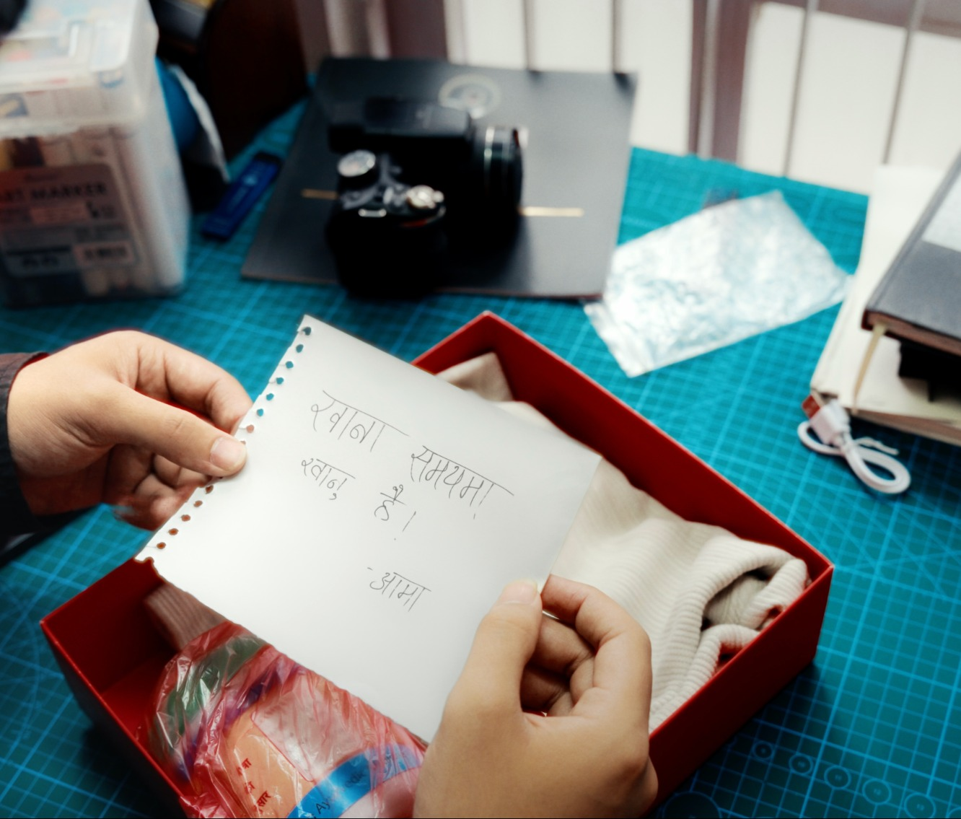
Target Audience
The story is built around people who understand distance from home.
Primary audience
Students and young adults living away from home for study or work.
Secondary audience
Parents and families who send useful items to loved ones.
Nepali family culture makes food, care and emotional support from home meaningful and relatable.
Dash Logistics TVC | Distance Doesn’t Matter
05

Slide 6
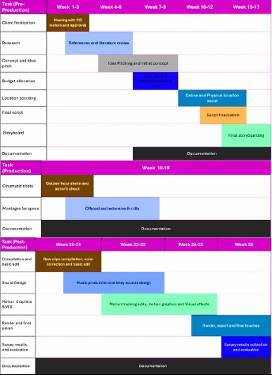
Project Plan
The plan moved from concept and research into production, post-production and feedback.
Gantt chart role
Organised pre-production, production and post-production stages.
Kept research, script, storyboard and location planning in order.
Tracked editing, sound design, colour grading, survey and final export.
Dash Logistics TVC | Distance Doesn’t Matter
06

Slide 7
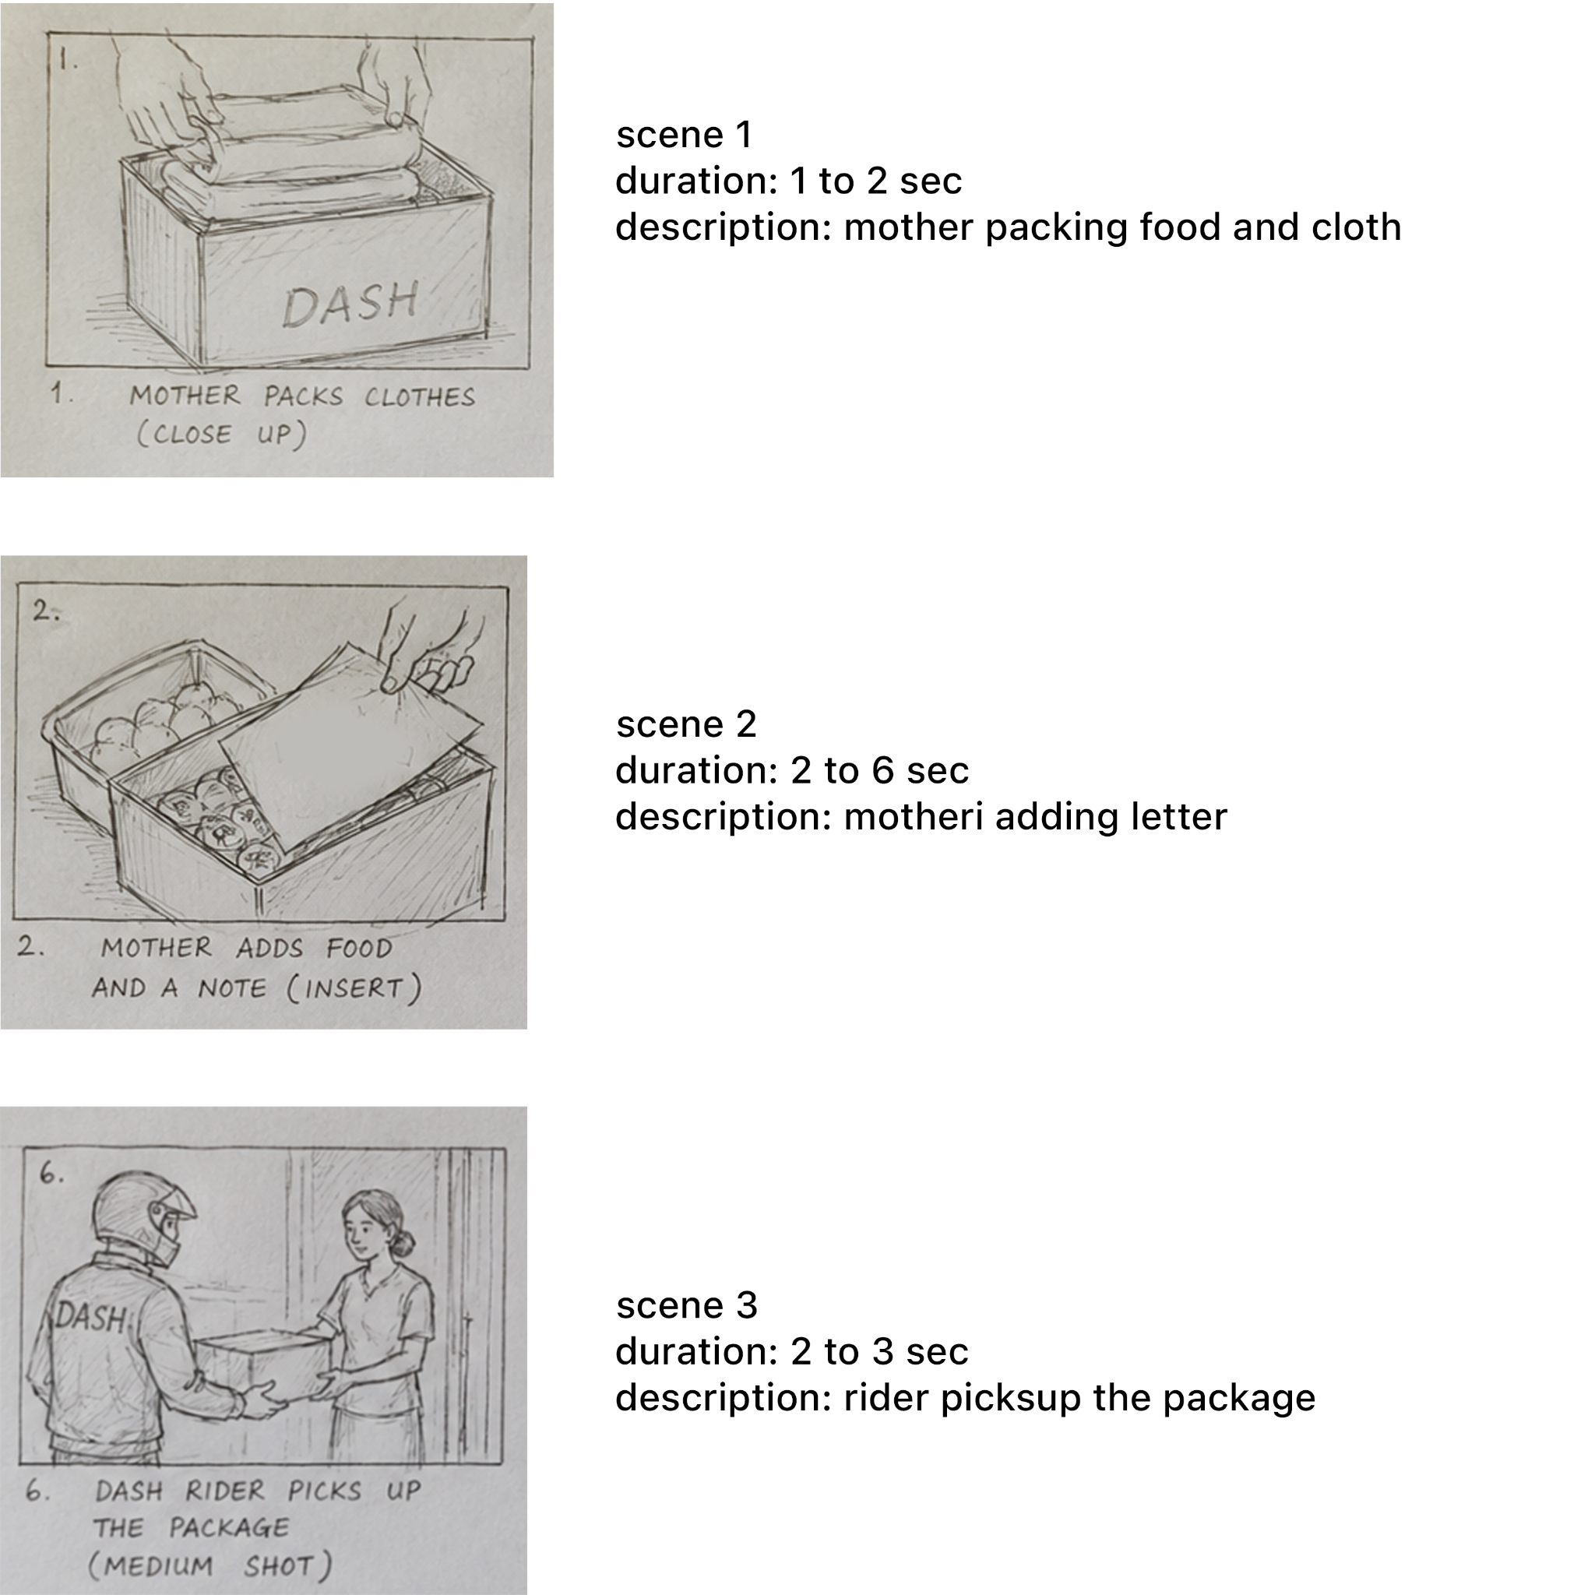
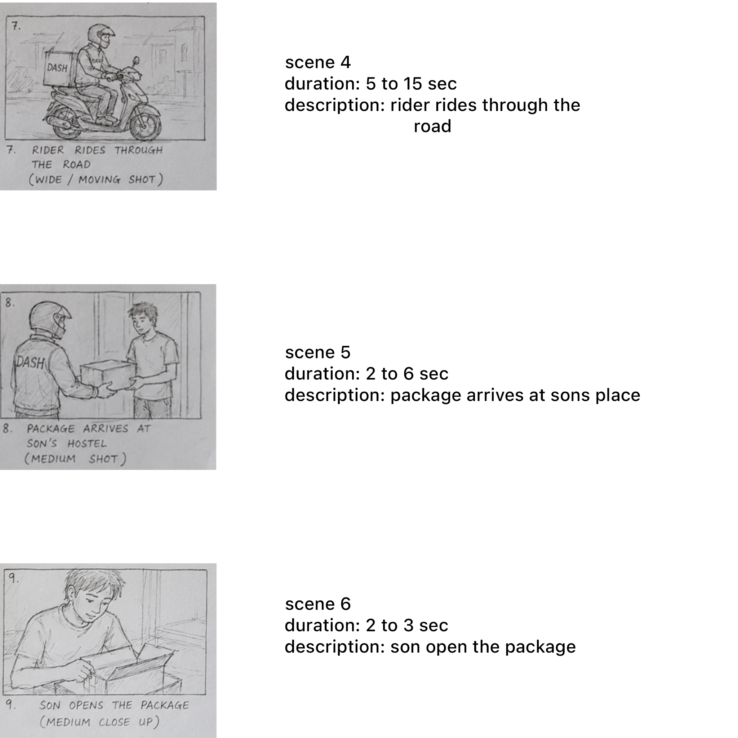
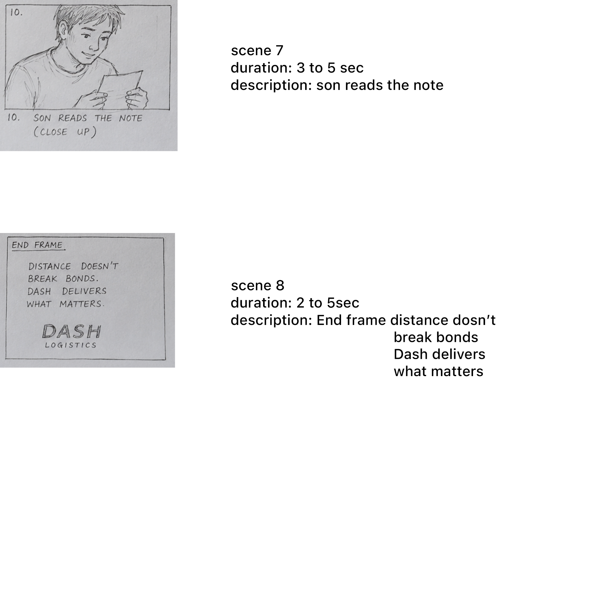
Script & Storyboard
The final script was visual because the TVC has no dialogue.
Storyboard pages used to plan scene order, duration and action.
Dash Logistics TVC | Distance Doesn’t Matter
07

Slide 8
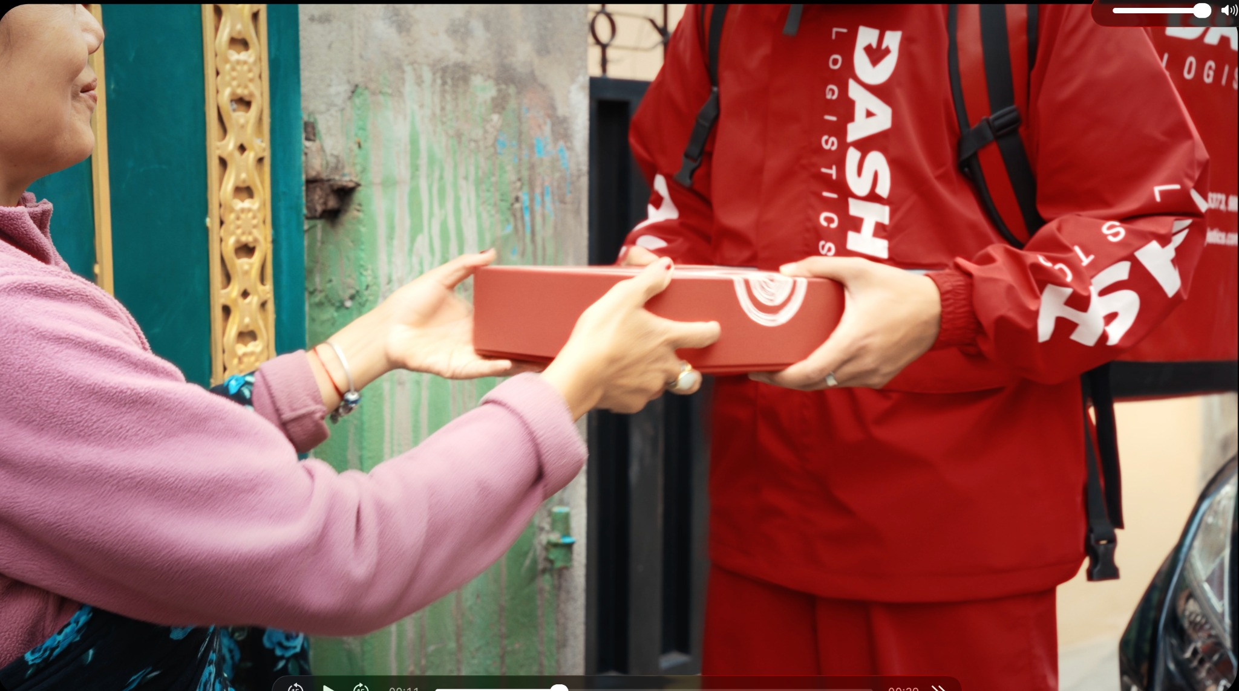
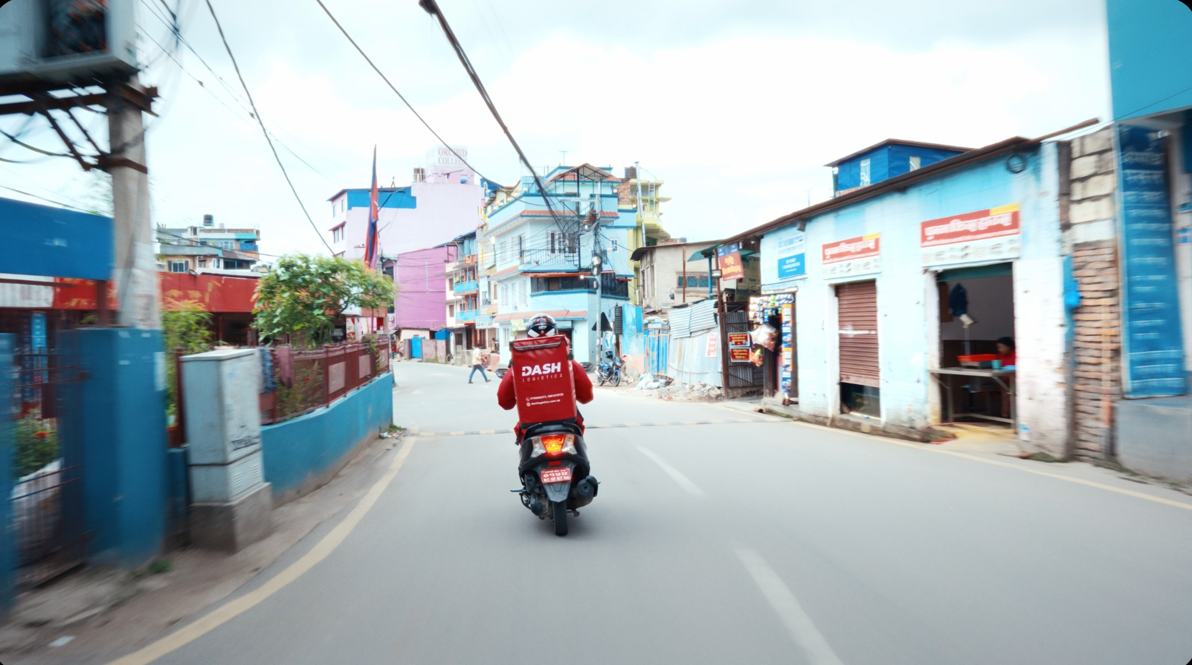
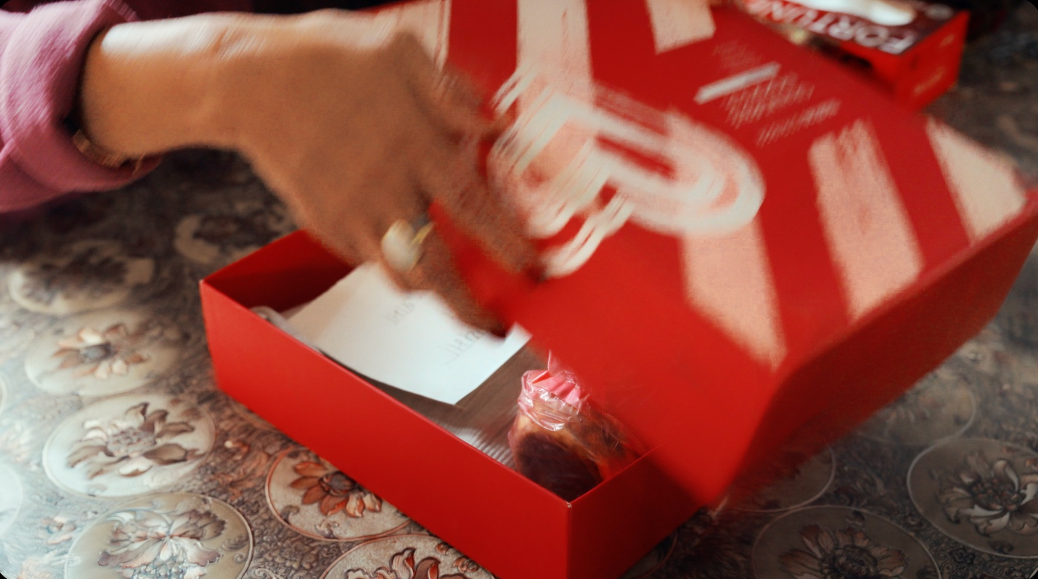
Production Process
The shoot used practical locations and available resources to keep the story natural.
Dash Logistics TVC | Distance Doesn’t Matter
08

Slide 9
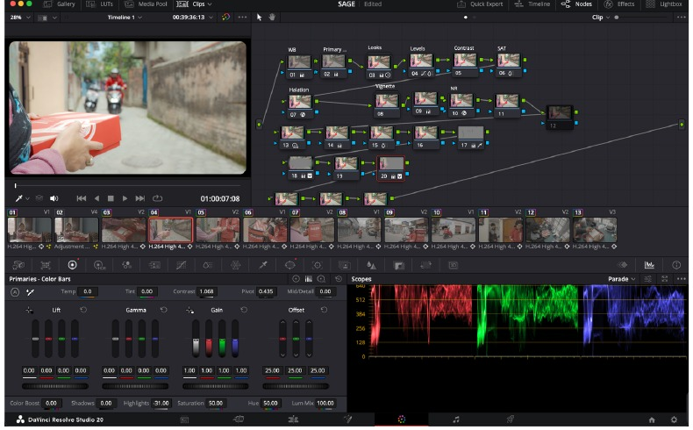
Post-Production Workflow
The full post-production process was completed in DaVinci Resolve.
DaVinci Resolve was used for:
Importing and organising footage
Editing clips according to the storyboard
Sound balancing and music placement
Colour correction and grading
Final render and export
Export: H.265 / QuickTime • 3840 × 2160 • 24 fps
Dash Logistics TVC | Distance Doesn’t Matter
09

Slide 10
Resources Used
The production was built with available gear, practical locations and help from friends.
Camera
Support
Sony A7 IV + Sigma 20–70mm lens
K&F Concept tripod + DJI RS4 gimbal
Lighting
Delivery
Natural light, RGB bar light and panel light
Friend’s scooter as Dash delivery vehicle
Monitoring
Post
iPad A16 used to check framing and focus
DaVinci Resolve for edit, sound, colour and export
Dash Logistics TVC | Distance Doesn’t Matter
10

Slide 11
User Testing & Findings
Feedback checked whether the no-dialogue story was clear and emotional.
1
Story clarity
Was the mother-son story easy to understand?
Expected outcome
Clear story
2
Emotion
Did the TVC feel emotional and relatable?
Strong emotion
3
Brand visibility
Was Dash Logistics clearly shown?
Brand remembered
4
Technical quality
Did music, colour and pacing support the story?
Dash Logistics TVC | Distance Doesn’t Matter
11

Slide 12
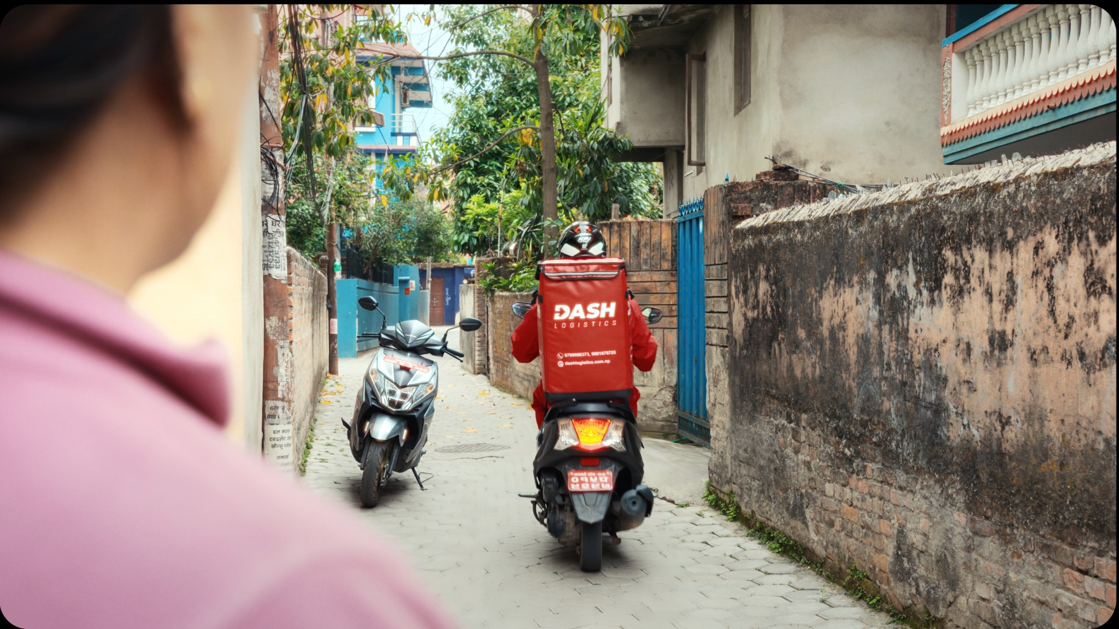
Conclusion
A simple delivery story becomes a human message for Dash Logistics.
The project presents Dash Logistics as a reliable and caring brand by turning a simple delivery into a story of home, distance and connection.
Distance doesn’t break bonds.
Dash delivers what matters.
Thank you
Dash Logistics TVC | Distance Doesn’t Matter
12

