Slide 1


CAPSTONE PROJECT SIGN LANGUAGE DETECTION
Presented By-
Student Name: BINAY KUMaR PRASAD
College Name: ITM COLLEGE OF MANAGEMENT
Department: B.C.A (BACHELOR OF COMPUTER applications)
Email ID: binaykumar863731@gmail.com
AICTE Student ID: STU6766c906558171734789382

Slide 2
OUTLINE
Problem Statement
Proposed System/Solution
System Development Approach
Algorithm & Deployment
Result (Output Image)
Conclusion
Future Scope
References

Slide 3
Problem Statement
Communication is the crucial part in human life, it has shaped humanity to where its now. Communication barriers exist for individuals who are hearing impaired or non-verbal, particularly in environments where sign language interpreters are unavailable. This creates challenges in daily interactions, limiting access to services, education, and inclusive participation in society. There is a growing need for accessible, real-time sign language interpretation tools that can bridge this communication gap and facilitate better understanding between sign language users and non-users.

Slide 4
Proposed Solution
The proposed system is a real-time American Sign Language (ASL) detection tool that uses computer vision and machine learning techniques to recognize hand gestures corresponding to ASL alphabets. The system captures live video feed through a webcam, detects hand landmarks using MediaPipe, and interprets specific hand positions as sign language characters. This model aims to act as a bridge between hearing and hearing-impaired individuals by translating visual gestures into readable characters or text.

Slide 5
System Approach
Programming Language: Python
Libraries and Frameworks:
MediaPipe: Used for hand landmark detection and tracking.
OpenCV: Used for real-time video capture and image processing.
NumPy: For numerical operations on image data.
Platform: Desktop environment with webcam access.
Dataset: The system uses a reference image (“sign-language-alphabet.png”) and predefined hand landmark logic to identify ASL letters.

Slide 6
Algorithm & Deployment
Algorithm:
Initialize webcam and load MediaPipe Hands module.
Capture video frame-by-frame using OpenCV.
For each frame:
Convert to RGB and process with MediaPipe to extract hand landmarks.
Identify the relative positions of hand joints.
Match the detected pattern with known ASL gestures.
Display the identified character on the screen.
Continue the loop in real time until the application is closed.
Deployment:
Local Deployment:
Run main.py in a Python environment with required libraries installed.
Ensure webcam access for live gesture detection.

Slide 7
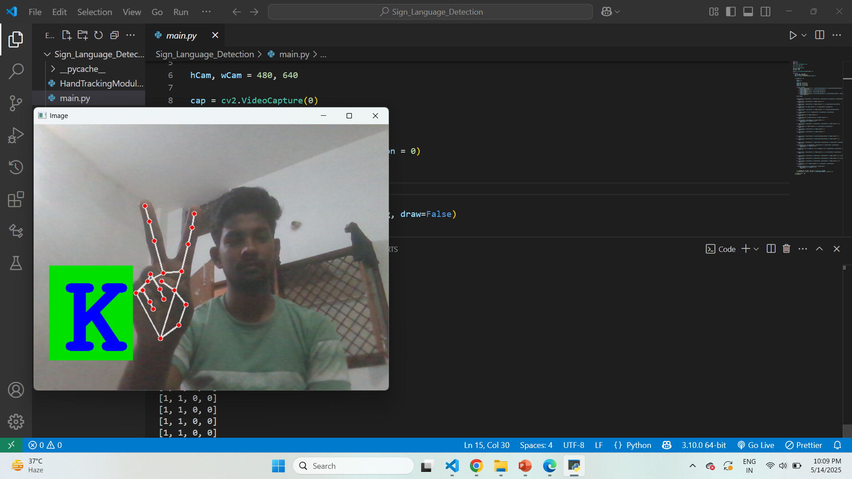
Result
Here is a sample result output from the system:

Slide 8
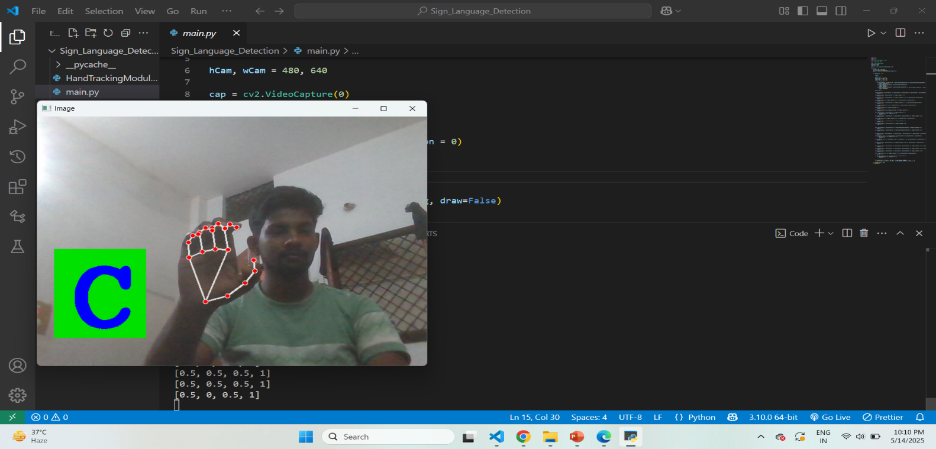
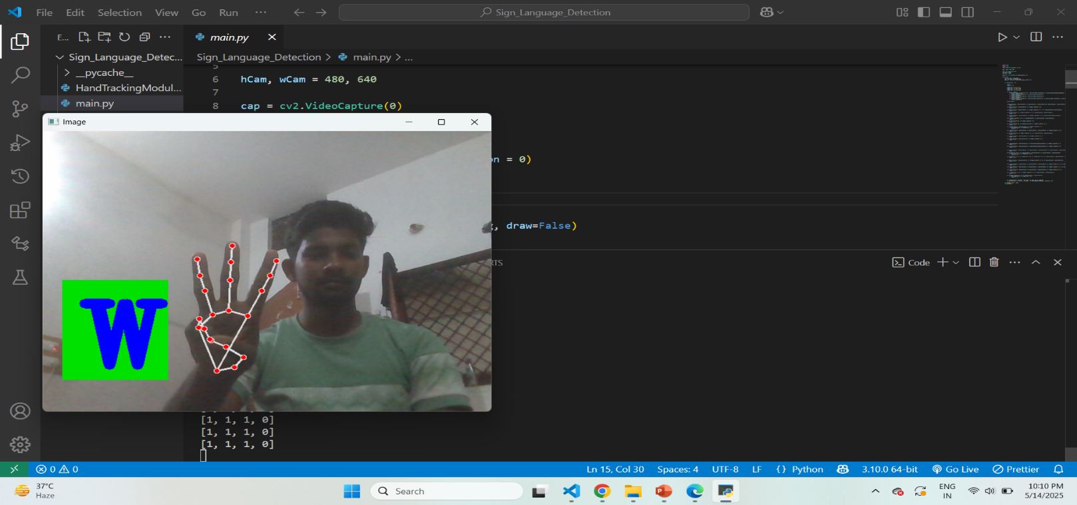

Slide 9
Conclusion
The real-time sign language detection system effectively interprets ASL alphabet gestures using computer vision and Media Pipe's hand tracking capabilities. It demonstrates how accessible technology can assist in reducing communication barriers for the hearing-impaired community. While currently limited to alphabet recognition, the system shows significant potential as a foundation for full sign language translation applications.

Slide 10
Future scope
Full Sign Language Sentence Recognition: Extend the system to recognize full words and sentences beyond just alphabets.
Multilingual Sign Language Support: Incorporate other sign languages like BSL (British Sign Language) or ISL (Indian Sign Language).
Integration with Voice Assistants: Provide voice output for recognized signs.
Mobile Application Development: Create cross-platform mobile apps for greater accessibility.

Slide 11
References
MediaPipe by Google: https://mediapipe.dev/
OpenCV Documentation: https://docs.opencv.org/
ASL Alphabet Chart: American Sign Language Chart
Github Link:- https://github.com/binaykumar8467/sign_language_detection

Slide 12
Thank you

