Slide 1
gradient boosting algorithms on second order functional and its application
2019. 1. 12
Notes:
在组设置中可使用此模板作为演示培训材料的起始文件。
节
右键单击幻灯片以添加节。 节可以帮助您组织幻灯片或促进多个作者之间的协作。
备注
使用“备注”节传递备注或为受众提供其他详细信息。 演示过程中，可在“演示文稿视图”中查看这些备注。
请记住字体大小(对于可访问性、可见性、录像和联机生产都非常重要)
协调的色彩
特别注意图形、图表和文本框。
请考虑与会者将以黑白或 灰色调打印。请运行测试打印，以确保当以纯黑白和 灰色调打印时，您的颜色工作正常。
图形、表格和图表
保持简单: 如果可能，请使用一致的、不分散的样式和颜色。
标记所有图表和表格。

Slide 2
2 Research Objectives
1 Gradient Boosting Algorithm
1.1 Gradient Boosting Algorithm
1.2 Derivations from second order functional
1.3 LiteMORT

Slide 3
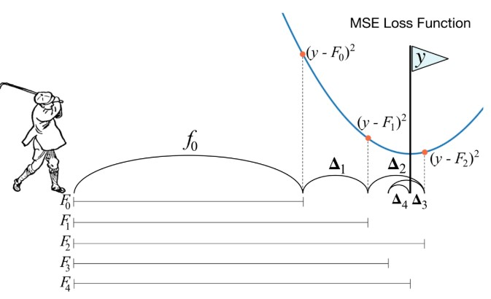

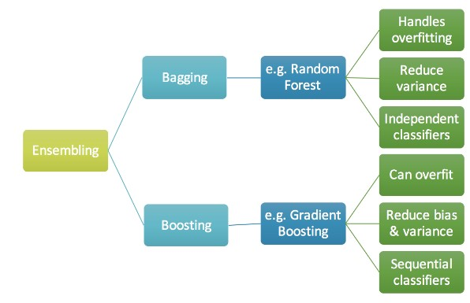

1.1 Gradient Boosting Algorithm
Gradient boosting is a machine learning technique for regression and classification problems, which produces a prediction model in the form of an ensemble of weak prediction models, typically decision trees. It builds the model in a stage-wise fashion like other boosting methods do, and it generalizes them by allowing optimization of an arbitrary differentiable loss function.
The idea of gradient boosting originated in the observation by Leo Breiman that boosting can be interpreted as an optimization algorithm on a suitable cost function.^{[1]} Explicit regression gradient boosting algorithms were subsequently developed by Jerome H. Friedman,^{[2][3]} simultaneously with the more general functional gradient boosting perspective of Llew Mason, Jonathan Baxter, Peter Bartlett and Marcus Frean.^{[4][5]} The latter two papers introduced the view of boosting algorithms as iterative functional gradient descent algorithms. That is, algorithms that optimize a cost function over function space by iteratively choosing a function (weak hypothesis) that points in the negative gradient direction. This functional gradient view of boosting has led to the development of boosting algorithms in many areas of machine learning and statistics beyond regression and classification.

Slide 4
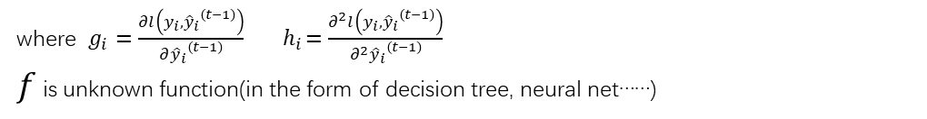
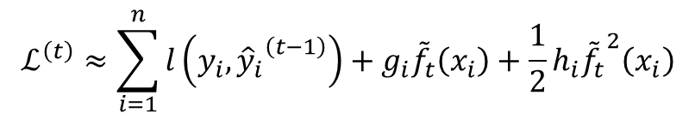
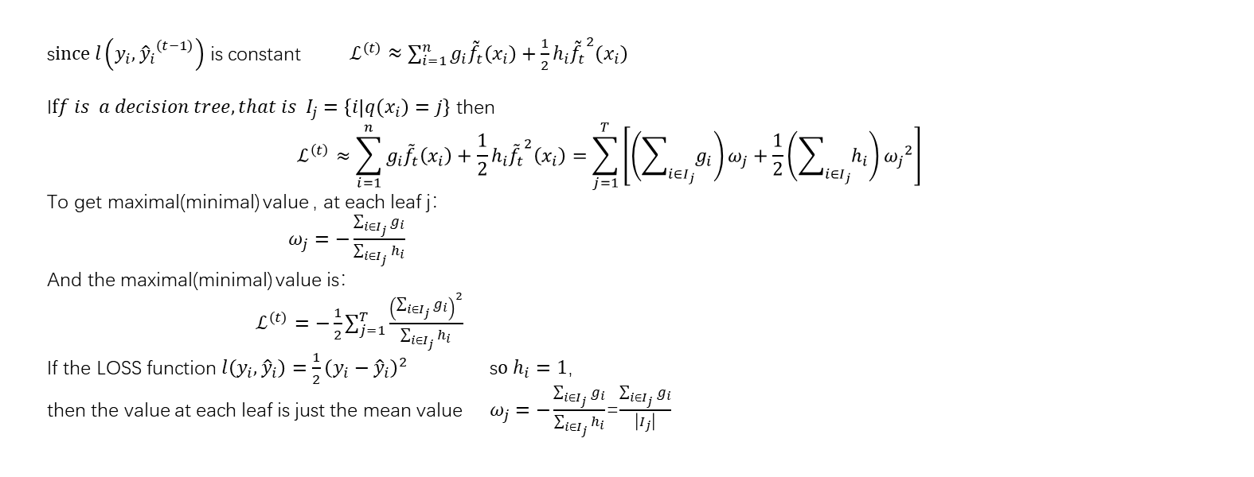
1.2 Derivations from second order functional
$$ℒ^{\left(t\right)}≈\sum_{i=1}^{n}{l\left(y_{i},{{\hat{y}}_{i}}^{\left(t−1\right)}\right)+g_{i}{\tilde{f}}_{t}\left(x_{i}\right)+\frac{1}{2}h_{i}{{\tilde{f}}_{t}}^{2}\left(x_{i}\right)}$$
where $g_{i}=\frac{∂l\left(y_{i},{{\hat{y}}_{i}}^{\left(t−1\right)}\right)}{∂{{\hat{y}}_{i}}^{\left(t−1\right)}}{ h}_{i}=\frac{∂^{2}l\left(y_{i},{{\hat{y}}_{i}}^{\left(t−1\right)}\right)}{∂^{2}{{\hat{y}}_{i}}^{\left(t−1\right)}}$
$f$ is unknown function(in the form of decision tree, neural net……)
s$ince l\left(y_{i},{{\hat{y}}_{i}}^{\left(t−1\right)}\right)$ is constant$ℒ^{\left(t\right)}≈\sum_{i=1}^{n}{g_{i}{\tilde{f}}_{t}\left(x_{i}\right)+\frac{1}{2}h_{i}{{\tilde{f}}_{t}}^{2}\left(x_{i}\right)}$
I$ff is a decision tree,that is I_{j}=\left\{i\left|{q(x}_{i}\right)=j\right\}$ then
$$ℒ^{\left(t\right)}≈\sum_{i=1}^{n}{g_{i}{\tilde{f}}_{t}\left(x_{i}\right)+\frac{1}{2}h_{i}{{\tilde{f}}_{t}}^{2}\left(x_{i}\right)}=\sum_{j=1}^{T}{\left[\left(\sum_{i∈I_{j}}{g_{i}}\right)ω_{j}+\frac{1}{2}\left(\sum_{i∈I_{j}}{h_{i}}\right){ω_{j}}^{2}\right]}$$
To get maximal(minimal) value , at each leaf j：
$ω_{j}=−\frac{\sum_{i∈I_{j}}{g_{i}}}{\sum_{i∈I_{j}}{h_{i}}}$
And the maximal(minimal) value is：
$ℒ^{\left(t\right)}=−\frac{1}{2}\sum_{j=1}^{T}{\frac{{\left(\sum_{i∈I_{j}}{g_{i}}\right)}^{2}}{\sum_{i∈I_{j}}{h_{i}}}}$
If the LOSS function $l\left(y_{i},{\hat{y}}_{i}\right)=\frac{1}{2}{\left(y_{i}−{\hat{y}}_{i}\right)}^{2}$ s$o h_{i}=1$，
then the value at each leaf is just the mean value$ω_{j}=−\frac{\sum_{i∈I_{j}}{g_{i}}}{\sum_{i∈I_{j}}{h_{i}}}$=$\frac{\sum_{i∈I_{j}}{g_{i}}}{\left|I_{j}\right|}$

Slide 5
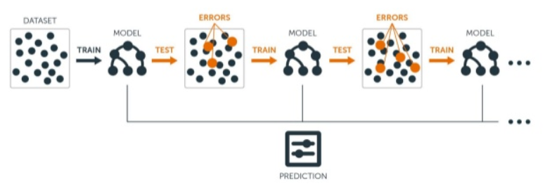
1.3 Software – LiteMORT
LightMORT
LiteMORT https://github.com/closest-git/LiteMORT
A fast gradient boosting framework on manifolds(from regression tree,classification tree,neural net....). Easy to use and override.
LightGBM, XGBoost, CatBoost…

Slide 6
1 Topic Basis
2 Application
2.1 classifying genetic mutations based on clinical evidence
2.2 Modeling Total Projected Customer Value for a Health Insurer

Slide 7
