Slide 1
FPGA Training (I)
Introduction to FPGA
lin.cx@googoltech.com
linchengxi@tsinghua.org.cn
Q2 2013

Slide 2
Warm-up Exercise (I)
Karnaugh map(卡诺图) of a 1-bit full adder
A
B
Input |  |  | Output
A | B | C_i | C_o | S
0 | 0 | 0 | 0 | 0
1 | 0 | 0 | 0 | 1
0 | 1 | 0 | 0 | 1
1 | 1 | 0 | 1 | 0
0 | 0 | 1 | 0 | 1
1 | 0 | 1 | 1 | 0
0 | 1 | 1 | 1 | 0
1 | 1 | 1 | 1 | 1
1 bit full adder
C_o
C_i
S

Slide 3
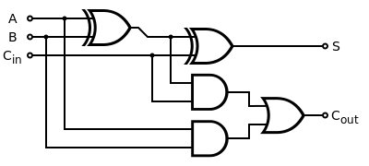
Warm-up Exercise (II)
Interpretation of the 1-bit full adder Karnaugh table

Slide 4

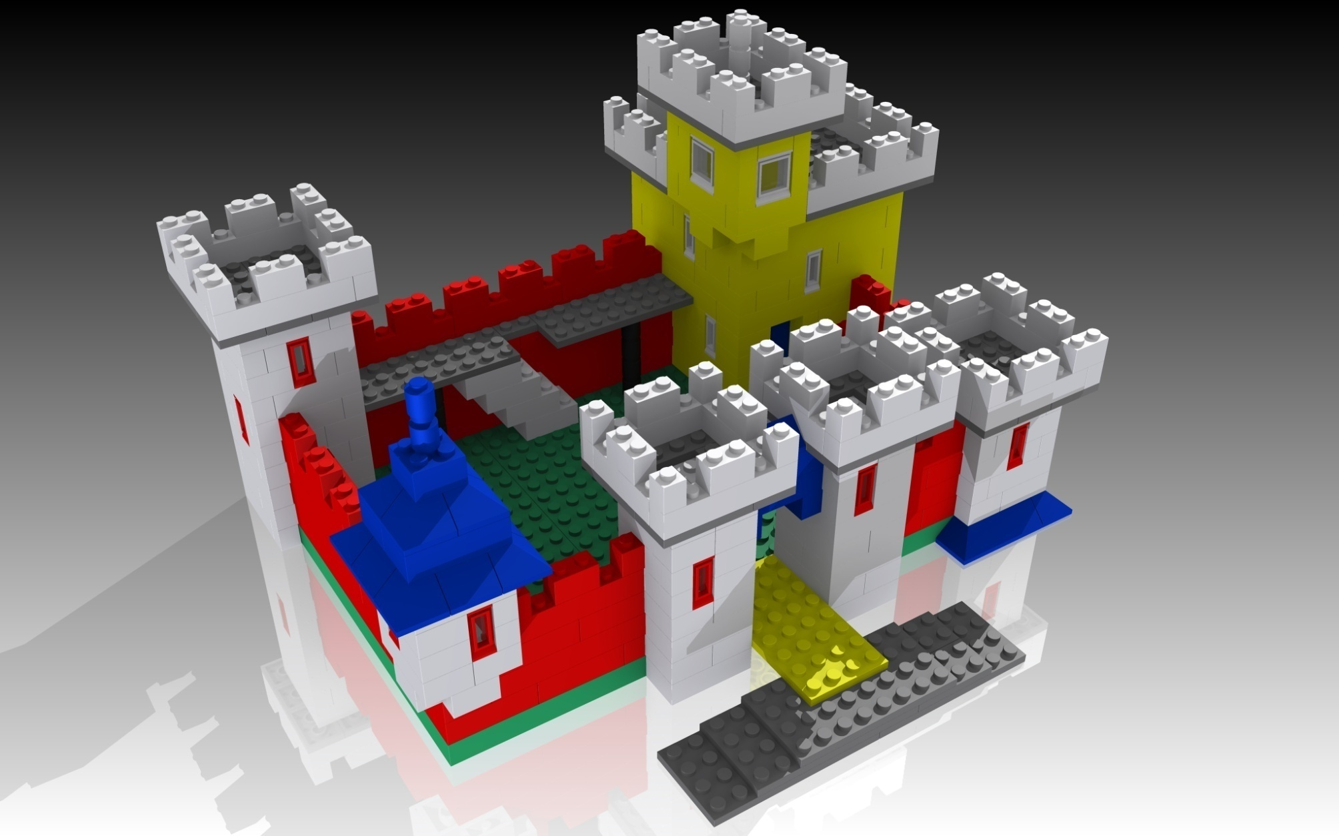

What’s FPGA (I)

Slide 5
What’s FPGA(II)
Filed Programmable Gate Array
A box of LEGO toys with which electronic engineers build up their system
Theory proves that any given combinational logic can be translated into SoP (sum of product) or PoS (product of sum) forms
AND, OR, NOT gates are the “three-primary colors” in the electronical world, forming the basic building blocks in our LEGO box

Slide 6
Actual Circuit inside FPGA
A xor B = (A & (~B)) + ((~A) & B);
A xnor B = ((~A) & (~B)) + (A & B);
In reality, FPGA uses N-input-LUT as its basic building blocks
A N-input-LUT is equivalent to a N-input Karnaugh table
By cascading a chain of different N-input-LUT, one can realize any kind of combinational logic

Slide 7
1-bit Full Adder Example (I)
A
2-Input LUT
XOR
2-Input LUT
XOR
2-Input LUT
2-Input LUT
B
C_i
S
2-Input LUT
AND
2-Input LUT
AND
2-Input LUT
OR
C_o
2-Input LUT
2-Input LUT
2-Input LUT
2-Input LUT
2-Input LUT
2-Input LUT

Slide 8
1-bit Full Adder Example (II)
Karnaugh table generation
Break down complex Karnaugh table into small pieces which can be realized in N-input-LUT
Route all the related N-input-LUTs in sequence to perform the required function

Slide 9
How About Sequential Logic
How to “preserve” a value?
  Positive feedback
Latch & Flip-flop
  Latch : level sensitive
  Flip-flop : edge sensitive

Slide 10
Latch (I)
Phase 1 : enable data input, disable positive feedback
Phase 2 : disable data input, enable positive feedback

Slide 11
Latch (II)
ENA
D
D
Q
Q
E
E = 1, Q = D
E = 0, Q stays the same

Slide 12
Setup Time of Latch(I)
Phase 1
  S1 is ON and S2 is OFF
  Propagation delay of cascading NOT gates
Tpd 1
Tpd 2
D
D
Q
S1
S2

Slide 13
Setup Time of Latch (II)
Transition from phase 1 to phase 2
  S1 switches from ON to OFF and S2 switches from OFF to ON
  What if D also makes a transition at the same time
D
D
Q
S1
S2

Slide 14
Setup Time of Latch(III)
Input should stay stable BDFORE S1, S2 switches
Otherwise, feedback might not be stable
S1
S1 switches off, latch goes to phase 2
Tpd1
Tpd2
D
D input goes low BEFORE S1 switches off
D
~D goes high after a certain delay
Q
Again, Q goes high after a certain delay
S2
S2 switches on simultaneously
S2 switches on while Q is still 1
Oscillation due to meta-stability

Slide 15
Setup Time of Latch(IV)
Minimum amount of time the data signal should be held steady before the clock event so that the data are reliably sampled by the clock.
Setup time can not be zero because propagation delay can not be zero.
In other words, the faster the circuit is, the less setup time is required.
In our simplified latch model, Tsu = Tpd1 + Tpd2

Slide 16
Hold Time of Latch (I)
Phase 1
  S1 is ON and S2 is OFF
Tpd 1
Tpd 2
D
D
Q
S1
S2

Slide 17
Hold Time of Latch(II)
Transition from phase 1 to phase 2
  S1 switches from ON to OFF and S2 switches from OFF to ON
  What if S1’s transition time is too large
D
D
Q
S1
S2

Slide 18
Hold Time of Latch(III)
Input should stay stable AFTER S1, S2 switches
Otherwise, feedback might not be stable and latch
becomes transparent
S1
S1 switches off, latch goes to phase 2
Tpd1
Tpd2
D
D input goes low AFTER S1 switches off
Tswitch
D
~D goes high after a very short delay
Q
Again, Q goes low after a very short delay
S2
S2 switches on after a certain delay
S2 switches on after Q finishes the transition
Oscillation due to meta-stability

Slide 19
Hold Time of Latch(IV)
minimum amount of time the data signal should be held steady after the clock event so that the data are reliably sampled.
Hold time can be zero or even negative because propagation delay can larger than switch transition time.
In other words, the slower the circuit is (positive feedback path), the less hold time is required.
In our simplified latch model, Th = Tswitch – (Tpd1 + Tpd2)

Slide 20
Where Does Delay Come From (I)
Digital circuits are actually analog
Parasitic capacitors always exist and it takes time for a CMOS gate to charge & discharge
Actual waveform of voltage has some sort of slew rate which can be modeled by a simple RC constant
Tpd_h
Tpd_l

Slide 21
Where Does Delay Come From (II)
Logical 0 : input/output voltage is below a certain criteria (for saying, 0.7V)
Logical 1 : input/output voltage is above a certain criteria (for saying, 3.0V)
Logical X : input/output voltage is between the above criteria (for saying, between 0.7V & 3.0V)
When logical X is sampled, it might be interpreted as either “0” or “1”
So sampling should avoid touching the “X” state

Slide 22
Where Does Delay Come From (III)
3.3V
1
Tpd_h
3.0V
X
0.7V
0
0.0V
3.3V
1
Tpd_l
3.0V
X
0.7V
0
0.0V

Slide 23
Flip-Flop
D
Q0
Q
D
D
Q
Q
D
Q
E
CLK
E
E0
E1
CLK
Posedge of CLK, Q = D
Else, Q stays the same
Please describe how this two-stage Master-Slave latches work

Slide 24
Definition of Flip-Flop
Tsu
  Minimum amount of time the data signal should be held steady before the clock event so that the data are reliably sampled by the clock.
  Increase of speed is good for Tsu
Th
  Minimum amount of time the data signal should be held steady after the clock event so that the data are reliably sampled
  Increase of speed is bad for Th
Tcq
  Time the flip-flop takes to change its output after the clock edge

Slide 25
Timing Constraints of Synchronous Digital Design (I)
D0
Q0
D1
Q1
D
Q
Tpd_logic
D
Q
CLK
CLK
CLK
Tc – Tcq – Tp > Tsu
Tcq + Tp > Th (always satisfied in FPGA)

Slide 26
Timing Constraints of Synchronous Digital Design (II)
D0
Q0
D1
Q1
D
Q
Tpd_logic
D
Q
CLK
CLK
CLK0
CLK1
Tskew
What if CLK has some kind of uncertainty?

Slide 27
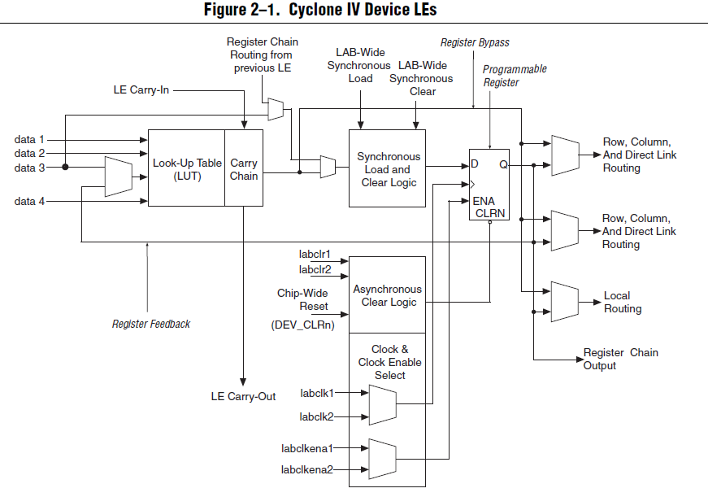
Design with FPGA (I)
From “Cyclone IV Device Handbook”

Slide 28
Design with FPGA (II)
Use HDL language to describe the hardware functionality
Translate the HDL into
  Canonical form (Boolean algebra), using AND, OR, NOT, XOR, XNOR gates……
  Flip-flops
Map the needed Boolean algebra & flip-flops into basic FPGA logic elements
Place the needed logic elements into the targeted FPGA chip
Route all the logic elements together to get the final result

Slide 29
Mainstream FPGAs in Googoltech
Altera’s Cyclone series
  Cyclone II : EP2C5
  Cyclone IV: EP4CE10/15
Xilinx’s Spartan series
  Spartan6 : XC6SLX25/45T
Lattice’s XO/XO2 Series (classified as CPLD)
  Mach XO 640
  Mach XO2 1200

