Slide 1
FPGA Training (II)
Cope with FPGA & HDL
lin.cx@googoltech.com
linchengxi@tsinghua.org.cn
Q2 2013

Slide 2
10 Types of Engineers
Altogether there’re 10 types engineers in the world
First type are those who know about binary coding
Second type are those who don’t know about binary coding
Apparently, FPGA engineers are those geeks who get fully understanding of this joke……

Slide 3
How the World is Like in a Software Engineer’s Eyes
int, short, long, unsigned of the above
Structure, Union
math.h, stdio.h……
*p, &var, **p
Event, Handler
Creat, Kill, GC

Slide 4
How the World is Like in an FPGA Engineer’s Eyes
0
1
WIRE, REG
AND, OR, NOT, XOR, XNOR, MUX, CNT

Slide 5
Requirements for an FPGA Engineer (I)
FPGA engineers are sometimes called “logic engineers”
Every single word in his/her mouth should absolutely makes sense and logically correct
So this digital herd are sometimes (or most of the time) quite boring compared to those analog herd
When somebody talking about “1”, FPGA engineers’ first response is what if a “0”

Slide 6
Requirements for an FPGA Engineer (II)
Besides, to be an excellent FPGA engineer, one must be always curious
And, he or she needs to read abundant materials to know what’s happening in the high technology industry (can somebody give a reason?)
And, he or she must get a thorough understanding of actual hardware

Slide 7
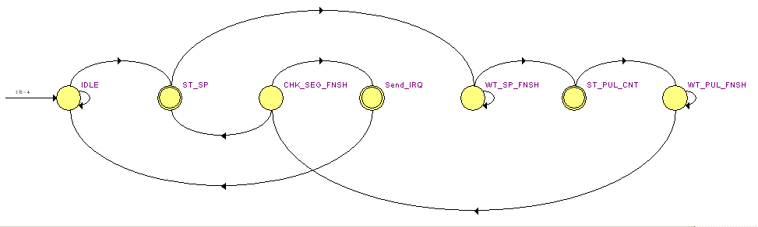
Basic Tools : FSM

Slide 8
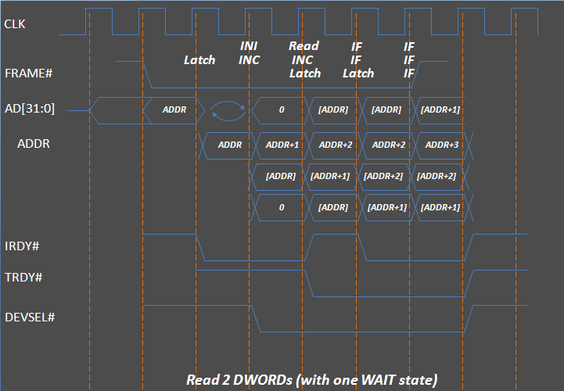
Basic Tools : Timing Diagram

Slide 9
Practical Coding Style (I)
Design First, Coding Last!
Coding is a mean to realize what you have designed.
Excellent FPGA engineers always have the whole system built up in their minds before typing a single word

Slide 10
Practical Coding Style (II)
Codes are to be read
Codes are to be understood
Codes are to be further modified
Codes are to be maintained

