Slide 1

-Final project- Requirement and Analysis Design
Tran Quoc Bao
Trang Si Nam
521H0494
521H0276

Slide 2
Overall final project
Business Requirement
01
02
System Requirements Analysis
B2B SYSTEM
System Requirements Implementation
System Requirements Design
4
03

Slide 3
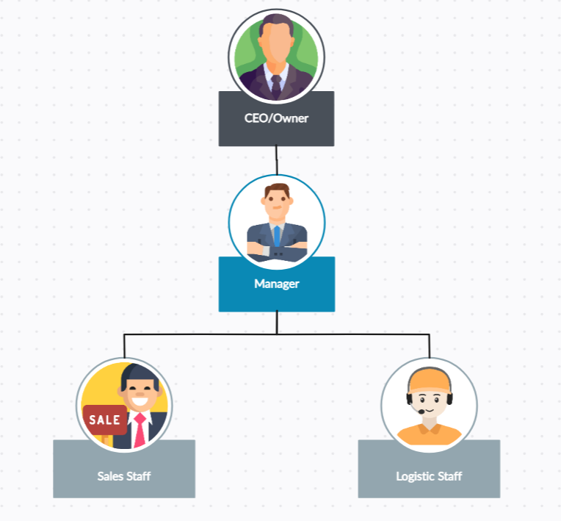
Organization Chart / Project Chart/Gantt Chart

Slide 4
Business Modelling / Requirements
Account Management: This is the first layer of the business model. It involves the creation and management of user accounts. Each retail store will have an Admin account provided by the company. The Manager of each retail store will be able to create accounts for each staff member. This ensures proper access control and accountability with the system.
Product Management: This involves managing the lifecycle of products in store inventory. Administrators will have the ability to modify products. Each product will have a unique identifier (barcode/QR Code), name, import price, retail price, category, and creation date. Products can only be deleted when not in any order. Sales staff can view the product list but cannot change any content or see the original price.
Customer Management: This involves managing customer data and interactions. The sales interface will allow for the creation of a new customer for the first-time purchase and viewing of customers’ personal information and purchase history. This helps in maintaining a good relationship with the customers and also aids in personalized marketing.
Sales Management: This involves managing the sales transactions for each retail store and providing a total sale of the company. This helps in tracking the performance of each store and the overall performance of the company.
Inventory Management: This involves managing the inventory, creating Goods Received when the distributor imports goods, and creating Goods Delivery Note to deliver goods to Agents. This ensures that there is always enough stock to meet the demand and helps in avoiding overstocking.
Reports: This involves generating reports for the company & agents’ retail store. These reports can provide insights into sales trends, inventory levels, customer behaviour, etc. This can help in making informed business decisions

Slide 5
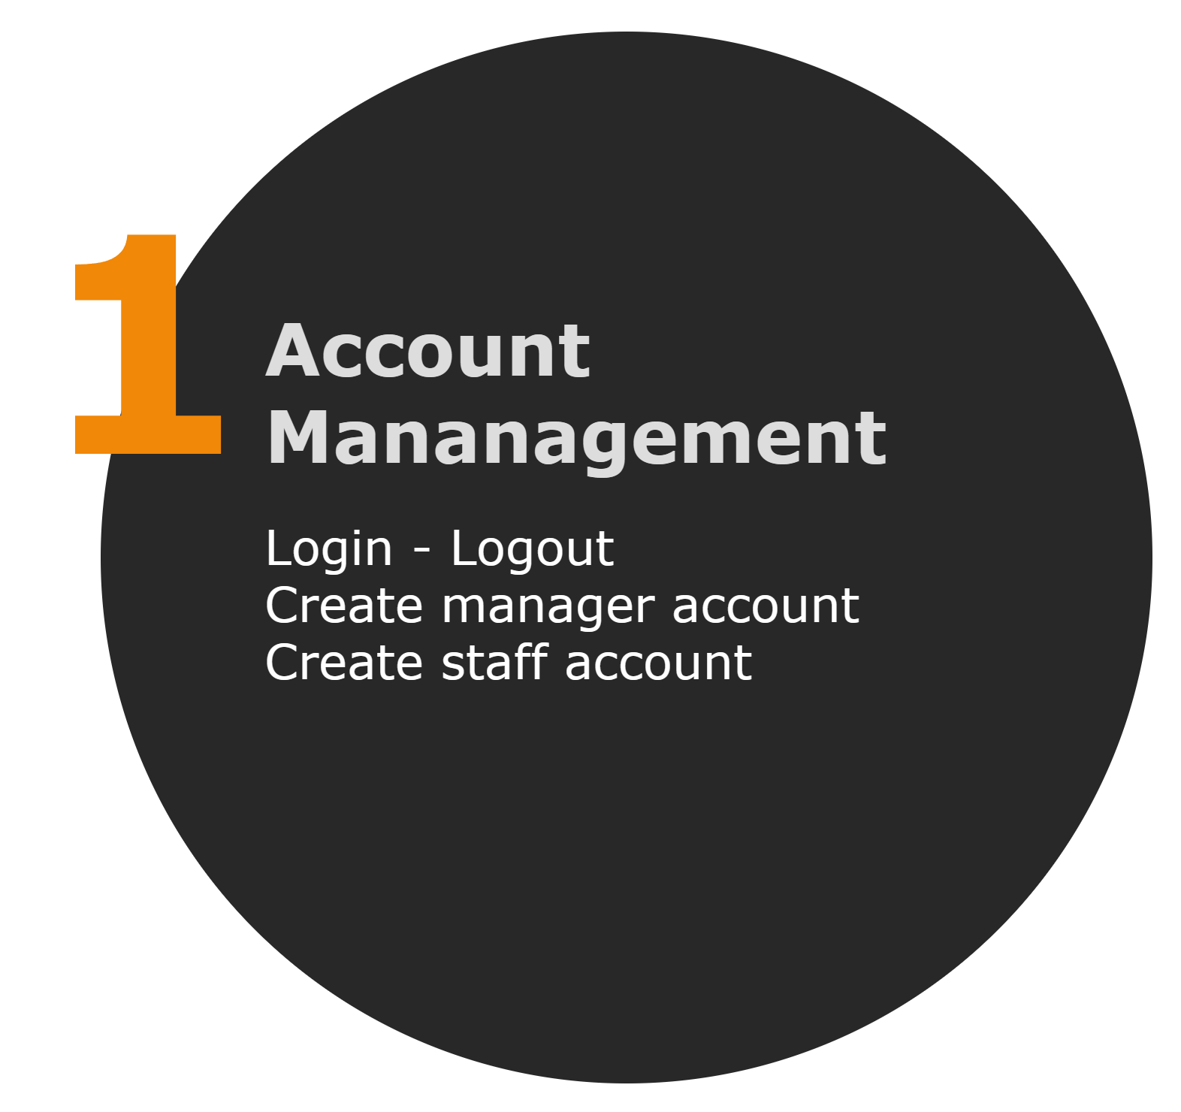
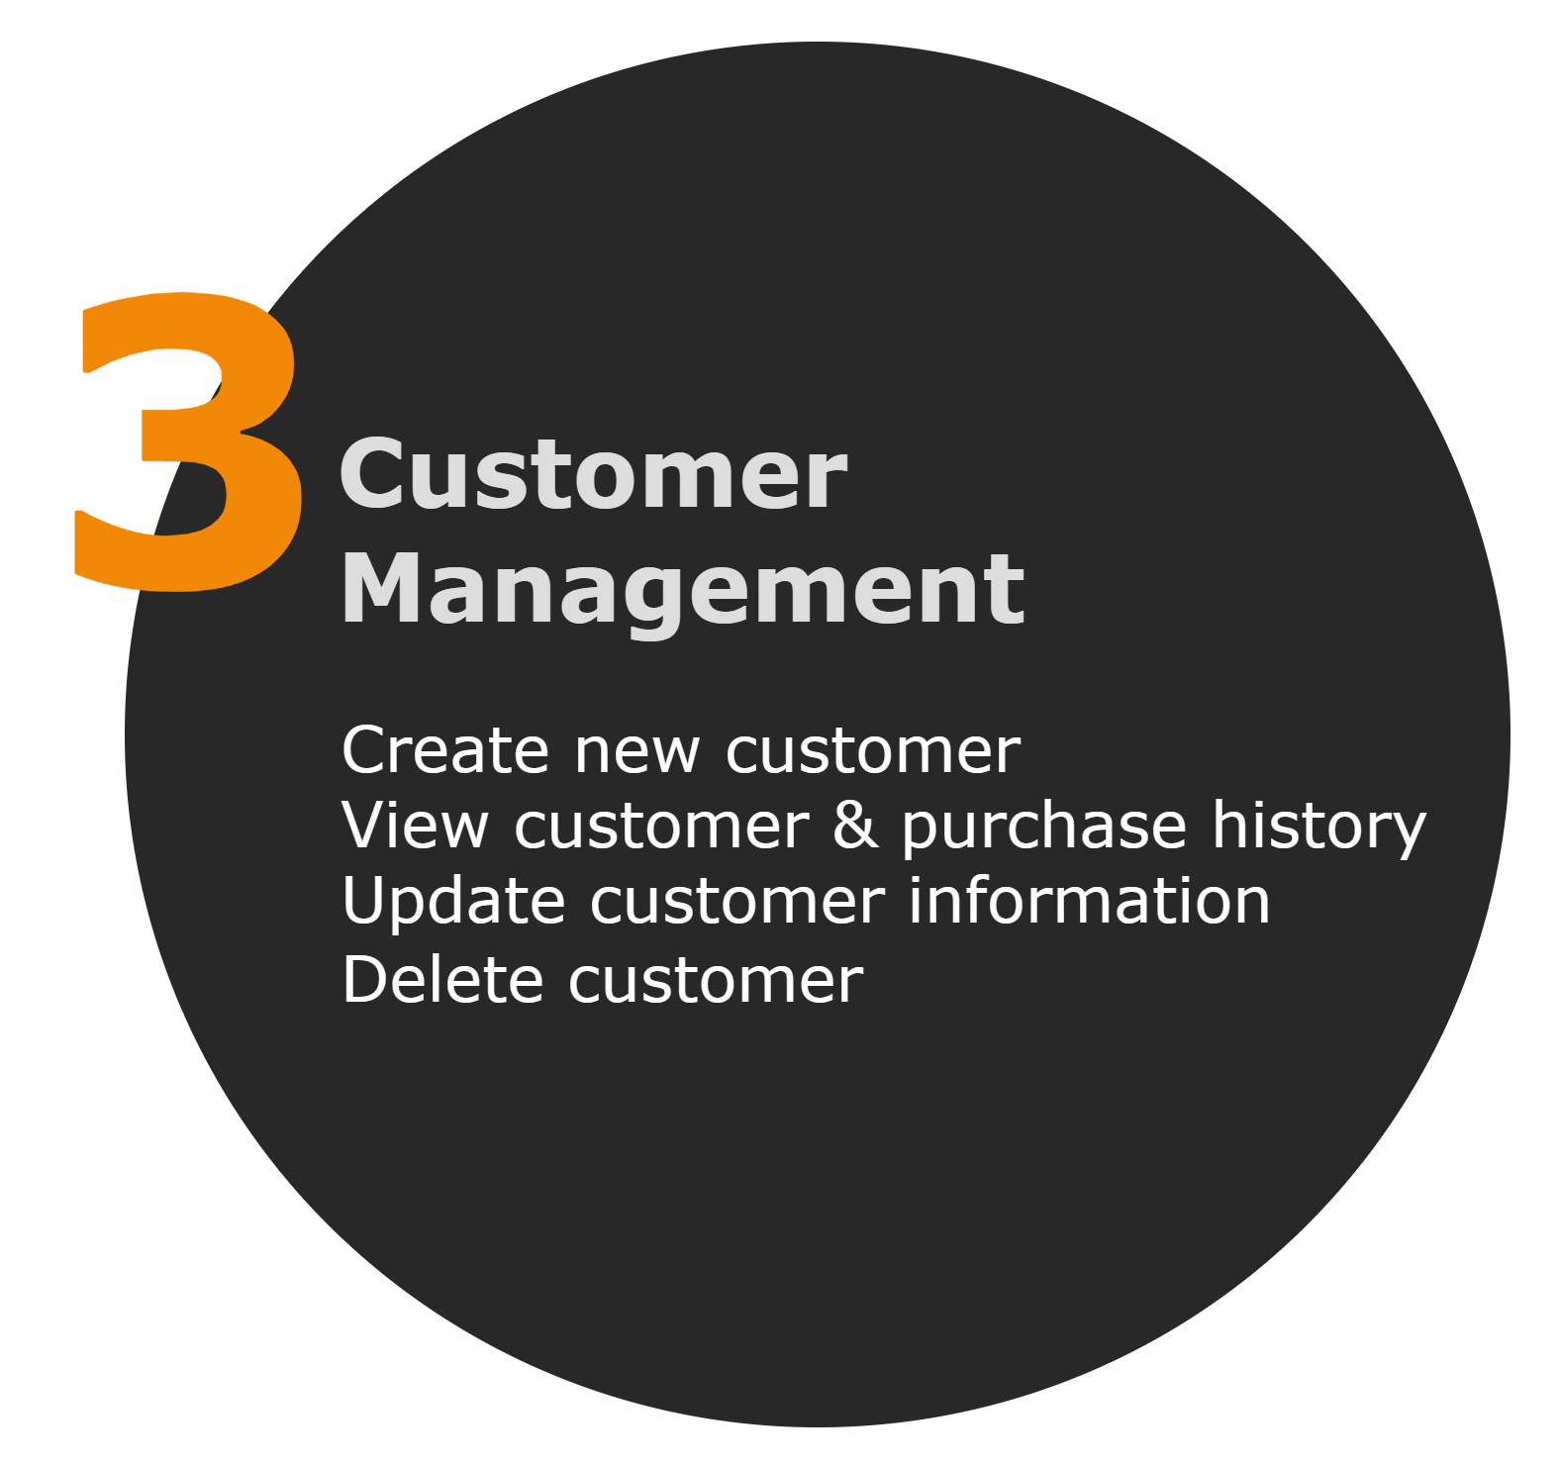
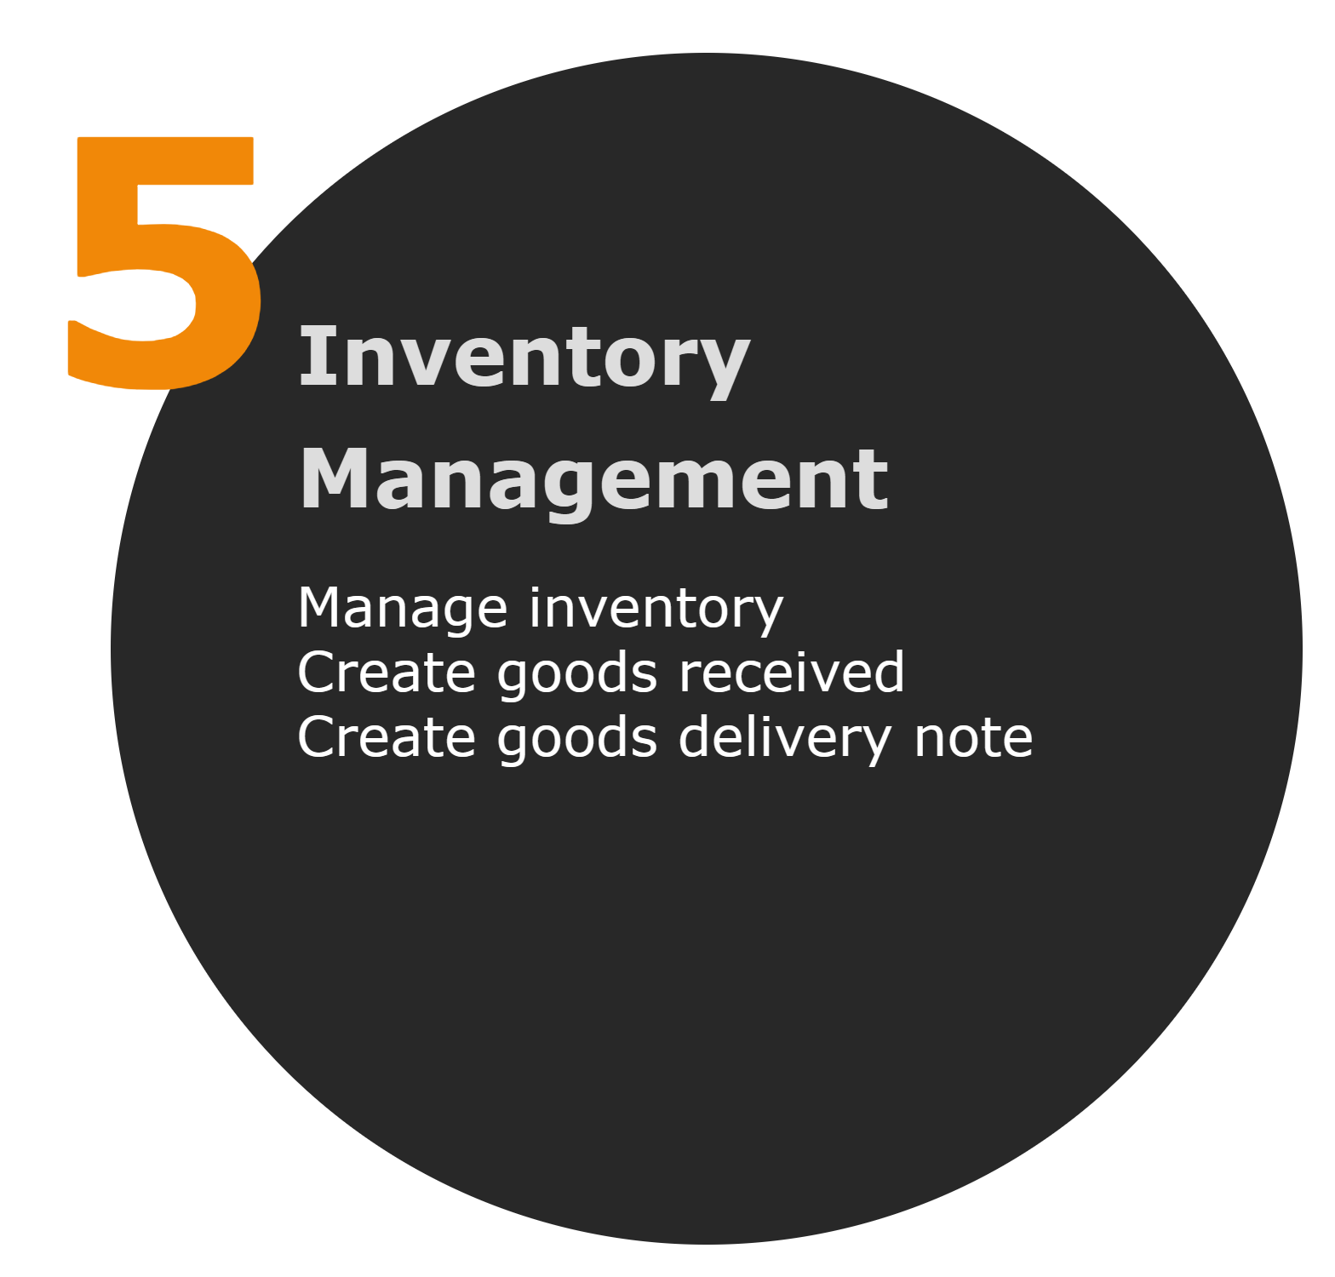
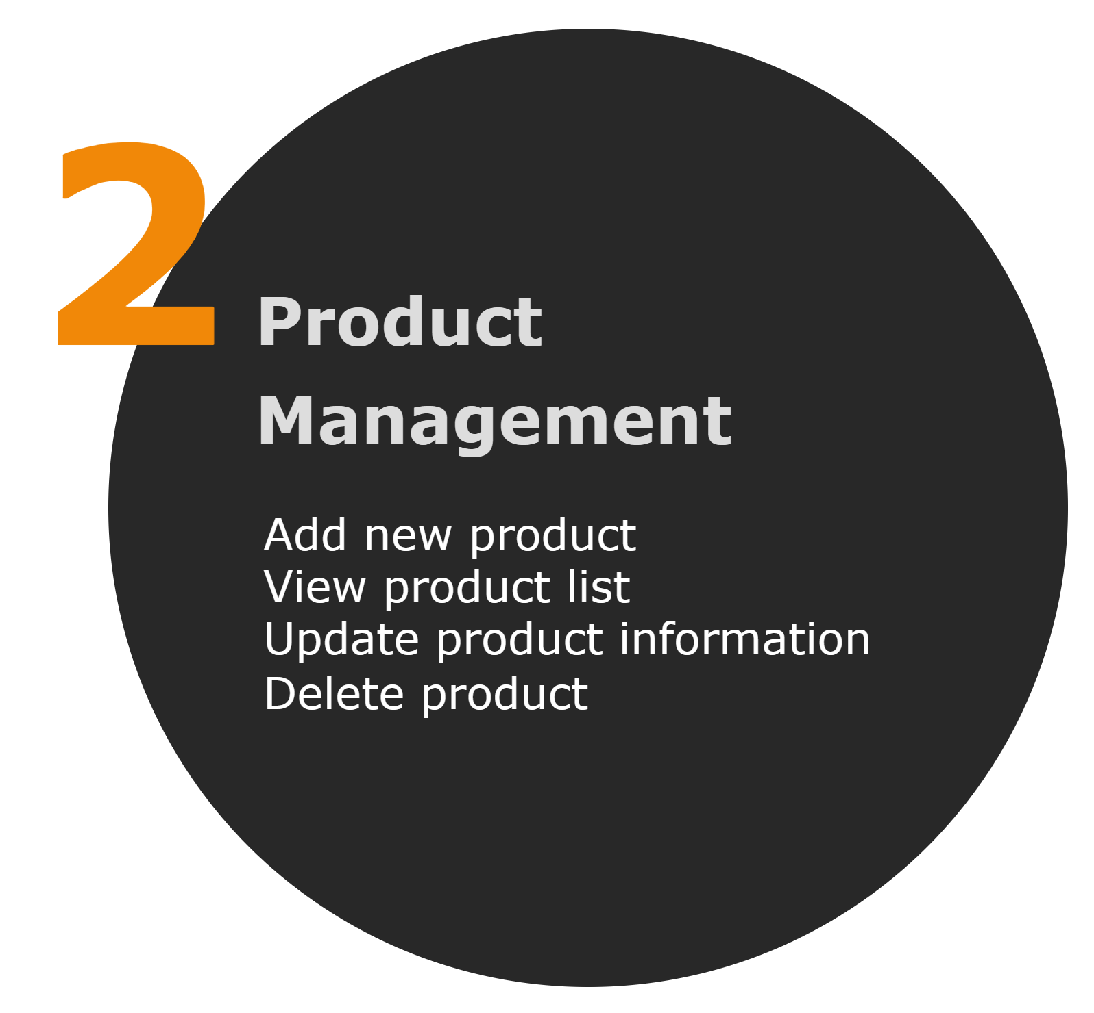
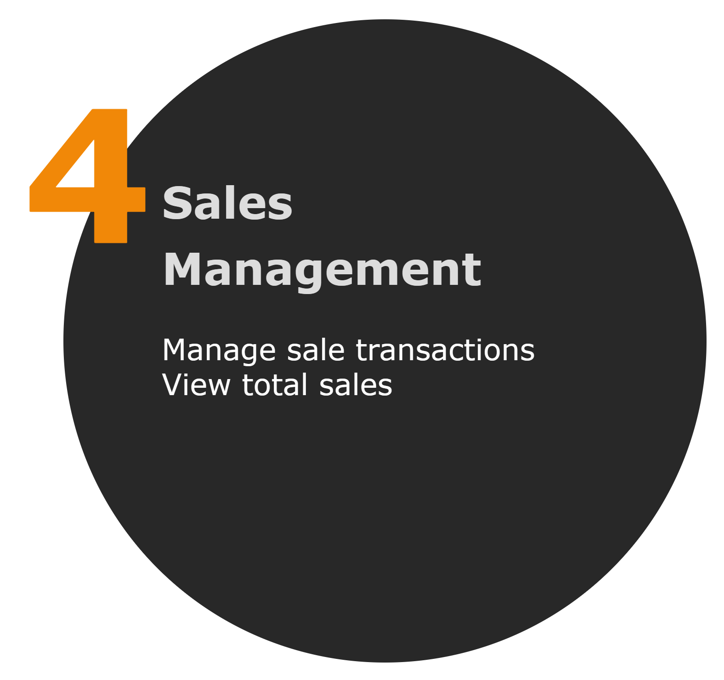
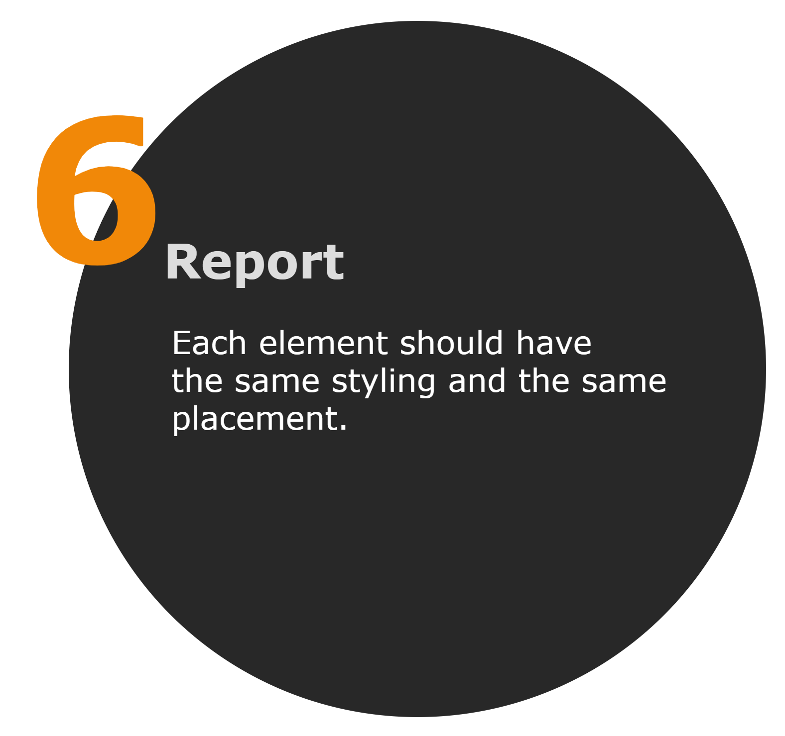
Business Processes / Flowchart of Requirements

Slide 6
Requirements | Functional | Non-Functional
The company must provide a manage account for each retail store agent | X
The system must allow administrators to modify product | X
The system must allow company users to create a new customer for the first-time purchase | X
The system must allow company users to manage Sale transactions for each retail store agent | X
The system must allow company users to manage the inventory | X
The system must allow company users to make report for the company & retail store agents | X
Only administrator can change product information |  | X
Sale staff are allowed to view the product list but cannot change any content |  | X
Sale staff cannot see the original price of the product |  | X
The system must not show the Delete button with the Salesperson account |  | X
Work breakdown
LIST OF REQUIREMENTS

Slide 7
System Narrative
Company system
A retail store agent logs in to the POS system using his or her account. The system verifies the account and displays the main menu with different options according to the agent’s role and permissions (admin, manager, staff).
The agent can perform various tasks such as managing products, customers, sales, inventory, and reports. For each task, the agent can select the corresponding option from the main menu and the system will show the relevant interface.
For example, if the agent wants to add a new product, he or she can select the product management option and then the add product option. The system will prompt the agent to enter the product information such as barcode, name, price, category, etc. The system will validate the input and store the product in the database.
The agent can also view, update, or delete existing products from the product list. The system will display the product details and allow the agent to make changes or remove the product. The system will update or delete the product in the database accordingly.
Similarly, the agent can manage customers, sales, inventory, and reports using the POS system. The system will provide the necessary functions and interfaces for each task and interact with the database to store or retrieve the data.
The system will also generate receipts, invoices, and other documents for the transactions and print them out for the customers or the agents. The system will also keep track of the sales and inventory status and alert the agents if there are any issues or discrepancies. The system will also produce various reports for the company and the agents to monitor and analyse the business performance.
Alternate scenario - Customer cancels the order.

Slide 8
User/Actor | User Goal
Company | Manage Manager Account
Manager | Manage Staff Account
 | Manage Product
 | Manage Inventory
Staff | Manage Customer
 | Manager Transactions
Users and their goals

Slide 9
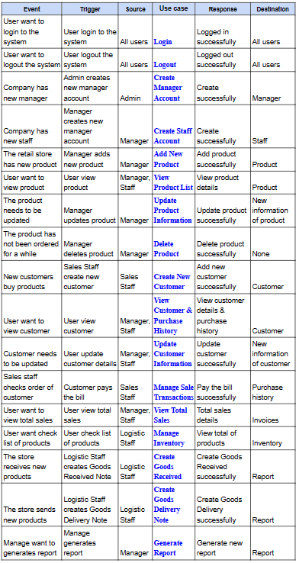
List of event

Slide 10
List of Actors
B2B System
01
Admin
Retail store
02
Manager
Sales staff
Logistic staff
03
Staff

Slide 11
List of use cases
Login
Logout
Create Manager Account
Create Staff Account
Manage Sale Transactions
View Total Sales
Add New Product
View Product List
Update Product Information
Delete Product
Manage Sale Transactions
View Total Sales
Create New Customer
View Customer & Purchase History
Update Customer Information
Delete Customer
Generate Report

Slide 12
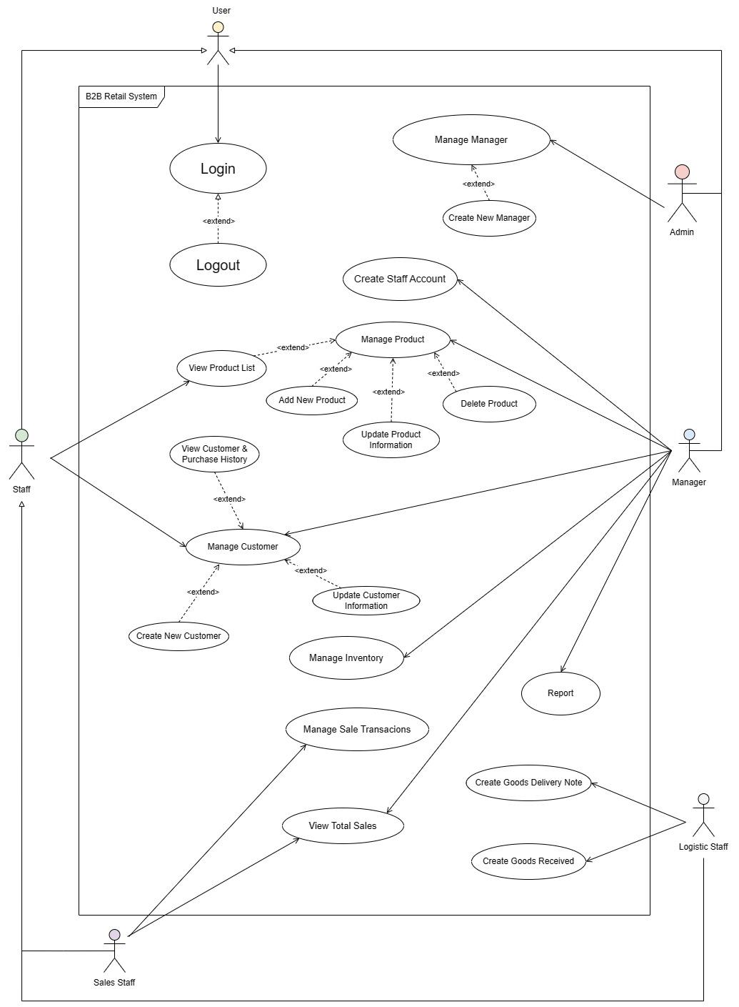
Use Case Diagram

Slide 13
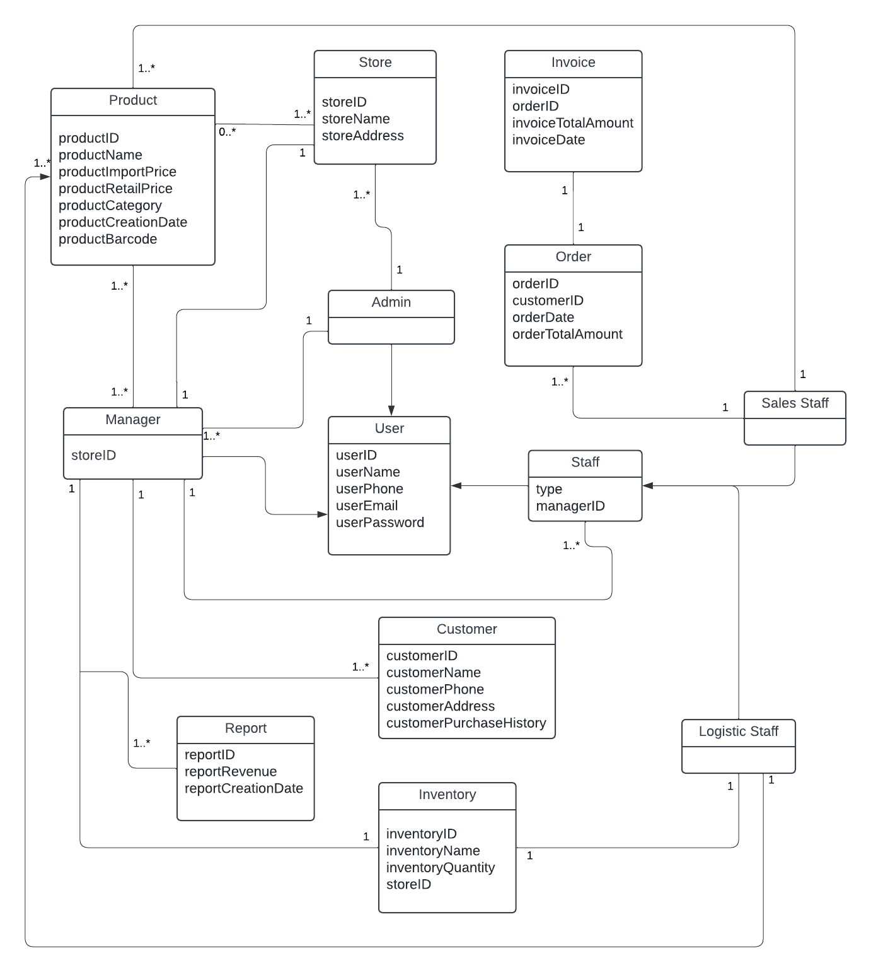
Domain class diagram

Slide 14
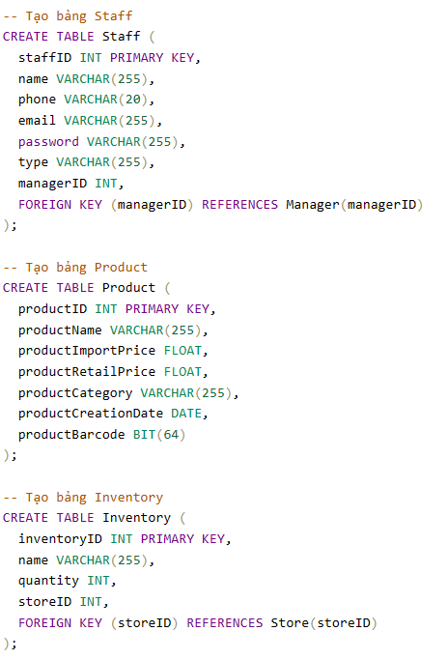
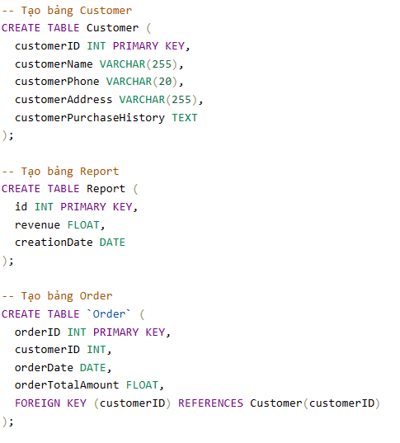
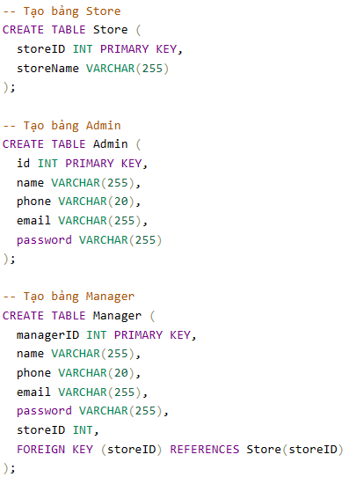
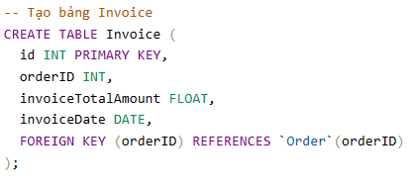
SQL code

Slide 15
Conclusions
Overall, my team has roughly outlined the main aspects of retail operations management. It includes admin account management, allowing store managers to create accounts for employees. The product management system allows administrators to perform essential operations such as viewing, adding, updating, and deleting products. Sales staff have limited access to view product listings without modifying content or viewing original prices. Customer management allows creating new customer accounts and tracking their purchase history. Sales management facilitates the creation of invoices and reports for sales transactions, while inventory management ensures effective inventory tracking and control across retail stores. Finally, the reporting system allows generating reports for both the company and individual retail stores.
However, because of the tight schedule and many projects, the team was unable to complete system development on time.

Slide 16
-THANKS FOR WATCHING-

