Slide 1
.NET and C#

Slide 2


.NET Framework
A software framework developed by Microsoft that runs primarily on Microsoft Windows.
It includes a large class library named as Framework Class Library (FCL) and provides language interoperability across several programming languages.
Programs written for .NET Framework execute in a software environment named the Common Language Runtime (CLR).
FCL and CLR together constitute the .NET Framework.
Notes:
By late 2000, the first beta versions of .NET 1.0 were released.

Slide 3
Supported Languages
C#
C++/CLI
ClojureCLR
Cobra
Component Pascal
Eiffel
F#
F*
Fantom
IronPython
IronScheme
JScript .NET
Limnor Studio
Managed Jscript
Nemerle
Oxygene
PeachPie
Phalanger
PowerBuilder
Small Basic
Silverfrost FTN95.
Synergy DBL .NET
Team Developer
Visual Basic .NET (VB.NET)
Visual COBOL
PowerShell
X#

Slide 4

.NET Architecture
Common Language Infrastructure (CLI)
Common Language Runtime (CLR)
Assemblies
Class Libraries: BCL/FCL
App models: Web, Desktop, Communication etc.
Notes:
CLR - Execution engine of .NET Framework and offers many services such as memory management, type safety, exception handling, garbage collection, security and thread management.
FCL- provides user interface, data access, database connectivity, cryptography, web application development, numeric algorithms, and network communications.

Slide 5
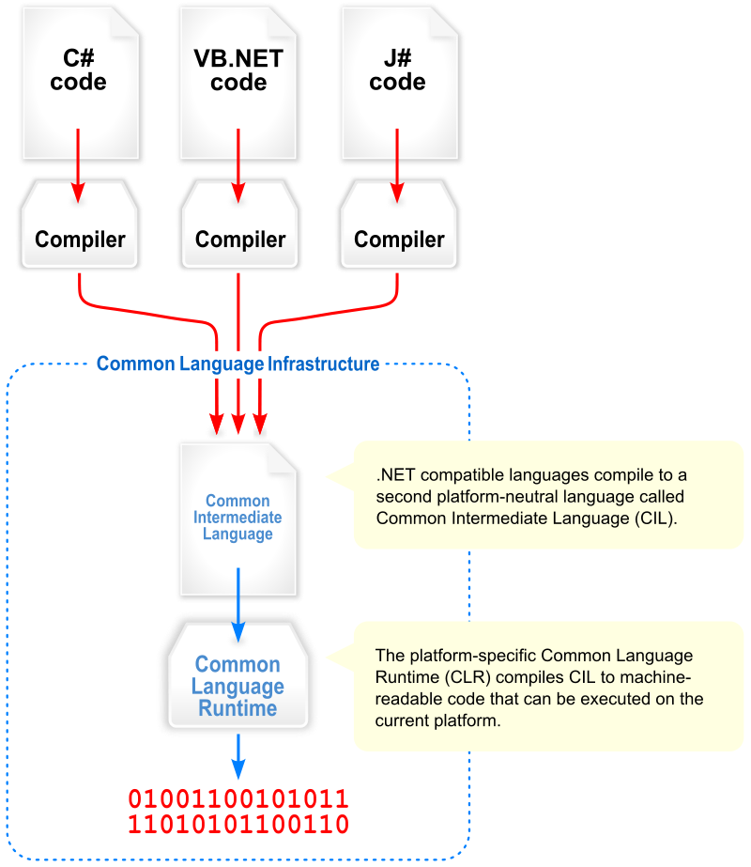

Slide 6
.NET Design Principles
Interoperability
Language independence
Type safety
Portability
Security
Memory management
Performance

Slide 7


.NET Siblings
Notes:
.NET Framework: Supports entire API canvas and a variety of application platforms. Windows only.
Mono: Open source platform based on the .NET Framework and the ECMA standards for C# and the Common Language Infrastructure (CLI).
.NET Core: Runs on any platform. New lean modular cross-platform and open source version of .NET, written from ground up.
.NET Siblings (Alternate Implementations)

Slide 8
.NET Core
.NET Core is a free and open-source framework for Windows, Linux, and macOS operating systems. It is a cross-platform successor to .NET Framework.
.NET Core 1.0 released on June 27, 2016.
Fully supports C# and F# and partially supports Visual Basic.

Slide 9
.NET Core Architecture
.NET Core supports:
ASP.NET Core web apps
Command-line apps
Libraries
Desktop technologies:
Universal Windows Platform apps (UWP)
Windows Forms
Windows Presentation Foundation (WPF)
NET Core supports use of NuGet packages
Unlike .NET Framework, which is serviced using Windows Update, .NET Core relies on its package manager to receive updates.

Slide 10
History
1999
.NET Framework Started
2000
.NET 1.0 beta release
2001
CLI and C# were verified by ECMA
2004
Mono 1.0
2007
.NET 3.5 under Microsoft Reference Source License.
2017
.NET Core 2.0
2002
Microsoft and Intel worked to standardize CLI and C#
Mono Announced
.NET 1.0
2016
.NET Core 1.0
2015
CoreRT
2014
.NET Native (UWP)
.NET Core announced
2012
.NET 4.5
2010
.NET 4.0
Unity
2009
MonoTouch for iOS 1.0
2008
.NET 3.5
2003
ISO also Standardize both CLI and C#.
.NET Compact Framework 1.0
2006
.NET 2.0
Mono AOT
.NET Micro 1.0
Silverlight 1.0
2019
.NET Core 3.0
.NET 4.8
2020
.NET 5
(based on .NET Core)
2011
Mono for Android 1.0

Slide 11

C# Programming Language
A general-purpose, multi-paradigm programming language encompassing strong typing, imperative, declarative, functional, generic, object-oriented and component-oriented programming disciplines.
C# is one of the programming languages designed for CLI.
Notes:
C# was designed by Anders Hejlsberg, and its development team is currently led by Mads Torgersen. The most recent version is 8.0, which was released in 2019 alongside Visual Studio 2019 version 16.3.

Slide 12
Distinguishing features (with C, C++, and Java)
Portability : Could generate machine code
Typing : var, new[], bool, safe implicit conversions etc.
Meta Programming : Attributes
Methods and functions : Scope modifier virtual keyword unlike Java, extension methods, dynamic for runtime method binding, strongly typed function pointer with delegate etc.
Property : Encapsulation for pair of methods – accessor (getter) and mutator (setter) operations
Namespace : Code isolation
Memory Access : Memory address pointers can be used with unsafe blocks
Polymorphism : No multiple inheritance, operator overloading unlike Java
LINQ : Querying IEnumerable<T> object, XML docs, ADO.NET Dataset and SQL database
Functional Programming : first-class functions and closures through anonymous delegates, lightweight lambda expressions, extension methods, list comprehension, tuples and pattern matching
Notes:
C# compiler could generate machine code like traditional compilers of C++ or Fortran.
bool (strict, integer is not assumed true/false), more type safe than C++ (safe implicit conversions enforced at compile-time, JIT and some cases runtime)
Query IEnumerable<T> object, XML docs, ADO.NET Dataset and SQL database with language structures like query expressions, lambda expressions, anonymous types , implicitly types variables, extension methods and object initializers.
Though imperative, supports first-class functions and closures through anonymous delegates, lightweight lambda expressions, extension methods, list comprehension, tuples and pattern matching

Slide 13
Integrated Development Environment (IDE)

Slide 14
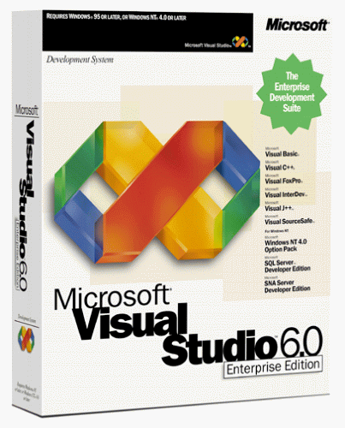
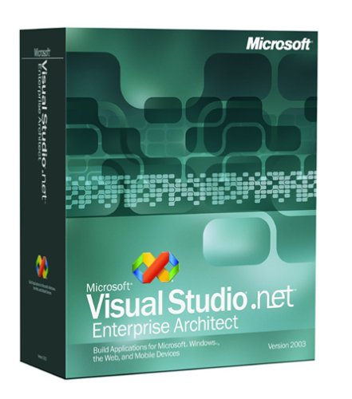
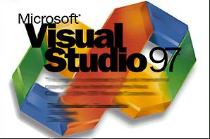
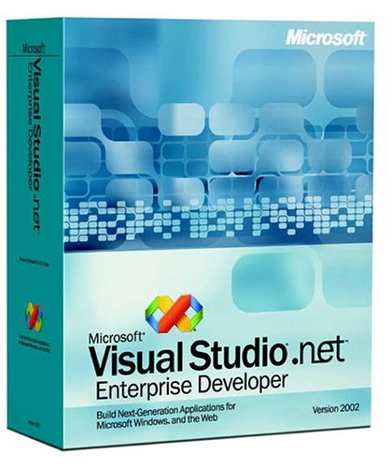
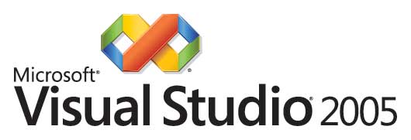
#vshistory
Notes:
VS 97, VS 6.0 (1998), VS .NET (2002), VS .NET 2003, 2005, 2008, 2010, 2012, 2013, 2015, 2017, 2019

Slide 15




VS2010
VS2012
VS2013

Slide 16




VS2015
VS2017
VS2019

Slide 17
.NET, .NET Core and C# Together
Version | Release Date | .NET/.NET Core | Visual Studio
C# 1.0 | Jan 2002 | .NET 1.0 | Visual Studio .NET 2002
C# 1.1 and 1.2 | Apr 2003 | .NET 1.1 | Visual Studio .NET 2003
C# 2.0 | Nov 2005 | .NET 2.0 | Visual Studio 2005
C# 3.0 | Nov 2007 | .NET 2.0 | Visual Studio 2008
 |  | .NET 3.0 | Visual Studio 2010
 |  | .NET 3.5
C# 4.0 | Apr 2010 | .NET 4 | Visual Studio 2010
C# 5.0 | Aug 2012 | .NET 4.5 | Visual Studio 2012, Visual Studio 2013
C# 6.0 | Jul 2015 | .NET 4.6, .NET Core 1.0 | Visual Studio 2015
C# 7.0 | Mar 2017 | .NET 4.6.2, .NET Core 1.1 | Visual Studio 2017
C# 7.1 | Aug 2017 | .NET 4.7, .NET Core 2.0 | Visual Studio 2017(15.3)
C# 7.2 | Nov 2017 | .NET 4.7.1, .NET Core 2.0 | Visual Studio 2017(15.5)
C# 7.3 | May 2018 | .NET 4.7.2, .NET Core 2.1 | Visual Studio 2017(15.7)
C# 8.0 | Sep 2019 | .NET 4.8, .NET Core 3.0 | Visual Studio 2019(16.3)

Slide 18
Nuts and bolts
GitHub Account
GitHub Repo: https://github.com/binbsr/.NETClassesCotiviti.git
Installations:
Latest .NET Core SDK (Its 3.0 as of 10/31/2019)
Visual Studio Code with C# extensions (For keyboard lovers ☺)
Or Visual Studio 2019 any editions (For mouse lovers ☺)

Slide 19

Before We Start
https://docs.microsoft.com/en-us/dotnet/csharp/tutorials/intro-to-csharp/

