Slide 1
AMD HACKATHON · ENGINEERING REVIEW
01 / 08
AlphaNoah A1 Edge Agent
Local AI workflow for industrial equipment troubleshooting.
AMD Ryzen AI Max+ 395
Local inference path
Human-controlled workflow
A bounded and auditable edge AI workflow.
Notes:
[Sources]
- User-provided, confirmed AlphaNoah A1 Edge Agent deck brief, 2026-08-06.
- https://github.com/binc64358-rgb/AlphaNoah-A1-Edge-Agent-Public/blob/00b65c667a89ba9202d4fd1769f9d369c84aeba6/README.md

Slide 2
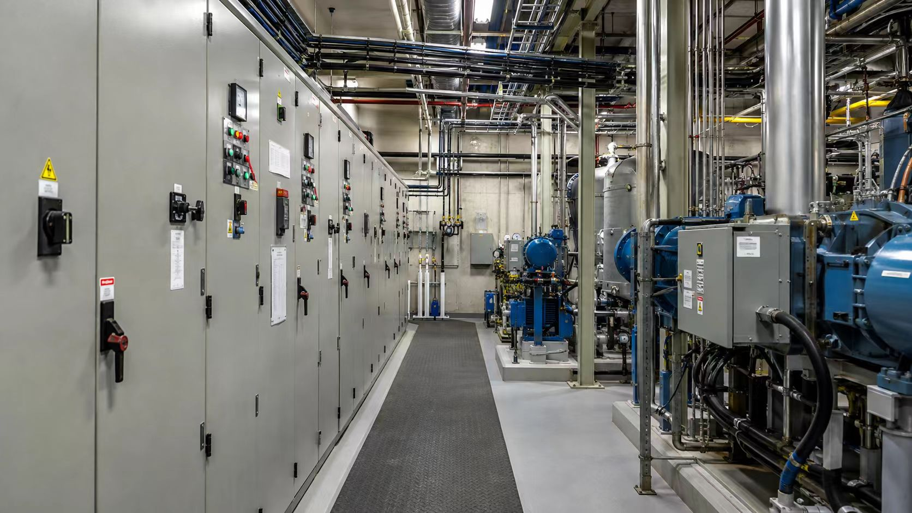
AMD HACKATHON · ENGINEERING REVIEW
02 / 08
The Problem
Troubleshooting knowledge exists, but it is difficult to apply consistently at the moment of need.
Equipment troubleshooting depends on individual experience.
Procedures and past observations are difficult to reuse.
Cloud-first AI may not fit private industrial environments.
ALPHANOAH A1 EDGE AGENT
Notes:
[Sources]
- User-provided, confirmed AlphaNoah A1 Edge Agent deck brief, 2026-08-06.
- https://github.com/binc64358-rgb/AlphaNoah-A1-Edge-Agent-Public/blob/00b65c667a89ba9202d4fd1769f9d369c84aeba6/README.md

Slide 3
AMD HACKATHON · ENGINEERING REVIEW
03 / 08
From Problem Report to Human Decision
Problem Report
Local AI Analysis
Structured Preliminary Diagnosis
Recommended Actions
Human Review
No device command is generated.
ALPHANOAH A1 EDGE AGENT
Notes:
[Sources]
- User-provided, confirmed AlphaNoah A1 Edge Agent deck brief, 2026-08-06.
- https://github.com/binc64358-rgb/AlphaNoah-A1-Edge-Agent-Public/blob/00b65c667a89ba9202d4fd1769f9d369c84aeba6/README.md

Slide 4
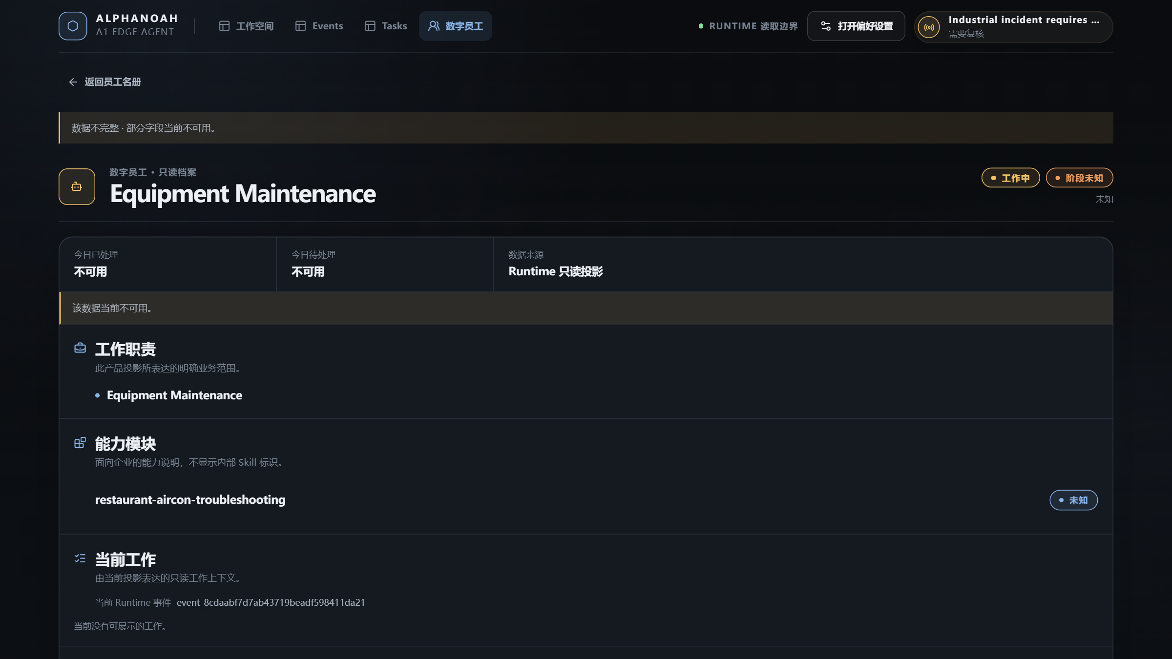
AMD HACKATHON · ENGINEERING REVIEW
04 / 08
Digital Employee Concept
Digital Employee =
Capability
+ Knowledge
+ Role Context
Equipment Troubleshooting Employee
A human-understandable, read-only capability projection.
Not a chatbot · Not an autonomous worker
ALPHANOAH A1 EDGE AGENT
Notes:
[Sources]
- User-provided, confirmed AlphaNoah A1 Edge Agent deck brief, 2026-08-06.
- https://github.com/binc64358-rgb/AlphaNoah-A1-Edge-Agent-Public/blob/00b65c667a89ba9202d4fd1769f9d369c84aeba6/README.md

Slide 5
AMD HACKATHON · ENGINEERING REVIEW
05 / 08
System Architecture
Operator
Capability Resolution
Local User Interface
Knowledge Context
AlphaNoah Runtime
SQLite State & Audit
Bounded Event
Explicit AI Provider
Structured Result
AI analyzes bounded context.
LOCAL EXECUTION FOUNDATION
Ollama · ROCm · AMD Hardware
Human Review
Runtime controls state, validation and the human-review boundary.
ALPHANOAH A1 EDGE AGENT
Notes:
[Sources]
- User-provided, confirmed AlphaNoah A1 Edge Agent deck brief, 2026-08-06.
- https://github.com/binc64358-rgb/AlphaNoah-A1-Edge-Agent-Public/blob/00b65c667a89ba9202d4fd1769f9d369c84aeba6/README.md

Slide 6
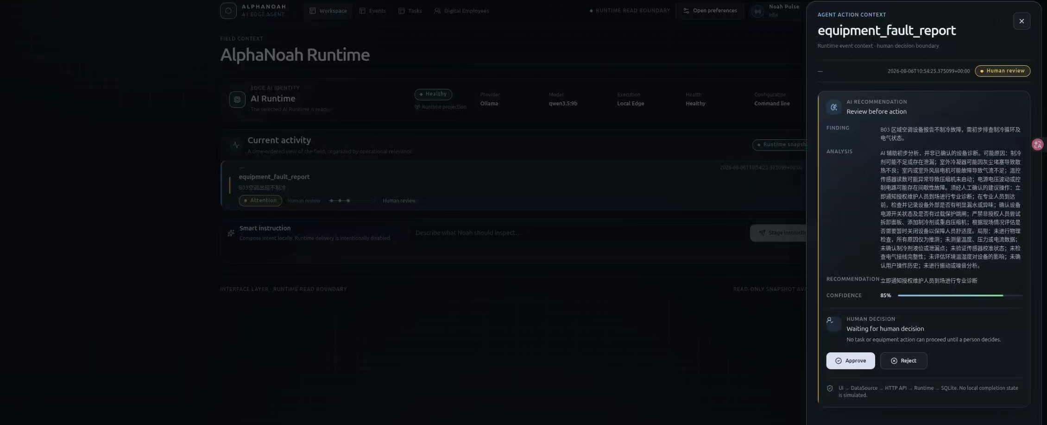
AMD HACKATHON · ENGINEERING REVIEW
06 / 08
Demo Scenario
INPUT
LOCAL ANALYSIS
STRUCTURED RESULT
Location
Possible causes
B03
Local Ollama
Recommended actions
Problem
qwen3.5:9b
Human review required
空调出现不制冷
Bounded request
Fixed output contract
PENDING_HUMAN_REVIEW
ALPHANOAH A1 EDGE AGENT
Notes:
[Sources]
- User-provided, confirmed AlphaNoah A1 Edge Agent deck brief, 2026-08-06.
- https://github.com/binc64358-rgb/AlphaNoah-A1-Edge-Agent-Public/blob/00b65c667a89ba9202d4fd1769f9d369c84aeba6/README.md

Slide 7
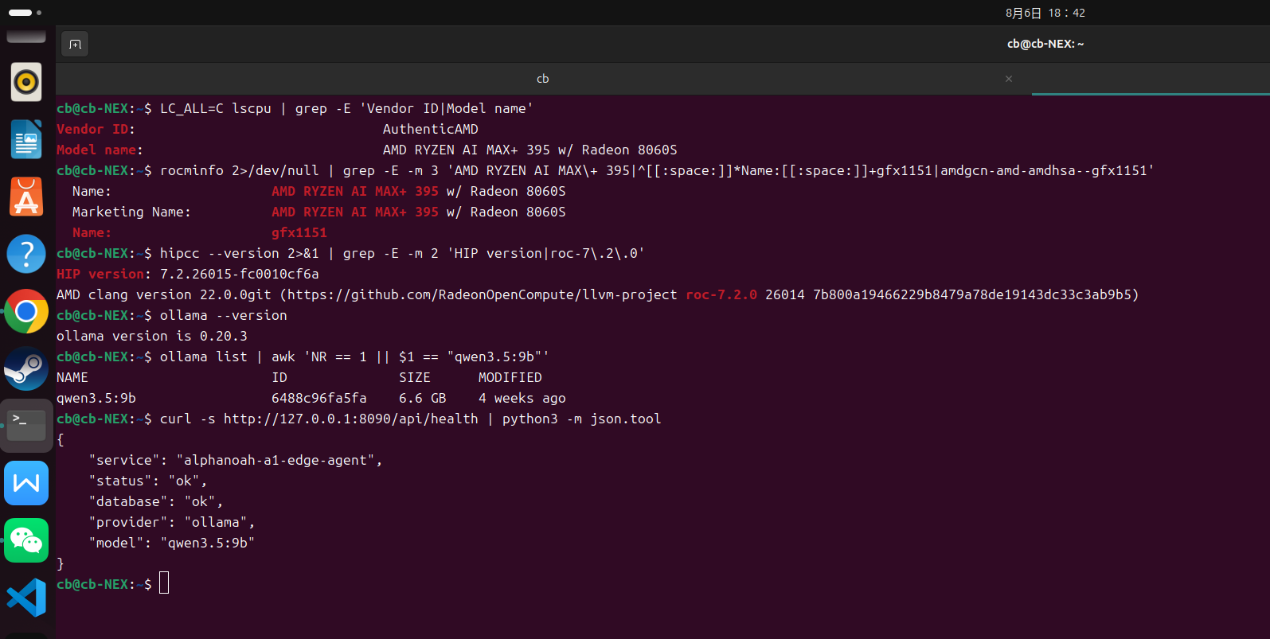
AMD HACKATHON · ENGINEERING REVIEW
07 / 08
AMD Edge Validation
A real local execution path was validated on the AMD ROCm environment.
qwen3.5:9b
Ollama
ROCm 7.2
AMD Radeon 8060S
Ryzen AI Max+ 395
Local response completed
Structured contract passed
Human review remained mandatory
Integration record — not a performance benchmark.
ALPHANOAH A1 EDGE AGENT
Notes:
[Sources]
- User-provided, confirmed AlphaNoah A1 Edge Agent deck brief, 2026-08-06.
- https://github.com/binc64358-rgb/AlphaNoah-A1-Edge-Agent-Public/blob/00b65c667a89ba9202d4fd1769f9d369c84aeba6/README.md
- https://github.com/binc64358-rgb/AlphaNoah-A1-Edge-Agent-Public/blob/8301346acdfaaa8e7632950303d4546e7108f3ad/docs/demo/OLLAMA_EVENT_ANALYSIS.md

Slide 8
AMD HACKATHON · ENGINEERING REVIEW
08 / 08
Current Capability and Future Direction
CURRENT — VERIFIED
FUTURE — PLANNED
Controlled air-conditioner troubleshooting demo
Additional Digital Employees
Local Ollama analysis
Sensor and vision integration
Structured output
Industrial context layer
Human review workflow
Current value: bounded local analysis with a visible human decision boundary.
Future items are not part of the Hackathon release.
ALPHANOAH A1 EDGE AGENT
Notes:
[Sources]
- User-provided, confirmed AlphaNoah A1 Edge Agent deck brief, 2026-08-06.
- https://github.com/binc64358-rgb/AlphaNoah-A1-Edge-Agent-Public/blob/00b65c667a89ba9202d4fd1769f9d369c84aeba6/README.md

