Slide 1
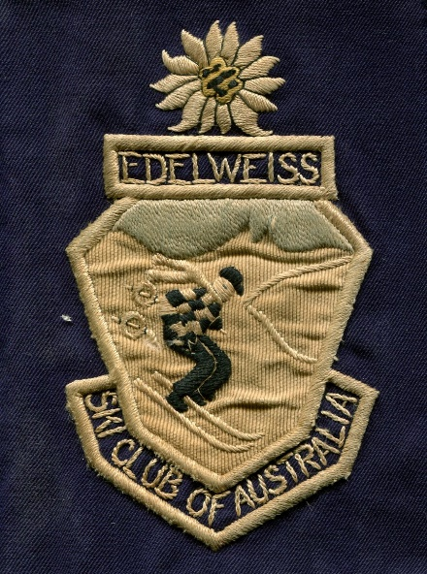
Edelweiss Ski Club New Member’s Information

Slide 2
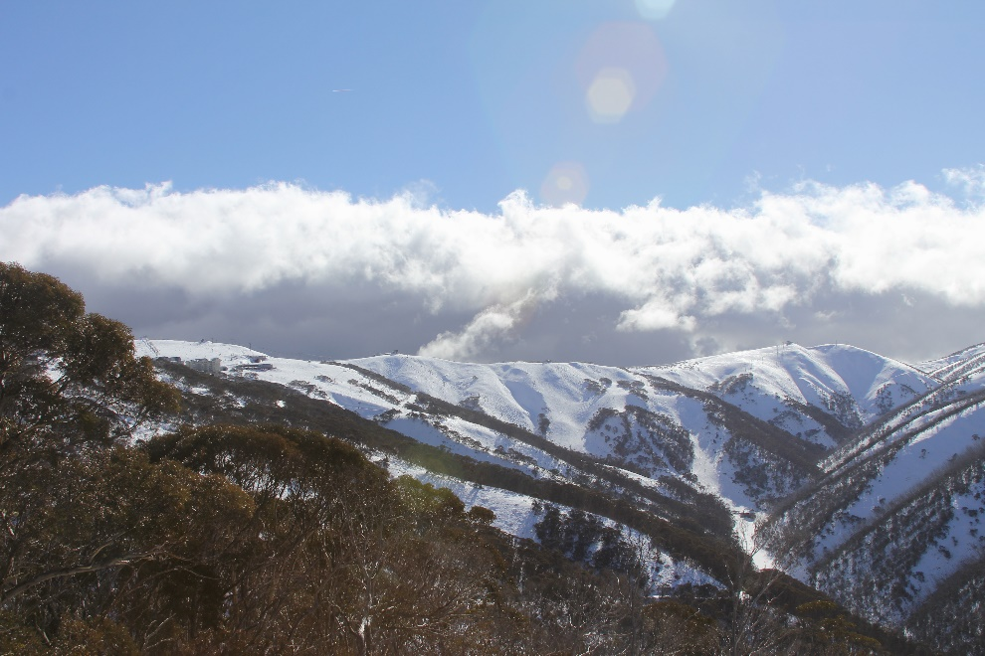
Invitation
An opportunity to become a private member of the “Edelweiss” ski club at Mt Hotham is available.
This opportunity has arisen after the MHRMB (Mt Hotham Resort Management Board) required that the sewer system at the property be updated and connected to the mains reticulate system, which has placed some financial burden on the Club. With the sewer works now funded, we are now looking to increase the membership to help raise funds required for building upgrades, and to secure the future of the Club.
Edelweiss is positioned on a truly unique site, and we are looking forward to welcoming like minded new members to the Club who are excited by all the wonders that Mt Hotham has to offer.
View from the Edelweiss

Slide 3
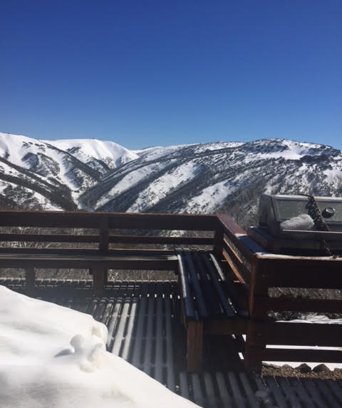
About Edelweiss
History
The Edelweiss ski club was formed in 1934
It is one of the original three private ski clubs granted leases at Mt Hotham between 1945-1947, and has occupied the current site for the last 60 years
The existing membership of Edelweiss includes 3rd generation families descended from the founding members
The Club is proud to be associated with the significant role the original members played in establishing the skiing culture that exists at Hotham today.
Why is Edelweiss special?
Uninterrupted spectacular views
Unique quiet location
Safe / private outdoor kids play area
Outside deck & BBQ area
Great access to both ski runs (Davenport Access) and walking tracks (Cobungra Ditch)
Family style accommodation, maintaining the original historical building and atmosphere established by the founding members
Active, energetic, successful working committee
Local cabin manager in Winter to help open / close the lodge
Deck & BBQ

Slide 4
Lodge Facilities & Location
Facilities
The lodge sleeps 14 people max, with 3 family rooms (small rooms containing bunk beds).
2 communal showers, and 2 communal toilets.
Shared kitchen / living area.
Large food / pantry area
Drying room
Ski room
Additional Amenities: Dishwasher, oven, microwave, fridge, freezer, clothes washer, vacuum, full set of kitchen utensils (including toaster, sandwich press etc), outside gas BBQ, TV / DVD player (not with antenna)
Lodge meets all Health & Safety inspections as dictated by MHRMB (Mt Hotham Resort Management Board).
In Winter a local Cabin Manager can help with opening the lodge (turning on the gas, hot water etc) and also help with cleaning after departure (for a small fee).
Location
As per most lodges at Hotham there is no roadside parking, so luggage needs to be offloaded at the top of the driveway and carried down to the lodge (~100m).
The Davenport Access track is within walking distance of the lodge, so if the snow is good you can be on a chair lift within 10 minutes.
The village bus will pick up and drop off at the top of the driveway, which allows for quick and easy access to all the ski slopes.

Slide 5
Club Background
The Club’s vision is (and always has been) to provide affordable accommodation at Mt Hotham to families year-round, so that they can enjoy all the wonders that Mt Hotham has to offer.
Edelweiss Ski Club of Victoria is an Incorporated Association operating under the Model Rules, under Section 46 of the Associations Incorporations Reform Act 2012.
The Club’s structure consists of a President, Secretary, Treasurer and Cabin Manager.
There are currently ~20 Full Club Members.
For a family, there is only one Full member. Both spouses and children of members are recognized.
Child members that come of age (18 yrs) are offered full membership, continuing the strong generational foundation of the Club.
While there are upgrades needed to the lodge the Club is not looking to ever become the next Hotham Hilton.
In 2018 the MHRMB (Mt Hotham Resort Management Board) required that the sewer system at the property be updated and connected to the mains reticulate system.
Recently there has been some uncertainty as to whether or not the Lease on the property would be renewed because of this issue. This matter has now been resolved with the recent approval of a 10 years Lease (on the provision that the sewer works be completed).
The required sewer works will be completed post the 2018 Winter season.

Slide 6
Club Background
There is an expectation that club members are active participants in the Club and attend both the annual AGM, and the annual working party.
Active participation had been a recent issue for the Club. The committee is hoping to address this with the news of the recent 10 year lease renewal and initiating a new membership drive to attract like minded families that have a love of Hotham.
An online booking system is used to make bookings. It opens on Jan 1st each year.

Slide 7
Proposed Payment Schedule
Overnight Rate Type | 2019
Member | $30
Child Member | $15
Guest – Adult (high / low season) | $50
Guest – Child (high / low season) | $20
Summer Rate (whole lodge) | $100
Non member summer rate (whole lodge) Night / Week | $200 / $1,000
Annual Sub Type | 2019
Full Member | $800
Spouse Member | $100
Overseas Member | $200
Working party Levy | $100
Committee Member Levy | -$100
New member: 6x subs (eg for a family = 6x $900) | $5,400
Child member → Full Member: 3x subs (= 3x $800) | $2,400
While a New Member buy-in does seem expensive, it is still very attractive when compared to staying elsewhere on the mountain. Example: Family of 4 staying for 7 nights:
Edelweiss (subs + accom) = $1530
Other = $2500 - $10,000 **
** This doesn’t take availability into account. Search results as per http://www.mthothamaccommodation.com.au/

Slide 8
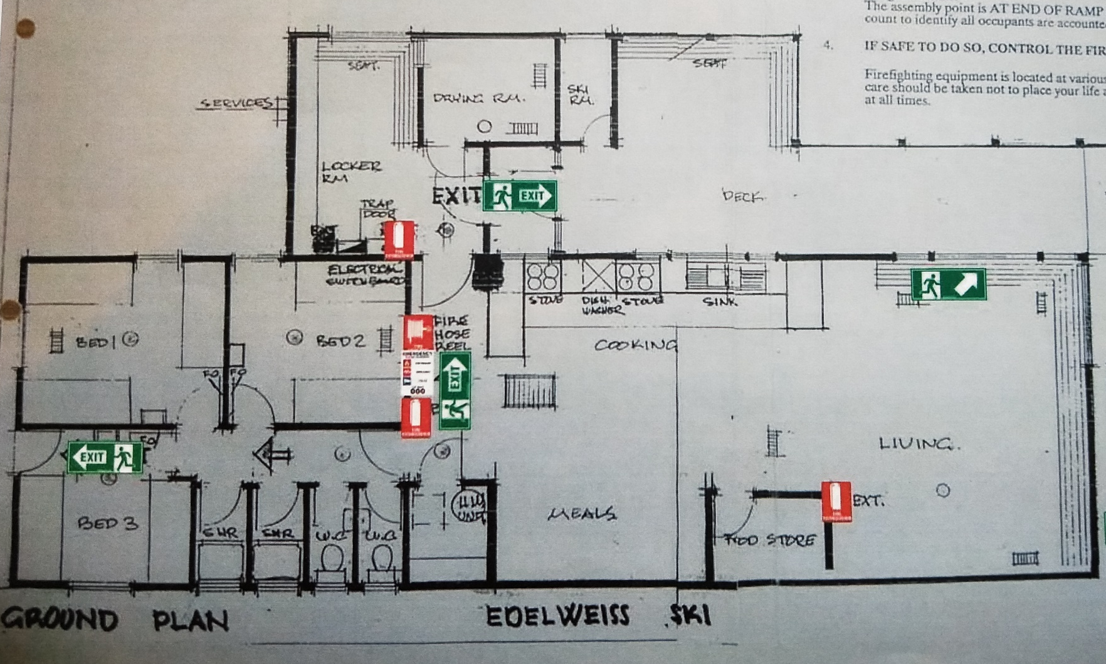
Gallery
Floor Plan

Slide 9
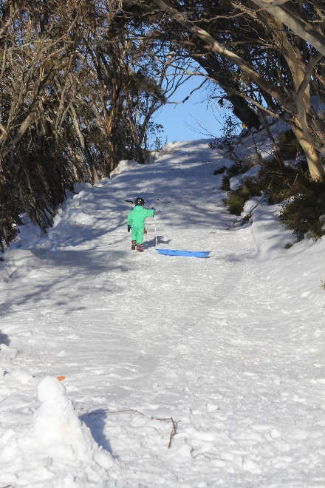
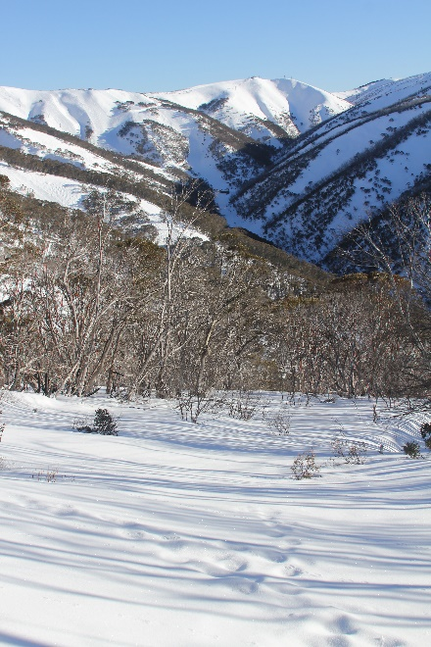
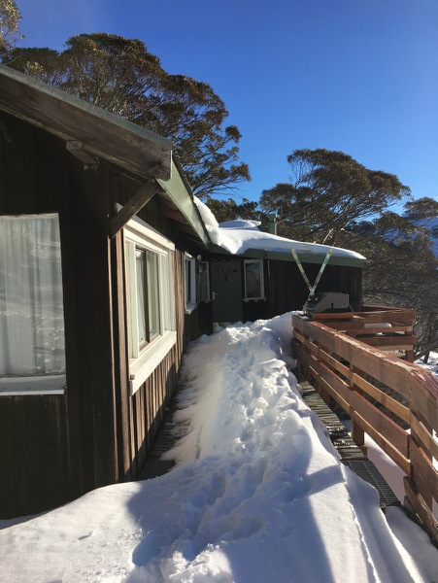
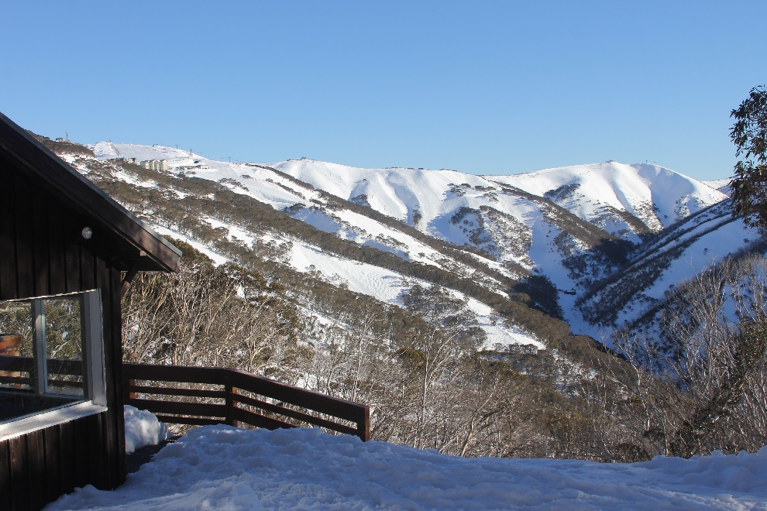
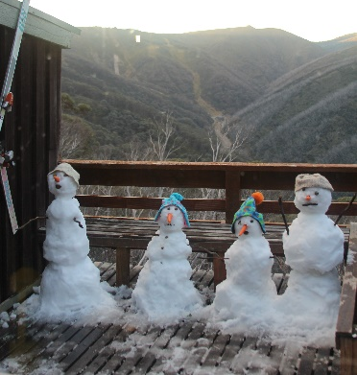
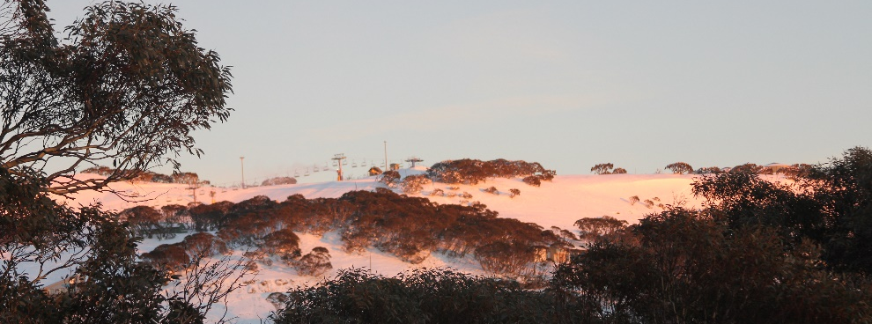
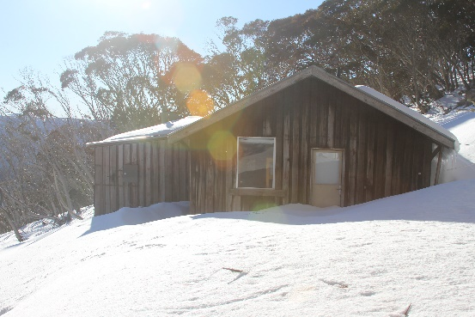
Gallery
Driveway
Play area in front of Lodge
Entrance
Lodge & View
Early snow in Easter
View of Big D
Side of lodge

