Slide 1
Air Quality Index Prediction
Using Ridge and Lasso Regression
REVIEW – 3
Penneti Bindhu Madhavi – 2520030077
Mandapati Keerthi Sri – 2520030079
Guide: Shaik Asif, Assistant Professor, CSE
Department of Computer Science & Engineering
Academic Year: 2026–27
Review-3 • Machine Learning • CSE

Slide 2
Review-3 Objectives
Case scenario → practical EDA → algorithm demonstration → evaluation
01 Case-Based Scenario
02 Practical EDA
Translate the pollution problem into a realistic short-term AQI prediction use case.
Execute Python-based dataset inspection, quality checks, distributions and correlations.
03 Algorithm Demonstration
04 Evaluation
Implement Ridge and Lasso Regression with standardized numerical predictors.
Compare MAE, MSE, RMSE and R² using the actual dataset execution.
Review-3 • Machine Learning • CSE
2

Slide 3
Case-Based Scenario
A concrete operational situation for short-term AQI prediction
Scenario
A city monitoring team receives recent pollutant and environmental readings from monitoring stations.
The team needs a short-term AQI estimate to understand air-quality conditions and support timely monitoring.
Station Data
Pollutants + environment
ML Prediction
Ridge / Lasso
AQI Estimate
Predicted AQI
Why this case matters
AQI depends on multiple variables. Regularized regression provides an interpretable baseline for learning how pollutant and environmental measurements relate to AQI.
Review-3 • Machine Learning • CSE
3

Slide 4
Problem → Proposed Solution
From raw measurements to an evaluated regression model
Problem
Proposed Solution
Actual Dataset Snapshot
• Increasing pollution affects health and ecosystems
• AQI is influenced by several pollutant/environmental parameters
• Multiple variables are difficult to interpret together
• A reproducible prediction pipeline is needed
• Load the Kaggle dataset
• Perform practical EDA
• Select AQI as target
• Split and standardize numerical predictors
• Train Ridge and Lasso models
• Evaluate on held-out data
Rows: 3,660
Columns: 13
Missing values: 0
Duplicate rows: 0
Numeric predictors: 9
Review-3 • Machine Learning • CSE
4

Slide 5
Dataset Description
global_air_quality_dataset • Kaggle
Actual Dataset Facts
Column Names
Model Predictors
Rows: 3,660
Columns: 13
Target: AQI
Missing values: 0
Duplicate rows: 0
Date: object
City / Country: categorical text
AQI: int64
Other measurements: float64 / int64
• Date
• City
• Country
• AQI
• PM2.5 (µg/m³)
• PM10 (µg/m³)
• NO2 (ppb)
• SO2 (ppb)
• CO (ppm)
• O3 (ppb)
• Temperature (°C)
• Humidity (%)
• Wind Speed (m/s)
• PM2.5 (µg/m³)
• PM10 (µg/m³)
• NO2 (ppb)
• SO2 (ppb)
• CO (ppm)
• O3 (ppb)
• Temperature (°C)
• Humidity (%)
• Wind Speed (m/s)
Baseline uses numerical predictors only; Date/City/Country remain available for EDA/context.
Review-3 • Machine Learning • CSE
5

Slide 6
EDA – Dataset Overview
Actual inspection results from the uploaded CSV
Rows
Columns
Missing
Duplicates
3,660
records
13
variables
0
cells
0
rows
print(df.head())
print(df.shape)
print(df.columns.tolist())
df.info()
print(df.isna().sum())
print("Duplicates:", df.duplicated().sum())
Data Quality Result
All 13 columns are populated in the uploaded dataset.
No missing cells were detected and no duplicate rows were detected.
The model code retains a median imputer for robustness.
Review-3 • Machine Learning • CSE
6

Slide 7
EDA – Practical Python Implementation
Core code used to inspect the actual dataset
df = pd.read_csv("global_air_quality_dataset.csv")
print(df.head())
print("Shape:", df.shape)
print("Columns:", df.columns.tolist())
df.info()
print(df.isna().sum())
print("Duplicate rows:", df.duplicated().sum())
print(df.describe(include="all").T)
# Numerical distributions
num_cols = df.select_dtypes(include=np.number).columns
for col in num_cols:
df[col].hist(bins=30)
plt.title(f"Distribution: {col}")
plt.show()
# AQI distribution
df["AQI"].hist(bins=30)
plt.title("AQI Distribution")
plt.show()
Review-3 • Machine Learning • CSE
7

Slide 8
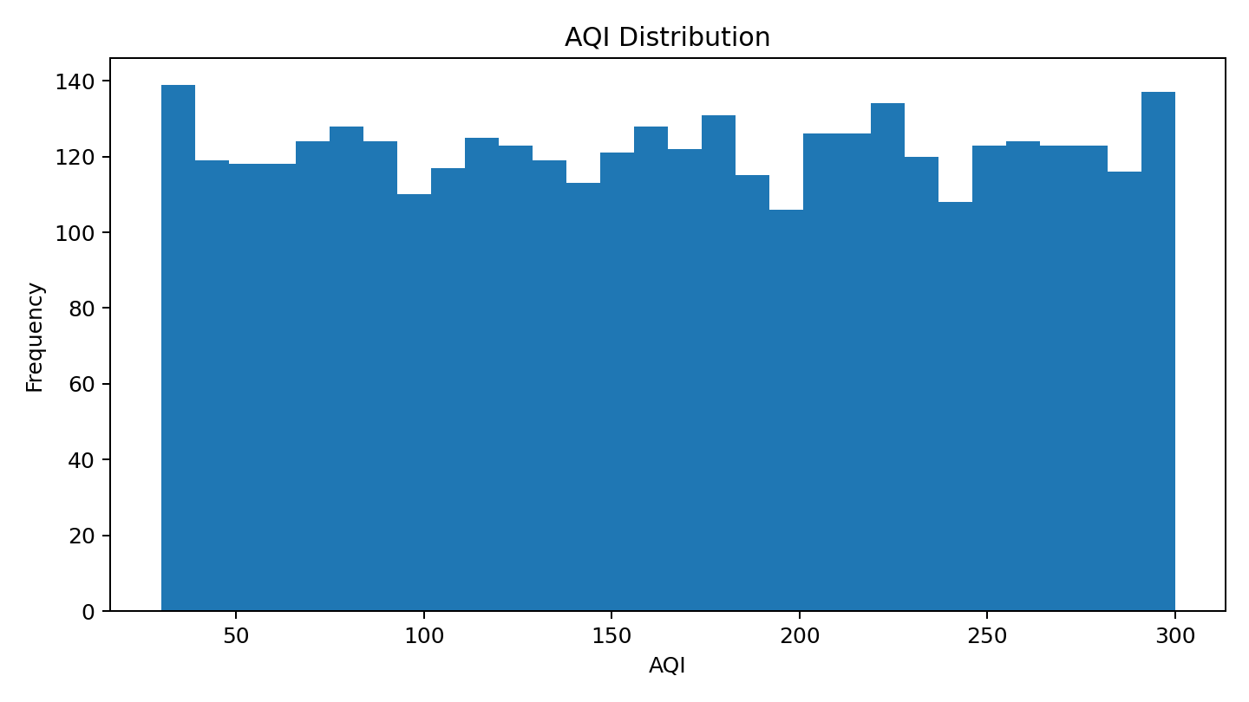
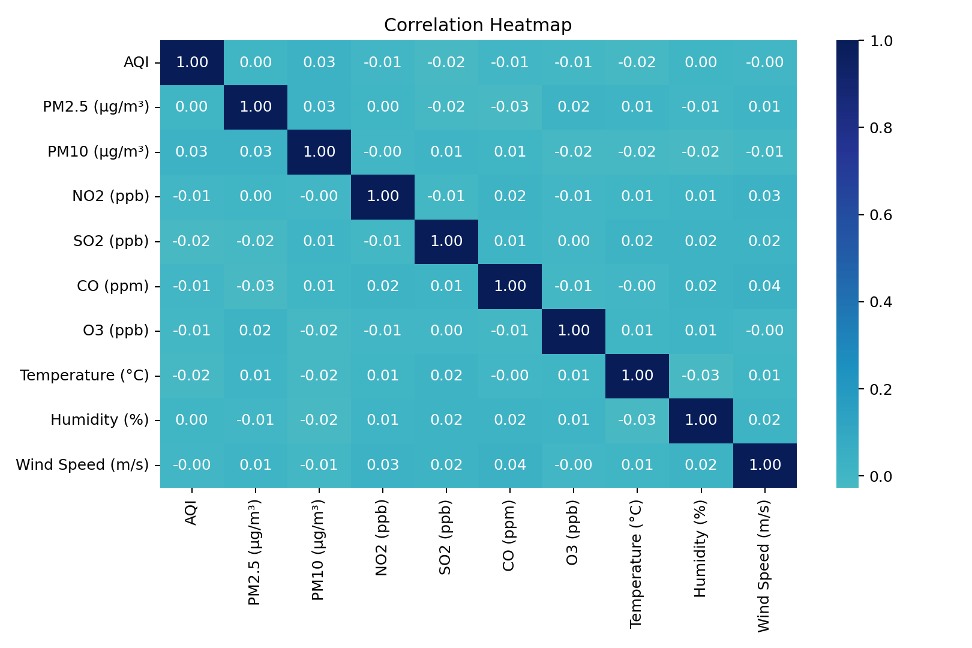
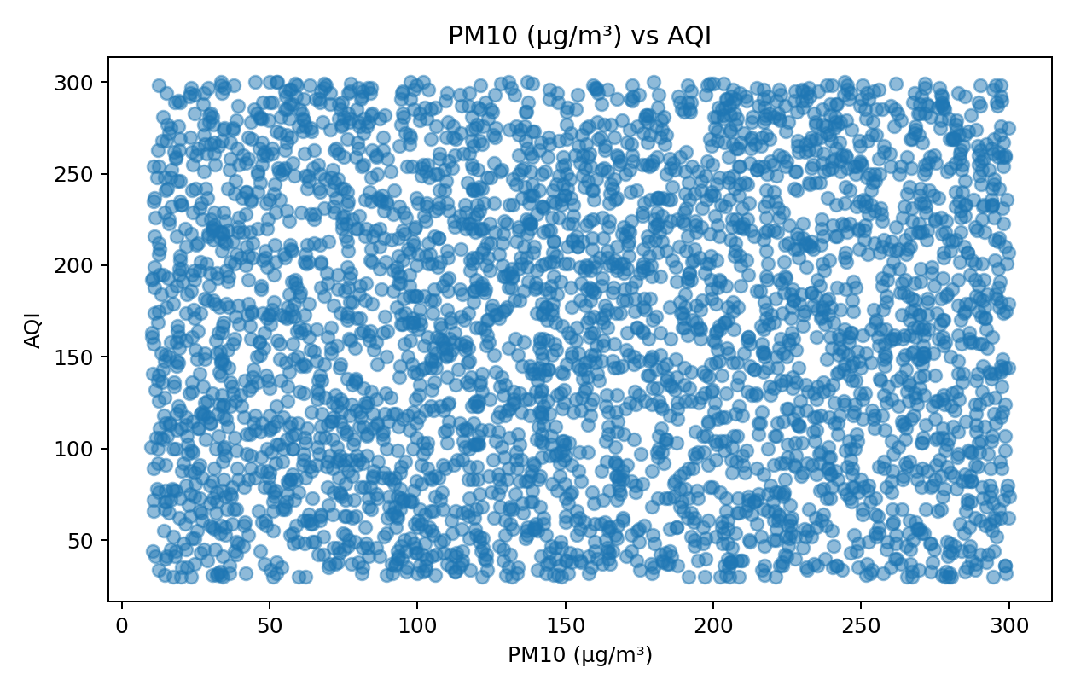
EDA – Visualizations & Correlation Analysis
Actual visual evidence from the uploaded dataset
Strongest AQI Relationships
• PM10 (µg/m³): r = 0.031
• SO2 (ppb): r = -0.025
• Temperature (°C): r = -0.017
• O3 (ppb): r = -0.015
Pollutant / AQI View
Scatter plot shown below for:
PM10 (µg/m³) vs AQI
Pearson correlation: 0.031
Review-3 • Machine Learning • CSE
8

Slide 9
Ridge Regression – Concept + Implementation
L2 regularization controls coefficient magnitude
Concept
Key Idea
ridge = Pipeline([
("imputer", SimpleImputer(strategy="median")),
("scaler", StandardScaler()),
("model", Ridge(alpha=1.0))
])
ridge.fit(X_train, y_train)
ridge_pred = ridge.predict(X_test)
Ridge adds an L2 penalty to least squares.
It discourages very large coefficients and can improve stability when predictors are correlated.
It provides a regularized multi-variable baseline for AQI prediction.
Objective:
minimize ||y − Xβ||² + α||β||²
α controls regularization strength.
Project setting:
α = 1.0
Review-3 • Machine Learning • CSE
9

Slide 10
Lasso Regression – Concept + Implementation
L1 regularization can shrink some coefficients to zero
Concept
Key Idea
lasso = Pipeline([
("imputer", SimpleImputer(strategy="median")),
("scaler", StandardScaler()),
("model", Lasso(alpha=0.1, max_iter=10000))
])
lasso.fit(X_train, y_train)
lasso_pred = lasso.predict(X_test)
Lasso adds an L1 penalty to least squares.
The penalty encourages sparse coefficients, so some features may receive zero weight.
This supports feature selection and model simplification.
Objective:
minimize ||y − Xβ||² + α||β||₁
α controls regularization strength.
Project setting:
α = 0.1
Review-3 • Machine Learning • CSE
10

Slide 11
Model Evaluation & Comparison
Actual results from an 80/20 train-test split (random_state=42)
Model
MAE
MSE
RMSE
R²
Ridge Regression
69.6459
6346.9878
79.6680
-0.0001
Lasso Regression
69.6351
6344.9692
79.6553
0.0002
Evaluation meaning
Experiment settings
MAE: average absolute prediction error
MSE: squared-error measure
RMSE: error in target scale
R²: proportion of target variance explained
Dataset: 3,660 rows × 13 columns
Predictors: 9 numerical features
Split: 80% train / 20% test
Ridge α: 1.0 • Lasso α: 0.1
Review-3 • Machine Learning • CSE
11

Slide 12
Overall Workflow / System Architecture
End-to-end pipeline used in the project
Dataset
3,660 rows
EDA
Inspect • clean • visualize
Preprocessing
Select • split • scale
Models
Ridge + Lasso
Evaluation
MAE • MSE • RMSE • R²
Prediction
AQI estimate
Design principle
Fit preprocessing only on training data, then apply the fitted transformation to test/new observations to avoid data leakage.
Review-3 • Machine Learning • CSE
12

Slide 13
Conclusion & Future Scope
Review-3 outcomes based on actual dataset execution
Conclusion
Future Scope
• Dataset contains 3,660 rows and 13 columns
• No missing cells or duplicate rows were found
• EDA quantified pollutant/environmental relationships with AQI
• Ridge and Lasso were implemented with standardized predictors
• MAE, MSE, RMSE and R² were calculated on held-out data
• The pipeline is reproducible and ready for further tuning
• Tune α using cross-validation
• Explore time-aware forecasting using Date
• Encode City/Country where appropriate
• Compare with Elastic Net and tree-based regressors
• Analyze coefficient stability and feature importance
• Deploy an AQI prediction dashboard
Review-3 • Machine Learning • CSE
13

Slide 14
Thank You
Questions & Discussion
REVIEW – 3
Penneti Bindhu Madhavi • 2520030077
Mandapati Keerthi Sri • 2520030079
Review-3 • Machine Learning • CSE

