Slide 1
Nutrition Assistant App
MERN Stack Project
Team Members:
• Bhogireddy Tejasri Sai Vaishnavi
• Konkey Bindhu Vasanthi
• Mandapati Venkata Yamini
SRKR Engineering College,bhimavaram

Slide 2
Empathy:
• Users struggle to monitor nutrition daily.
• Manual tracking is time-consuming.
• Need one app for meals, BMI, water and goals.

Slide 3
Define:
Problem:
Develop a MERN Stack Nutrition Assistant that tracks meals, calories, water intake and provides BMI-based recommendations.

Slide 4
Brainstorming:
Ideas Finalized:
• Authentication
• Dashboard
• Meal Tracker
• Water Tracker
• BMI Calculator
• Goal Management
• Recipe Suggestions

Slide 5
Prototype:
Frontend: React + CSS
Backend: Node.js + Express
Database: MongoDB
Authentication: JWT
Version Control: Git & GitHub

Slide 6
Architecture:
User
↓
React Frontend
↓ REST APIs ↓
Express + Node.js
↓
MongoDB
User
│
▼
⚛️ React
│
REST API
│
▼
🟢 Node.js + 🚂 Express
│
▼
🍃 MongoDB

Slide 7
Modules:
Authentication
Dashboard
Meal Tracker
Water Tracker
BMI Calculator
Goals
Profile
Recipes

Slide 8
Test:
✔ Login & Register
✔ CRUD Operations
✔ Frontend-Backend Integration
✔ MongoDB Storage
✔ Responsive UI

Slide 9
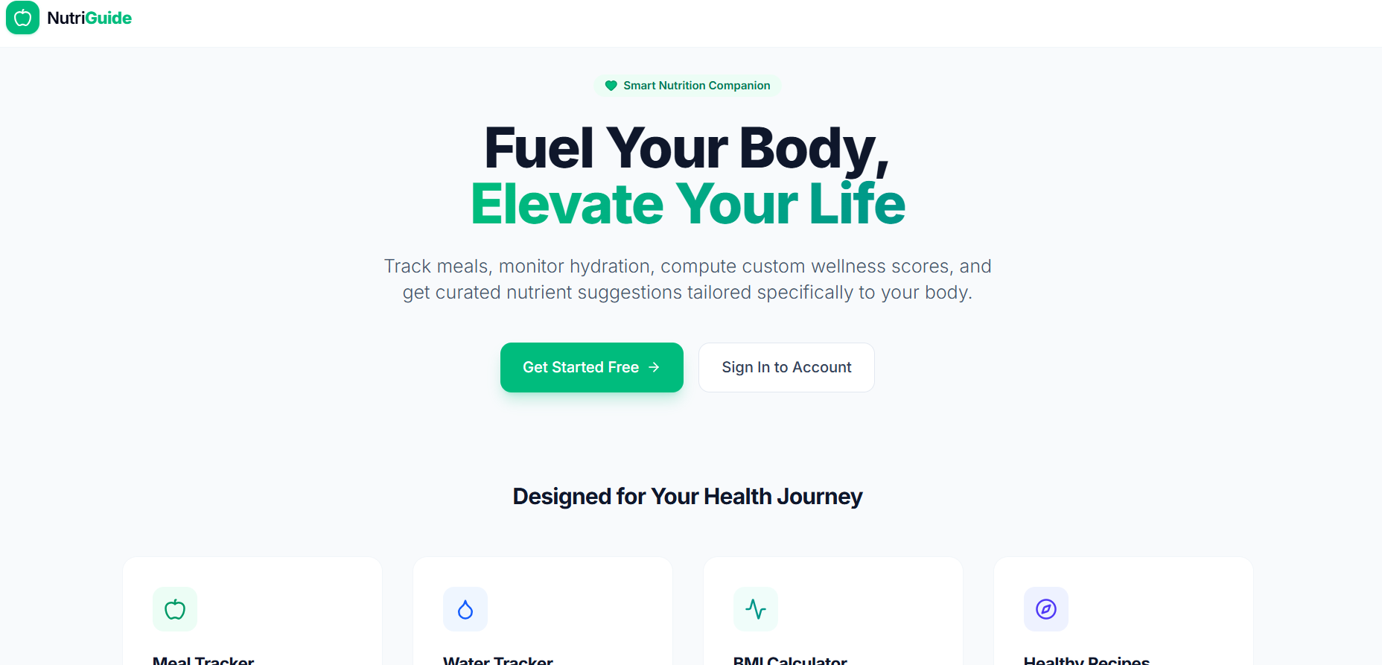
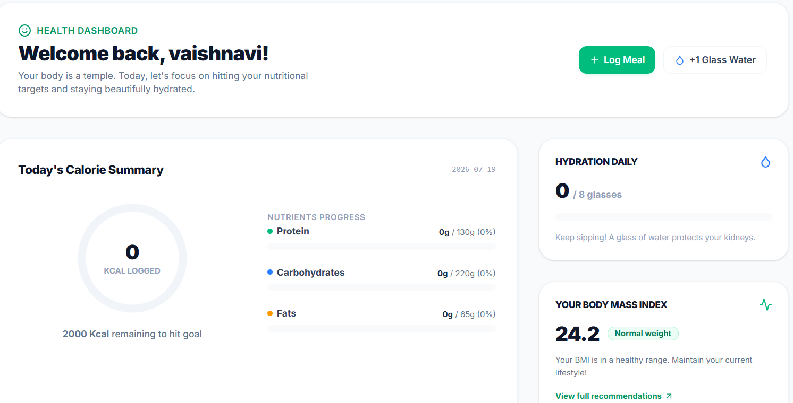
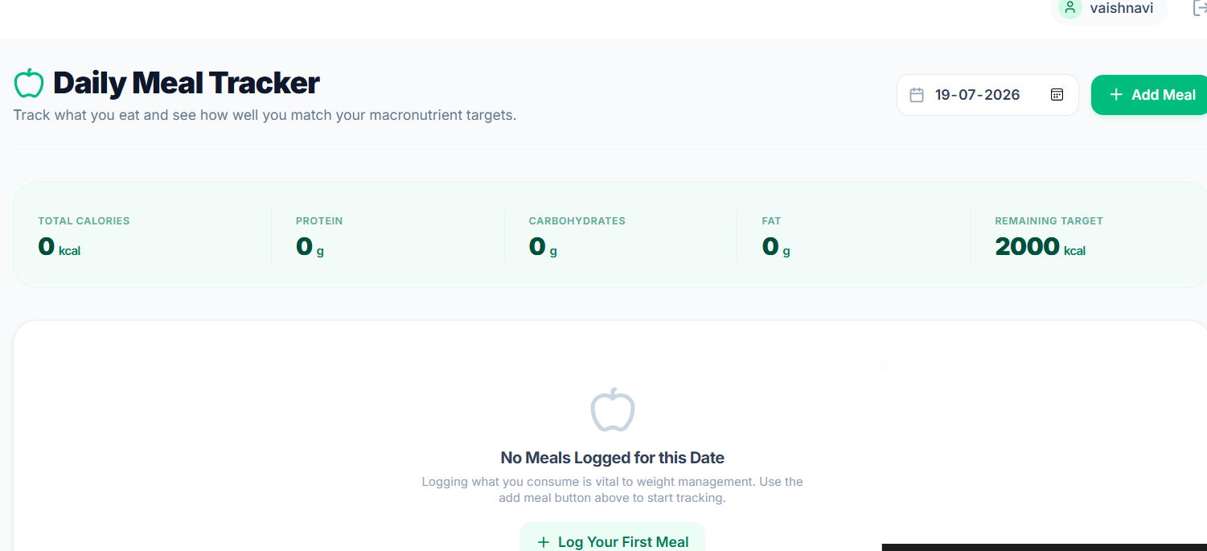
Output:
Add screenshots:
• Login Page
• Dashboard
• Meal Tracker

Slide 10
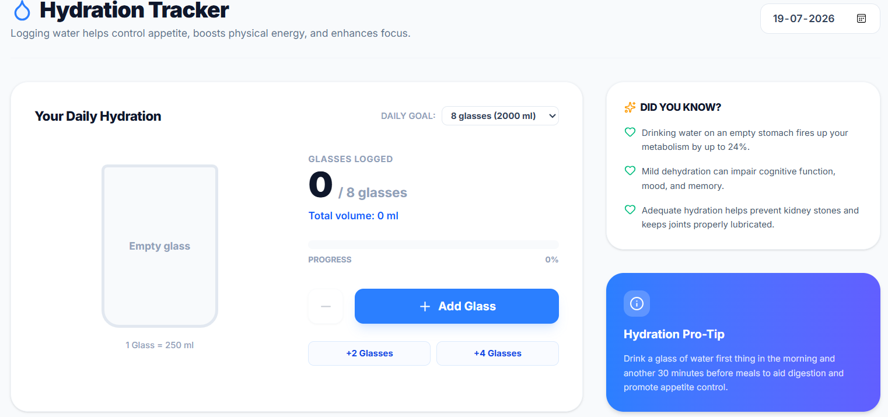
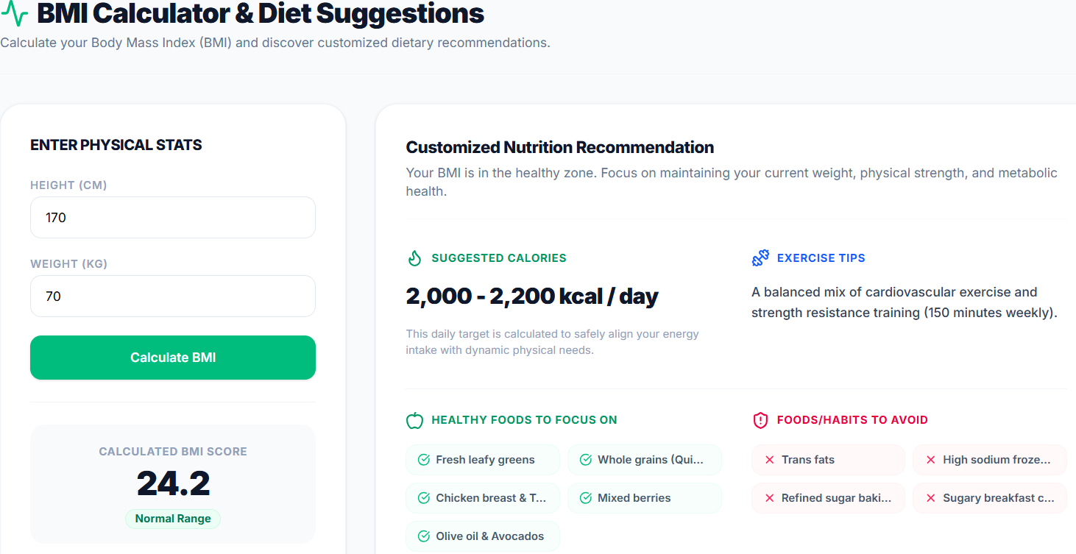
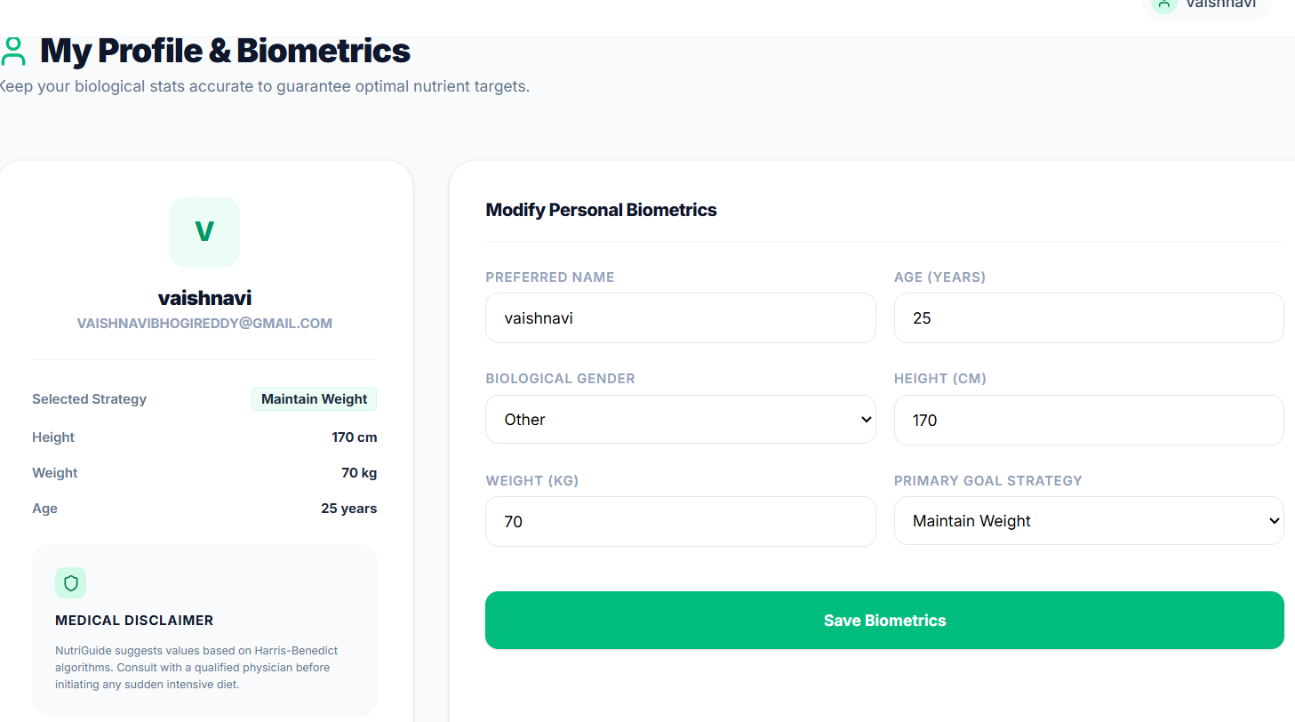
Output:
Add screenshots:
• Water Tracker
• BMI Calculator
• Profile

Slide 11
Conclusion
• Successfully developed a Nutrition Assistant using MERN Stack.
• Helps users maintain healthy habits.
Thank You!

