Slide 1
8-BIT ARITHMETIC LOGIC UNIT (ALU)
Implementation of Arithmetic and Logical Operations
Verilog HDL Simulation Project

Slide 2
Project Description
An Arithmetic Logic Unit (ALU) is a fundamental digital circuit used to perform arithmetic and bitwise logical operations.
This project implements an 8-bit ALU using Verilog HDL.
Inputs:
• A[7:0] – 8-bit operand A
• B[7:0] – 8-bit operand B
• opcode[3:0] – operation selector
Outputs:
• result[7:0] – operation result
• carry – carry/no-borrow indicator
• zero – indicates result is zero

Slide 3
Objective and Operations
Objective
• Implement an 8-bit ALU with arithmetic and logical operations.
• Verify each operation using a Verilog testbench.
• Observe result, carry and zero flags.
• Analyze the design using simulation waveforms.
Supported Operations
0000 – ADD : A + B
0001 – SUB : A - B
0010 – INC : A + 1
0011 – DEC : A - 1
0100 – AND : A & B
0101 – OR : A | B
0110 – XOR : A ^ B
0111 – NOT : ~A

Slide 4
ALU Design / Working Principle
The opcode selects one operation inside the combinational ALU.
1. Inputs A and B are supplied as 8-bit binary values.
2. The 4-bit opcode selects the required arithmetic or logical function.
3. The selected operation produces an 8-bit result.
4. Arithmetic operations can generate the carry flag.
5. The zero flag becomes HIGH when result = 00H.
Design flow:
A, B, opcode → ALU operation selection → result + carry + zero

Slide 5
Simulation Setup
Design file: alu.v
Testbench: tb_alu.v
Simulation procedure
• Apply different A, B and opcode combinations.
• Wait 10 ns between test cases.
• Monitor result, carry and zero.
• Generate a VCD waveform file using $dumpfile and $dumpvars.
• Open the VCD file in a waveform viewer.
Recommended tool flow:
Verilator → simulation / trace generation
GTKWave → waveform visualization
Note: GHDL is primarily a VHDL analyzer/compiler/simulator, so it is not the natural simulator for this Verilog source. For this Verilog project, Verilator is the appropriate choice.

Slide 6
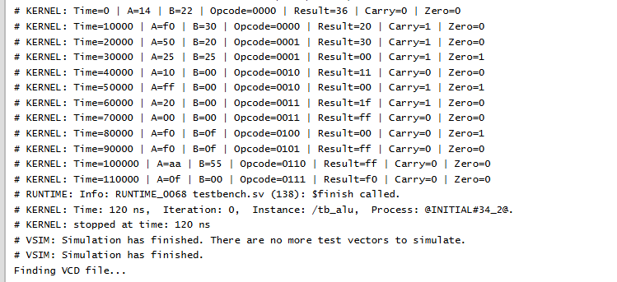
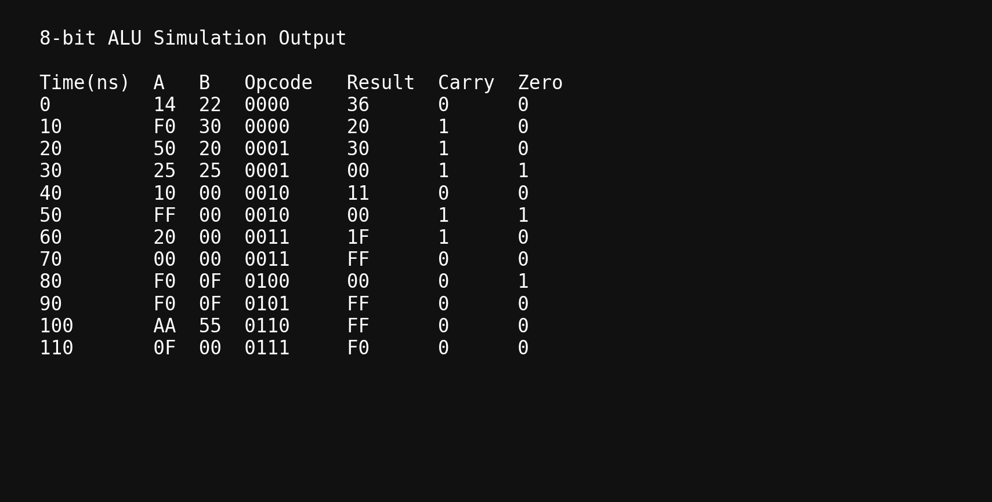
Simulation and Output Screenshot

Slide 7
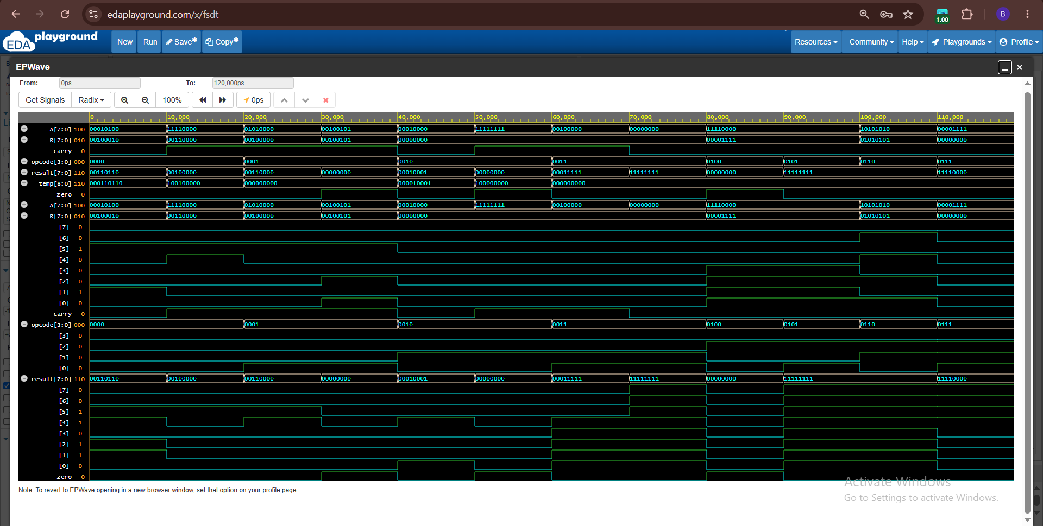
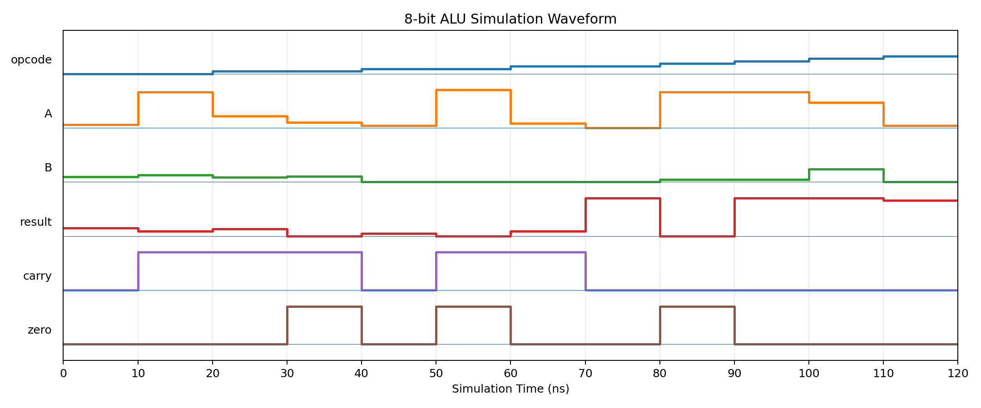
Waveform Analysis
EPWave simulation waveform of the 8-bit ALU

Slide 8
Conclusion
• An 8-bit ALU was successfully designed using Verilog HDL.
• The design supports four arithmetic operations: ADD, SUB, INC and DEC.
• It supports four logical operations: AND, OR, XOR and NOT.
• The testbench verifies the functional behavior using multiple input combinations.
• Carry and zero flags provide additional status information.
• Simulation output and waveforms confirm the expected operation of the ALU.
Future enhancement:
Additional flags such as negative/sign and overflow can be added for a more complete ALU.

Slide 9
References
1. EDA Playground
Used for Verilog simulation and testing.
2. EPWave
Used for viewing and analyzing the simulation waveform.

