Slide 1

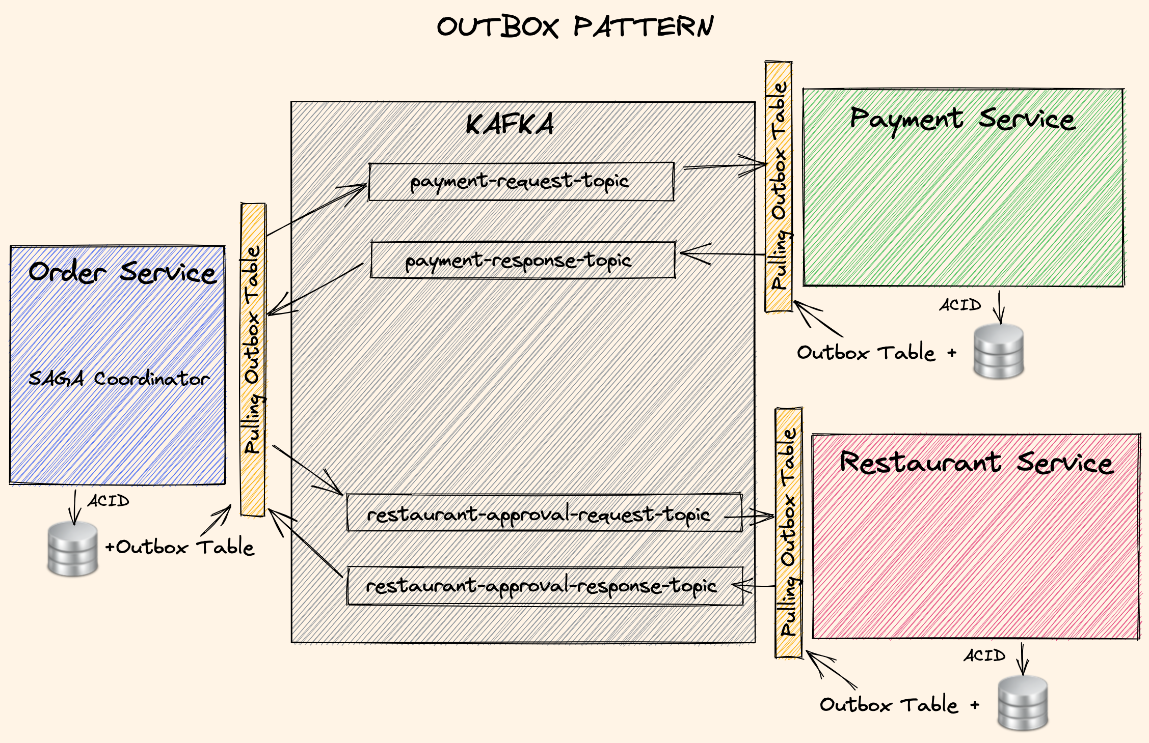
Outbox Pattern
Outbox: Help use of local ACID transactions
to let consistent (eventual) distributed transactions.
It will complete SAGA in a safe and consistent way.
Persist events in local database automatically with ACID transaction
Read the events and publish
- Pulling Outbox Table: Pull the events with a scheduler
- Change Data Capture: Listen transaction logs
Keep track of saga and order status in Outbox Table
Ensure idempotency: Do not consume same data
Optimistic locks and DB Constraints: Prevent data corruption

