Slide 1

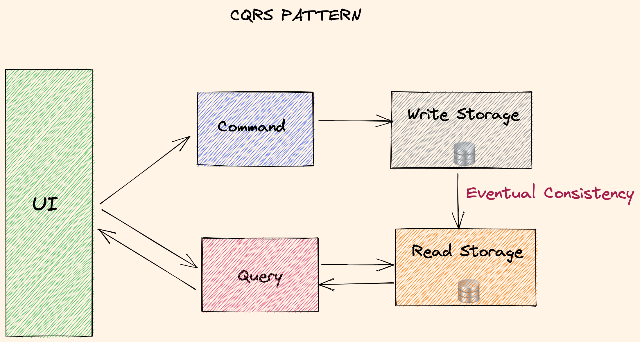
CQRS Pattern
(CQRS): Separate read and write operations. Better performance on read part using right technology for reading, and preventing conflicts with update commands. Scale each part separately.
Leads to eventual consistency, as the read store is updated asynchronously.
Once the write operation is persisted, an event is stored in event-store.
Events can be replayed multiple times based on requirements to create different type of query store.

