Slide 1
Recap:
- Use LR model to test 3 filter methods.
- KNN vs Mean Imputation.
- Class weights.
- Scaling.
- 10 features vs 20 features.
- 60:40 vs 80:20 split.
Conclusion 80:20 split with class weights mRMR best specificity - 80%, but sensitivity - 33%, accuracy - 45%.
Need to explore more complex algorithms to improve both sensitivity and specificity.

Slide 2
OHE
What:
One hot encoding is a process by which categorical variables are converted into a form that could be provided to ML algorithms to do a better job in prediction.
Why:
Problem with label encoding is that it assumes higher the categorical value, better the category. This is why we use one hot encoder to perform “binarization” of the category and include it as a feature to train the model.
How:
List all categorical features in the dataset. Convert them into binary values. New columns will be added to dataset.

Slide 3
RF
WHY
no overfitting - use of nultiple binary trees increases accuracy
training time is less
large data more accruacy
good with big data
estimates missing data
WHAT
Constructs multiple DT
Decision of majority DT is selected
builds decision node on different features thus even missing values are predicted using decion nodes.
e.g. if a bowl contains orange, apple, cherry and some of them dont have color then based on diamter cherries can be predicted.
Entropy
measure of randomness/unpredictability.
This gets lesser with each decision node.
Info gain
Reduces number of decision nodes based on entropy level.
Used in
used in remote sensing,
ETM - Enhanced Thermatic Mapper -
Xbox kinect - a commercial game uses RF for recognizing dance movements

Slide 4
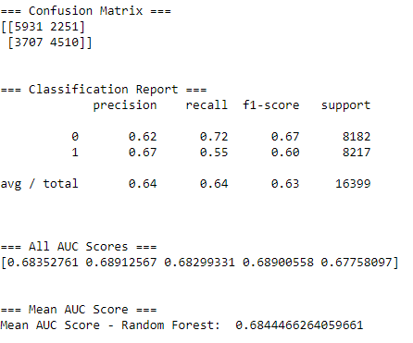
Cm for RF, K-fold=5

