Slide 1
My Internship@EPFL
Junyao Zhao
2015/8/28

Slide 2
Overview
1. HDFS Support for
X-Stream [SOSP’13]
X-STREAM
HDFS
MOTIVATION
IMPLEMENTATION
EXPERIMENT RESULTS
CONCLUSION
2. Understand
GridGraph [ATC’15] Results
GRAPHCHI
MOTIVATION
OUR FINDING
EXPERIMENT RESULTS
CONCLUSTION

Slide 3
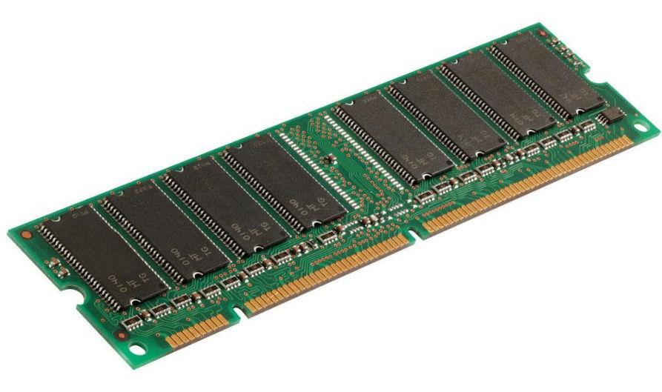
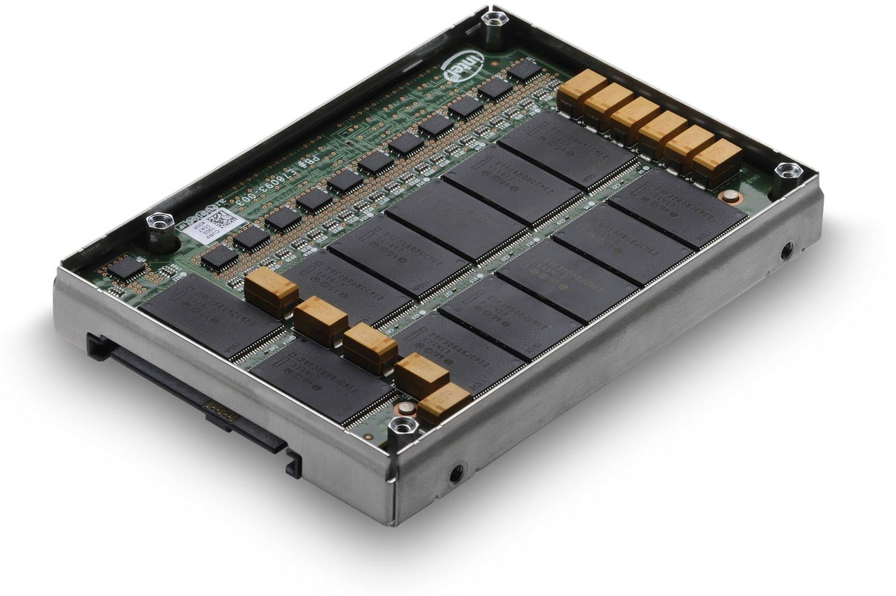
X-Stream
A single-machine graph processing system based on the idea of streaming edges from secondary storage.
Scatter Phase
Gather Phase
Edges
Vertices
Updates
Updates
Vertices
Edges

Slide 4
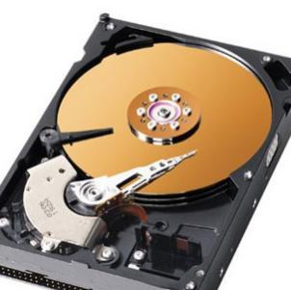
Streaming Partitions
Random
Edges
Vertices
Sequential
Partition 1
Partition 2
Random
Edges
Vertices
Sequential

Slide 5

Hadoop Distributed File System

Slide 6

Motivation
X-Stream requires the entire graph structure to be present in local storage. But usually these graphs are stored in large data warehouses or distributed file systems(e.g. HDFS).
X-Stream is limited by the storage of a single machine.
X-Stream

Slide 7
Implementation
Possible solutions:
Library | Feature
libhdfs | a JNI-based API in HDFS
libhdfs3 | built on RPC
hdfs-fuse | mount HDFS like local disk
Apache Thrift | cross-language development
webhdfs | web service API in HDFS

Slide 8
Implementation
Library | Advantage | Drawback
libhdfs | reliability robustness a part of Hadoop project | must deploy the HDFS jars on every machine
libhdfs3 | easy to use and deploy | individual project potential bugs
hdfs-fuse | easiest to use and deploy minimum modification of origin code | hides important features of HDFS like replication number, file block size

Slide 9
Difficulties
X-Stream opens file with O_RDWR no support for O_RDWR in libhdfs, libhdfs and hdfs_fuse
X-Stream uses ‘fseek’ to rewind file which causes non fatal errors in HDFS libraries

Slide 10
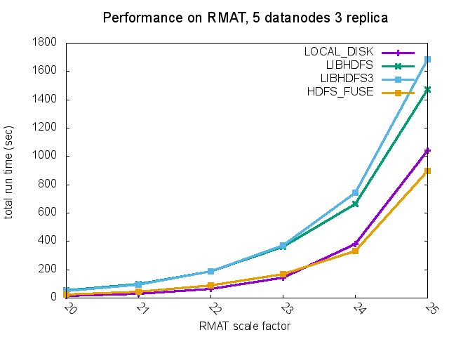
Experiment Results

Slide 11
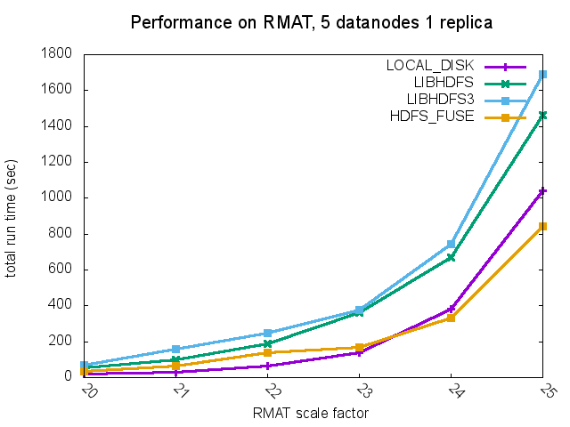
Experiment Results

Slide 12
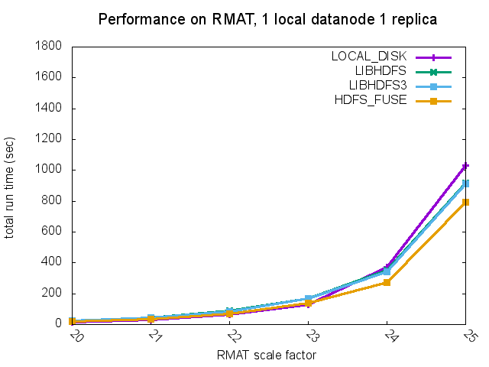
Experiment Results

Slide 13
Capacity
Integrating X-Stream with HDFS makes processing large graph possible. On the local LABOS cluster, we could theoretically process 1T edges.
The bottleneck here is the computing resource and the network interface of a single machine.
Chaos was designed to solve these problems.

Slide 14
Conclusion
Support of HDFS for X-Stream enables processing bigger graph.
Hdfs-fuse outmatches libhdfs and libhdfs3 in all cases.
When graph is small, local file system has better performance.
When graph is large, HDFS outperforms local file system.

Slide 15
Evaluation of X-Stream and Graphchi [OSDI’12]

Slide 16
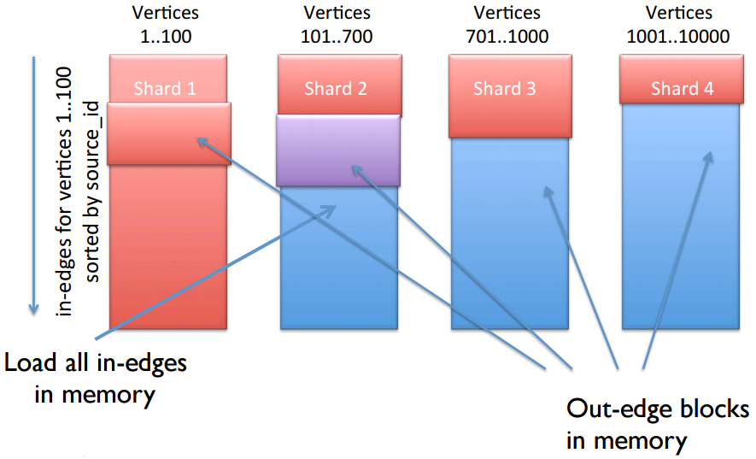
Graphchi Another single-machine graph processing system

Slide 17
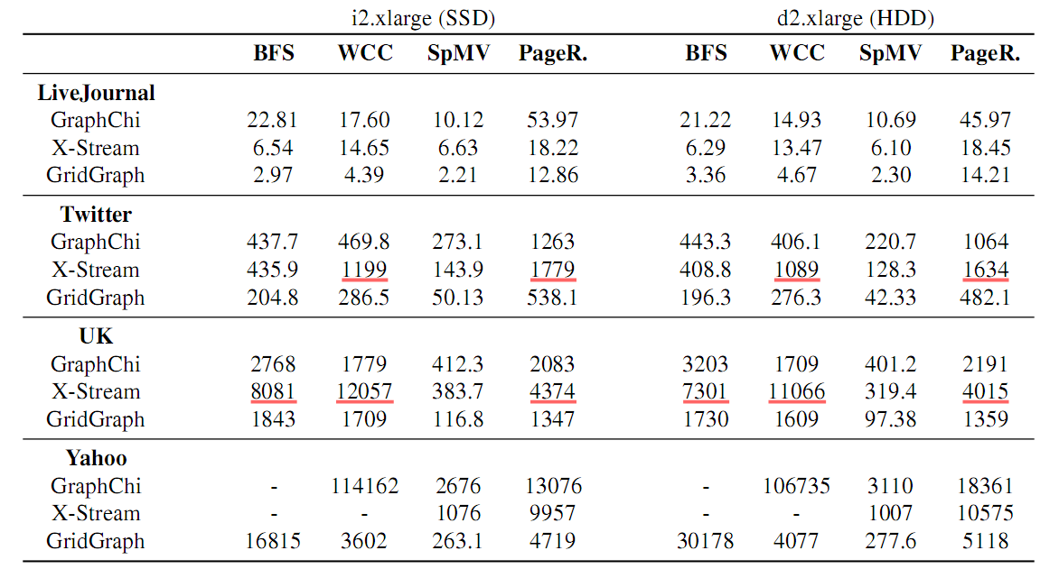
Motivation

Slide 18
Findings
Benchmarking is not that easy, the results from experiments without rigorous experiment setting can be misleading.
There are many details we should pay attention to:
Graph dataset:
undirected/directed
unweighted/weighted
Graphchi:
async/sync
with/without in-memory optimization
Algorithm:
start node for BFS

Slide 19
Experiment Setting
Enviroment:
local ubuntu server, 30GB memory, 3 hdds
ec2 d2.xlarge, 30GB memory, 3 hdds
Input dataset:
soc-livejournal, uk-2002, twitter(all unweighted)
binary format for X-Stream, tsv format for Graphchi
Other things:
block memory to leave only 8GB free memory
run graphchi with async mode
start node for BFS on twitter is node 12

Slide 20
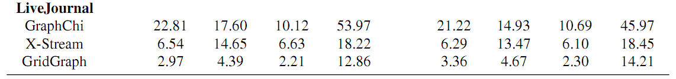
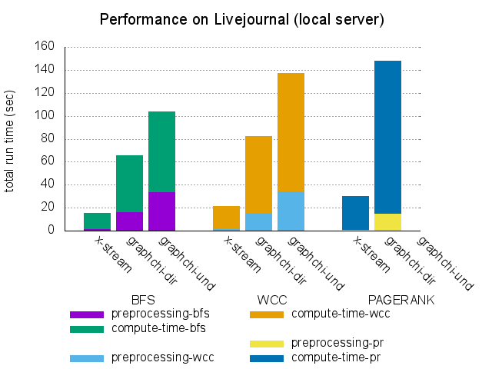
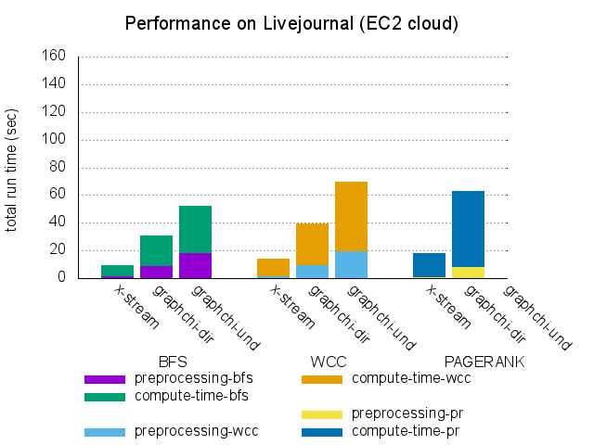
Experiment Results

Slide 21
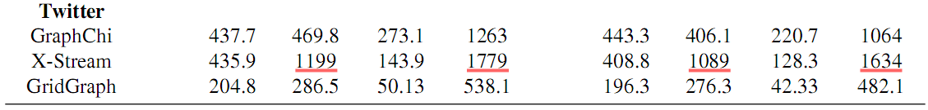
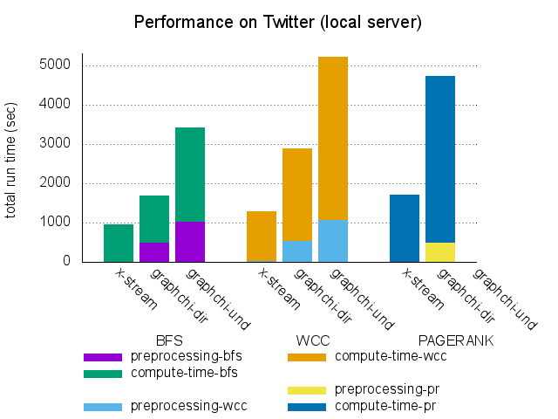
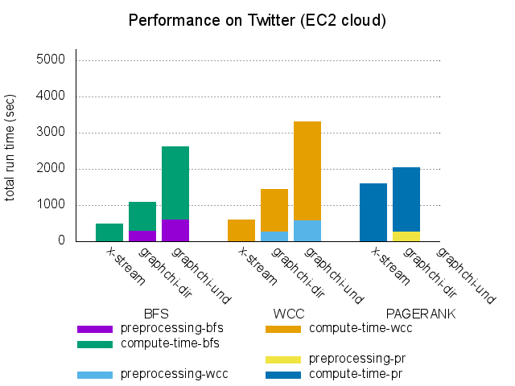
Experiment Results

Slide 22
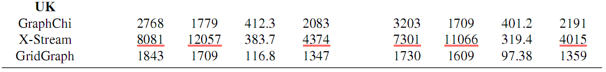
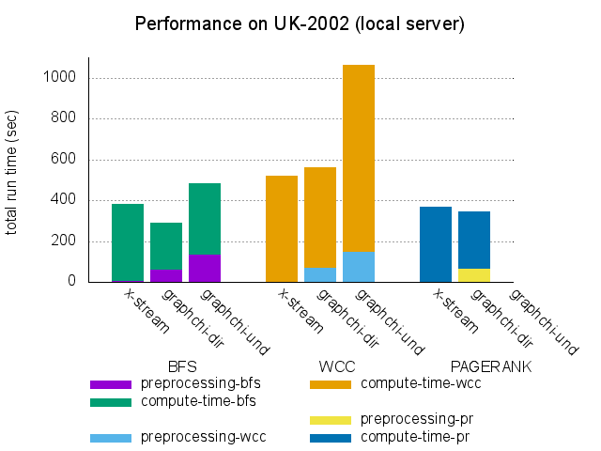
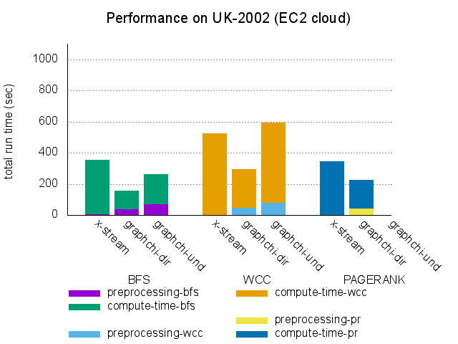
Experiment Results

Slide 23
Insight from UK-2002
Good graph:
Bad graph:

Slide 24
Conclusion
We should be careful with the experiment setting for benchmarking. A minor change to the right setting can make unfair comparison and cause misleading results.
Generally X-Stream is more efficient than Graphchi on different graphs.
Graphchi beats X-Stream on the graph “UK-2002”.

Slide 25
Learnings
Read papers in the field of graph processing:
X-Stream, Graphchi, GridGraph, Chaos, Scale-up Graph Processing in the Cloud [CloudDP’14], etc.
Practical skills:
Read and understand X-Stream code.
Integrate new features to a complex system.
Learn how to evaluate different systems and use different tools like fio to help understand experiment results in the research.

