Slide 1

Exploring Mental Health Data
Presented By :
Bindu (21F2000511)

Slide 2


Exploring Mental Health Data A Data-Driven Approach
Problem Statement:
Depression is a growing global concern.
Predict key risk factors.
Objective:
Identify key risk factors using data analysis.
Use machine learning to uncover hidden patterns.

Slide 3
Project Workflow: Depression Prediction
Data Understanding
Analyze dataset structure
EDA
Data Cleaning & Preprocessing
Handle missing values
Drop unnecessary columns
Encode categorical variables
Feature Scaling
MinMaxScaler
StandardScaler
Model Selection
XGBoost (Boosting-based approach)
Logistic Regression (Baseline model)
Random Forest (Ensemble method)
Model Evaluation
Accuracy
F1-score
Confusion_matrix
Result - Features, Shape, Null Values
Result – Skewness, No outliers, Irrevant data, Key Features
Descriptive statistics
Outliers
Plots
Result – Clean Data with proper Encoding
Result – Stability, Convergence
Result – Best accurate model

Slide 4
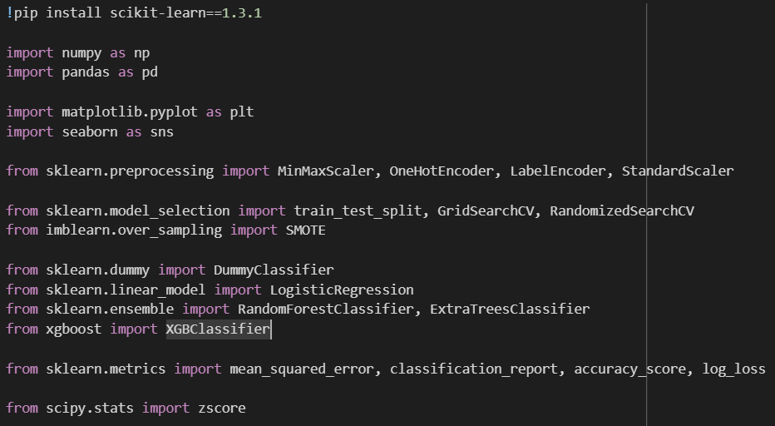
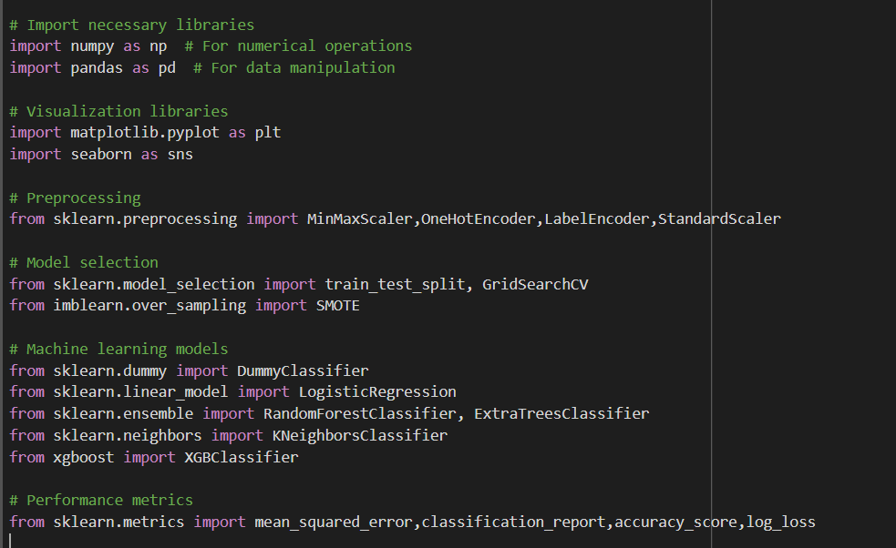
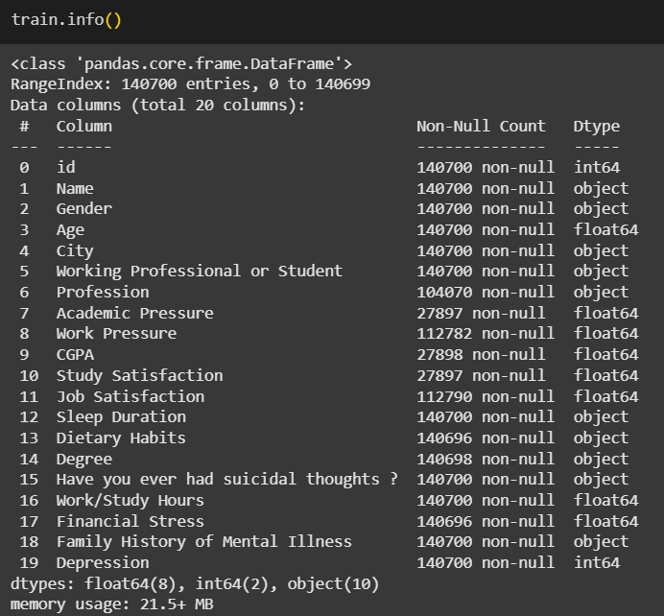
Data & Technology
Data Source: Kaggle -Playground Series - Exploring Mental Health .
Key Variables:
Tools and Technology

Slide 5
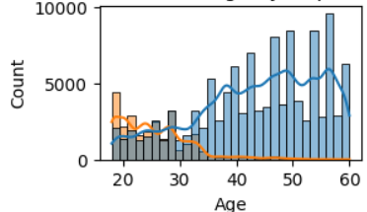
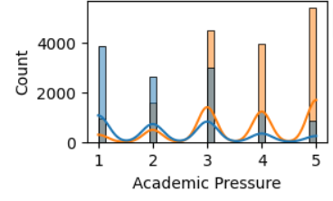
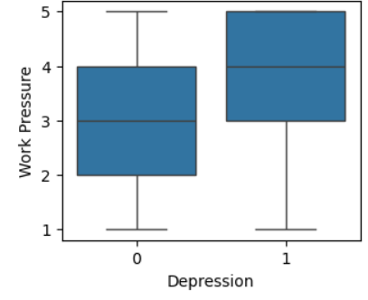
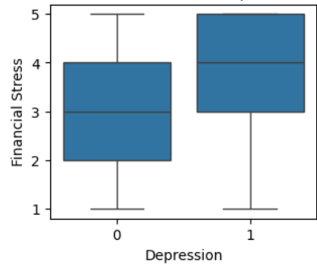
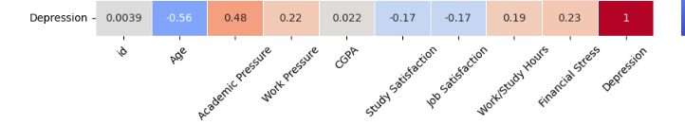
Exploratory Data Analysis (EDA)
Key Observations:
Skewness Analysis (Descriptive Statistics):
Most features have right skewness.
No significant outliers detected.
Identifying Influential Factors :
Name,City,Dietary Habits-Less influential factors

Slide 6
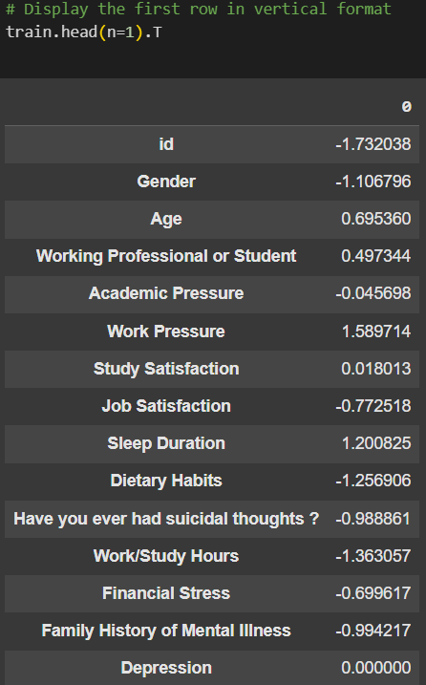

Data Preprocessing & Feature Scaling
Data Cleaning & Preprocessing :
Handling Missing Values: Used Median Imputation.
Dropped unnecessary columns.
Encoding Methods: Applied LabelEncoding.
Feature Scaling:
Scaling Techniques : Used StandardScaler.
.

Slide 7
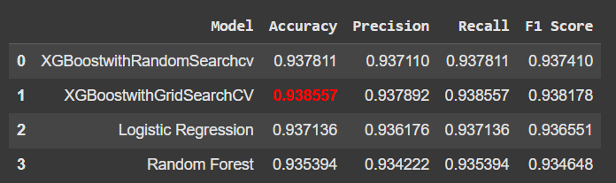
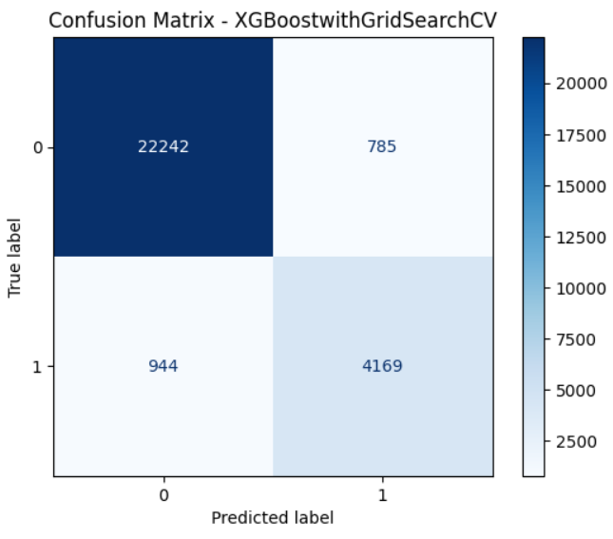
Model Selection & Model Evaluation
Dummy Model Baseline:
Dummy Classifier Score: 0.81
Train-Test Split:
Data split for training & evaluation
Model Performance (With Hyperparameter Tuning):
Best Model: XGBoost with GridSearchCV
Highest Accuracy: 0.93855
True Negatives (TN) = 22,242
True Positives (TP) = 4,053

Slide 8
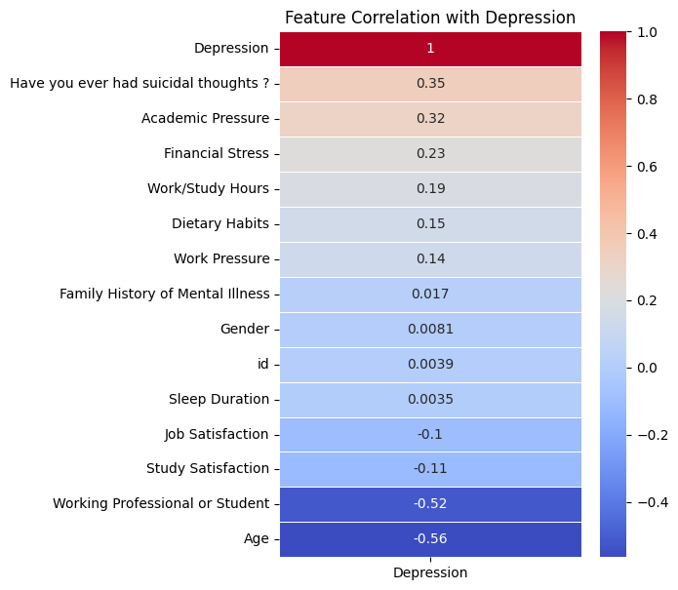
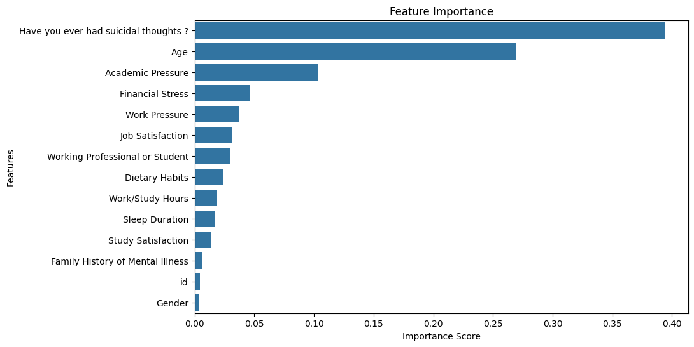
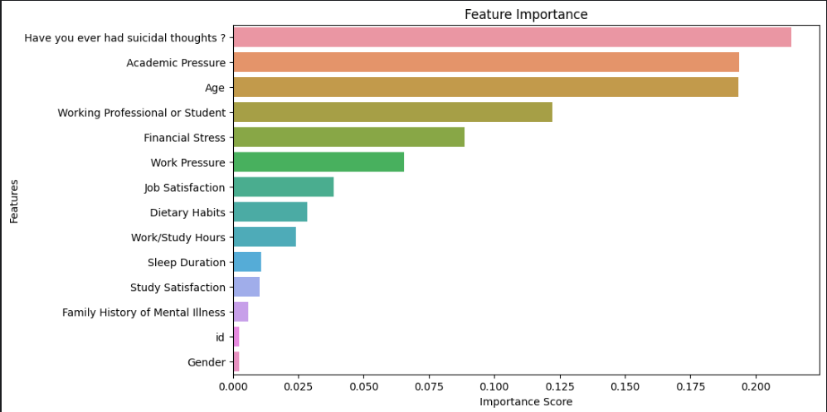
Key Findings – Factor Analysis
Correlation Heatmap Insights:
Age has a negative correlation (-0.56) → Younger individuals more affected
Academic pressure & financial stress increase depression risk
Suicidal thoughts have a strong positive correlation (0.35)
Feature Importance Analysis:
Suicidal thoughts is the top predictor of mental health issues
Age, Academic stress, and Financial Stress play a crucial role

Slide 9
Future Scope & Conclusion
What next:
AI Chatbot for Stress – Real-time mental health insights
Smart Study & Career Planner – AI-driven academic & job guidance
To sum up:
Youth at Higher Risk – Pressure from finances & academics
Predict & Prevent Depression – Data-driven early intervention
Empowering Student Well-being – Proactive mental health support
THANK YOU…

