Slide 1
Automated Dashboards for Data-Informed Decisions at AtliQ Hardware
Power BI Dashboard For A Computer Hardware Manufacturer
-Bindu Lingamaneni

Slide 2
Problem Statement
AtliQ Hardware, a prominent supplier of computer hardware and peripherals in India, is facing significant challenges in managing and understanding its sales data amidst a dynamically growing market. Bhavin Patel, the Sales Director, struggles to track regional sales performance and gain actionable insights due to inconsistent and overly optimistic verbal reports from regional managers. The reliance on multiple Excel files for reporting adds to his frustration, as it complicates the process of obtaining a clear and concise view of the business performance. This lack of accurate, real-time insights hinders Bhavin's ability to make data-driven decisions necessary for improving sales and identifying key focus areas.

Slide 3
Business Objective
The primary objective for AtliQ Hardware is to develop an automated dashboard solution that provides clear, accurate, and real-time insights into sales performance across different regions (North India, South India, and Central India). This dashboard should help Bhavin Patel:
Track overall and regional sales performance accurately.
Identify trends in revenue growth and year-over-year (YOY) sales trends.
Pinpoint underperforming regions and areas needing immediate attention.

Slide 4
Solution
To address these challenges, an automated Power BI dashboard will be created, leveraging data analysis through SQL and Power BI. The solution will involve:
Data Integration and Cleaning
Dashboard Design and Development
Sales Dashboard
Performance Insights Dashboard
Profit Analysis Dashboard

Slide 5
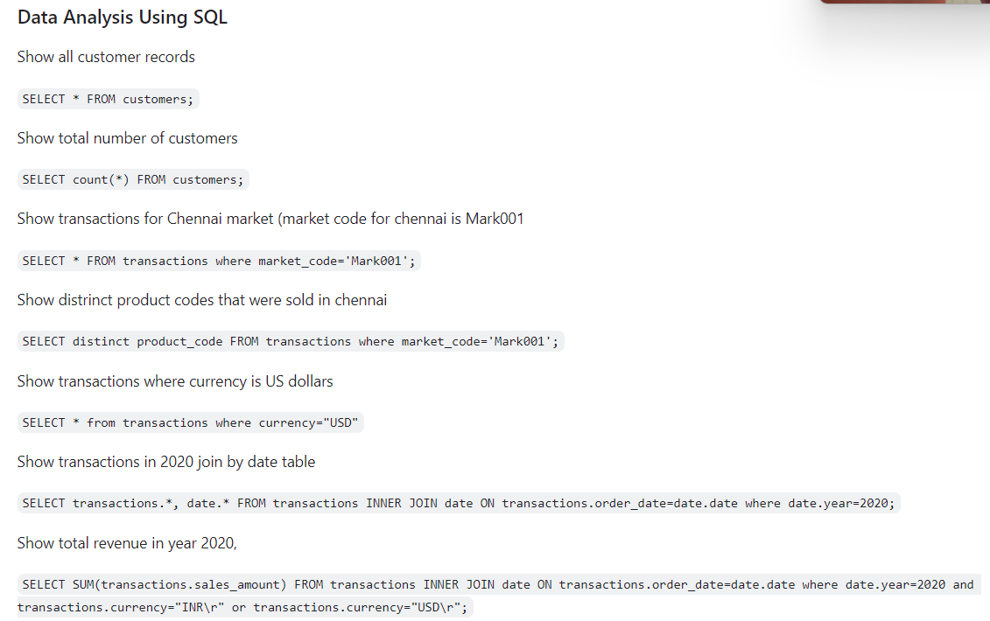
Data Analysis Using MySQL

Slide 6
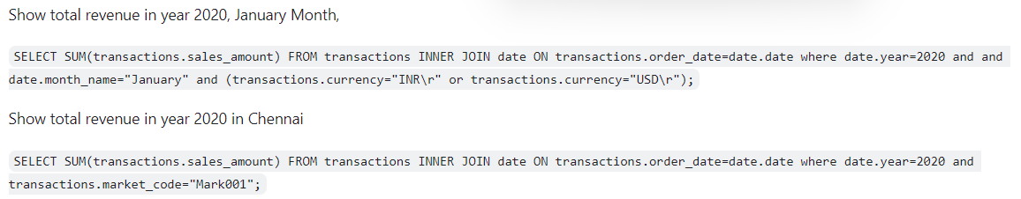

Slide 7
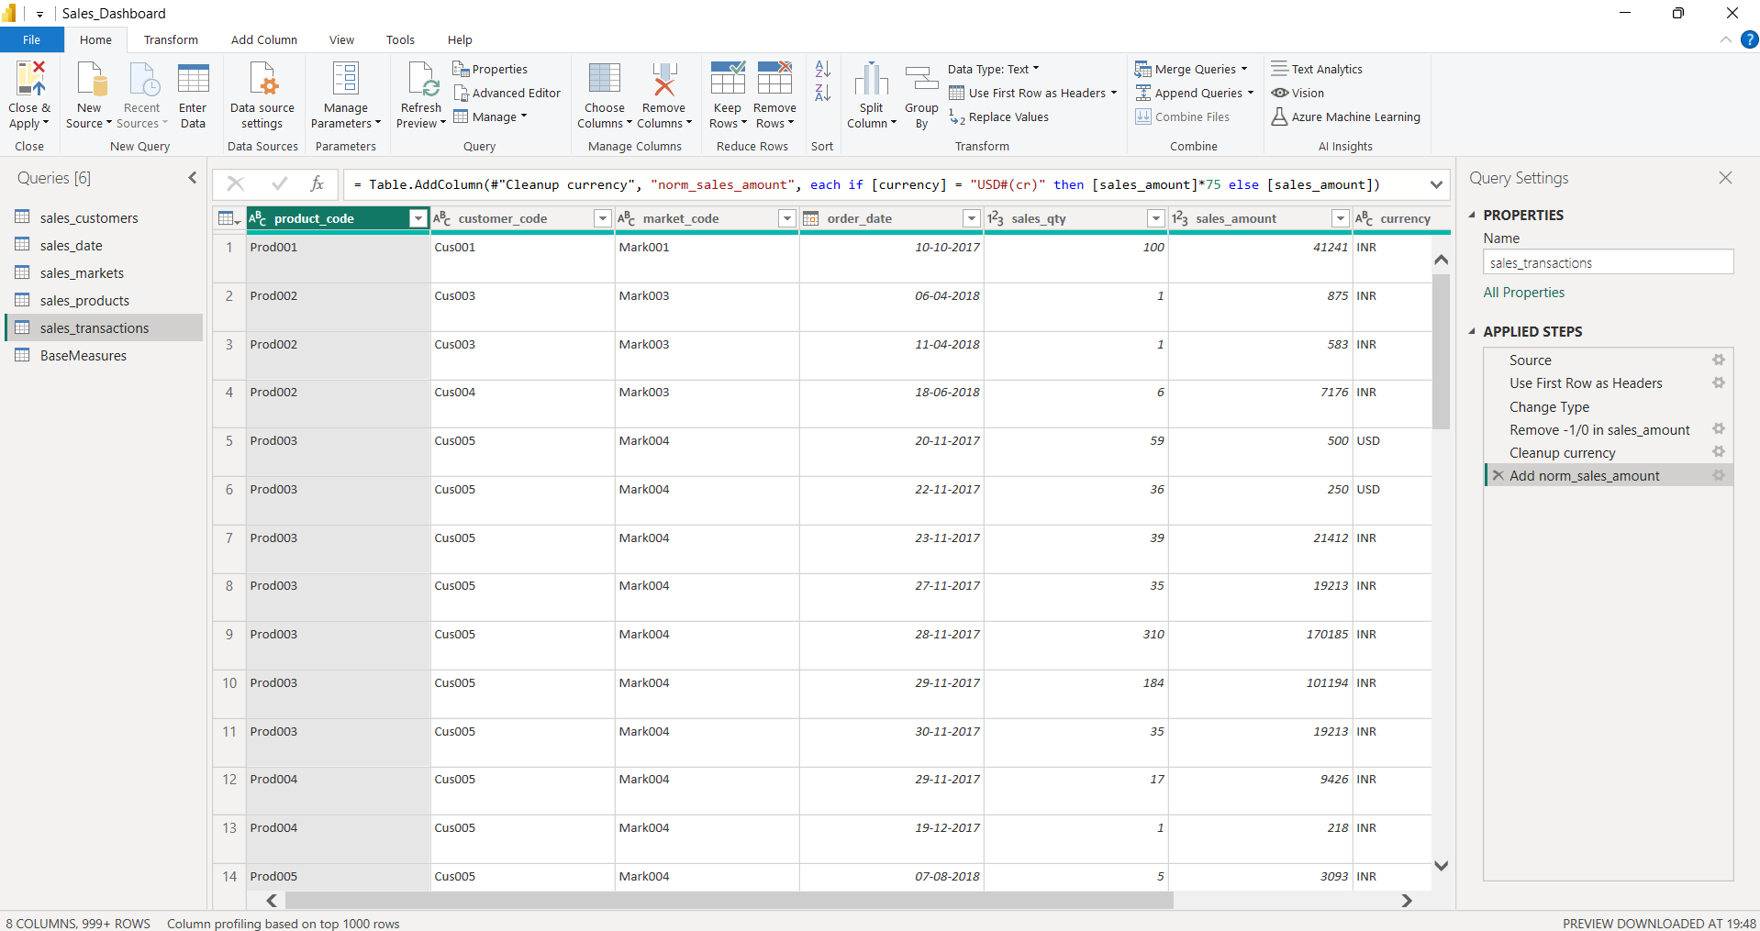
Data Cleaning & ETL in Power Query

Slide 8
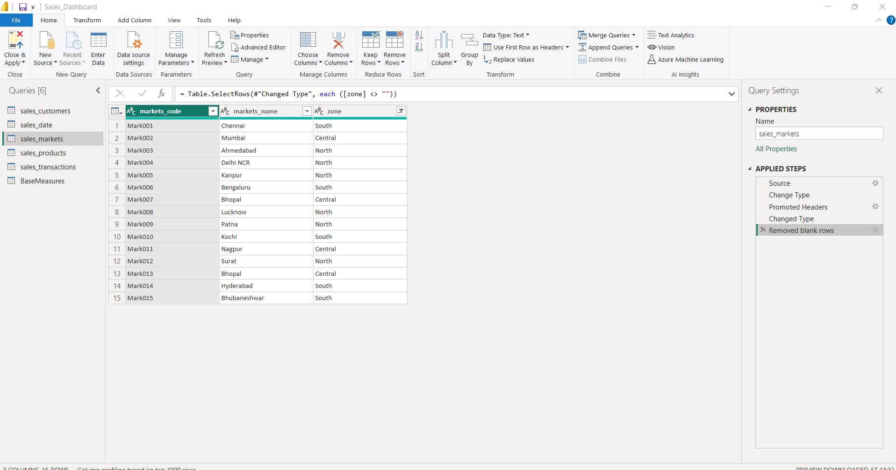
Data Cleaning & ETL in Power Query

Slide 9
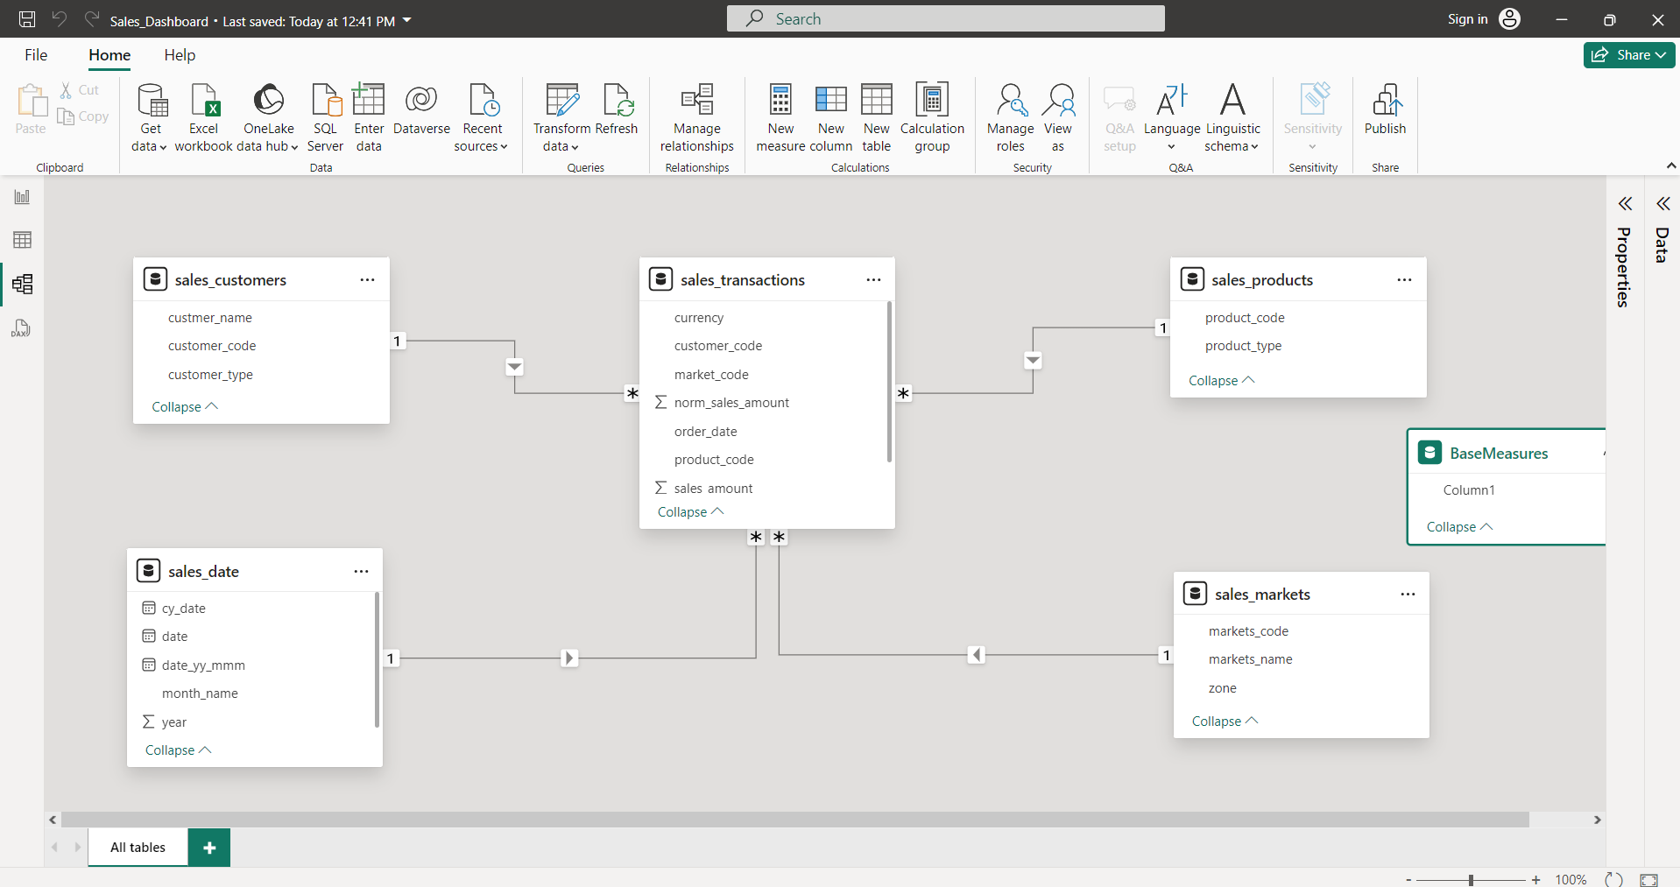
Data Modelling in Power Pivot

Slide 10
Solution
A few measures were created to calculate the revenue, sales quantity, profit margin, profit margin contribution, revenue contribution, etc.
Revenue = SUM(‘sales_transactions 2’[sales_amount])
Sales Qty = SUM(‘sales_transactions 2’[sales_qty])
Profit Margin % = DIVIDE([Total Profit Margin], [Revenue],0)
Profit Margin Contribution % = DIVIDE([Total Profit Margin], CALCULATE([Total Profit Margin], ALL('sales_products 2'),ALL('sales_customers 2 (2)'), ALL('sales_markets 2’)))
Total Profit Margin = SUM('sales_transactions 2'[profit_margin])
Revenue Contribution % = DIVIDE([Revenue], CALCULATE([Revenue], ALL('sales_products 2'),ALL('sales_customers 2 (2)'), ALL('sales_markets 2’)))
Revenue LY = CALCULATE([Revenue], SAMEPERIODLASTYEAR('sales_date 2'[date]))

Slide 11
Solution
A parameter created to set profit target
Profit Target = GENERATESERIES(-0.05, 0.15, 0.01)
Measures under the parameter created:
Profit Target Value = SELECTEDVALUE('Profit Target'[Profit Target])
Target Difference = [Profit Margin %]-'Profit Target'[Profit Target Value]

Slide 12
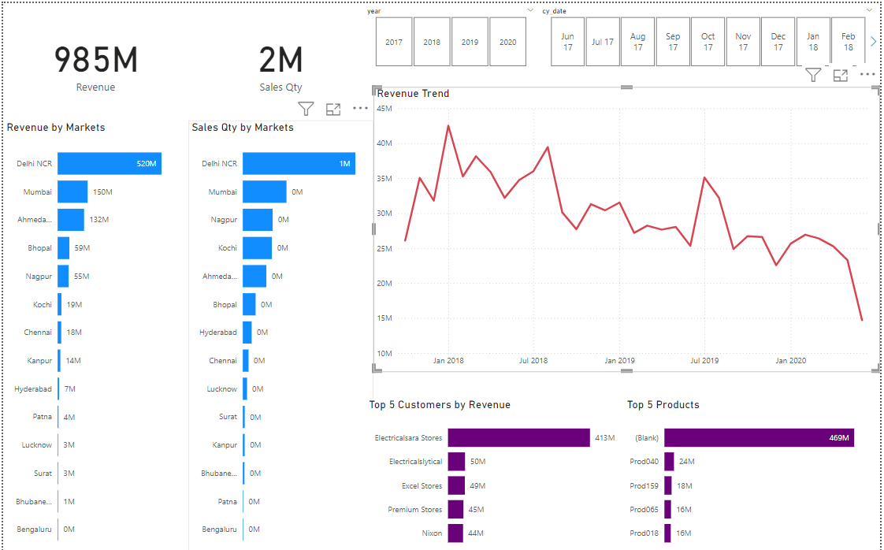
Key Insights

Slide 13
Dashboard 1: Key Insights Dashboard
Features:
Total Revenue Display: Shows the overall revenue in monetary value (₹985M).
Sales Quantity Display: Shows the total sales quantity (2M units).
Revenue by Markets: A bar chart displaying revenue contributions from various markets, such as Delhi NCR, Mumbai, and Ahmedabad.
Sales Quantity by Markets: A bar chart showing sales quantities across different markets.
Revenue Trend Over Time: A line chart showing the revenue trend over a selected period (June 2017 to June 2020).
Top 5 Customers by Revenue: A horizontal bar chart listing the top 5 customers based on revenue, including Electricalsara Stores and Electricalsytical.
Top 5 Products by Revenue: A horizontal bar chart listing the top 5 products by revenue.

Slide 14
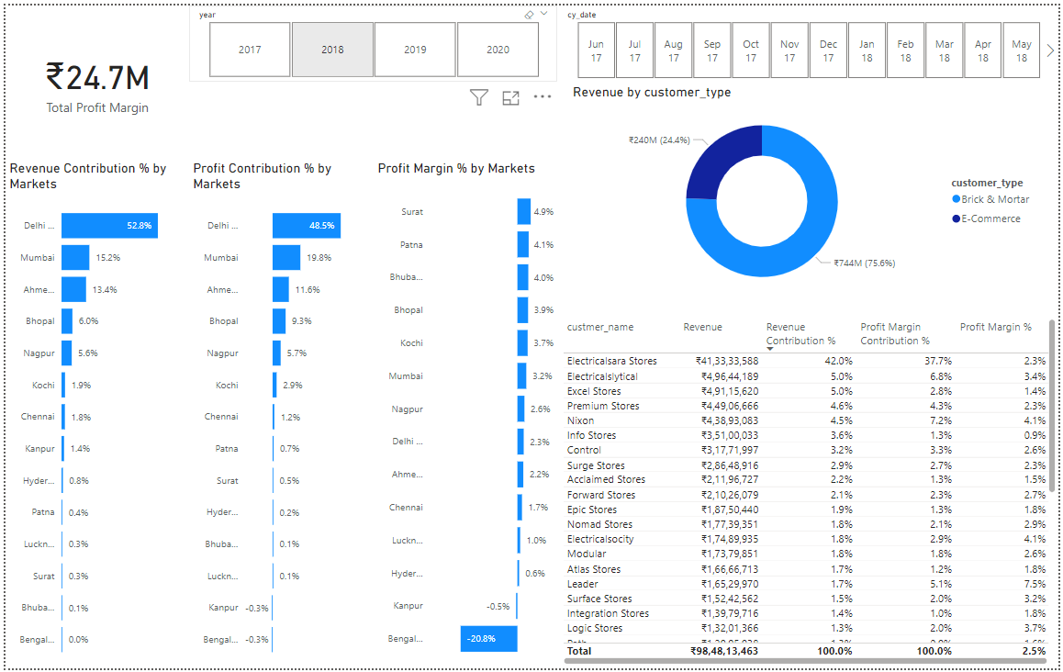
Profit Analysis

Slide 15
Dashboard 2: Profit Analysis Dashboard
Features:
Total Profit Margin Display: Shows the overall profit margin in monetary value (₹2.1M) and a percentage target (2%).
Revenue Contribution by Markets: A horizontal bar chart displaying the revenue contribution percentages from various markets, such as Bhubaneswar, Hyderabad, and Chennai.
Revenue and Profit Margin Over Time: A combined line and bar chart that visualizes the revenue, last year's revenue (LY), and profit margin percentage over a selected period (year 2020).
Revenue by Customer Type: A donut chart that segments revenue by customer type (Brick & Mortar and E-Commerce).
Customer Revenue Contribution: A detailed table listing customer names along with their revenue, revenue contribution percentage, profit margin contribution percentage, and profit margin percentage. Top customers include Electricalsara Stores, Excel Stores, and Premium Stores.

Slide 16
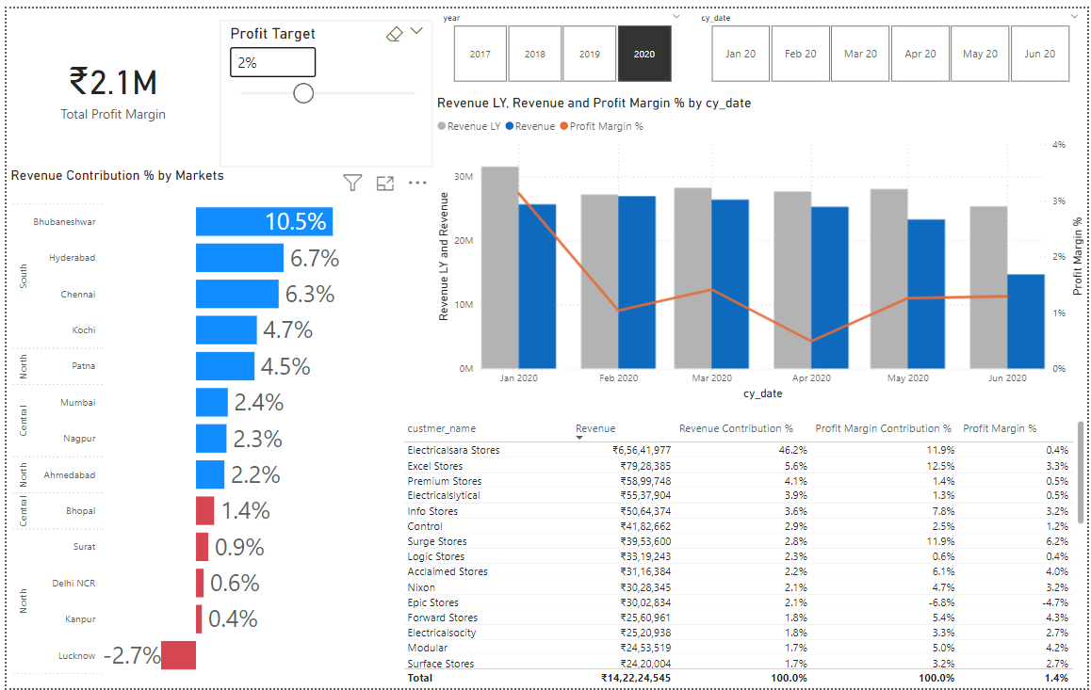
Performance Insights

Slide 17
Dashboard 3: Performance Insights Dashboard
Features:
Total Profit Margin Display: Shows the overall profit margin in monetary value (₹24.7M).
Profit Target: An interactive element to set and adjust profit targets.
Revenue Contribution by Markets: A bar chart showing the revenue contribution percentages from different markets, such as Delhi NCR, Mumbai, and Ahmedabad.
Profit Contribution by Markets: A bar chart showing the profit contribution percentages from various markets, such as Delhi NCR, Mumbai, and Ahmedabad.
Profit Margin by Markets: A bar chart displaying profit margins for different markets, highlighting areas like Surat, Patna, and Bhubaneswar.
Customer Revenue Contribution: A detailed table listing customer names along with their revenue, revenue contribution percentage, profit margin contribution percentage, and profit margin percentage. Top customers include Electricalsara Stores, Electricalsytical, and Excel Stores.

Slide 18
Insights
Customer Prioritization: Prioritizing high-revenue and high-profit customers, such as Electricalsara Stores and Electricalsytical, can help allocate resources more effectively. Providing personalized services and targeted offers to these key customers can foster loyalty and drive further sales.
Customer Segmentation: Brick & Mortar stores significantly outperform E-Commerce in terms of revenue, suggesting a focus area for boosting online sales.
Revenue Trends: The fluctuation in monthly revenue and profit margins highlights the need for a more stable and consistent growth strategy.
High-Value Customers and Products: Identifying top-performing customers and products can help in strategizing for better customer relationship management and inventory planning.
Profit Optimization: Markets with low or negative profit margins require targeted strategies to improve profitability.

Slide 19
Conclusion
The dashboard provided actionable insights that would lead to potential revenue increase of 7% in the next quarter. Insights that were generated via this dashboard helped to perform customer prioritization and product optimization which eventually increase the sales.
This project provided crucial insights into AtliQ Hardware's market performance, revealing significant disparities and growth opportunities. By analyzing data visualizations, we identified the need for market-specific strategies, boosting E-Commerce revenue, stabilizing revenue trends, and optimizing profit margins. Prioritizing high-value customers and products emerged as key for enhancing customer relationships and inventory planning. Implementing these insights will enable data-driven decisions, sustainable growth, and a competitive edge in the market.

Slide 20


