Slide 1
Context level fairness in Programmable WLANs - A Distributed Approach

Slide 2
Problems to address
User specific fairness
Application specific fairness
FAFA concentrates on achieving fair throughput among all wireless stations (STAs) connected to the Pro-AP. It doesn't consider fairness issues between users within a single STA.
FAFA considers transport protocols (TCP/UDP) but might not address fairness needs of specific applications. Meaning, it treats all applications within a transport protocol equally.

Slide 3
Solution
Offers distributed control i.e, shares the workload among devices, potentially reducing strain on the AP.
Offers adaptability where devices can adjust fairness based on local conditions and user needs.
Context level fairness aggregation

Slide 4
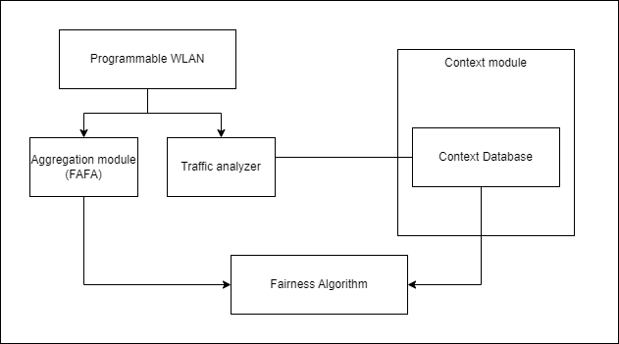
Redesign of Pro-AP

Slide 5
Algorithm
Initialization
User information and context from context database.
User Information Update
Update channel SNR for each user.
Context-aware weighting
Update weight based on obtained context.
Demand-Supply Ratio (DSR) calculation
Calculate DSR for each user.
Fairness Evaluation
Calculate Jain’s Fairness Index (JFI).

Slide 6
Algorithm - Contd.
6. FAFA trigger check
FAFA is activated when the fairness metric is below a threshold value.
7. Determination of aggregation size (AGG_SIZE)
Use FAFA/context-aware mode to determine AGG_SIZE and prioritize users with lower weighted DSR for smaller aggregation sizes.
8. Aggregation
Transmit frames according to the determined aggregation sizes.
9. Adaptation
Based on reports/fairness metric changes, the Pro-AP can dynamically adjust aggregation sizes or switch between FAFA and context-aware modes.

Slide 7
Evaluation metrics
Delay
D = Time taken for a packet to travel from source to destination in sec
Jitter
J = Absolute_Difference { Delay - Average_Delay }
Throughput
T = Total amt. of data transferred (in bits)/Time interval(sec)
Frames-Success Delivery Rate (FSDR)
FSDR = (Number of successfully delivered frames) / (Total number of transmitted frames) * 100
Packet overhead
Packet_Overhead = Total_Packet_Size - Payload_Size

Slide 8
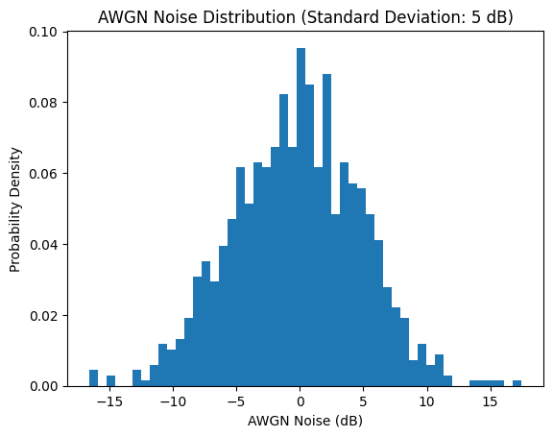
Visualization
User demand and supply of multiple users using AWGN considering weighting factors based on context alongside DSR.

