Slide 1
Fairness and Applications’ transport protocol aware frame aggregation using programmable WLANs

Slide 2
Challenges to address
Challenge 1
Challenge 2
Challenge 3
Fairness issue
Local frame aggregation schemes could lead to unfairness issues among STAs (Wi-Fi stations) with poor signal strength.
Dominance of UDP STAs
UDP STAs transmit at higher rates than TCP STAs due to lack of flow control and congestion control.
Aggregation Size
It is necessary to set a suitable AGG_SIZE for STAs by centrally coordinated frame aggregation schemes running at Access Point.

Slide 3
Solution
The FAFA scheme is evaluated against existing schemes using Network Simulator-3 (NS-3).
In various test scenarios, the results show that the FAFA is able to maintain Jain’s Fairness Index (JFI) around 0.9 for STAs in the network.
Existing works like PNOFA and FCCI are able to maintain JFI 0.3 to 0.7 only in terms of throughput, delay, and jitter.
Fairness and Applications’ transport protocol aware frame aggregation (FAFA) scheme using Pro-APs.

Slide 4
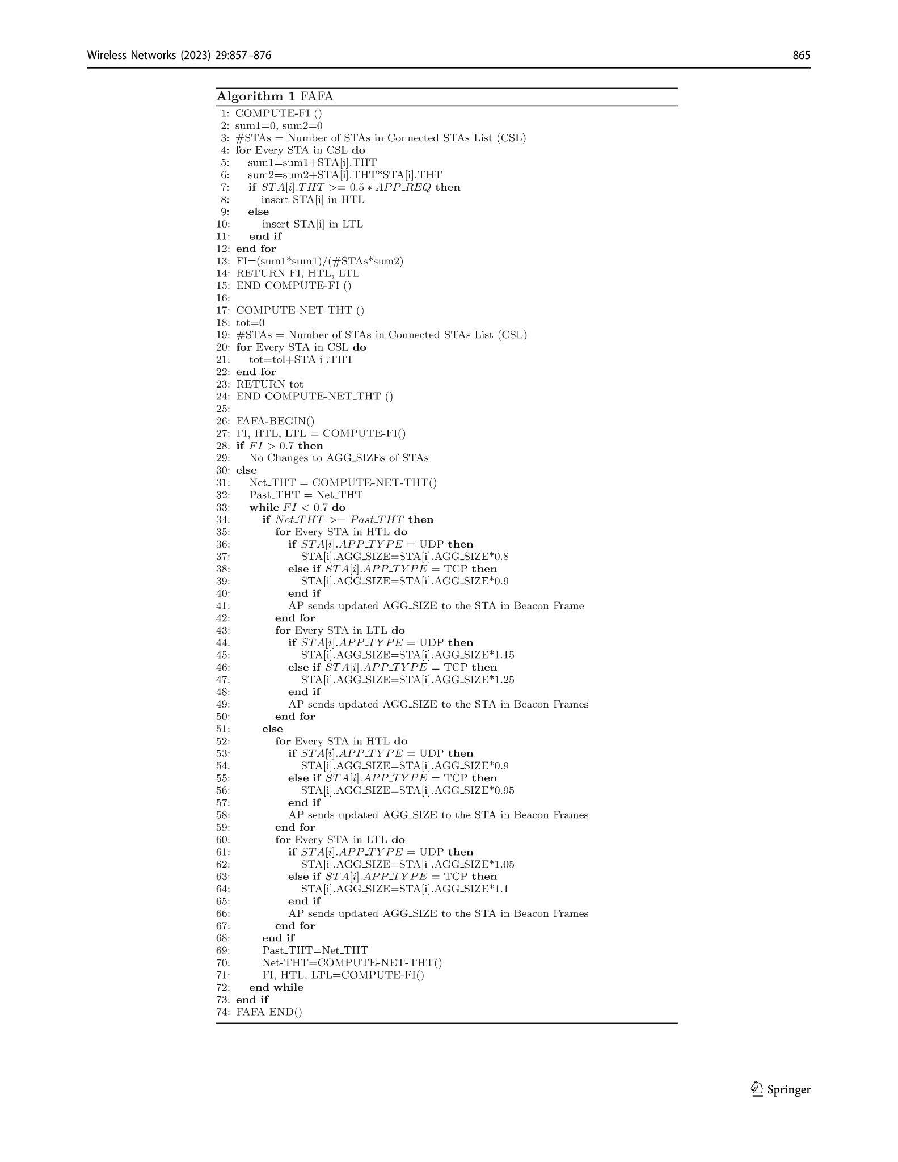
Algorithm

Slide 5
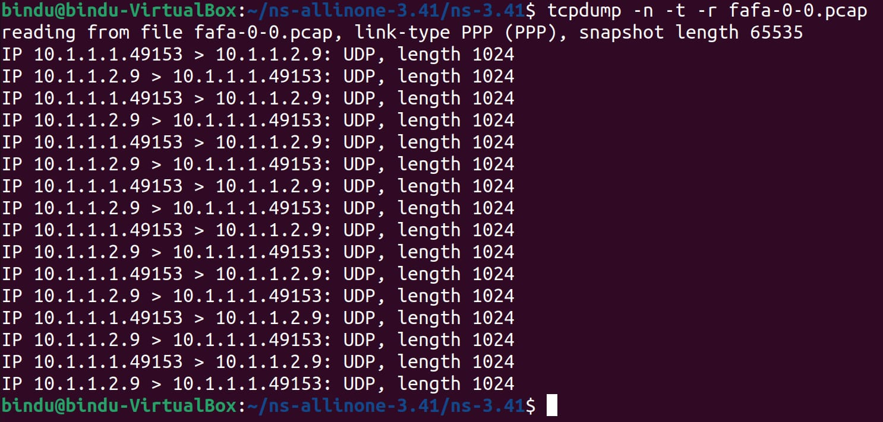

PCAP files

Slide 6
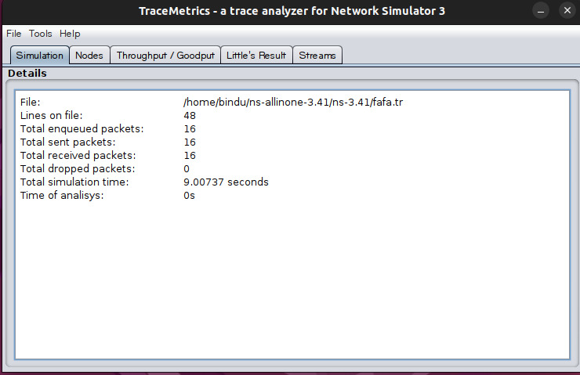
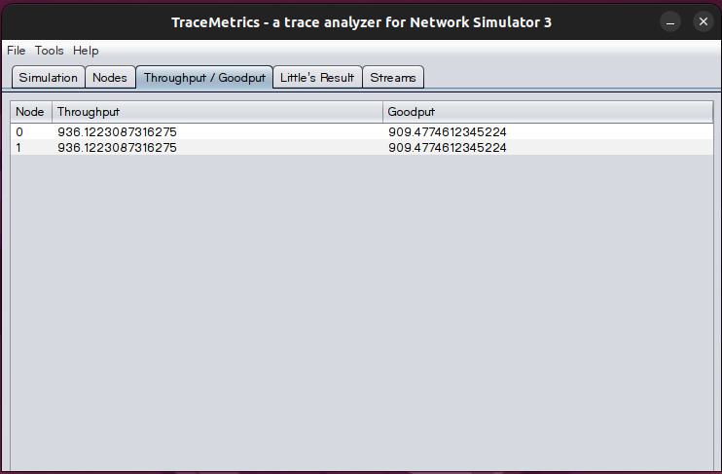
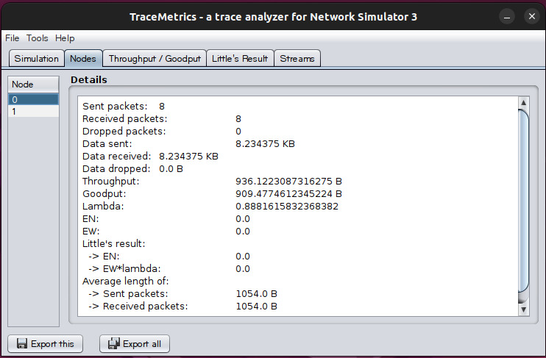
Trace file

Slide 7
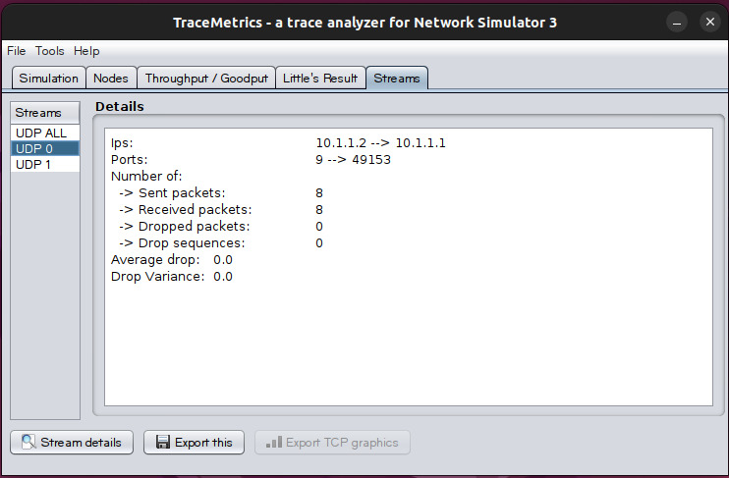
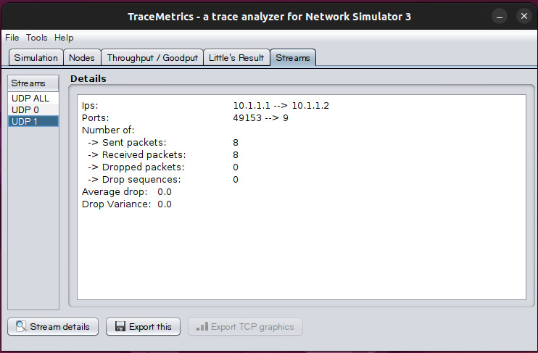
Trace file - Contd.

