Slide 1
TASK 5
Capstone Integration &
Portfolio Finalization
●
DATA
●
EDA
Data Analytics Internship • E-Commerce Sales Performance Analysis
●
BI
●
STATS
Atthuluri Bindu
Final Portfolio Presentation • September 2026
●
PORTFOLIO
ApexPlanet Data Analytics Internship • Task 5
1

Slide 2
Task 5 — Objective & Deliverables
Consolidate the internship work into one professional, end-to-end portfolio.
1
Master Portfolio
2
Presentation & Reflection
Create a single GitHub portfolio as the central reference for all completed work, with a strong README and project links.
Include the refined final deck, key technical learnings, and a concise reflection on the internship experience.
3
Portfolio Structure
4
Final Deliverables
README.md • project repositories • final presentation • skills & learnings • optional GitHub Pages site.
Master GitHub portfolio plus a 3–5 minute walkthrough/video explaining the projects and learning outcomes.
Source: Task 5 brief shown in the provided internship PDF
2

Slide 3
From Raw Data to Business Story
The completed work follows an end-to-end analytics workflow.
1
Data preparation
2
EDA + SQL
3
Power BI
4
Statistical validation
5
Portfolio
Excel dataset
quality checks & cleaning
Python analysis
patterns & business queries
Interactive dashboard
KPIs & visual exploration
Welch’s t-test
hypothesis evaluation
Integrate outputs
README + final presentation
Core toolset: Excel • Python (Pandas, NumPy, Matplotlib, Seaborn) • SQLite/SQL • Power BI • SciPy
The workflow combines descriptive analysis, visualization, querying, and statistical validation.
Source: completed notebooks, cleaned dataset, Power BI dashboard, and Task 4 report
3

Slide 4
Dataset & Business Problem
E-Commerce Sales Performance — analysis period: 2025
1,000
Total records
992
Unique orders
947
Unique customers
5K
Total quantity
₹139.40M
Total sales
Business Problem
• Identify sales trends and high-performing periods.
• Find top-performing products and categories.
• Compare sales across cities and customer groups.
• Convert raw transactions into actionable business insights.
Data & Preparation
• 14 fields including order, customer, product, category, quantity, price and sales.
• Quality checks included shape, column review, information, descriptive statistics, missing values and duplicates.
• Analysis was performed on the cleaned sales dataset.
Source: Cleaned_Sales_Dataset.xlsx and Task 4 report
4

Slide 5
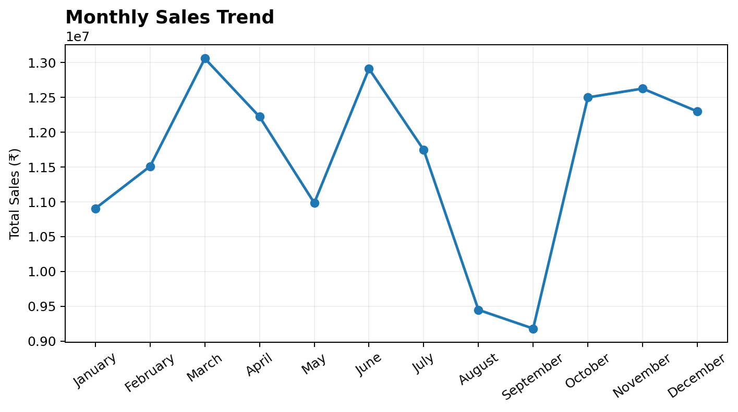
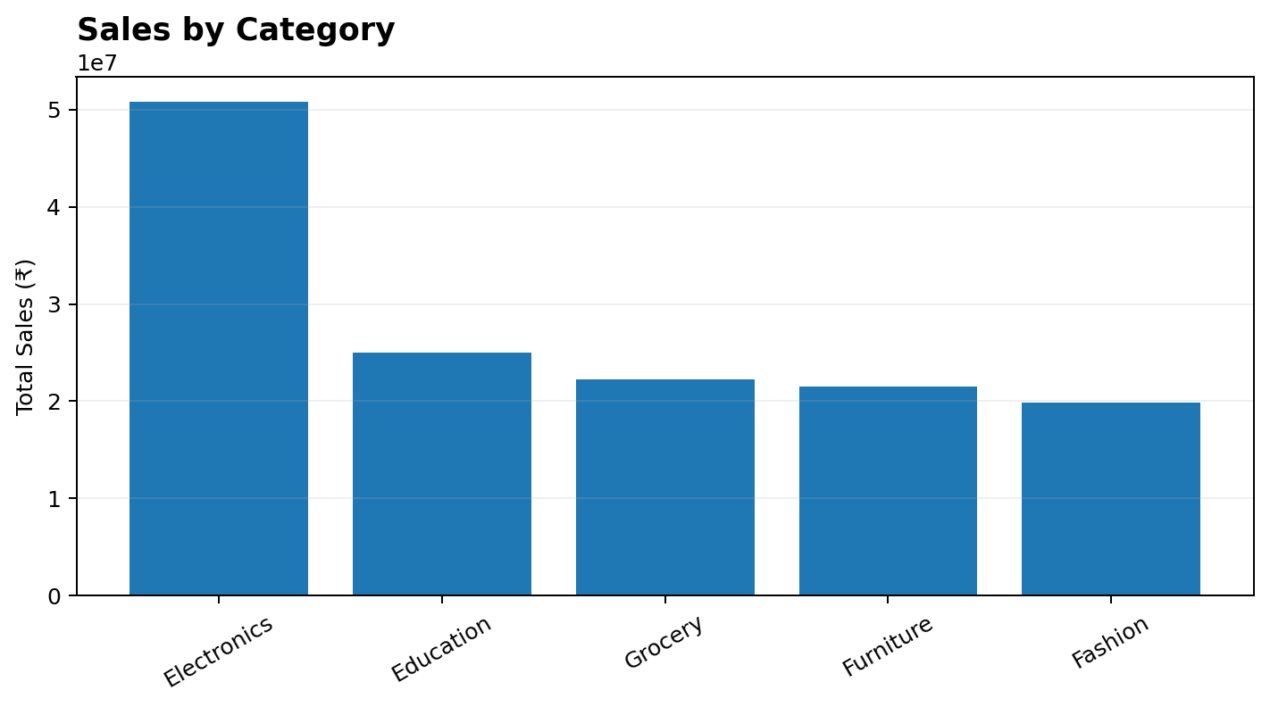
Exploratory Analysis & SQL
Python was used for exploration; SQL queries translated business questions into repeatable analysis.
SQL business questions
Total Sales • Average Sales • Top 10 Products • Sales by Category • Sales by Gender • Monthly Sales • Top Cities
The same dataset was loaded into SQLite and queried using GROUP BY, ORDER BY, LIMIT, SUM and AVG.
Source: Dashboard (1).ipynb — EDA and SQLite/SQL analysis
5

Slide 6
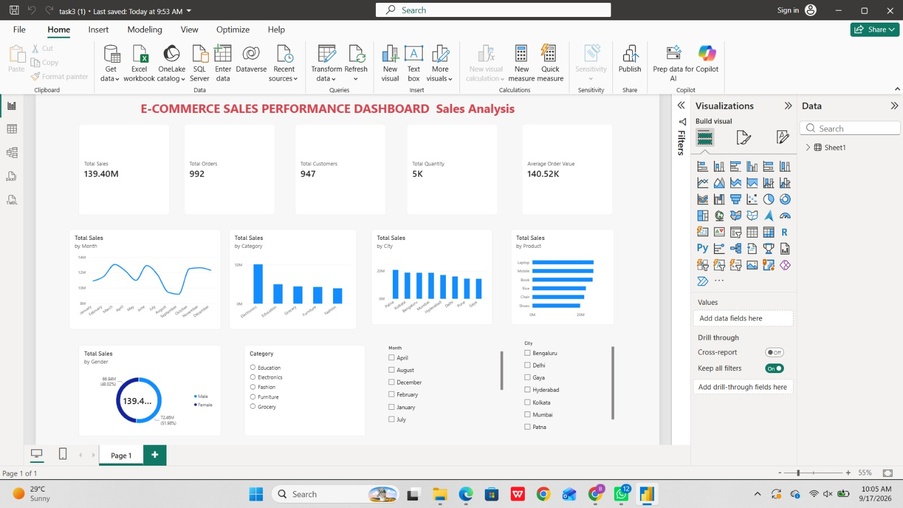
Power BI Sales Performance Dashboard
Interactive view of KPIs, monthly sales, category, city, product and gender performance.
₹139.40M
Total Sales
992
Total Orders
947
Total Customers
5K
Total Quantity
₹140.52K
Average Order Value
Source: Power BI dashboard screenshot supplied for Task 4
6

Slide 7
Key Business Insights
The Power BI analysis and Task 4 report identified the following results.
Electronics
Laptop
₹50,778,581.70
₹25,443,008.51
Highest category revenue
Highest product revenue
March
Patna
₹13,059,899.94
₹20,826,584.43
Highest monthly sales
Highest city-wise sales
Source: Task 4 report, page 3 — Key Insights from the Dataset
7

Slide 8
Statistical Validation
Business question: Is there a significant difference in average Total Sales between Male and Female customers?
H₀ — Null Hypothesis
• There is no significant difference in average Total Sales between Male and Female customers.
H₁ — Alternative Hypothesis
• There is a significant difference in average Total Sales between Male and Female customers.
Test
• Independent Samples T-Test (Welch’s t-test)
• Significance level α = 0.05
0.682610
T-Statistic
0.495011
P-Value
0.05
Significance Level
Fail to Reject H₀
Decision
Female: 489 records • average ₹136,883.21 | Male: 511 records • average ₹141,807.34
Because p = 0.495011 ≥ 0.05, the Task 4 report concludes that the observed gender difference is not statistically significant at the 5% level.
Source: Task 4 report, pages 5–6; Task4_Hypothesis_testing.ipynb
8

Slide 9
Integrated Business Story & Actions
Turning analysis into practical next steps.
What the analysis tells us
• Electronics generated the highest category revenue.
• Laptop was the top-performing product.
• March recorded the highest monthly sales.
• Patna recorded the highest city-wise sales.
• Gender alone did not show a statistically significant difference in average sales.
• The dashboard provides a repeatable way to monitor sales performance.
Action Points
• Maintain sufficient Laptop inventory based on observed demand.
• Study the drivers of high March sales and assess whether successful approaches can be reused.
• Strengthen marketing and customer engagement in Patna.
• Review low-performing products and categories for improvement opportunities.
• Use multiple customer and sales factors—not gender alone—when developing business strategies.
• Use dashboard insights for inventory planning and ongoing monitoring.
Source: Task 4 report, page 7 — Recommendations / Call to Action
9

Slide 10
Portfolio Finalization
A single professional home for the completed internship work.
Recommended GitHub structure
• README.md — internship overview, objectives, tools and outcomes.
• Project repositories — links to each completed task/project.
• Final presentation — refined capstone deck.
• Screenshots / outputs — dashboard and selected analysis visuals.
• Skills & learnings — Python, SQL, Power BI, statistics and data storytelling.
• Optional GitHub Pages site — visual portfolio presentation.
Python / Pandas
SQL / SQLite
Power BI
Data Visualization
Statistics / SciPy
Business Storytelling
Final outcome
A complete analytics workflow—from raw sales data to validated insights, interactive reporting, and a professional portfolio.
Task 5 deliverable: master portfolio + final presentation + walkthrough
10

