Slide 1
thirtybees
(Software Testing project)
Jagadish Paled (2812076)
Bindu Manjunath Raju (2862245)

Slide 2
Introduction:
Thirty Bees (v 1.4.0)
E-commerce based platform.
Based on the PretaShop 1.6.
Uses PHP and MySQL
Moto : “Provide a stable, reliable, and friendly e-commerce platform”
Some features:
Product management
Order management
Payment management
Shipping, etc.,

Slide 3
Testing
Goal of the project: To test the software using testing techniques to ensure software quality.
Used manual testing for:
Functional testing
Graphical user interface testing
Functions tested | Functions not tested
User Registration (Sign Up) | Performance
Log in | Payment and shipping
Product browsing and search | Security
Cart feature

Slide 4
Test Plan
Objective:
To ensure previously mentioned functions and features are working as intended.
Ensure the platform is user friendly.
Ensure the platform is compatible.
To identify and report any defects, bugs or other issues.
Scope:
Perform Functionality, Usability and compatibility testing.

Slide 5
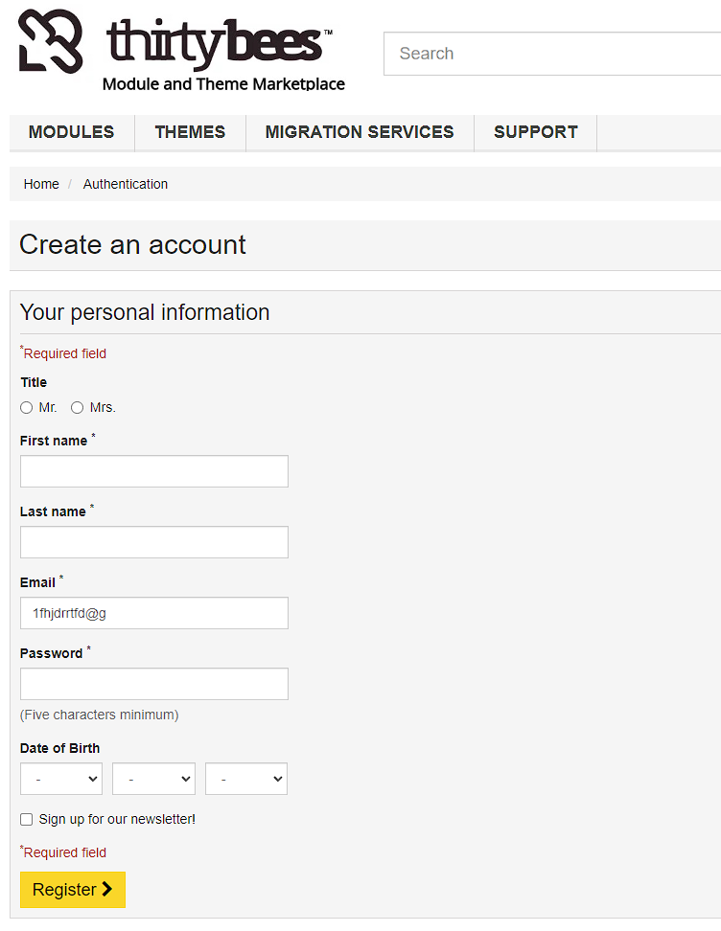
Test case design:
Test cases designed for Functionality and Usability.
Example Test case: User registration or Sign-Up functionality.
Input parameters : First name, Last name, Email Id, Password, Date of Birth.
Design of a testcase: tried to cover few possibility using input parameters.

Slide 6
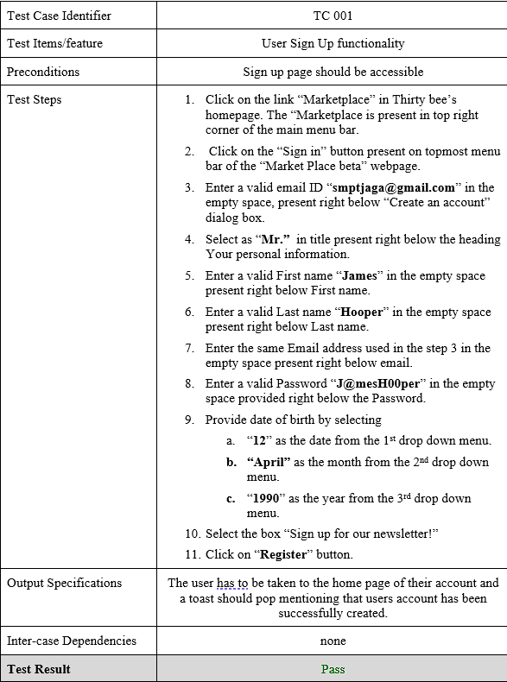
Test case design:

Slide 7
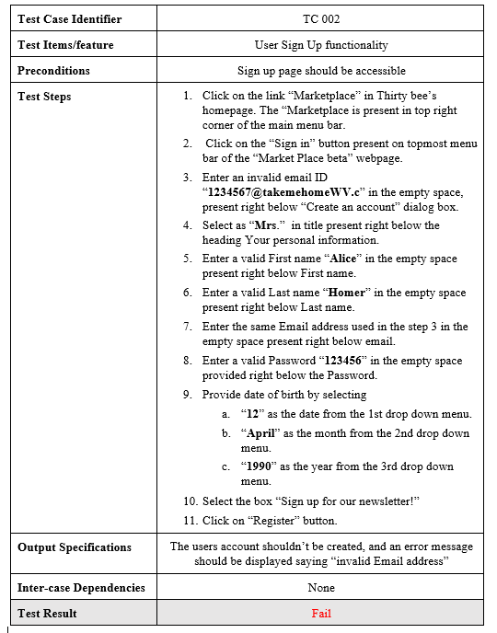

Slide 8
Conclusion
Learnt different testing techniques
Test case designing
Test execution and defect report

