Slide 1

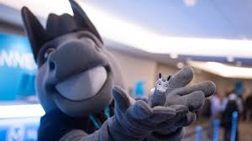
MuleSoft Basic
What is MuleSoft ?
Mule soft is an integration platform that allows developers to connect application together quickly and easily, enabling them to exchange the data. It’s a lightweight Java based enterprise service bus(ESB)
It enables easy integration of existing system, regardless of the different technologies that the applications use, including JMS, Web services, http and many more
Bindushree C M
16/12/2021

Slide 2
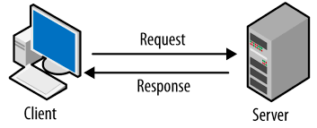
What is an API ?
API stands for Application Programming Interface API.
Allows to communicate or exchange the data between two system
Bindushree C M
16/12/2021

Slide 3
What is API management platform?
It is a platform which provides an access for
Design API
Develop API
Deploy API
Manage API
Secure API
Reuse API
Bindushree C M
16/12/2021

Slide 4
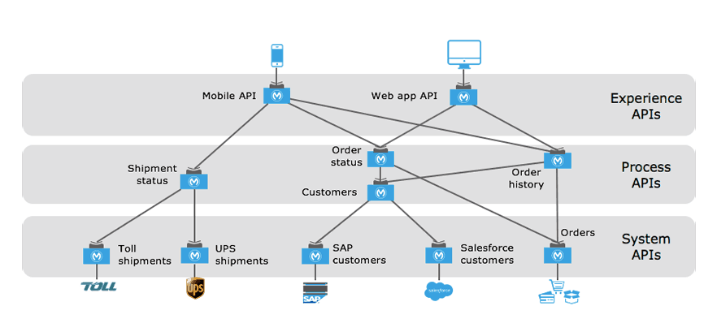
What API-Led Connectivity Approach?
Bindushree C M
16/12/2021

Slide 5
System API:
System API is able to connect through underlying systems ( Any system which contains a raw data)
Basically system API contain sensitive information as it contains raw data.
Should never be exposed for public use.
Example API which connect to database Salesforce SAP system Hadoop system etc.
Bindushree C M
16/12/2021

Slide 6
Process API:
Process API are built to compose or combined two or more system API ‘s
Usually to do any kind of transformation or to implement any kind of business logics or shape the data out of the system api’s .
It may perform aggregation or splitting or routing the data.
Process API SP private and should not be exposed to the public for use.
Example aggregating customers data and product data that comes from to system API where actual data is originated to provide order status.
Bindushree C M
16/12/2021

Slide 7
Experience API’s
These are API’s which are a kind of a wrapper either to process API’s(If present) or to system API’s, so that client/consumers can use it.
Client/Consumers will not have exposure or contact with direct Raw data.
We can have minimal Data Transformation like the final result to be in JSON or xml or whatever the consumer wants to have.
Bindushree C M
16/12/2021

