Slide 1
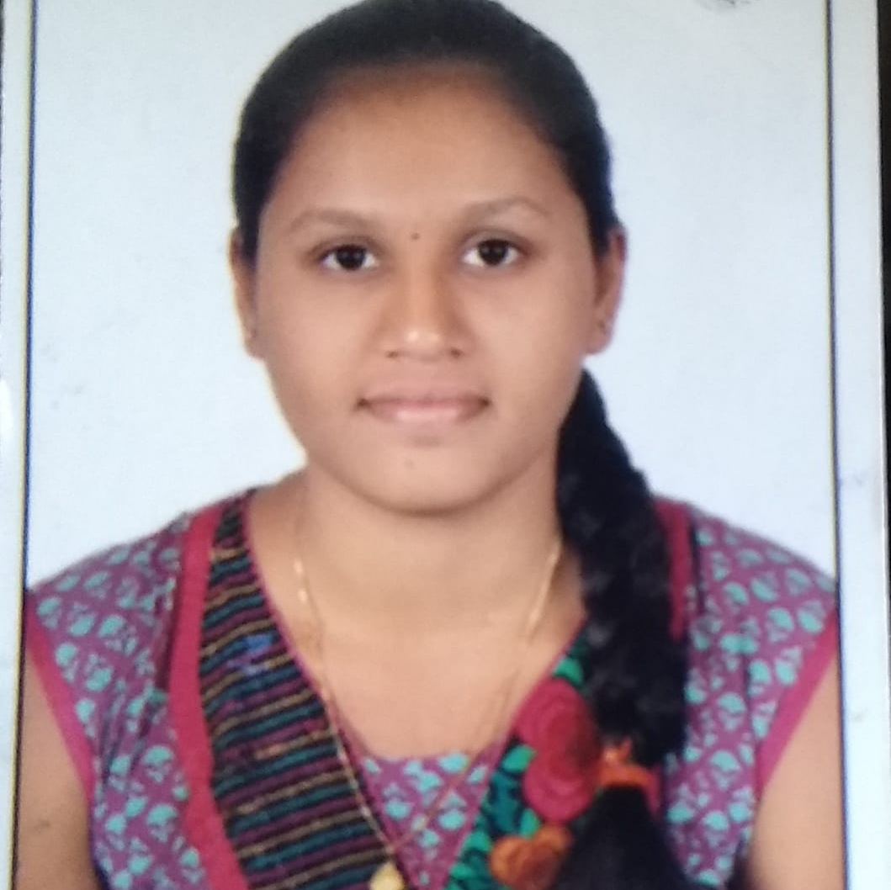



BINDUSHREE B R
Analyst/Software Engineer
BACHELOR OF TECHNOLOGY
2017-2021
Skills Java
Spring Boot
Microservice
MERN Stack
MongoDB
Database
No SQL database – MongoDB
SQL – MYSQL
Web Technologies
HTML5
CSS3
Javascript
AddOns
Github
postman
Additional skills
Leadership Qualities
Quick Learner
Team management
BANGALORE
BINDUSHREE.B-R@CAPGEMINI.COM
+91 9108718329
A4
Eager to work in a team of dedicated people and serve a key role in the enhancement and development of the project.
Software Engineer who is Strong in design and integration with intuitive problem-solving skills. Passionate about implementing and launching new projects.
Ready to learn new technologies and implement them to further improve my knowledge.
Has working knowledge on Angular and Java Microservice Development using Spring framework on an intermediate level.
https://github.com/bindushreebr
Online Railway Reservation :
Completed end to end case study of Online Railway Reservation along with JWT authentication, Swagger. . Material-UI and ANGULAR used for user interface.
https://www.linkedin.com/in/bindushree-b-r-9441071b5
Check out my work on GitHub & Video Profile

