Slide 1
22MCA43 – Project Phase-2
Object Detection and Audio Generation Using Generative AI
BINDU SHREE Y R
IV Semester
Under the Guidance of
Ms.K.Sangeetha
Assistant Professor
Department of MCA

Slide 2
Project Overview
Objective: AI-powered system to convert images into natural audio descriptions.
Problem Statement:
Visually impaired users struggle to understand visual content in digital media.
Few solutions integrate image-to-audio conversion smoothly.
Need for a simple, affordable, and accessible solution.

Slide 3
Aim of the Project
Build a user-friendly system to convert images into audio descriptions.
Enhance accessibility for visually impaired users.
Combine image recognition, language processing, and speech generation.
Deliver natural-sounding image descriptions.
Provide a simple web-based interface.

Slide 4
Literature Review
Paper | How It Works (Simple) | Example
1. BLIP (2022) | Looks at an image → generates a meaningful caption | Input: image of dog → Output: “A brown dog sitting on grass.”
2. Groq AI Hardware (2023) | Runs AI models extremely fast with very low latency | Real-time model runs in milliseconds → no lag
3. GTTS (Google TTS) | Takes text → converts into spoken audio | “Person detected ahead” → becomes clear voice output
4. FoleyGen (2024) | Generates realistic sound effects from images | Image of waterfall → produces waterfall sound
5. Gotta Hear Them All (2024) | Finds multiple sound-producing objects → generates audio for each | Street photo → dog bark + traffic noise + wind

Slide 5
Paper | How It Works (Simple) | Example
6. An Eye for an Ear (2024) | Takes a caption → generates natural-sounding audio description | “A man crossing the road” → spoken explanation
7. Diffusion Audio Captioning (2024) | Creates smooth, human-like audio descriptions | Audio: “A bird is chirping softly in a quiet park.”
8. NowYouSeeMe (2024) | Understands context + objects → produces smart descriptions | Image: person running → “A man running on a track”
9. Citizen Cane (2024) | Detects objects + generates audio descriptions | Camera sees a chair blocking the hallway → speaks “Chair ahead.”
10. Novel Image Captioning (2025) | High-quality image caption generation using deep learning | Image: baby + toy → “A baby playing with a red toy.”

Slide 6
Key Insights
LLaMA-3 refinement improves fluency and makes text natural for audio.
gTTS integration adds accessibility with instant speech output.
Research Gaps:
Limited real-time performance
Lack of offline support
Need for domain-specific fine-tuning
Need of Integrate image-to-audio conversion smoothly

Slide 7
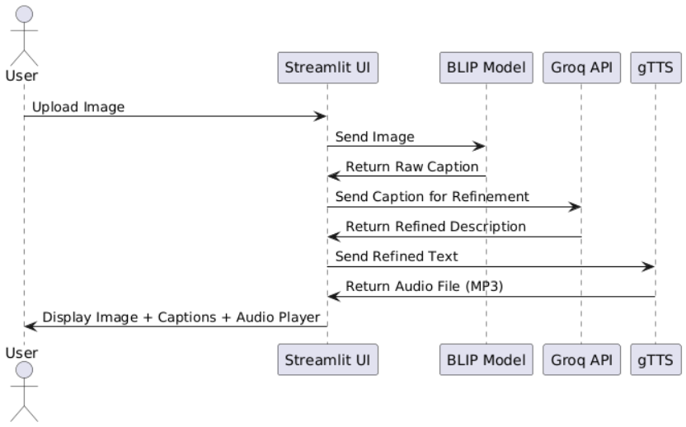
Proposed system

Slide 8
Methodology used
Step 1: Image Upload
Step 2: Image Captioning (BLIP)
Step 3: Caption Refinement (Groq LLaMA)
Step 4: Speech Generation (gTTS)
Step 5: Output Display

Slide 9
Tools & technology used
🔹 Programming Language:
Python
🔹 Frameworks & Libraries:
Streamlit – Web interface
Hugging Face Transformers – BLIP model
Groq API – LLaMA-3 for caption refinement
gTTS – Text-to-Speech conversion

Slide 10
Requirements
🔹 Hardware Requirements
Intel Core i5 / AMD Ryzen 5 or higher
8–16 GB RAM
Stable Internet Connection
Optional NVIDIA GPU for faster inference
🔹 Software Requirements
OS: Windows / Linux / macOS
Python
Libraries: Streamlit,BLIP, gTTS, Groq
IDE: Jupyter Notebook / VS Code

Slide 11
Design

Slide 12
Testing methodology
Unit Testing(image upload, caption generation, TTS)
Integration Testing
Functional Testing
Performance Testing
Usability Testing

Slide 13
Sample test cases
TC ID | Test Case | Description | Expected Result
TC_01 | Image Upload | Upload a valid JPG image | Image displays without error
TC_02 | Caption Generation | Generate caption using BLIP | Caption appears correctly
TC_03 | Caption Refinement | Send caption to Groq LLaMA-3 for refinement | Refined caption is returned
TC_04 | API Failure Handling | Disable Groq API | System shows failure message properly
TC_05 | Audio Conversion | Convert text to audio using gTTS | MP3 audio plays successfully
TC_06 | Invalid File Upload | Upload a .txt file | Error message shown

Slide 14
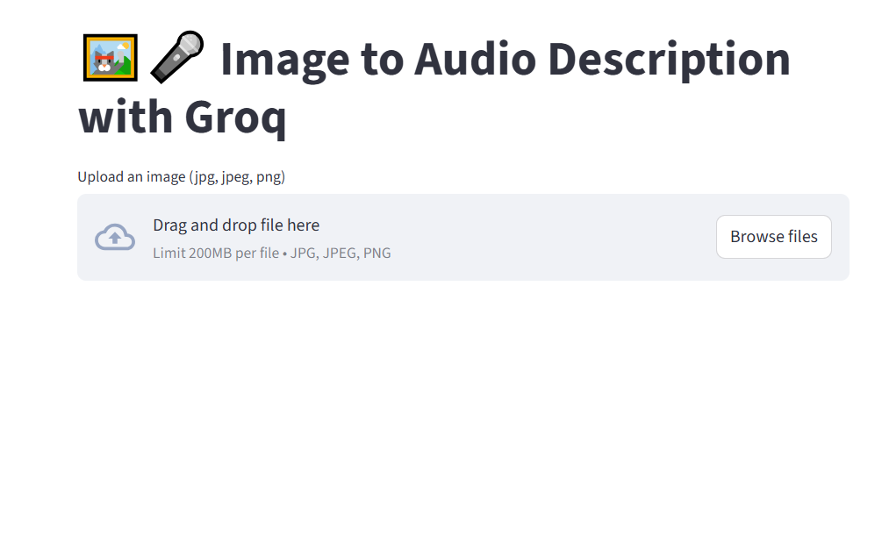
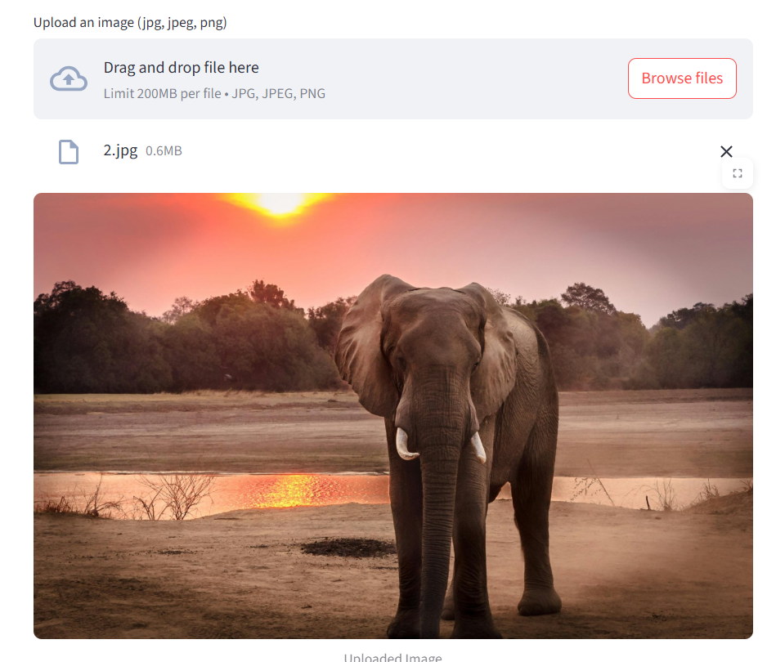
Screenshots

Slide 15
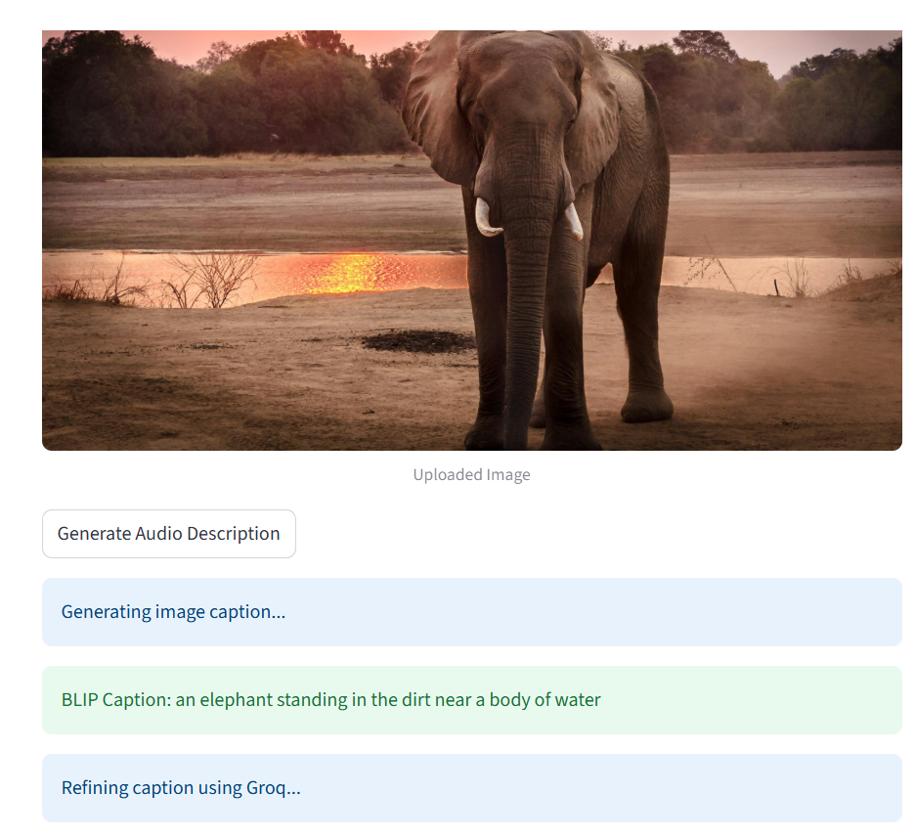
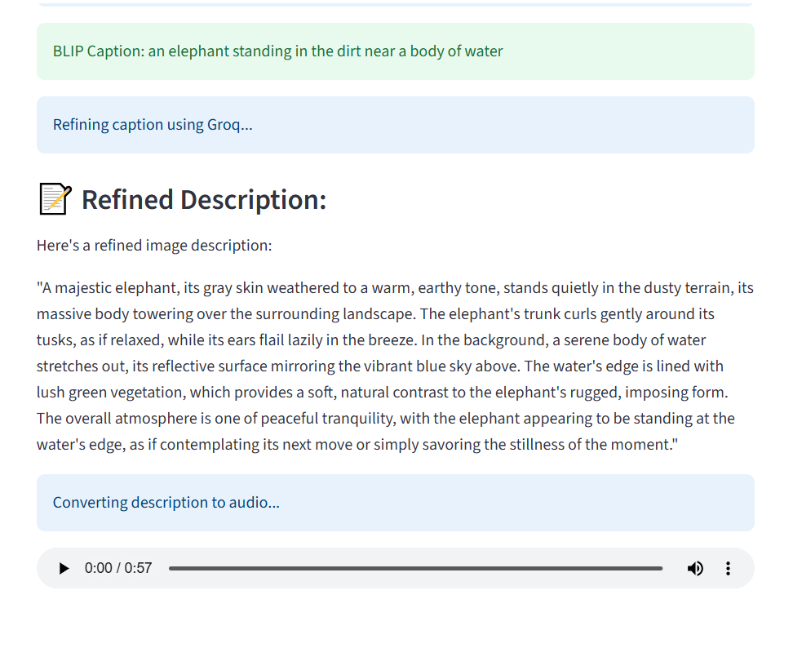

Slide 16
Conclusion
Successfully built an AI-powered Image-to-Audio System for accessibility.
Integrated BLIP (image captioning), Groq LLaMA-3 (caption refinement), and gTTS
Provides clear and natural audio descriptions.
Simple Streamlit web interface for ease of use.
Supports visually impaired users and broader accessibility needs.

Slide 17
Future enhancement
Multilingual Support – Generate captions and audio in multiple languages.
Mobile & Wearable Integration – Extend accessibility on smartphones and AR devices.
Offline Functionality – Use lightweight local models without internet dependency.
Voice Customization – Add natural voices, tones, and accents.
Cloud Storage & Sharing – Save and share generated captions and audio.
Domain-Specific Fine-Tuning – Tailor for education, healthcare, and other industries.
Enhanced Security & Privacy – Stronger encryption for user data.

Slide 18
References
J. Li, R. Li, and J. Gao, “BLIP: Bootstrapping Language-Image Pre-training for Unified Vision-Language Understanding and Generation,” arXiv preprint arXiv:2201.12086, 2022.
Groq Inc., “Groq: High-performance AI Acceleration,” 2023. [Online]. Available: https://www.groq.com/
R. M. Rayhane, “GTTS: Google Text-to-Speech Python Library,” GitHub Repository, 2023.
X. Mei et al., “FoleyGen: Visually-guided Audio Generation,” IEEE MLSP Workshop, 2024.
W. Guo et al., “Sound Source Aware Vision to Audio Generation,” arXiv preprint arXiv:2411.15447, 2024.
H. Malard et al., “Zero-shot Audio Description using Audiovisual Distribution Alignment,” arXiv:2410.05997, 2024.
M. Xu et al., “Diverse and Efficient Audio Captioning via Diffusion Models,” arXiv:2409.09401, 2024.
S.-H. Lee et al., “Context-Aware Automatic Audio Description,” arXiv:2412.10002, 2024.
A. Navhule et al., “Citizen Cane—An Object Detection and Image Description System,” IEEE DELCON 2024.
A. Khan and J. Singh, “Image Captioning Using Deep Learning Methodology,” ICCK Transactions on Machine Intelligence, 2025.

Slide 19


