Slide 1
Treasury Banking – Money Market Operations Mentor – Mr. Jatin Sethi
Bineek Raja, Vikash Anand, Vandana Sharma, Mohit Pandey
B-Tech CSE BFSI – 5th Semester

Slide 2
Abstract
Treasury department of any organization performs several tasks. In this project we will focus on the money market operations. The calculation involves of formulas which are based on parameters calculated from a set of another formula. Thus the entire process becomes complex and time consuming. We will focus on reducing the complexity by providing an automated application which will take the inputs and calculate the results efficiently. The size of data is also very large which further makes the calculation difficult task. All the formulas are implemented manually which is very tedious task for the employees of the treasury.

Slide 3
Introduction
Treasury management includes management of an enterprise's holdings, with the ultimate goal of managing the firm's liquidity and mitigating its operational, financial and reputational risk. One of the main functions of a treasury department is to control and manage the bank's money and to make sure that all parts of the bank can readily access the cash they need for their business activities.
The money market is where financial instruments with high liquidity and very short maturities are traded. It is used by participants as a means for borrowing and lending in the short term, with maturities that usually range from overnight to over year or even more than that. Money market transactions are wholesale, meaning that they are for large denominations and take place between financial institutions and organizations rather than individuals.

Slide 4
Objective
To Study Money Market Operations
To implement an application using C which can perform various Money Market Operations

Slide 5
Problem Statement
Money Market Operation has complex calculation with large amount of data size. As of now traditional method that is spread sheets are usually used to perform various money market operations. But to minimize the complexity and to make the whole process user friendly there is a need of an application which can perform all the operations.

Slide 6
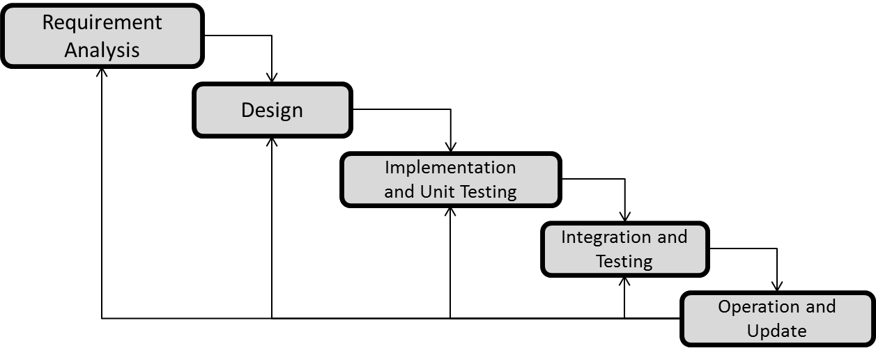
Methodology
We are using ITERATIVE WATERFALL MODEL due to large data size and complexity of our project.

Slide 8
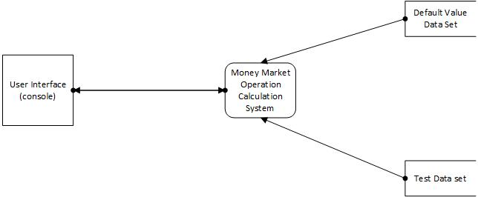
Data Flow Diagram
Level 0 DFD

Slide 9
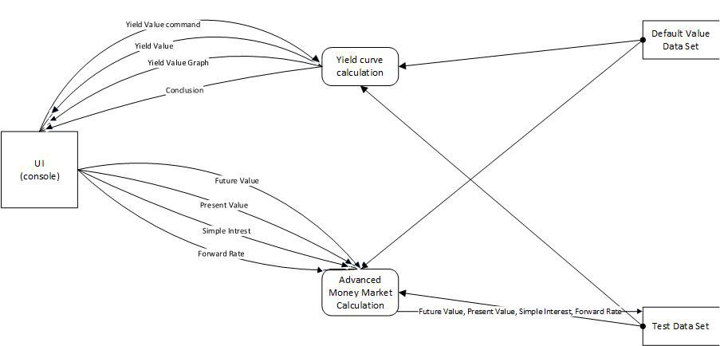
Data Flow Diagram
Level 1 DFD

Slide 10
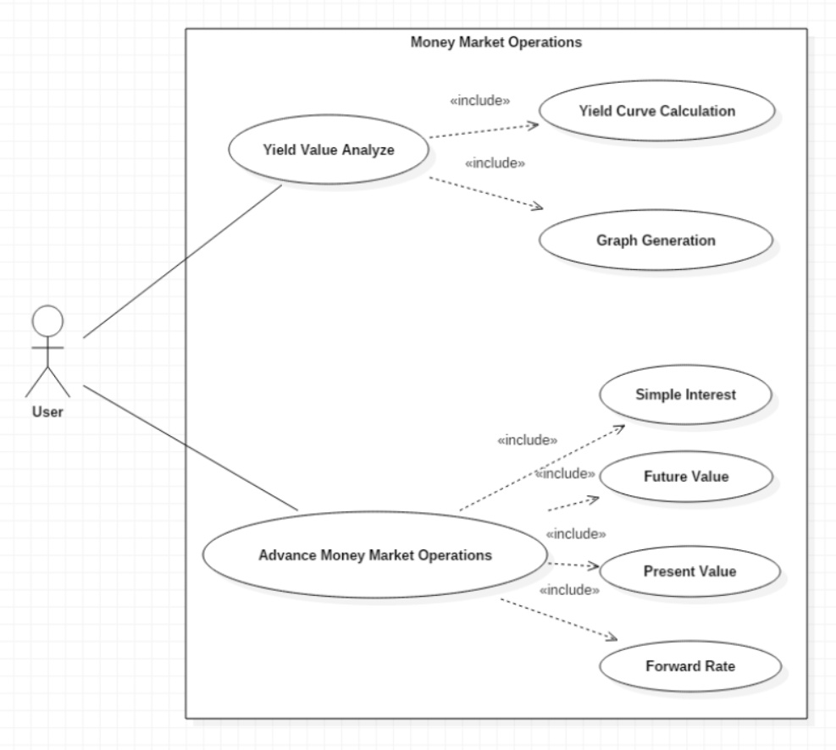
Use Case Diagram

Slide 11
Test Case
Test Case ID | Test Scenario | Test Data | Expected Results | Actual Results | Pass/Fail
TSI-01 | Simple Intrest | C=5000000 ,r=0.03 ,D=31 ,B=365 | Interest=12739.73
TSI-02 | Simple Intrest | C=6700000 ,r=0.045 ,D=47,B=365 | Interest=38823.29
Test Case ID | Test Scenario | Test Data | Expected Results | Actual Results | Pass/Fail
TFV_1-01 | Future Value (< 1Year) | PV=1000000 ,r=0.06,D=92,B=365 | Future Value= 1015123.29
TFV_1-02 | Future Value (< 1Year) | PV=1250000 ,r=0.052 ,D=85 ,B=365 | Future Value= 1265136.99

Slide 12
Test Case
Test Case ID | Test Scenario | Test Data | Expected Results | Actual Results | Pass/Fail
TFV_2-01 | Future Value (> 1Year) | PV=1080000 ,r=0.042,N=7 | Future Value= 1440448.87
TFV_2-02 | Future Value (> 1Year) | PV=1160000 ,r=0.03,N=4 | Future Value= 1305590.22
Test Case ID | Test Scenario | Test Data | Expected Results | Actual Results | Pass/Fail
TPV_1-01 | Present Value (< 1Year) | FV=1000000 ,r=0.055,D=61,B=365 | Present Value= 990891.94
TPV_1-02 | Present Value (< 1Year) | FV=1250000 ,r=0.052 ,D=85 ,B=365 | Present Value= 1235044.12

Slide 13
Test Case
Test Case ID | Test Scenario | Test Data | Expected Results | Actual Results | Pass/Fail
TPV_2-01 | Present Value (> 1Year) | FV=1000000 ,r=0.055, N=2 | Present Value= 935721.33
TPV_2-02 | Present Value (> 1Year) | FV=1250000 ,r=0.052 ,N=1 | Present Value= 1184834.12
Test Case ID | Test Scenario | Test Data | Expected Results | Actual Results | Pass/Fail
TFR_1-01 | Forward Rates Calculation (< 1 YEAR) | r1= 7.75% (91 days), rs=7.5(183 days), Dl=183,DS=91,Dl-S=92,B=365 | FR=6.7374%
TFR_1-02 | Forward Rates Calculation (< 1 YEAR) | r1= 7.93% (95 days), rs=7.7(190 days), D1=190,DS=95,D1-S=95, B=365 | FR=6.7976 %

Slide 14
Test Case
Test Case ID | Test Scenario | Test Data | Expected Results | Actual Results | Pass/Fail
TFR_2-01 | Forward Rates Calculation (> 1 YEAR) | r1= 5.75% , rs=5.5, N=15,n=2,N-n=13 | FR=5.78882%
TFR_2-02 | Forward Rates Calculation (> 1 YEAR) | r1= 5.855% , rs=5.54, N=16,n=4,N-n=12 | FR=5.96141 %

Slide 15
Algorithm
Calculating YIELD
YIELD(FAV,i,MV)
{
MV=FAV;
roi=(i*FAV)/100;
for (i=1 to MV.length)
{
roi=Effective_ROI(MV, FAV);
}
}
Effective_ROI(MV,FAV)
{
EROI=(MV/FV)*100;
return EROI;
}
MV: Market Value, FV: Future Value, roi: Rate of Interest, i: Amount
Calculating Simple Interest
INTEREST(C,r,D,B)
{
I=C*r*Effective Days(D,B)
}
Effective Days(D,B)
{
EDAYS=(D/B)
return EDAYS
}
C: Capital Amount, D: Number of Days of Interest Period, B: Days Basis of Calculation,
I: Simple Interest, r: Rate of interest

Slide 16
Algorithm
Calculating Present Value(> 1 year)
PRESENT_VALUE2(FV,T7)
{
PV=FV/T7;
}
Term7(r,N)
{
T7=pow(1+r,N);
return T7;
}
FV: Future Value, PV: Present Value, r: Rate of Interest, N: Terms in Year
Calculating Present Value(< 1 year)
PRESENT_VALUE1(FV,T6)
{
PV=FV/T6;
}
Term1(r ,D,B)
{
T6=1+(r*(D/B));
return T6;}
FV: Future Value, PV: Present Value: r: Interest Rate,
B: Days Basis of Calculation,
D: Number of Days of Interest Period

Slide 17
Algorithm
Calculating Forward Rate(< 1 year)
FORWARD_RATE1(T3,T4,T5)
{
FR={(T3/T4)-1}*T4;
}
Term3(rl,Dl,B)
{
T3={1+(rl*(Dl*B))}
return T3;
}
Term4(rs,Ds,B)
{
T4={1+(rs*(Ds/B))};
return T4;
}
Term5(B,Dl-Ds)
{
T5=B/(Dl-Ds);
return T5;
}
FR: Forward Rate, rl: Long Term Interest Rate, rs: Short Term Interest Rate,
Dl: Number of Days, Long Term Ds: Number of Days, Short Term B: Day Basis of Calculation
Calculating Forward Rate( >1 year)
FORWARD_RATE2(T1,T2)
{
FR={pow(T1,T2)}-1;
}
Term1(rl,rs,N,n)
{
T1={pow(1+rl,N)/pow(1+rs,n)};
return T1;
}
Term2(N,n)
{
T2=1/(N-n);
return T2;
}
FR: Forward Rate, rl: Long Term Interest rate, rs: Short Term Interest rate, N:Terms in Year (Long Term) n: Terms in Year (Short Term)

Slide 18
Algorithm
Calculating Future Value (< 1year)
FutureValue1(PV,r,D,B)
{
FV=PV*(1+(r*(Effective_days(D,B));
return FV;
}
FV: Future Value, PV: Present Value: r: Interest Rate, B: Days Basis of Calculation,
D: Number of Days of Interest Period,
Calculating Future Value(> 1 year)
FutureValue2(C,T8)
{
FV=C*T8;
}
Term8(r,N)
{
T8=pow(1+r,N)
return T8;
}
FV: Future Value, r: Rate of Interest, N:Terms in Year, C: Capital Amount

Slide 19
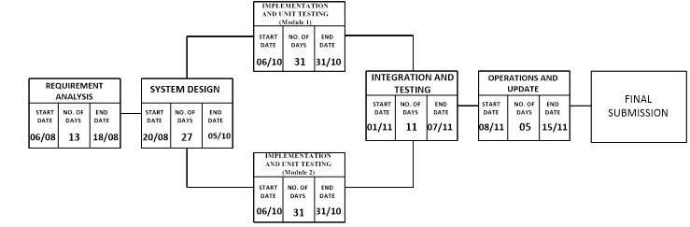
Project Progress
Study of Money Market Operation.
Collection of Test Data and Implementation of Test data in formula.
Formation of Algorithms.
Formation of Use Case Diagram and Data Flow Diagram.
Study of Exact flow of execution of Code.

Slide 20
References
Jae K. Shim and Joel G. Siegel, Financial Management, 3rd edition.
Roman L. Weil, Katherine Schipper and Jennifer Francis, Financial Accounting: An Introduction to Concepts, Methods and Uses, 14th edition.
Finance Trainer, Financial Mathematics Money Market

Slide 21
Thankyou

