Slide 1


Slide 2
Agenda
A Brief Overview of Artificial Intelligence and ANN – Day 1
Hands-on
PyTorch fundamentals -Day 1
Simple ANN model using PyTorch - Day 2
Working of Forward and Back propagation – Day 3
Getting started with ANN MNIST dataset – Day 4 and 5
CNN with CIFAR dataset – Day 6 and 7
Using pre-trained models – Day 8

Slide 3
What is Artificial Intelligence?
Artificial intelligence can be loosely interpreted to mean incorporating human intelligence to machines
Sometimes called machine intelligence, is intelligence demonstrated by machines
Computers that mimic "cognitive" functions that humans associate with the human mind, such as "learning" and "problem solving"

Slide 4
Machine Learning
Machine learning is an application of artificial intelligence (AI) that provides systems the ability to automatically learn and improve from experience without being explicitly programmed
ML is a subset of artificial intelligence; in fact, it’s simply a technique for realizing AI
It is a method of training algorithms such that they can learn how to make decisions.
Supervised Learning
Unsupervised Learning

Slide 5
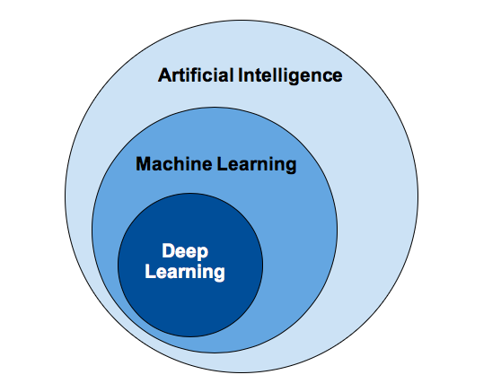
Deep Learning
Deep Learning is a subfield of machine learning concerned with algorithms
Inspired by the structure and function of the neurons in brain called Artificial Neural Networks (ANN).
Deep Learning algorithm takes longer time to train due to large number of parameters
Interpretability - it gives quite excellent and is near human performance, does not reveal why

Slide 6
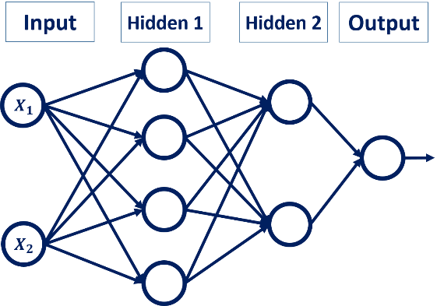
Architecture of ANN

Slide 7
Popular types of ANN
Artificial Neural Networks (ANN)
ANN is Artificial Neural Network, or ANN, is a group of multiple perceptrons/ neurons at each layer
Also known as a Feed-Forward Neural network
ANN consists of 3 layers – Input, Hidden and Output
ANN does not perform well when
While solving an image classification problem , spatial information is important
ANN cannot capture sequential information in the input data - Vanishing and Exploding Gradient
Convolution Neural Networks (CNN or ConvNet)
CNN is a class of deep neural networks, most commonly applied to analyzing visual imagery
The hidden layers of a CNN typically consist of a series of convolutional layers that perform convolution operation.
Used for: Image processing and computer vision
Recurrent Neural Networks (RNN)
RNNs, are a type of artificial neural network that maintain an internal state.
They will be able to explicitly learn and exploit context in sequence prediction
Used for: Time Series, NLP, Audio Processing

Slide 8



Popular Deep learning Frameworks

Slide 9
PyTorch
PyTorch is an open source machine learning library
Developed by Facebook's AI Research lab (FAIR)
PyTorch defines a class called “torch.Tensor” to store and operate on homogeneous multidimensional rectangular arrays of numbers
PyTorch Tensors are similar to NumPy Arrays
Initial release: October 2016; 3 years ago
Repository: github.com/pytorch/pytorch

Slide 10


Slide 11
