Slide 1


Slide 2
Agenda
A Brief Overview of Artificial Intelligence and ANN – Day 1
Hands-on
PyTorch fundamentals -Day 1
Simple ANN model using PyTorch - Day 2
Working of Forward and Back propagation – Day 3
Getting started with ANN MNIST dataset – Day 4 and 5
CNN with CIFAR dataset – Day 6 and 7
Using pre-trained models – Day 8

Slide 3
What is Artificial Intelligence?
Artificial intelligence can be loosely interpreted to mean incorporating human intelligence to machines
Sometimes called machine intelligence, is intelligence demonstrated by machines
Computers that mimic "cognitive" functions that humans associate with the human mind, such as "learning" and "problem solving"

Slide 4
Machine Learning
Machine learning is an application of artificial intelligence (AI) that provides systems the ability to automatically learn and improve from experience without being explicitly programmed
ML is a subset of artificial intelligence; in fact, it’s simply a technique for realizing AI
It is a method of training algorithms such that they can learn how to make decisions.
Supervised Learning
Unsupervised Learning

Slide 5
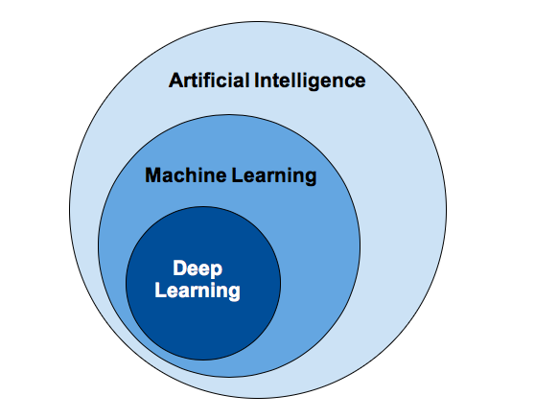
Deep Learning
Deep Learning is a subfield of machine learning concerned with algorithms
Inspired by the structure and function of the neurons in brain called Artificial Neural Networks (ANN).
Deep Learning algorithm takes longer time to train due to large number of parameters
Interpretability - it gives quite excellent and is near human performance, does not reveal why

Slide 6
Popular types of ANN
Artificial Neural Networks (ANN)
ANN is Artificial Neural Network, or ANN, is a group of multiple perceptrons/ neurons at each layer
Also known as a Feed-Forward Neural network
ANN consists of 3 layers – Input, Hidden and Output
ANN does not perform well when
While solving an image classification problem , spatial information is important
ANN cannot capture sequential information in the input data - Vanishing and Exploding Gradient
Convolution Neural Networks (CNN or ConvNet)
CNN is a class of deep neural networks, most commonly applied to analyzing visual imagery
The hidden layers of a CNN typically consist of a series of convolutional layers that perform convolution operation.
Used for: Image processing and computer vision
Recurrent Neural Networks (RNN)
RNNs, are a type of artificial neural network that maintain an internal state.
They will be able to explicitly learn and exploit context in sequence prediction
Used for: Time Series, NLP, Audio Processing

Slide 7



Popular Deep learning Frameworks

Slide 8
PyTorch
PyTorch is an open source machine learning library
Developed by Facebook's AI Research lab (FAIR)
PyTorch defines a class called “torch.Tensor” to store and operate on homogeneous multidimensional rectangular arrays of numbers
PyTorch Tensors are similar to NumPy Arrays
Initial release: October 2016; 3 years ago
Repository: github.com/pytorch/pytorch

Slide 9
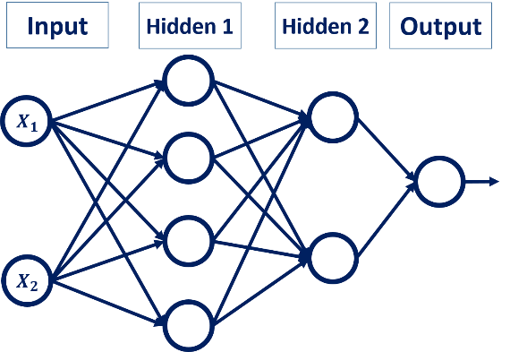
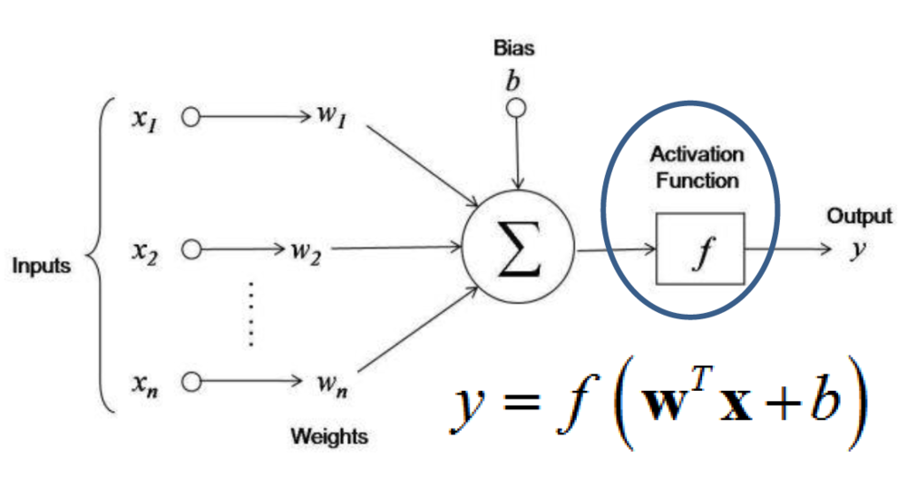
Architecture of ANN

Slide 10
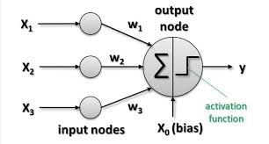
Activation function
There is activation function in all hidden layers and output layers
We can choose the type of activation function that we want in the hidden layer as well as at the output layer of the network
Activation function decides, whether a neuron should be activated or not by calculating weighted sum and further adding bias with it.
The purpose of the activation function is to introduce non-linearity into the output of a neuron

Slide 11
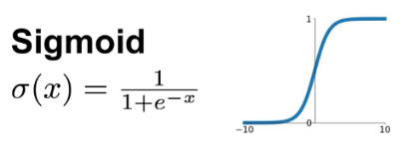
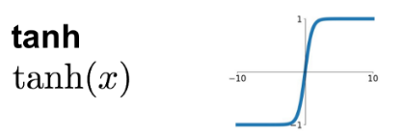
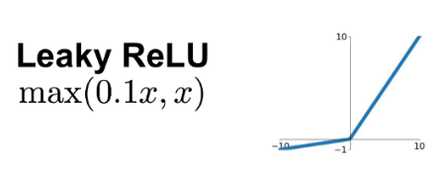
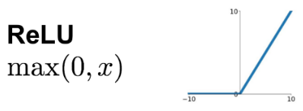
Types of activation function

Slide 12
Forward propagation
As the name suggests, the input data is fed in the forward direction through the network.
Each hidden layer accepts the input data, processes it as per the activation function and passes to the successive layer.
Backward propagation
It minimizes the error as it acts as a feedback loop
Using Forward Propagation, we compute the final prediction based on test data. And then use Back propagation, then compute the error at each layer.

Slide 13
Types of loss function
Continuous value/ Linear model:
MSE/MAE
Classification problem
CrossEntropyLoss

Slide 14
Optimizer
Optimization is how learning algorithms minimize their loss function.
The loss function represents the difference between predicted and actual values
Imagine a person is trying to get down a mountain with a blindfold on.
Eventually, if he keeps taking steps that lead him downwards, he’ll reach the base.
The loss function is the guide to the point, telling the optimizer when it’s moving in the right or wrong direction
It’s impossible to know which direction to go in, but there’s one thing he can know: if he’s going down or going up.
Two commonly used optimizer function
SGD
ADAM (Adaptive Moment Estimation)

Slide 15
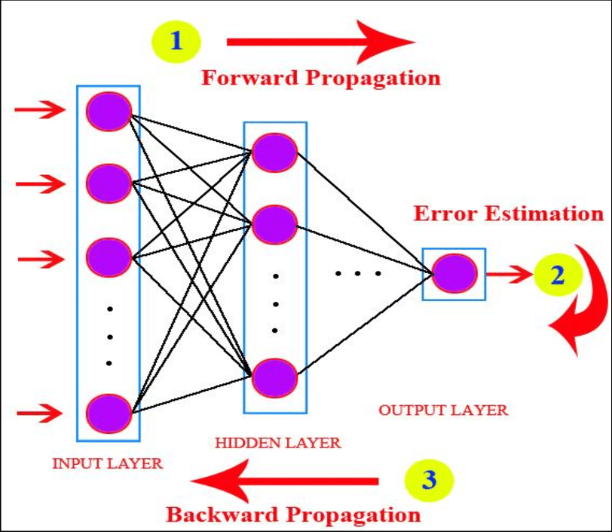
Epoch
One successful iteration of forward and backward prorogation is called as epoch

Slide 16


Slide 17
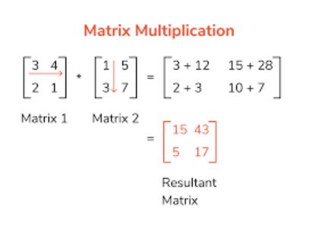
Matrix Mult

Slide 18
What is the role of bias in neural network
This means weight decide how fast the activation function will trigger whereas bias is used to delay the triggering of the activation function
Bias is like the intercept added in a linear equation. It is an additional parameter in the Neural Network which is used to adjust the output along with the weighted sum of the inputs to the neuron.
Therefore Bias is a constant which helps the model in a way that it can fit best for the given data.

Slide 19
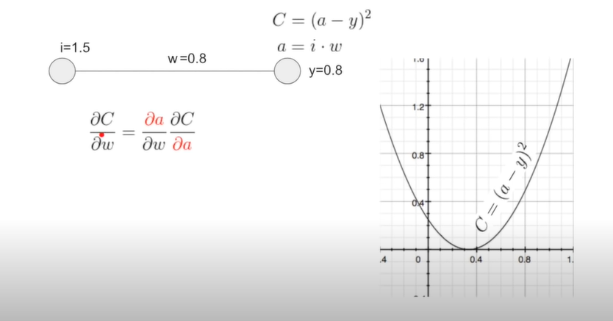
How does backward propagation work in NN

Slide 20
How categorical cross entropy is calculated
Binary classification is nothing more than an estimation of distribution P(y|x), where y is a target variable , and x is an input vector.
Probability measures that tells us how far away we are from our goal
Since we know that any probability measure must have measure of 1 over probability space , i.e. sum(integral) of probabilities of all events must be 1

Slide 21
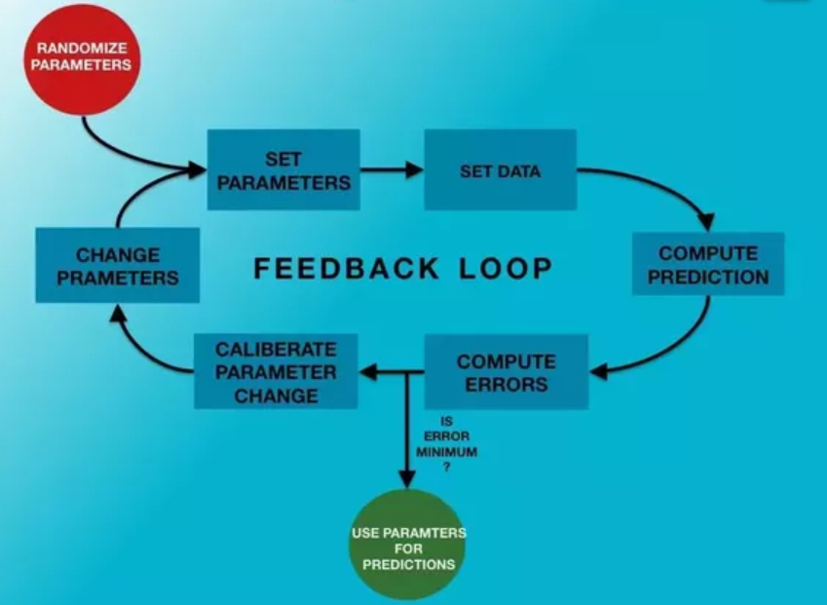
What happens during backward propogation

