Slide 1
Bloating Factor Result Analysis
Uncertain Linear Systems

Slide 2
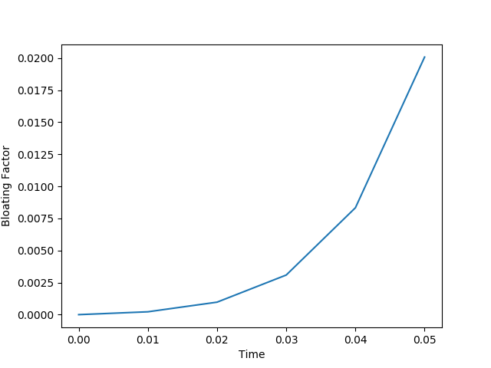
PKPD Model
Non Linear Perturbations
|E| = 0.01

Slide 3
PKPD Model
Linear Perturbations
|E| = 0.01

Slide 4
PKPD Model
Linear Perturbations
|E| = 0.01
Oblivious of Structural Aspect. Only cares about the Norm

Slide 5
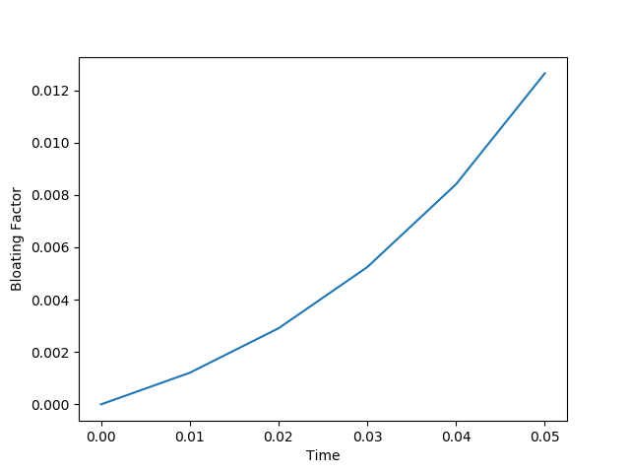
Co Op Vehicles
Non Linear Perturbations
|E| = 0.1005

Slide 6

Co Op Vehicles
Linear Perturbations
|E| = 0.1014 (Almost same)

Slide 7
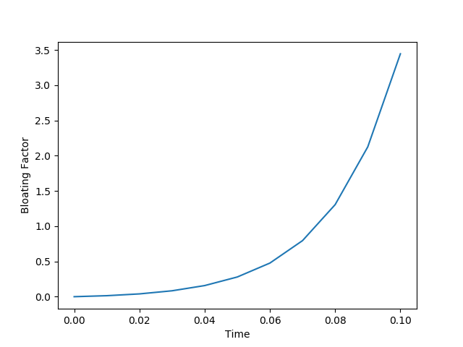
Spacecraft Rendezvous
|E| = 1.004

Slide 8
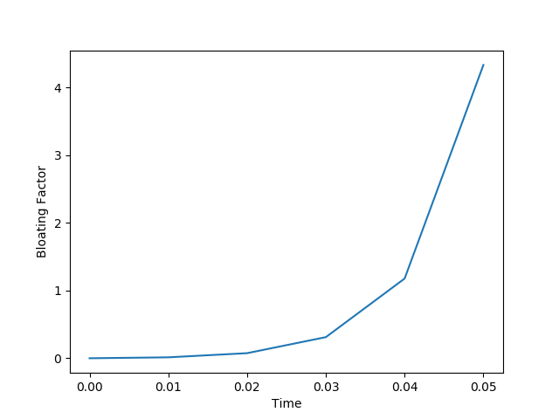
Holes
|E| = 0.05
|M| = 50.01

Slide 9
Holes
|E| = 0.05
|M| = 50.01
Problem with decomposition of M!

Slide 10
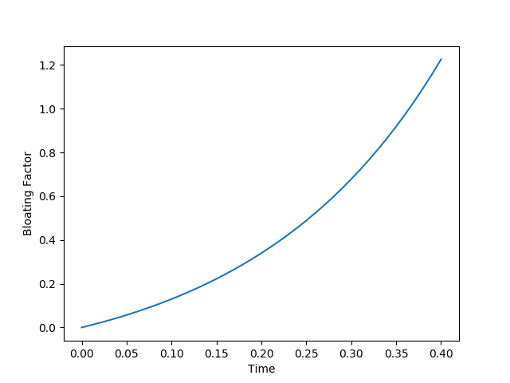
Motor Transmission
|E| = 1.0049
|M| = 1

Slide 11
Motor Transmission
|E| = 1.0049
|M| = 1
When both E and M’s are good. Note the time axis is long too! For small interval it looks linear!!

Slide 12
Problems
Overflow issue
Decomposition of A (min |M|)
Is Interval Norm a good (and correct) choice ?
Efficiency of Interval Norm Computation?!

