Slide 1
Bloating Factor Result Analysis
Uncertain Linear Systems
Comparison between Loan and Kagstrom

Slide 2
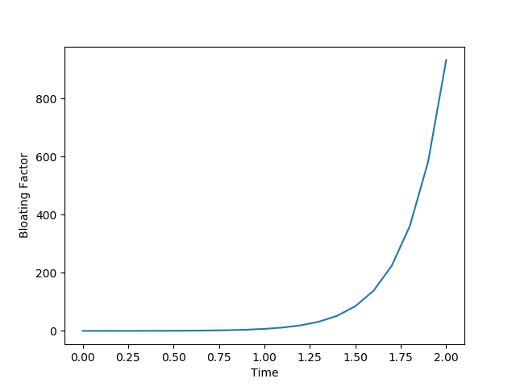
Co-operative Vehicles
Error: Linear

Slide 3
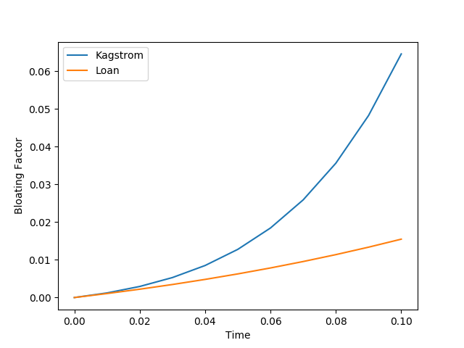
Co-operative Vehicles

Slide 4
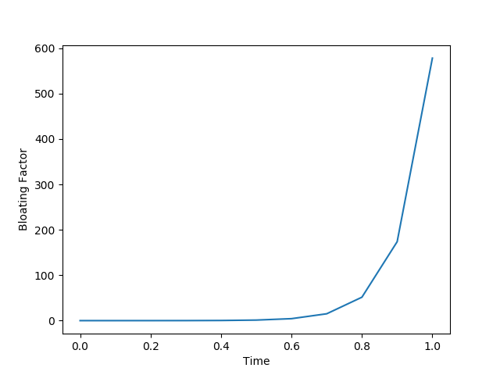
PKPD
Error: Linear

Slide 5
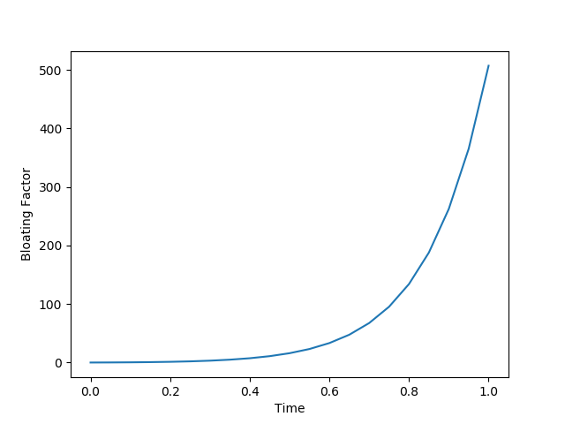
DC Converter

Slide 6
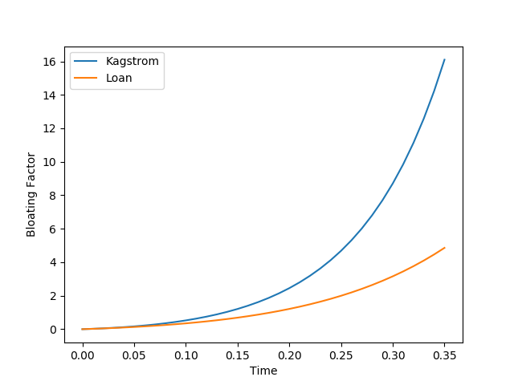
DC Converter

Slide 7
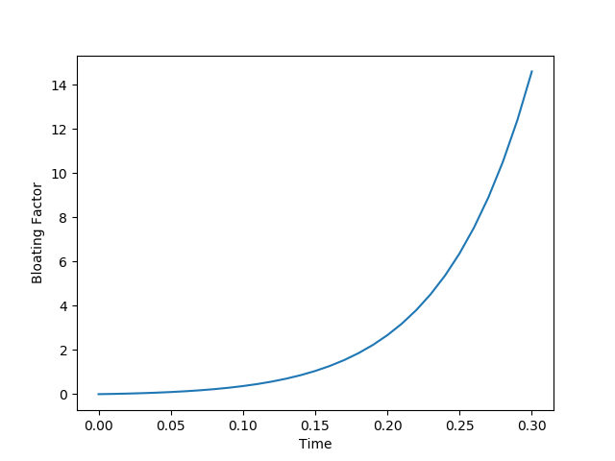
Spacecraft Rendezvous

Slide 8
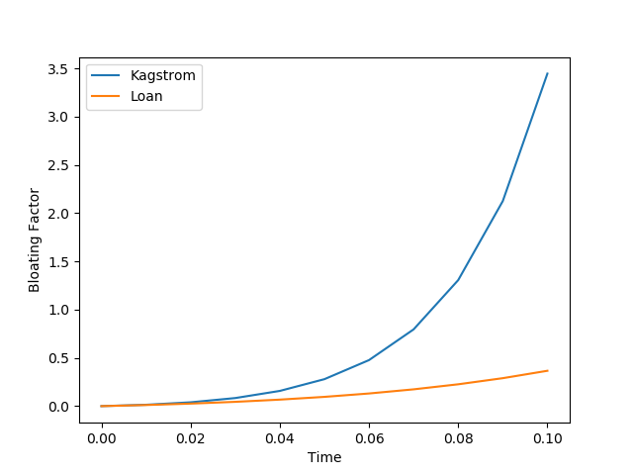
Spacecraft Rendezvous

Slide 9
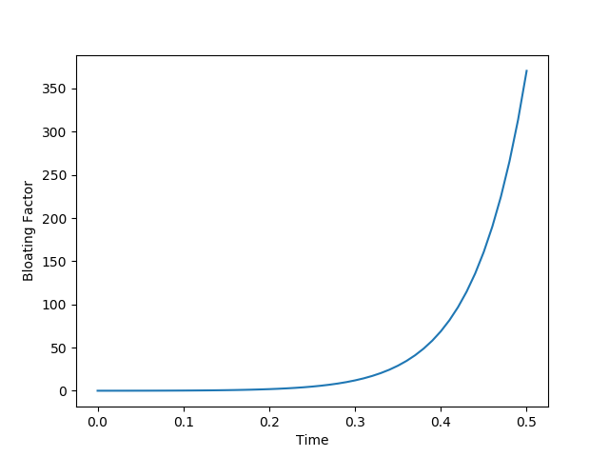
Holes

Slide 10
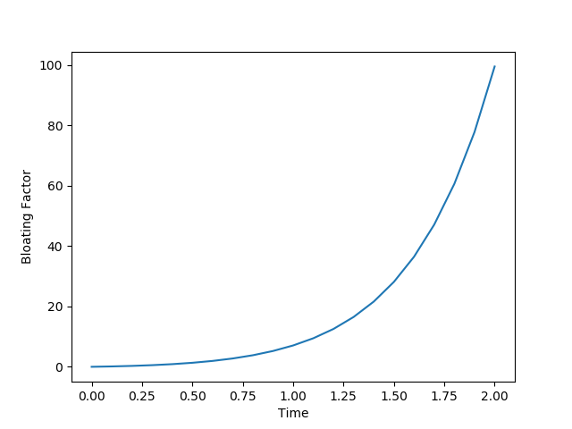
Motor Transmission

Slide 11
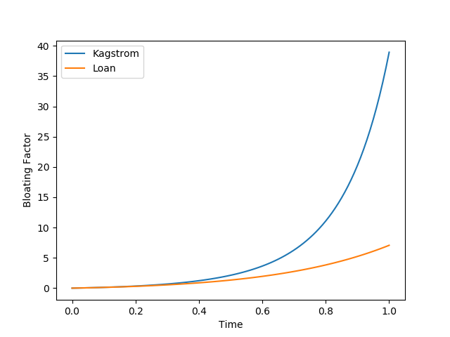
Motor Transmission

Slide 12
Problems
Loan is the clear winner! Catch: Minimal Norm not implemented
Loan solves overflow issue by Margin
Decomposition of A (min |M|) not required in Loan
Is Interval Norm a good (and correct) choice?
Efficiency of Interval Norm Computation?!

