Slide 1
Colorado Real Estate Assessment
Rodgers input for the-very-best-team
October 27, 2020

Slide 2
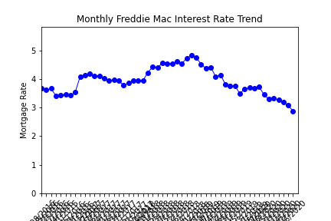
Freddie Mac Mortgage Rates
Mortgage rates have been steadily declining since …(sometime in) 2018

Slide 3
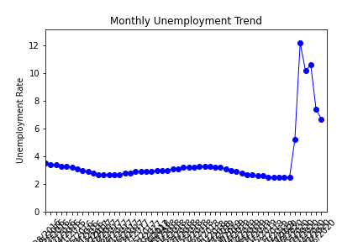
Unemployment Rates
Unemployment rates have been low and steady
until COVID-19 impacted the U.S. workforce in March 2020

Slide 4
Home Values
Home values in Colorado’s key metro areas have been on steady rise since … (some relevant date in the past)

Slide 5
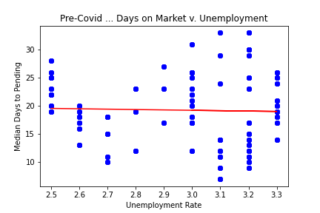
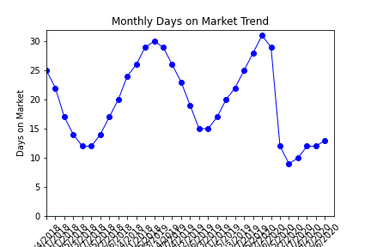
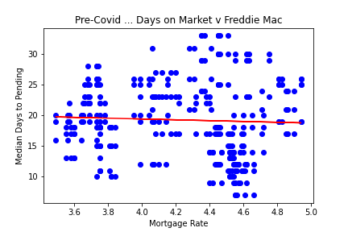
Days-on-Market (time-to-sell)
Days-on-market has held relatively steady within seasonal norms … Homes selling faster in the early summer months
Days-on-market does not appear to be impacted by unemployment or mortgage rates

Slide 6
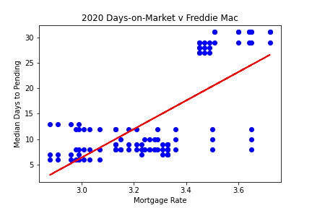
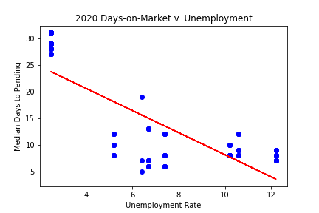
Days-on-Market in ‘COVID-19 Times’
Days-on-market and mortgage rates appear highly correlated in 2020 … 0.71 correlation coefficient
It is counter intuitive but days-on-market and unemployment appear to be highly correlated in 2020 … -0.78 correlation coefficient

