Slide 1
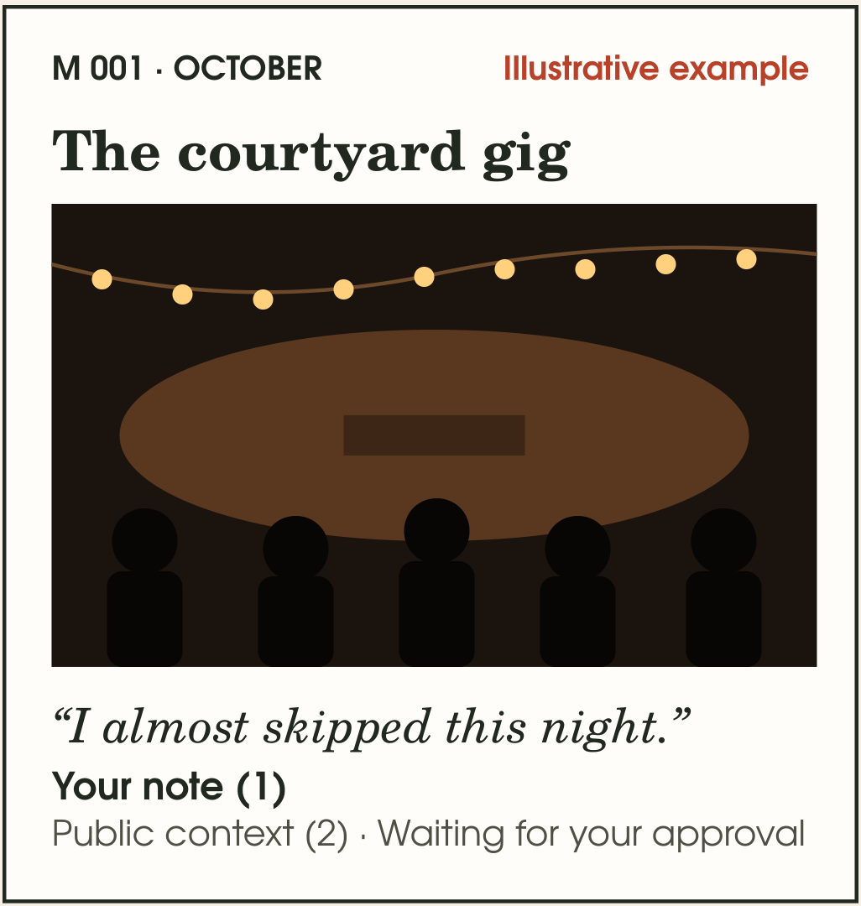
SCHEMA
Schema keeps the
story behind your
photos
A private journal for the details a photo misses. You write the notes. We add event facts from the event’s own page, and you approve each one.
Team LineOfCode · Delhi Technological University
Kritical Hacks 2026 · AI/ML Student Track
Notes:
Kritical adaptation of the supplied AZINHACK deck. Original handcrafted illustration preserved. Team roster follows the supplied HackIIITD team deck and needs final registration confirmation. Current prototype and future commercial plans are distinguished throughout.

Slide 2
A photo keeps the scene.
The details walk away.
WHAT A PHOTO CANNOT HOLD
A stranger arguing outside the gate
A kid who smiled when you gave ₹50
Who was there, and why it mattered
One photo.
A few words.
WHY WE ARE BUILDING THIS
Photos help us remember where we were. Our own words preserve why a day mattered. Schema brings them together in pages we can return to.
WHO IT IS FOR
Adults aged 18–30 who photograph their days and want to keep the story privately.
Expected benefit: easier capture and meaningful revisits. A 20-person adult pilot will test both.
2 / 8
Notes:
Audience and product motivation come from the supplied Schema blueprint and founder story. The pilot is proposed, not completed. No survey, retention or memory-loss statistic is claimed.

Slide 3
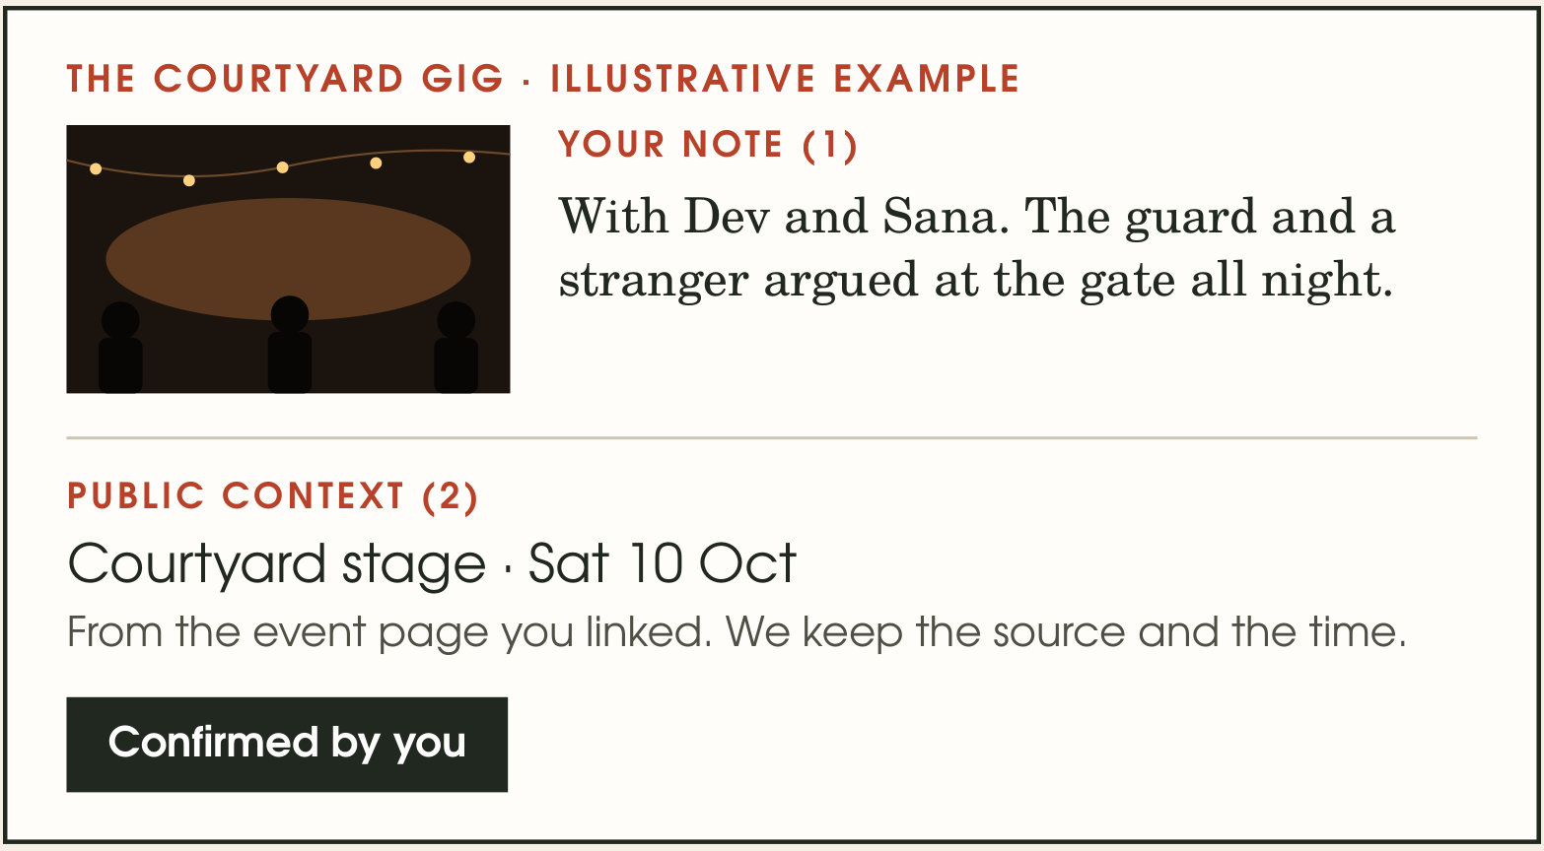
One page holds your memory and where
each fact came from
1
Add photos and write what you would forget
Your words keep the personal part of the story.
2
Paste a public event link
TinyFish finds the title, date, venue and program.
3
Check each fact, then save
Only selected facts enter your editable draft.
Later: revisit pages by year, person or place.
3 / 8
Notes:
The courtyard gig is explicitly an illustrative example from the supplied deck. It is not a real user testimonial or a TinyFish provider result.

Slide 4
TinyFish reads the event page. You approve
what it finds.
1. Public event link
2. Browser agent
3. Proposed facts
4. Reviewed draft
One URL, supplied by you.
Reads event details and schedule sections.
Title, dates, venue, program and source.
You select facts before saving.
A REAL PROVIDER TEST
WHY THE AGENT IS USEFUL
PyCon US 2026
Program details can sit behind navigation and interactive sections. The agent can follow those paths and return structured candidates for review.
13–19 May 2026
Long Beach Convention Center
Tutorials, keynotes and AI track
The live provider test completed in 5 steps. The app adapter has a 12-step cap and server-side credentials.
Private notes and photos stay outside TinyFish. Authenticated host save/reopen still needs live verification.
4 / 8
Notes:
Live connected TinyFish provider run 43e6a572-a11c-45c5-b8b5-a355b2abe946 completed on 20 October 2026 in five steps. This was not an authenticated request from a deployed Schema host. Dates/venue independently checked: https://us.pycon.org/2026/ . Evidence JSON is included in source. API limit documentation: https://docs.tinyfish.ai/key-concepts/runs .

Slide 5
Private pages and public web research
have separate paths
Web app
Authenticated server
TinyFish worker
Next.js and React.
Page editor and life archive.
Account checks, consent
and bounded research jobs.
Receives a public event URL
and fixed extraction goal.
Optional AI adapter
Private archive
Review before saving
Uses permitted saved text
and returns source references.
Postgres records and
private media storage.
You select facts and open
an editable page draft.
Technical approach: async TinyFish jobs, signed owner-bound run tokens, explicit fact selection, isolated customer hosting.
Current AI retrieval uses bounded keyword matching. Semantic memory threads and native mobile apps remain future work.
5 / 8
Notes:
Architecture verified from the copied source: app/api/tinyfish/route.ts, lib/tinyfish/provider.mjs, lib/tinyfish/context.mjs, lib/customer/ai.mjs and customer database adapters. Current standalone data layer uses Supabase Postgres/private storage. No pgvector/semantic retrieval or end-to-end encryption claim is made. Provider execution and authentication remain separate verification gates.

Slide 6
What a ₹149 subscription has to cover
₹149
₹27
₹96
proposed monthly price
typical variable cost
contribution before free users
and shared fixed costs
Monthly service cost (₹) | Typical use | Full allowance
Storage + delivery | 5.97 | 17.69
AI answers | 6.00 | 15.00
TinyFish research | 8.64 | 17.28
Processing + support | 6.00 | 7.00
Total variable cost | 26.61 | 56.97
Typical: 1 GB stored, 20 AI answers, one 6-step research run. Step price $0.016. Planning FX ₹90/USD.
Net receipts ≈₹123 after illustrative tax/fees. Free accounts and fixed costs still need funding. Model and sources accompany the deck.
6 / 8
Notes:
All prices, usage, FX, tax treatment and AI/support budgets are planning assumptions. Not a profit forecast. Detailed formulas: Schema_Kritical_Economics.xlsx. Provider rates checked 20 October 2026: https://www.tinyfish.ai/pricing ($0.016/step), https://supabase.com/pricing ($0.0213/GB-month storage and $0.09/GB uncached egress overages), https://razorpay.com/pricing/ (2% standard gateway fee, excludes promotions). A ₹149 tax-inclusive customer price is modeled with illustrative 18% sales tax and 18% tax on the gateway fee. Typical cost ₹26.607. Net receipts ₹122.755. Contribution ₹96.148 before free users and fixed costs. At 100 paid and 900 free users, typical cohort balance ≈₹2,860/month before salaries/acquisition, while the full-allowance stress case is slightly negative. No annual discount until real usage validates the model.

Slide 7
How we reach people, keep them, and earn
from it
REACH
PROPOSED COMMERCIAL PLANS
Start with an opt-in pilot of 20 adult DTU students. Measure capture and revisits before expanding.
 | Free | Plus
Price / month | ₹0 | ₹149
Media allowance | 250 MB | 5 GB
AI answers / month | 5 | 50
Research / month | Trial only | 1 capped run
REASON TO RETURN
Make a quick page now. Return to the people, places and words that connect your days.
REVENUE
A capped subscription funds storage and AI. Extra research packs follow measured costs.
These are pricing hypotheses. Current restricted demo quotas differ. Existing pages stay readable after downgrade.
Alternatives: Day One Silver $49.99/year, Gold $74.99/year. Journey $4.17/month billed annually. Schema tests crafted pages with reviewed event context.
7 / 8
Notes:
Competitors already provide media, AI, prompts and sharing, so those alone are not unique. Public USD prices checked 20 October 2026: https://dayoneapp.com/plans/ and https://journey.cloud/membership . These are not India checkout quotes or equivalent feature bundles. Schema plan limits are proposed, not implemented billing entitlements. Research trial cost needs a finite acquisition budget. Pilot numbers are targets, not achieved traction.

Slide 8
What we can show, and what comes next
TEAM LINEOFCODE · DTU
CURRENT EVIDENCE
Tushar Aggarwal
85
automated tests passing
Customer build and type checks pass
Product, integration and testing
Rajat Maan
5
steps in a live TinyFish provider test
Hosted save/reopen remains to verify
Backend and source-based answers
Shrivats Goel
TinyFish workflow and failure handling
NEXT BUILD
Vanshika Pasi
Verify the isolated host end to end. Then test better memory retrieval, voice and selected imports.
Design, editor and review experience
Longer term: native mobile pages, confirmed memory threads and carefully scoped shared albums.
Integrated B.Sc. M.Sc. in Data Science
8 / 8
Notes:
Names and roles come from the supplied LineOfCode HackIIITD deck. Confirm the Kritical registration roster before submitting. 85 tests means the original 81 plus three provider/draft-boundary tests and one journal save/reopen integration test added in this copy. Real customer-host login, configured TinyFish API request and save/reopen still need live acceptance. Mobile and stronger semantic retrieval are future scope.

