Slide 2
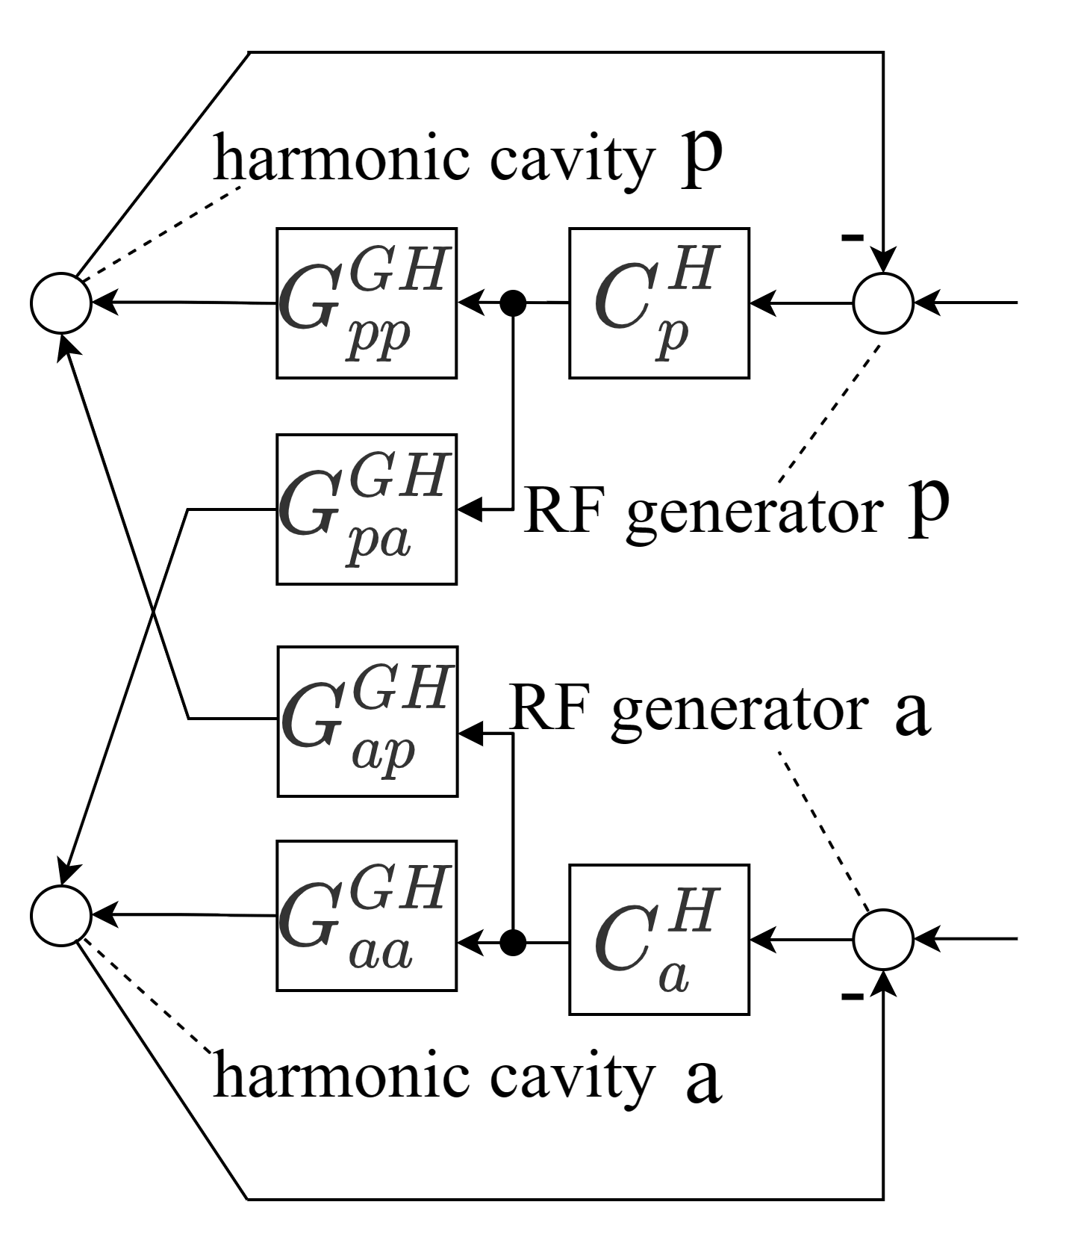
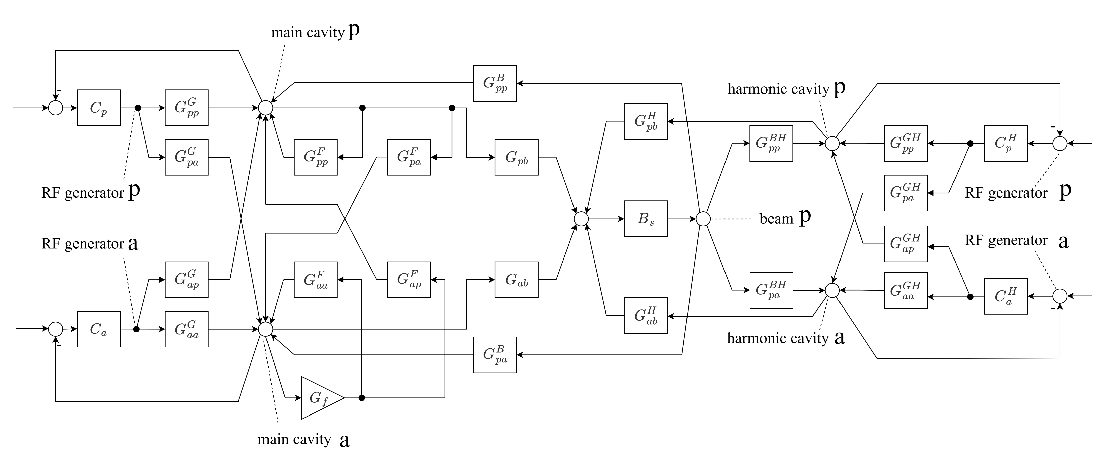

Slide 7
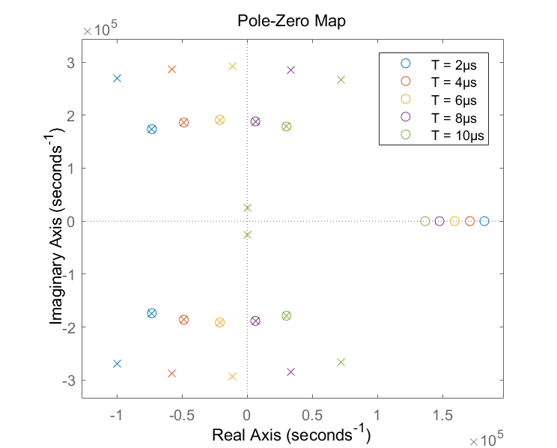
IB = 300/1000;
fF = -250/180*pi;
X = 1;
thetaL = -0/180*pi;
thetaLH = -0/180*pi;

